Slide 1
Workshop Goals
Overview of current trends in statistics education
Overview of current statistical needs in biology education
Examples of past collaborations
Develop collaboration between biologists and statisticians
Role of statistics in undergrad bio courses
Biological contexts in statistics courses
Provide time for joint development of a new activity to use in the upcoming year
Plan for continued collaboration and assessment

Slide 2
AGENDA
8:30-9 am Coffee & Donuts
9-9:30am Intros/Overview
9:30-10:15 Pedagogy in teaching statistics
10:15-11 Statistical methods & concepts needed in biology classes
11-11:15 Break
11:15-11:30 Current partnership at Cal Poly
11:30-12 Small group discussions – partnership opportunities
12-12:30 Report out from small groups
12:30-1:15 Lunch – catered box lunches by SLO Provisions
1:15-1:45 Possibilities in biology classes with collaboration
1:45-2:45 Small group discussions – development of specific ideas
2:45-3 Break
3-3:30 Debrief on small group discussions
3:30-4 Closing/Next steps

Slide 3
Teaching Statistics
Best Practices

Slide 4
GAISE (2016)
Guidelines for Assessment and Instruction in Statistics Education
Teach statistical thinking
Teach statistics as an investigative process of problem-solving and decision-making
Give students experience with multivariable thinking
Focus on conceptual understanding
Integrate real data with purpose
Foster active learning
Use technology to explore concepts and analyze data
Use assessments to improve and evaluate student learning
Notes:
Earlier in students’ statistical education
Disingenuious/Less exciting
First plenary: statistical insight
More appealing and accessible to a mathematically diverse audience
Regression vs. DOE, statistics vs. data science, statistics major vs. non-major
Help students see the common considerations and even terminology across these different audiences
Not that interesting to only think in terms of 1 or 2 variables. Going to data science courses in droves but what to make sure they are developing multivariable thinking as well. Push to make a second course more appealing and accessible to a mathematically diverse audience. Traditionally – matrix algebra, regression vs. ANOVA

Slide 5
GAISE (2016)
Guidelines for Assessment and Instruction in Statistics Education
Teach statistical thinking
Teach statistics as an investigative process of problem-solving and decision-making
Give students experience with multivariable thinking
Focus on conceptual understanding
Integrate real data with purpose
Foster active learning
Use technology to explore concepts and analyze data
Use assessments to improve and evaluate student learning
Notes:
Earlier in students’ statistical education
Disingenuious/Less exciting
First plenary: statistical insight
More appealing and accessible to a mathematically diverse audience
Regression vs. DOE, statistics vs. data science, statistics major vs. non-major
Help students see the common considerations and even terminology across these different audiences
Not that interesting to only think in terms of 1 or 2 variables. Going to data science courses in droves but what to make sure they are developing multivariable thinking as well. Push to make a second course more appealing and accessible to a mathematically diverse audience. Traditionally – matrix algebra, regression vs. ANOVA

Slide 6
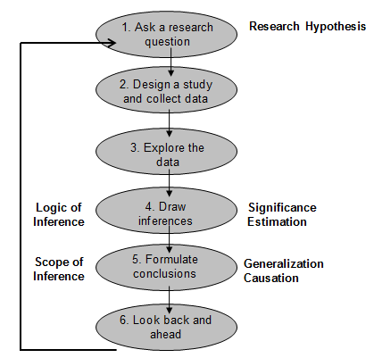
Teach statistical thinking: 6-step process
Historically: Focus of intro stat courses ➔ suite of statistical methods with heavy emphasis on mathematical underpinnings

Slide 7
Teach statistical thinking: Multivariable Thinking (MVT)
Recognize that variation in a response comes from many, many sources and be able to identify these sources
Recognize that relationships ‘discovered’ in a statistical analysis and/or data visualization between two variables (e.g., a response and explanatory variable) depend in large part on how the study has dealt with many other variables that may influence that response
Design studies that effectively control for the many variables that may influence the response (e.g., blocking, inclusion criteria, direct control, etc.)
Analyze data in the presence of confounding
Draw appropriate conclusions from a data analysis and convey the limitations of these conclusions

Slide 8
Step 4: Stat 1 Course - typical
Describe the distribution of wages
“The distribution of wages is approximately bell-shaped and symmetric without any apparent outliers. The mean wage is $527.60 per week with a standard deviation of $111.50 per week.”

Slide 9
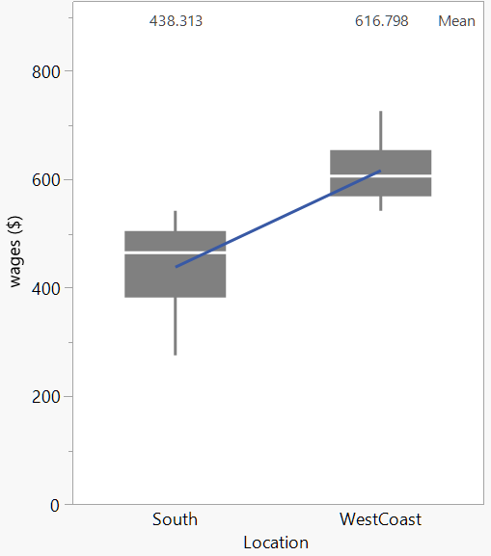
Stat 1 Course - typical
Compare the distributions of wage for the South and West Coast
Shape
Typical value
Variation
outliers

Slide 10
Stat 1 Course - MVT
What would the graph look like if there was no variation in wages?
What if there was only one wage value recorded for a single person?
What are some possible causes/reasons for the variation in the wages?
Type of job
Time in position/job
Experience, location, education

Slide 11
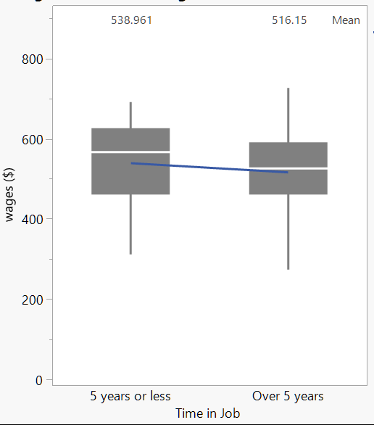
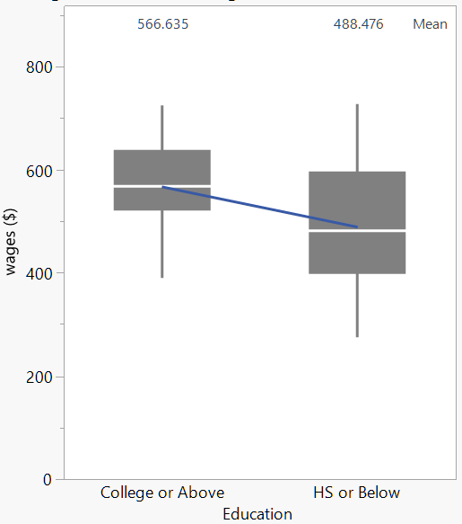
MVT: Which variable explains more variation in wages?

Slide 12
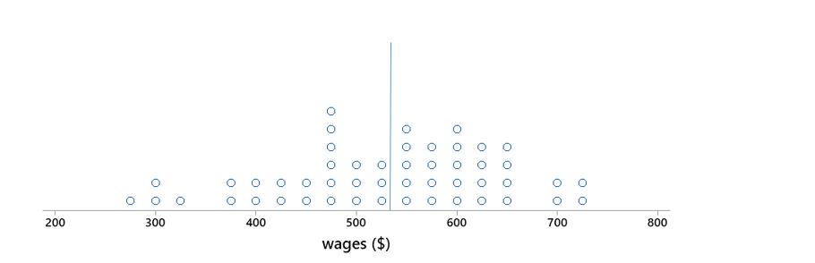
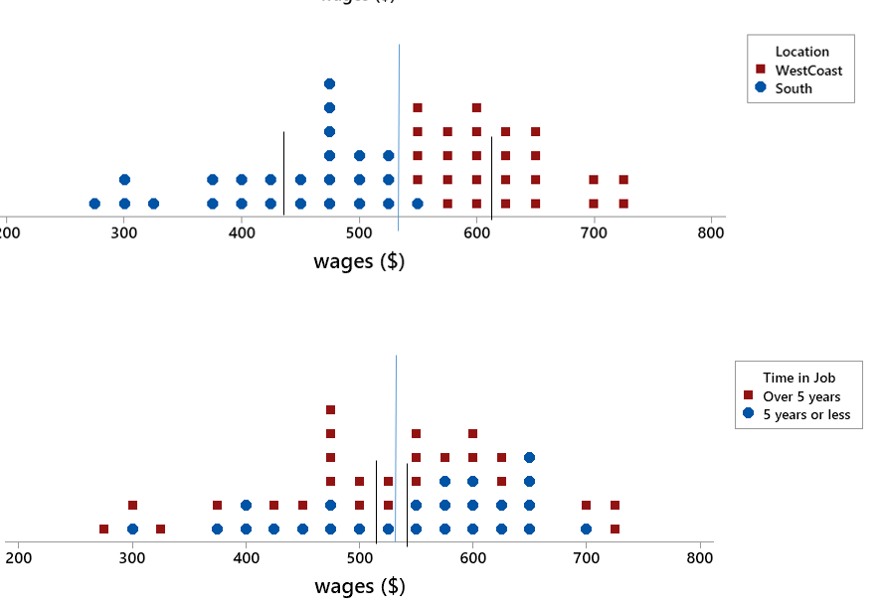
Wages tend to be closer to the location means
Location explains more variation in the wages than time in job.

Slide 13
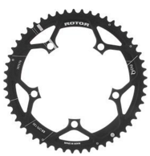
Step 3: (Stat 1 & Stat 2) Designing a Study
Researchers in Kinesiology at Cal Poly
Investigating 2 different types of chain ring on performance of competitive cyclists
Circular (standard) vs. Oval
$ to purchase 8 circular and 8 oval chain rings
Study participants will use their own bike

Slide 14
Step 3: (Stat 1 & Stat 2) Designing a Study
MVT: How should we measure ‘performance’?
1 km time trial (seconds)
MVT: What are some potential sources of variation in TT times?
Bike
Fitness level
Experience
Motivation
Stress, tired, eaten enough
Hydrated
Age, Biological Sex
Track or course
Weather
Timing mechanism
Notes:
Introduction to statistics

Slide 15
Sources of Variation Diagram
Observed Variation in: 1-km TT time (seconds) | Sources of Explained Variation | Sources of Unexplained Variation
Inclusion Criteria: | Type of Chain Ring (circular, oval)
Controlled by Design:
Bike
Fitness level
Experience, type of cyclist
Motivation
Stress, tired, diet
Age, Biological Sex
Unknown
Track or course
Weather
Timing mechanism

Slide 16
Inclusion Criteria (Reducing Variation)
Observed Variation in: 1-km TT time (seconds) | Sources of Explained Variation | Sources of Unexplained Variation
Inclusion Criteria: College-aged, Male, competitive triathlete | Type of Chain Ring (circular, oval)
Controlled by Design:
Bike
Fitness level
Experience, type of cyclist
Motivation
Stress, tired, diet
Age, Biological Sex
Unknown
Track or course
Weather
Timing mechanism

Slide 17
Inclusion Criteria (Reducing Variation)
Observed Variation in: 1-km TT time (seconds) | Sources of Explained Variation | Sources of Unexplained Variation
Inclusion Criteria: College-aged, Male, competitive triathlete | Type of Chain Ring (circular, oval)
Controlled by Design:
Bike
Fitness level
Experience, type of cyclist
Motivation
Stress, tired, diet
Age, Biological Sex
Unknown
Limits the Scope of Inference
Track or course
Weather
Timing mechanism

Slide 18
Control by Design (Reducing Variation)
Observed Variation in: 1-km TT time (seconds) | Sources of Explained Variation | Sources of Unexplained Variation
Inclusion Criteria: College-aged, Male, competitive triathlete | Type of Chain Ring (circular, oval)
Controlled by Design: Same 1-km course Same day/time of day Same timing device
Bike
Fitness level
Experience, type of cyclist
Motivation
Stress, tired, diet
Age, Biological Sex
Unknown
Track or course
Weather
Timing mechanism
Not real-world!

Slide 19
Random Assignment (Similar trt groups)
Participant #1
Participant #2
Participant #3
Participant #4
Participant #14
Participant #15
Participant #16
……
Bike
Fitness level
Experience
Motivation
Stress, tired, diet
Unknown
Is the random assignment eliminating or reducing the unexplained variation?

Slide 20
Purpose of Random Assignment
RQ
RV: TT Time
EV: Chain Ring
Bike
Fitness level
Experience
Motivation
Stress, tired, diet
Unknown
Sources of Unexplained Variation
Limits/reduces the potential for confounding

Slide 21
Accounting for the Rider-to-Rider Variability
Observed Variation in: 1-km TT time (seconds) | Sources of Explained Variation | Sources of Unexplained Variation
Inclusion Criteria: College-aged, Male, competitive triathlete | Type of Chain Ring (circular, oval)
Controlled by Design: Same 1-km course Same day/time of day Same timing device
Bike
Fitness level
Experience
Motivation
Stress, tired, diet
Unknown
Weather
Is there a way we can account for or remove the rider-to-rider variation?

Slide 22
Random Assignment within Participant
Participant #1
Participant #2
Participant #3
Participant #4
Participant #14
Participant #15
Participant #16
……
2nd
1st
Randomly assign the order of each chain ring for each rider
Bike
Fitness level
Experience
Motivation
Stress, tired, diet
Unknown

Slide 23
Accounting for the Rider-to-Rider Variability
Observed Variation in: 1-km TT time (seconds) | Sources of Explained Variation | Sources of Unexplained Variation
Inclusion Criteria: College-aged, Male, competitive triathlete | Type of Chain Ring (circular, oval)
Controlled by Design: Same 1-km course Same day/time of day Same timing device
Bike
Fitness level
Experience
Motivation
Stress, tired, diet
Unknown
Rider
Weather
1-km TT Type of Chain Ring + Rider

Slide 24
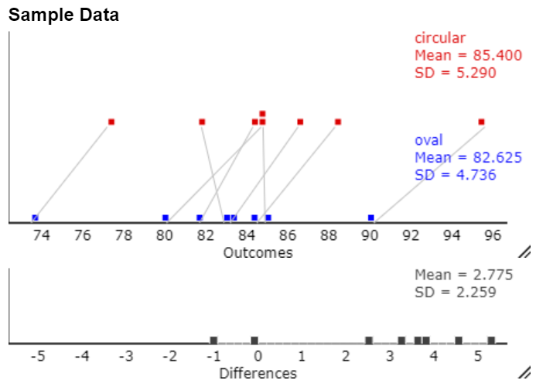
Accounting for the Rider-to-Rider Variability
Accounting for the rider ➔ Differences vary less than the individual TT times.

Slide 25
Step 4: Statistical Inference
Focus on conceptual understanding of how to use a sample of data to draw inferences to a population
Simulation-based Inference (SBI)
Used to teach the conceptual idea of a p-value
Statistical tests are each introduced using SBI ➔ parametric tests
Students leave the course with an understanding that all statistical tests are different versions of the same concept

Slide 26
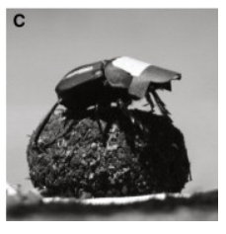
SBI Example
RQ: Do dung beetles use the stars to navigate their path at night?
Dacke, Baird, Byrne, Scholtz, and Warrant “Dung Beetles Use the Milky Way for Orientation,” Current Biology, 23, 2013
Beetles were randomly assigned to either wear a black cardboard cap to obscure their view of the night sky or a clear cap.
Placed at the edge of a platform and the time it took to reach the edge was measured for each (seconds).

Slide 27
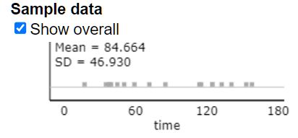
SBI Example

Slide 28
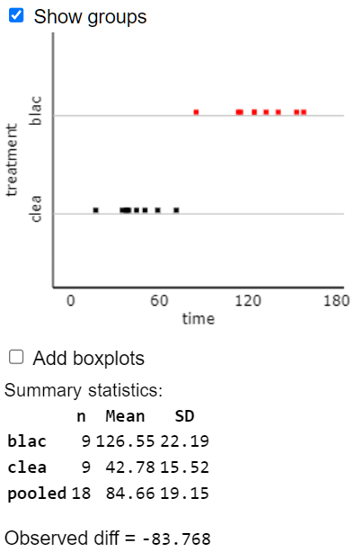
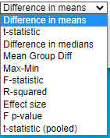
SBI Example
Measure how different the 2 groups are
Statistically significant?

Slide 29
SBI Example
How do we decide whether the observed difference in means, -83.768 seconds, is unusually large?
Need to understand what types of differences in means are expected just by random assignment when there is really no difference in the mean travel time for dung beetles with black caps and dung beetles with clear caps.

Slide 30
SBI Example
Need to generate a set of differences in means that result only from random assignment
Assume these 18 beetles would have taken the exact same time regardless of which cap they were wearing
Idea: The cap has no effect on time
Re-randomize the observed beetle times to the two groups: clear cap and black cap
Clear cap: n = 9 of the times
$${\overline{y}}_{clear}=$$
34.2
152.21
Etc.
38.5
123.61
Black cap: n = 9 of the times
$${\overline{y}}_{black}=$$

Slide 31
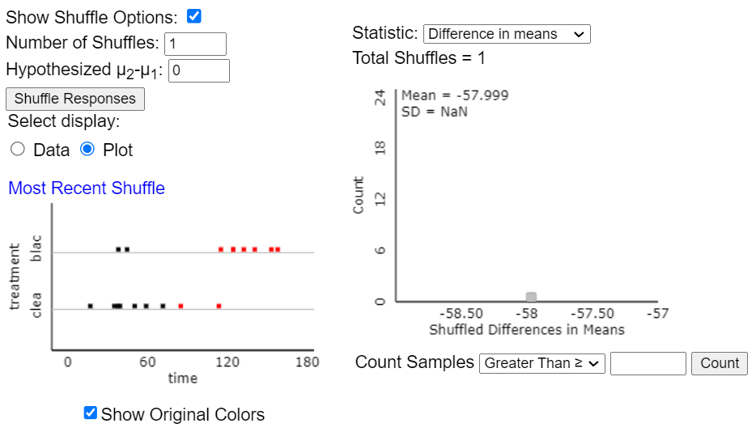
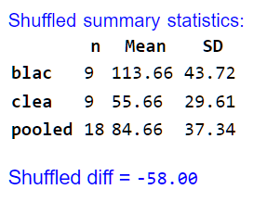
SBI Example

Slide 32
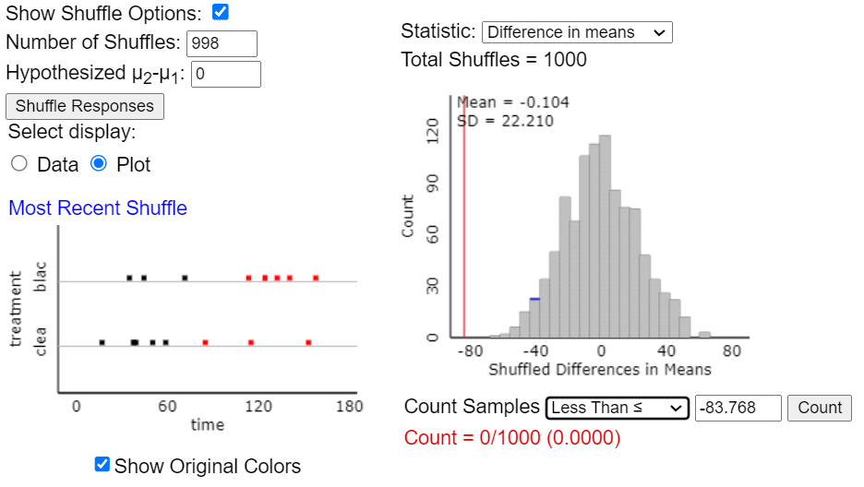
SBI Example
Is the observed mean statistically unusual (by random assignment)?
Small p-value means the observed outcome is unlikely to occur by random chance alone
Assuming the cap type has no effect on time, in many, many random assignments the observed difference in means of -83.768 seconds or less happens fewer than 1 in 1000 times.

Slide 33
SBI Example
Approximate p-value is used to formulate a conclusion for the question of interest:
Small p-value means the observed difference in means is unlikely to have happened by random chance alone (i.e., if the type of cap has no real effect on time).
Something else (besides random chance) is likely responsible for the observed difference
Assuming it was a well-designed study that has eliminated as many other possible reasons as possible ➔ we have sufficient evidence to conclude the type of cap has a true effect on time ➔ beetles must be navigating using the stars (or perhaps some other unknown mechanism)
Conclusion applies only to beetles similar to those in this study (see inclusion criteria and be careful about generalizing).

Slide 34
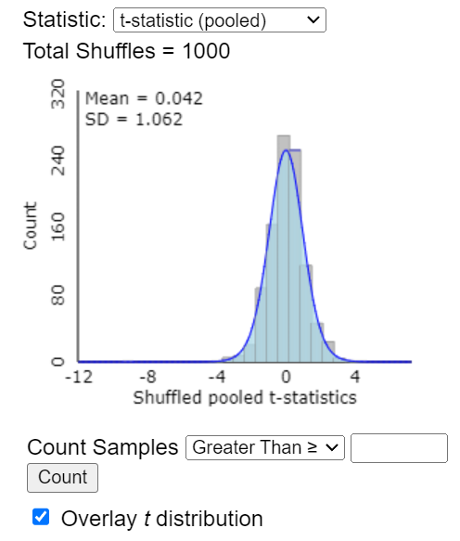
SBI Example
Follow-up with discussion of standardizing the difference in means ➔ t-statistic
Introduce the t-distribution
Two-sample t-test
Find theory-based p-value

Slide 35
SBI
The same process can be carried out for other statistical testing procedures
One proportion, Two proportions
One mean, Two mean, Multiple Means (ANOVA)
Regression
Many Stat 1 courses – statistical inference introduced within the first 2 weeks

Slide 36
GAISE (2016)
Guidelines for Assessment and Instruction in Statistics Education
Teach statistical thinking
Teach statistics as an investigative process of problem-solving and decision-making
Give students experience with multivariable thinking
Focus on conceptual understanding
Integrate real data with purpose
Foster active learning
Use technology to explore concepts and analyze data
Use assessments to improve and evaluate student learning
Notes:
Earlier in students’ statistical education
Disingenuious/Less exciting
First plenary: statistical insight
More appealing and accessible to a mathematically diverse audience
Regression vs. DOE, statistics vs. data science, statistics major vs. non-major
Help students see the common considerations and even terminology across these different audiences
Not that interesting to only think in terms of 1 or 2 variables. Going to data science courses in droves but what to make sure they are developing multivariable thinking as well. Push to make a second course more appealing and accessible to a mathematically diverse audience. Traditionally – matrix algebra, regression vs. ANOVA

