Slide 1
What They Remember May Not Be What They Understand: A Study of Mnemonic Recall and Performance by Introductory Statistics Students
CAUSE webinar
9/17/2024

Slide 3
What is a mnemonic?
A technique (25 centuries old!) used to assist memory in recalling a fact or a process
Collections in statistics: Hunt (2010), Lesser (2011), Stalder & Olson (2011)
EXAMPLES:
Acronym from first letters: PHANTOM
Problem
Hypotheses
Assumptions
Name of Test
Test Statistic
Obtain a p-value
Make a conclusion
Sentence mnemonic
In a left-skewed distribution, the tail points to the lower values.

Slide 4
Prior research (mostly surveys) on statistics mnemonics
vanVoorhis (2002), in Teaching of Psychology
Stalder and Olson (2011), in Teaching of Psychology
Mocko et al. (2017), in JSE (now JSDSE)

Slide 6
“Students cannot apply what they understand if they do not remember it.
Moreover, a good memory expands the repertoire of cognitive capabilities upon which new understandings can be developed and expedited.
Effective thinking does not occur in a vacuum.”
William Klemm (2007, p. 61)

Slide 7
The research questions
Open Recall: Which mnemonics do students recall more often?
Self-Reported Familiarity: Which mnemonics do students state familiarity?
Explained when Cued: Which mnemonics do more students explain when given the mnemonics as a cue?
Apply: What mnemonics do students apply correctly to exam-like questions given on the extra-credit surveys that would benefit from using mnemonics?
Associations: What is the association between Open-Ended Recall and Application as well as between Explained When Cued and Application for the 14 mnemonics in the study? Is there a difference between acronyms and more prolonged(e.g., sentence or song) mnemonics?
Predictive of Explained when Cued: Do the self-reported scores predict objective measures in memory?
Predictive of Application: Do the self-reported scores predict objective measures in performance?

Slide 8
Data Collection in 2017
Time Point | 1 | 2 | 3 | 4
Mnemonics | 1-7 | 8-14 | 1-14 | 1-14
Associated Exam(s) | 1 | 2 | 1 and 2 | 1 and 2
Exam Date | October 2 | November 6 | December 9 | December 9
Survey Date(s) | October 2 and 4 | November 7 | November 20 | Nov. 27 - Dec. 6
Survey Location | Computer Lab | Computer Lab | Computer Lab | Online
Students Taking Survey (% of class) | 136 (6.7%) | 164 (8.1%) | 152 (7.5%) | 868 (43.1%)

Slide 9
Recall: Which mnemonics do students recall more often when asked to list mnemonics to which they have been exposed?
Time Point 1
SOCS (60.1%)
When summarizing a dataset or describing a histogram, remember to talk about “SOCS” –Spread, Outliers, Center, Shape
BINS (50.0%)
Binary outcomes, Independent outcomes, Number of trials fixed in advance, Same chance p of success on each trial.
Time Point 2
PHANTOM (51.2%)
Parameter, Hypotheses, Assumptions, Name of Test, Obtain a p-value, Make a conclusion.
PANIC (25.6%)
Don’t PANIC, because you know the steps. – Parameter, Assumptions, Name of interval, Interval, make a Conclusion.

Slide 10
3. Explained when Cued: Out of the mnemonics assessed at that time point, which mnemonics do more students explain when given the mnemonics as a cue?
Time Point 1
Population
Population and Parameters both start with “p”; Sample and Statistic both start with “s”.
X axis
The explanatory variable is on the X axis.
Left skewed
Data that is skewed Left has a tail that goes to the Lower numbers.
Time Point 2
P-value decision
Hypothesis testing based on p-value: If the p-value is low, the null must go.
Three-way tie for t vs. z, Null and df
The t table is for “tiny” sample sizes, and the Z table is for “sizeable” samples.
Ho is what we “Hold” onto unless we get enough evidence to reject it, in which case the researcher is “Happy” because the evidence supports Ha (which is the hypothesis she was trying to “prove”).
With degrees of freedom, you step down. The d is for degrees and down.

Slide 11
4. Apply: What mnemonics do students apply correctly to exam-like questions (on the extra-credit surveys) that would benefit from using mnemonics?
Time Point 1
X axis
Left skewed
Time Point 2
t vs. z
P-value decision
df

Slide 12
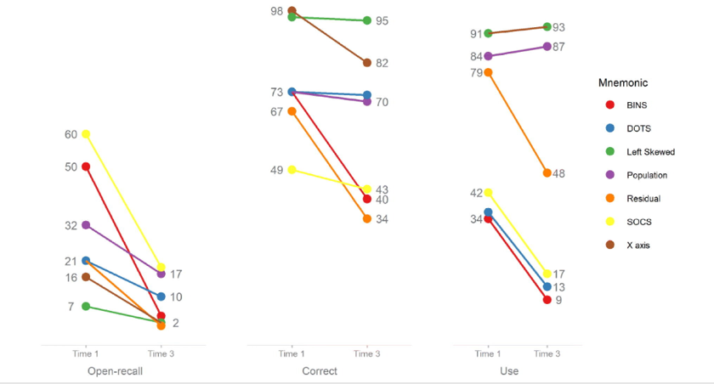
Open recall, correct, and use for time points 1 and 3
RQ 1
RQ 4
RQ 2

Slide 13
Recommendations for Teaching
Help students transition from recall to application.
Don’t assume a student can apply a mnemonic just because they remember it.

Slide 14
Next Steps
Methods of presenting mnemonics for easier recall
Training of teaching assistants for the use of mnemonics
Relationship between question difficulty and applicability of mnemonic use
Relationship between mnemonic use and statistical anxiety
Role of mnemonics in problem solving
Creation of mnemonics

Slide 15
Self–reported familiarity
how well they remembered the memory aid from class
how likely they were to think of the mnemonic if they needed to solve a problem or remember information for a test
if they thought that they could apply it

Slide 16
2. Self-Reported Familiarity: With which mnemonics do students state familiarity?
Time Point 1
Population
Population and Parameters both start with “p”; Sample and Statistic both start with “s”.
X axis
The explanatory variable is on the X axis.
Left skewed
Data that is skewed Left has a tail that goes to the Lower numbers.
Time Point 2
P-value decision
Hypothesis testing based on p-value: If the p-value is low, the null must go.
t vs. z
The t table is for “tiny” sample sizes and the Z table is for “sizeable” samples.

Slide 17
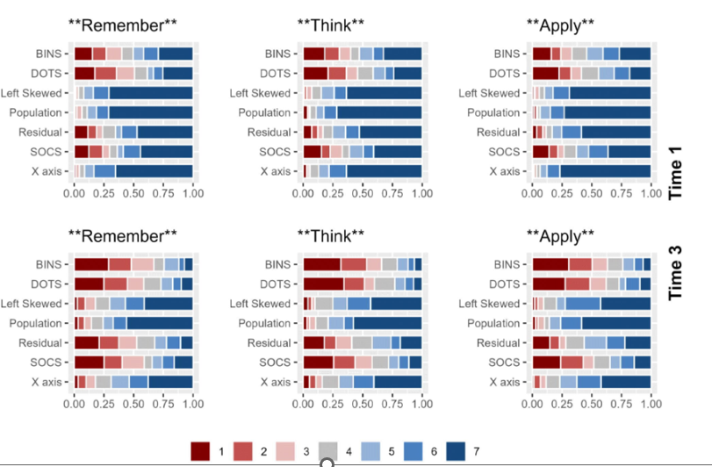
Self-Reported Familiarity for mnemonics 1 – 7 time points 1 and 3
Red (1) is low
Dark Blue (7) is high

Slide 18
5. Associations: What is the association between Open-Ended Recall and Application as well as between Explained When Cued and Application for the 14 mnemonics in the study? Is there a difference between acronyms and longer (e.g., sentence or song) mnemonics?
Students could recall, explain, and apply.
Students could move through levels of Bloom’s Taxonomy.

Slide 19
6. Predictive of Explained when Cued: Do the self-reported scores predict objective measures in memory?
Students who were more likely to say that they could remember it were also more likely to explain it.

Slide 20
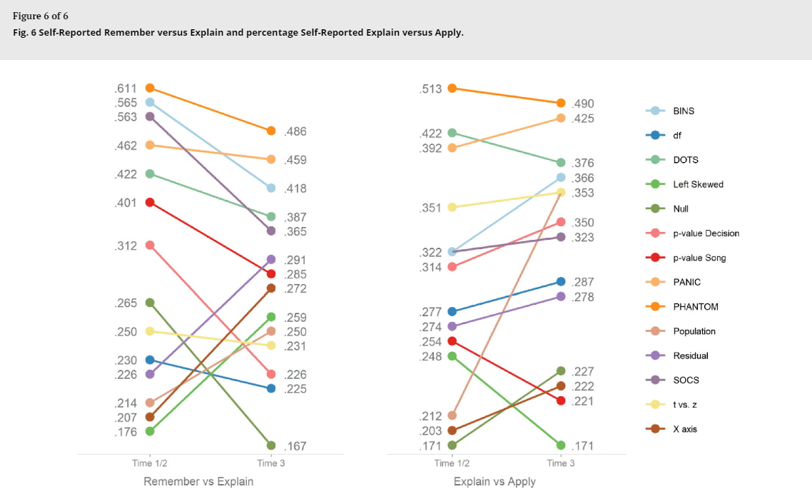
6 &7. Predictive of Explained when cued/Application: Do the self-reported scores predict objective measures in memory/performance?
Cramer’s V effect sizes reported in this figure
Notes:
See earlier comment about font size

