Slide 1
Sampling Variability: A hot topic in the Common Core
Anna Bargagliotti
Loyola Marymount University
Notes:
Anna

Slide 2
Background
Nationally there is a strong push for increasing statistics education for K-16
The Common Core State Standards for Mathematics (CCSSM) include a large amount of statistics content in the middle and high school grades and a smaller amount at the elementary school level
The Mathematics Education of Teachers Reports (MET I and MET II) have identified statistics as a large area of concern for teacher preparation

Slide 3
Statistics in the Common Core
At the elementary level, a small amount of statistics is included in the Measurement and Data strand
At the middle school level, a large amount of statistics is introduced
At the high school level, statistics is
interwoven in all courses,
in a stand alone AP course,
in a stand alone non-AP course, and
in the modeling strand

Slide 4
Challenges & Opportunities
The increased attention towards statistics is welcomed and needed
This provides huge opportunities for statistical learning
However, with these opportunities, we also have large challenges
A main challenge is the preparation of teachers in statistics

Slide 5
Pre-service Teacher Preparation
At the elementary level, teachers at best take 3 courses in mathematics departments with possibly only 1 chapter/unit dedicated to stats
At the middle level, teachers may have more math courses or they may have only what the elementary teachers have
At the high school level, teachers typically are undergraduate math majors or math minors during which they may or may not have statistics courses depending on their program

Slide 6
In-service Teacher Preparation
In-service teachers at all levels were for the most part trained before the CCSSM
Little to no statistics may have been present in their teacher preparation
There is a large need to help in-service teachers, as well as pre-service teachers, with statistical preparation
Note: their needs are similar

Slide 7
Statistical Topics Emphasized in CCSSM
One of the main concepts emphasized in the CCSSM is sampling variability
Other emphasized topics include bivariate data analysis, probability as used in decision-making, and distributions
Today we will focus on sampling variability

Slide 8
Sampling Variability
Sampling variability, defined as the variation of a statistic found from taking random samples repeatedly from a population, is a central concept in statistics
GAISE suggest the teaching of sampling variability be introduced in the middle grades and continue through high school
CCSSM address sampling variability in the middle school and high school grades
Notes:
Anna

Slide 9
Sampling Variability in the Common Core
Grade 7 standards:
Use random sampling to draw inferences about a population
Draw informal comparative inferences about two populations
Use measures of center and measures of variability in random samples to draw informal comparative inferences about two populations
Investigate chance processes and develop, use, and evaluate probability models
Approximate the probability of a chance event by collecting data on the chance process that produces it and observing its long-run relative frequency , and predict the approximate relative frequency given the probability
High School standards:
Understand and evaluate random processes underlying statistical experiments
Making inferences and justify conclusions from sample surveys, experiments, or observational studies
Use data from a sample survey to estimate a population mean or proportion, develop a margin of error through the use of simulation models for random sampling
Understand statistics as a process from making inferences about population parameters based on a random sample from that population
Decide if a specified model is consistent with results from a given data-generating process
Notes:
Anna

Slide 10
Teacher Knowledge
In light of the CCSSM emphasizing sampling variability, it is imperative for teachers to have a good understanding of the topic in order to effectively teach it to their students and meet the standards requirements
To address this need, the NSF-funded Project-SET aimed to develop professional development (PD) materials for teachers to learn about sampling variability
We first developed a hypothetical learning trajectory (LT) along with activities and assessments to be used to teach and test teacher understanding
We then tested the LT in two pilots with high school teachers and edited the materials accordingly

Slide 11
The Learning Trajectory
Development of the LT was an extensive multi-year process that underwent several iterations
In addition, after each pilot it has been significantly edited
You should have the before and after version of the LT
Note on the after (current) version: loop 5 is still undergoing some edits as the second pilot is just at this point right now!
Next week this should be finalized once and for all!

Slide 12
Testing the LTs
Pilot #1: Memphis, TN with 9 teachers
Pilot #2: Los Angeles, CA with 4 teachers
The pilots met for 15 weeks for three hours each time
1 loop was covered in 1 class meeting (therefore 5 class periods were dedicated to sampling variability)
For each loop of the LT, we developed 1 activity that teachers would work through during the PD to guide them through the knowledge in the loop
For each loop of the LT, we developed 1 open-ended assessment task that aimed to understand whether the teachers progressed through the loop
During pilot 1, several teacher misunderstandings were uncovered through the assessments
Edits were made to the LT, activities, and assessments accordingly to address the misunderstandings
The LT was presented to the teachers after its completion

Slide 13
Misunderstandings Uncovered
Misalignment of a statistical survey question with the goal of a study (discussed in eCOTS presentation)
Fixating that the mean and median are the only two possible numbers that can describe the center of a distribution (discussed in eCOTS presentation)
Confusing the population distribution, sample distribution, and sampling distribution
Misunderstanding that the mean of the sampling distribution of the mean approaches the mean of the population as the size of the sample increases
Misunderstanding that multiple samples are needed at all times in order to say anything about the population

Slide 14
Tackling the Misunderstandings
We want the PD materials developed to be “off the shelf”
Therefore it is very important to us that the activities and assessment and LT take into account any common pitfalls that teachers may fall into
After the first pilot, we drastically changed the approach in several of the activities to ensure that we were not creating any misunderstandings
Lets go through an activity that promoted many “ah-ha” moments during the second pilot
This activity was adjusted in order to ensure that it did not lead teachers to:
Confuse the population distribution, sample distribution, and sampling distribution
Misunderstand that the mean of the sampling distribution of the mean approaches the mean of the population as the size of the sample increases

Slide 15
Text Messages Revised
Sally, Jamal, Ivy, and Tom are students in Mr. Miller’s Statistics class. One day in class they get into a discussion about text messaging.
From their service carriers they obtain data about their text messaging use from the last three-years. Each of them records the number of text messages they send or receive every day for 1085 days. They then use statistical analysis to compare their text messaging patterns.
Each group is given one person’s text messaging data
For their assigned person, each finds an approximate sampling distribution for the mean text messages using samples of size 10, 30, and 50
They are asked to comment on the center, shape, and variation of their approximate sampling distributions
They also compute the means and the standard deviations for their sampling distributions

Slide 16
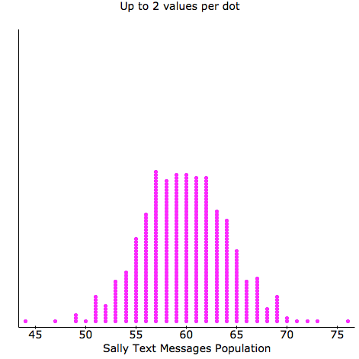
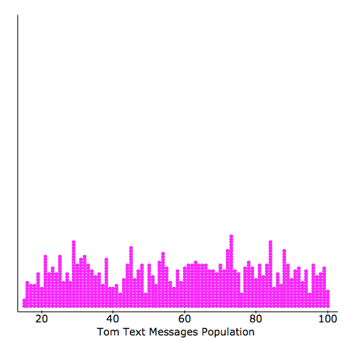
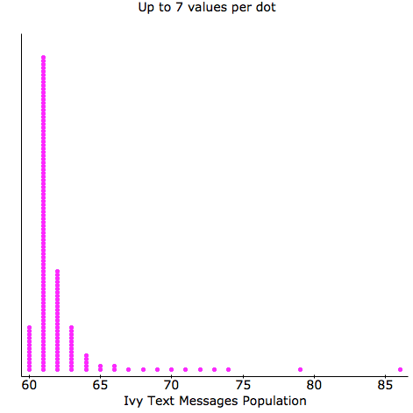
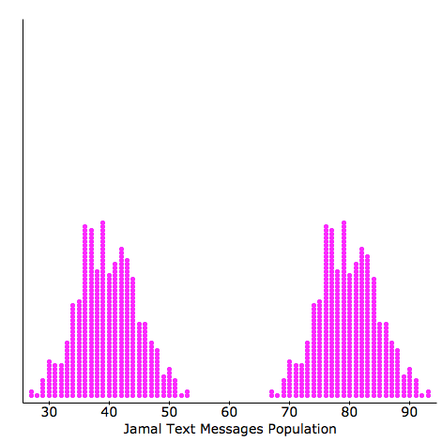
Text Messaging Distributions

Slide 17
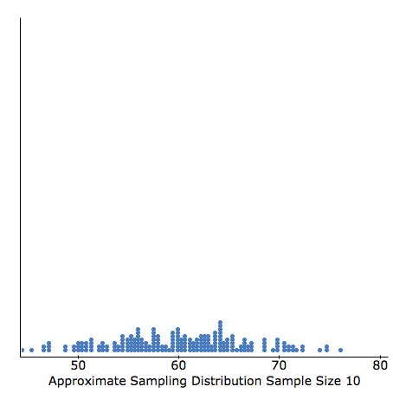
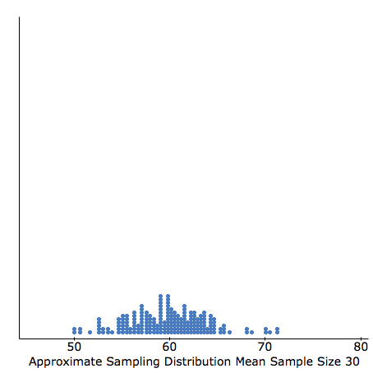
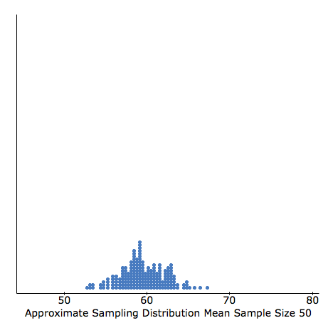
Results

Slide 18
Results
The second pilot results indicated a drastic improvement in teacher understanding of the overall flow of concepts
The flow is particularly important for a concept like sampling variability that has many important parts and applications
Here is an audio of one teacher in pilot 2 reflecting on their progression of topics in the LT

Slide 19
Conclusions
Presenting a topic such as sampling variability using a LT as the backbone can provide teachers with the needed big picture
This big picture is particularly important for teachers since they have to have a greater understanding of how everything fits together in order to teach it to their students
LTs can give us the structure needed to deliver effective PD for teachers
Here is an audio clip of another teacher explaining the LT:

