Slide 1
Updating the Guidelines for Undergraduate Programs in Statistics
CAUSE Teaching and Learning Webinar Series
Nicholas Horton (Amherst College)
nhorton@amherst.edu
November 12, 2013

Slide 2
Plan
Introduction and motivation
Brief descriptions of current guidelines
Open discussion
Summary of feedback to date
Next steps

Slide 4
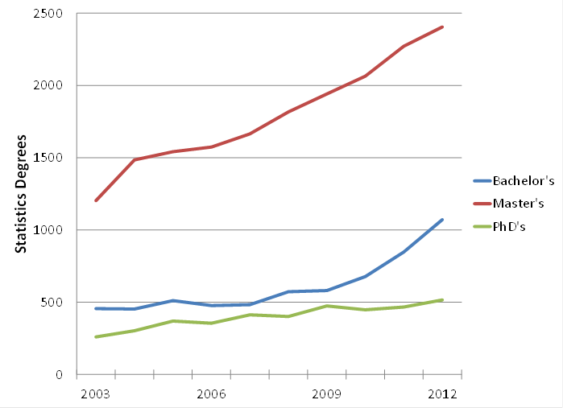
Statistics degrees at the bachelor’s, master’s, and doctoral levels in the United States. These data include the following categories: statistics, general; mathematical statistics and probability; mathematics and statistics; statistics, other; and biostatistics. Data source: NCES Digest of Education Statistics.
Notes:
Bachelor degrees for these combined categories are up 26% over the year before; Master’s are up 6%; and PhD’s are up 10% (mostly because biostatistics PhD’s jumped from 125 in 2011 to 173 in 2012.)

Slide 5
Current guidelines
Principles
Skills needed
Curriculum topics (Degrees)
Curriculum topics (Minors/Concentrations)
Additional resources
(details on pdf attachment from webinar email)

Slide 6
Principles
Equip students with quantitative skills to use in flexible ways
Emphasize concepts and tools for working with data
Provide experience with design and analysis
Distinct from mathematics: requires many non-mathematical skills

Slide 7
Skills needed
Statistical
Mathematical
Computational
Non-mathematical
Substantive area

Slide 8
Topics for Majors
Approaches to teaching topics should:
Emphasize real data and authentic applications
Present data in a context that is both meaningful to students and indicative of the science behind the data
Include experience with statistical computing
Encourage synthesis of theory, methods, and applications
Offer frequent opportunities to develop communication skills

Slide 9
Topics for Majors
Statistical topics
Statistical theory
Graphical data analysis methods
Statistical modeling
Design of studies

Slide 10
Topics for Majors
Mathematical topics and probability
Calculus (integration and differentiation) through multivariable calculus
Applied linear algebra
Emphasis on connections between probability concepts and their applications in statistics

Slide 11
Topics for Majors
Computational topics
Programming concepts
Database concepts and technology
Professional statistical software appropriate for a variety of tasks

Slide 12
Topics for Majors
Non-mathematical topics
Effective technical writing and presentations
Teamwork and collaboration
Planning for data collection
Data management
The undergraduate experience should include an internship, "capstone" course, consulting experience, or a combination

Slide 13
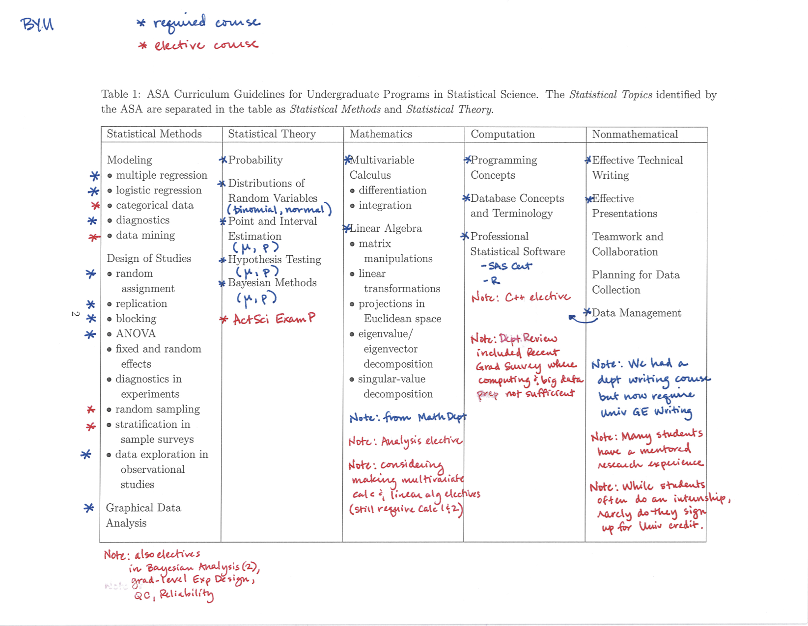

Slide 14
Topics for Minors
The core of a minor or concentration in statistics should consist of the following:
General statistical methodology
Statistical modeling
Exposure to professional statistical software
plus elective topics, capstone and/or relevant courses from other departments

Slide 15
Additional existing resources
Undergraduate programs and the future of academic statistics (David Moore)
Needs of Business, Industry and Government (BIG)
Guidelines for Bachelor of Science degrees in Statistical Science
Guidelines for Bachelor of Arts degrees in Statistical Science
Resource Material for Minors/Concentrations

Slide 16
What’s next?
Prior guidelines approved by ASA Board in 2000, widely promulgated and used
“Age of Big Data” arrived
Number of students has increased dramatically
What should be rethinking in terms of the undergraduate statistics curriculum?

Slide 17
Process and structure
ASA President Nat Schenker appointed a working group with representatives from academia, industry and government to make recommendations
Goal: draft of revised recommendations and supporting materials by JSM 2014 in Boston (Go Sox!)
Now soliciting feedback and suggestions

Slide 18
Questions for Discussion (I)
How do you use the curriculum guidelines? What adaptations or creative solutions have you used?

Slide 19
Questions for Discussion (I)
How do you use the curriculum guidelines? What adaptations or creative solutions have you used?
For example, how do you develop majors’ nonmathematical skills?
How are you including depth in a substantive area?
What statistical computing do your students learn?

Slide 20
Questions for Discussion (II)
What do you feel is lacking in the guidelines and/or accompanying resources?

Slide 21
Questions for Discussion (II)
What do you feel is lacking in the guidelines and/or accompanying resources?
Should more be done with “data issues” before analysis? Non-traditional data? Where do students learn data visualization skills? Where do students see “big data”?
What skills/topics do you think need to be added to the guidelines? Are there any that could be deleted?

Slide 22
Questions for Discussion (III)
How can we evaluate the effectiveness of our programs?

Slide 23
Questions for Discussion (III)
How can we evaluate the effectiveness of our programs?
What measures of quality have been used? Can they be improved?
What is the dividing line between a bachelor’s degree and a master’s degree?
What types of careers can BS students find?
Can we improve student preparation for life after graduation?

Slide 24
Feedback to date
“I wish I'd learned more on statistical modeling, computational topics, and especially the non-mathematical items listed.”
“students need to understand that the data will be messy – incomplete and inaccurately recorded”
“need to have some understanding of the ‘costs’ of gathering data from a logistical point of view”
“consider a bullet point ‘Principles of software development, revision control, test cases and software documentation’”
“need more database expertise: 20 years ago setting up a database required a huge monetary investment up-front and a lot of upkeep. Now the infrastructure is free and there's a large Open Source community for support, so there's no longer any excuse.”

Slide 25
Your turn…
We welcome your feedback!
More information about the existing curriculum guidelines, previous curriculum webinars as well as upcoming ones (11/18, “Building towards Big Data and Data Science”; 12/4, “The Role and variety of undergraduate statistics capstones”) plus a survey can be found at:
http://www.amstat.org/education/curriculumguidelines.cfm

