Slide 1
teaching data analysis to 10k+ at a time Jeff Leek Johns Hopkins Bloomberg School of Public Health
news feed: @leekgroup,@simplystats
blog: simplystatistics.org
email: jtleek@gmail.com
youtube: http://www.youtube.com/user/jtleek2007

Slide 2
how brian caffo convinced me to do an 8 week unpaid internship for coursera Jeff Leek Johns Hopkins Bloomberg School of Public Health
news feed: @leekgroup,@simplystats
blog: simplystatistics.org
email: jtleek@gmail.com
youtube: http://www.youtube.com/user/jtleek2007

Slide 3
my fellow guinea pigs
Roger Peng
“Computing for Data Analysis”
Brian Caffo
“Mathematical Biostatistics Bootcamp”
http://www.biostat.jhsph.edu/~rpeng/
http://www.bcaffo.com/

Slide 4
motivation for teaching coursera courses
We were going to do it anyway
Be part of the experiment
Advertising for Simply Statistics
Advertising for Hopkins

Slide 5
timeline
Previously: We had discussed putting lectures on Youtube and “flipping” the classroom.
7-1-2012: Brian tells me Hopkins has a deal with Coursera and invites me to do it, I invite Roger
7-2-2012: Roger and I sign up
7-5-2012: Roger and I make our advertising videos (Roger does his in one take)
7-17-2012: Official announcement by JHU
9/2012 – Roger’s/Brian’s courses run
1/2012 – Jeff’s course runs

Slide 6
official announcement

Slide 7
the next day
from: Gooding, Ira <igooding@jhsph.edu>
date: 7/18/12
I heard from Coursera this morning and learned that more than 10,000 students have already signed up for our JHSPH courses!

Slide 8
the day after that
from: jtleek@gmail.com
Roger let me know you gave him a ballpark figure for the number of students registered for his course "Computing for Data Analysis”. Could you give me an idea of how many have registered for my course "Data Analysis?”

Slide 9
the day after that
pangwei@coursera.org
from:
Hi Jeff,
7,000 students! It's pretty awesome. (You'll be able to check this out yourself next week, once the class sites are up.)

Slide 10
by the numbers “data analysis”
Measurement | Number of Participants
Students registered | 100,974
Students participated | 64,868
Students watching videos | 50,005
Students submitting quizzes | 18,605
Students submitting assignments | 5,341
Students posting to forum | 4,578

Slide 11
by the numbers “computing for data analysis (v1)”
Measurement | Number of Participants
Students registered | 50,651
Students participated | 34,828
Students watching videos | 26,707
Students submitting quizzes | 11,271
Students submitting assignments | 5,814
Students posting to forum | 2,266

Slide 12
by the numbers “computing for data analysis (v2)”
Measurement | Number of Participants
Students registered | 40,863
Students participated | 35,922
Students watching videos | 29,081
Students submitting quizzes | 16,146
Students submitting assignments | 8,550
Students posting to forum | 3,255

Slide 13
by the numbers “mathematical biostatistics bootcamp (v1)”
Measurement | Number of Participants
Students registered | 15,197
Students participated | 10,703
Students watching videos | 7,985
Students submitting quizzes | 2,141
Students submitting assignments | NA
Students posting to forum | 729

Slide 14
by the numbers “mathematical biostatistics bootcamp (v2)”
Measurement | Number of Participants
Students registered | 18,621
Students participated | 11,025
Students watching videos | 7,941
Students submitting quizzes | 5,361
Students submitting assignments | NA
Students posting to forum | 463

Slide 15
course structure (CDA – Peng)
4 weeks
4 programming assignments
4 quizzes
about 3 hours of videos in 8-10 min chunks
per week

Slide 16
course structure (MBB – Caffo)
7 weeks
7 quizzes
7 optional homework assignments
about 2 hours of videos in 10-25 min chunks per week

Slide 17
course structure (DA – Leek)
8 weeks
8 quizzes
2 data analysis assignments
about 2 hours of videos in 10-15 min chunks per week

Slide 18
coursera platform (videos)

Slide 19
coursera platform (quizzes)

Slide 20
coursera platform (peer review)

Slide 21
coursera platform (forums)

Slide 22
coursera platform (forums)

Slide 23
course support
Tech support locally/through Coursera
Roger/Brian/I created our own videos (Camtasia), uploaded our own videos, and ran the courses
Brian/Roger had a local TA
Coursera assigned “Community TAs”

Slide 24
lessons learned
People care about the certificate a lot
You will get feedback – the 1%/98%/1% rule of internet message boards applies “The internet in a class”™
Careful where you post data/send people

Slide 25
workload
First time, depends on course
Easily adaptable -> moderate effort
New/harder to adapt -> large effort
Repeat offerings
Much lower effort
Roger got an email telling him his class was finished.

Slide 26
integration with local curriculum
Brian’s course most closely matched his local offering
Used videos for “flipped classroom”
My class was lower level for Coursera
I primarily use some slides
Roger/I have discussed how it changes the way we think about what to teach locally

Slide 27
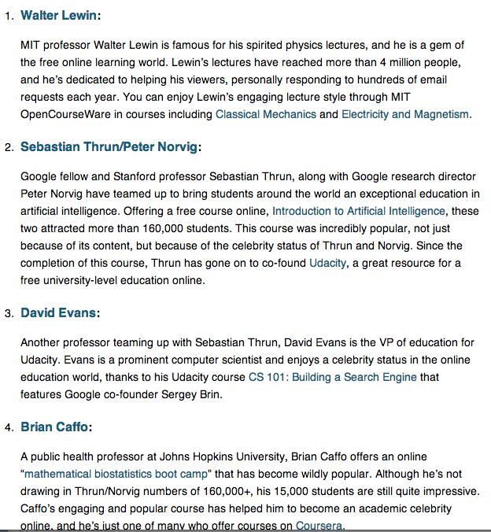
benefits of coursera

Slide 28
benefits of coursera

Slide 29
benefits of coursera
email to brian:
"I was reading the coursera course description you are teaching on Mathematical Biostatistics Boot Camp. I have a question for you. I have a son in prison in Georgia, and I would like him to take this course because he has the background for this class. The problem I have is that he is not allowed to use the internet. Would it be possible for me to down log the necessary information for him? He would be able to read and write the homework assignments, and I will write his answers for you."

Slide 30
things i’d do differently
Shorter videos (5-10 min)
Break it into more classes
Add comments to peer review
Make it part of my day job

