Slide 1
Using Data from Climate Science
to Teach Introductory Statistics
Gary Witt
Temple University

Slide 2
The following slides show one example of
combining data from climate science
with basic statistical methods
to tell an interesting story to students.

Slide 3
Using Regression
to analyze the rate of change of
Arctic Sea Ice Extent

Slide 4
In the late 1980’s when climate scientists began to raise concerns that increasing levels of atmospheric CO₂ would cause the earth to warm, they were unsure about the rate of climate change.
In particular, most estimated that the Arctic Ocean would never be ice free until the year 2100.
In the last five years, many have begun to predict a more rapid melt.

Slide 5
Using scatterplots and regression, we can analyze the data to see the evidence for ourselves.
The data we will analyze is a time series of September Arctic sea ice extent from 1979 until 2012.

Slide 6
What is meant by the term September Arctic sea ice?
Why is it important?

Slide 7
As far as we know, most of the Arctic Ocean has been covered in ice year round for thousands of years (the North Pole is near the center of the Arctic Ocean).
Since 1979, satellites regularly observe the ice in the Arctic Ocean. Computer programs calculate the area or extent of the ice coverage on a daily basis.
These daily numbers are averaged to get the September sea ice extent. September is the month when the ice stops melting each summer and reaches its minimum extent.

Slide 8
The next two slides reflect images from
September 1980 when the ice extent was 7,800,000 square kilometers and
September 2012 when the ice extent was 3,600,000 square kilometers.
The pink boundary depicts the median extent from
1980-2000.

Slide 9
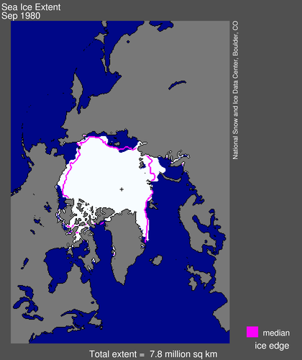

Slide 10
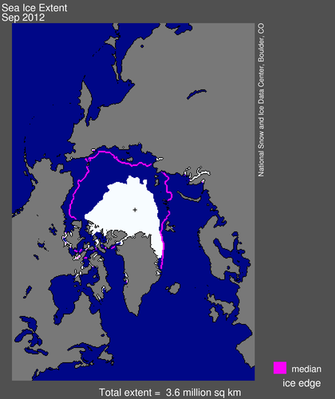

Slide 11
The next two slides display the entire data set, the average Arctic sea ice extent in millions of square kilometers for each September from 1979 until 2012.
Data were obtained from the National Snow and Ice Data Center in Boulder Colorado.

Slide 12
Time series from 1979-2012

Slide 13
Time series from 1979-2012

Slide 14
The regression slope of -0.092 means that the average rate of decline in September Arctic sea ice from 1979-2012 is 92,000 square kilometers per year.
For perspective, the state Maine is 92,000 square kilometers so an area of sea ice the size of Maine has been melting per year.

Slide 15
To understand why many climate scientists now believe that the melt rate of Arctic sea ice is accelerating, plot the data that was available in 2001.

Slide 16
Time series from 1979-2001
When this regression was run in 2001,
the slope was half as steep.

Slide 17
The following page is a table with the slope and intercept calculated from a linear regression run at the end of September each year since 2001.

Slide 18
The linear regression run each year since 2001.
First | Last
Year | Year | Intercept | Slope
1979 | 2001 | 98.3 | -0.046
1979 | 2002 | 108.5 | -0.051
1979 | 2003 | 112.0 | -0.053
1979 | 2004 | 115.6 | -0.055
1979 | 2005 | 125.2 | -0.059
1979 | 2006 | 126.8 | -0.060
1979 | 2007 | 149.5 | -0.072
1979 | 2008 | 162.2 | -0.078
1979 | 2009 | 163.4 | -0.079
1979 | 2010 | 168.8 | -0.081
1979 | 2011 | 175.4 | -0.085
1979 | 2012 | 190.1 | -0.092
Notice that the slope steepens every year.
The rate of decline of Arctic sea ice extent is growing.

Slide 19
A model that allows for a changing slope might fit the data better.

Slide 20
A quadratic function of the form
is a simple function that allows for the slope to change at a constant rate.
Its parameters, b₀, b₁, and b₂ , can be estimated from the data using regression.

Slide 22
The quadratic regression visually appears to be a better fit, especially for recent data.
Also, the quadratic regression increases R² (the percentage of the variance explained by X) from 72.5% to 82.2%.

Slide 23
What does this quadratic regression tell us about our original question?
How long will the Arctic summer sea ice last?

Slide 24
The ongoing debate among climate scientists: When will the ice melt?
A top Oceanographer, Professor Peter Wadhams of Cambridge University, stated in an interview with the London Telegraph on Nov 8, 2011 that,
“the fall-off in ice volume is so fast that it is going to bring us to zero very quickly. 2015 is a very serious prediction and I think I am pretty much persuaded that that's when it will happen.“

Slide 25
The ongoing debate among climate scientists: When will the ice melt?
Others, such as Axel Shweiger at the University of Washington’s Polar Science Center, are more cautious. On April 11, 2012 Shweiger and his colleagues wrote in a Real Climate article that, until further study,
“we need to … let previous model-based predictions of somewhere between 2040 and 2100 stand.”

Slide 26
Between those two extremes was a prediction made on June 27, 2011, by U.S. Navy Adm. Gary Roughead, chief of naval operations.”
“Within 25 years the Arctic could become a profitable sea route from Asia to Europe.”

Slide 27
If we project forward our quadratic regression trend, we can see that it is consistent with the Admiral’s statement.

Slide 29
The quadratic regression projects that September Arctic sea ice will melt completely by the year 2027.

Slide 30
Climate scientists rely on much more than just
a simple quadratic trend projection.
In this case other lines of evidence, such as the rapidly declining thickness of the Arctic sea ice reinforce the conclusion that the melt rate of Artic sea ice will continue to increase.
But for now, no one is certain how long the Arctic summer sea ice will remain.

