Slide 1
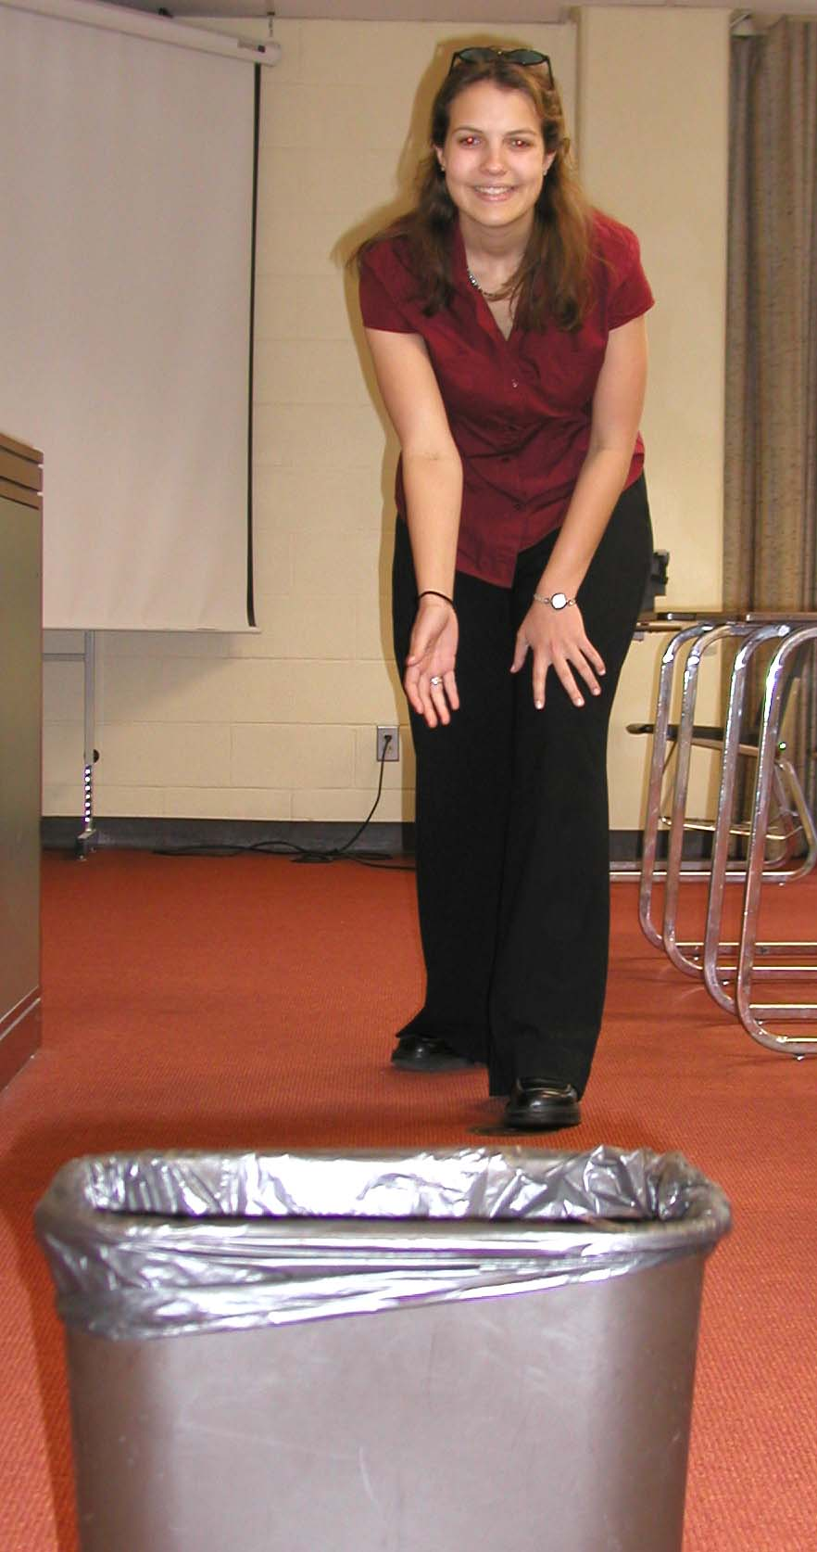
Trashball: A Logistic Regression Classroom Activity
Christopher Morrell
(Joint work with Richard Auer)
Mathematics and Statistics Department
Loyola University Maryland
chm@loyola.edu
http://evergreen.loyola.edu/~chm/
CAUSE Webinar: February 28, 2012

Slide 2
Background
Statistical methods or linear models courses initially discuss continuous numerical response variables.
Can also consider response variables that are either binary or categorical.
More introductory linear models and statistical methods books now include chapters or sections devoted to logistic regression (for example, see Kleinbaum et al. (2008), Kutner et. al. (2003), Ott, and Longnecker (2010)).

Slide 3
Trashball: The Activity
Students attempt to toss a ball into a trashcan.
The outcome or response variable is whether or not the ball ends up in the trashcan - “ShotMade.”
Success depends on the distance from the trashcan (and other factors).

Slide 4
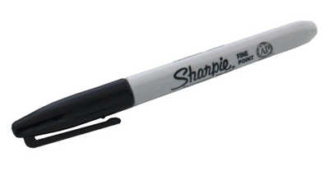
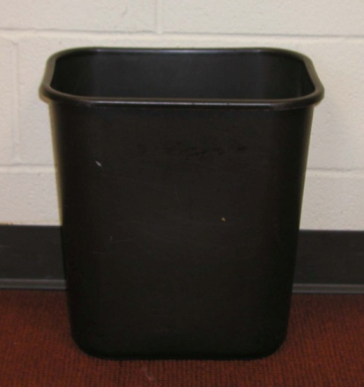
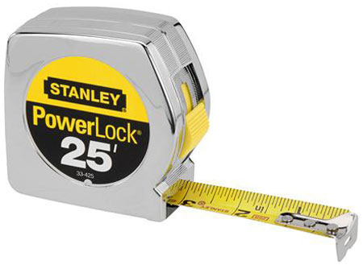
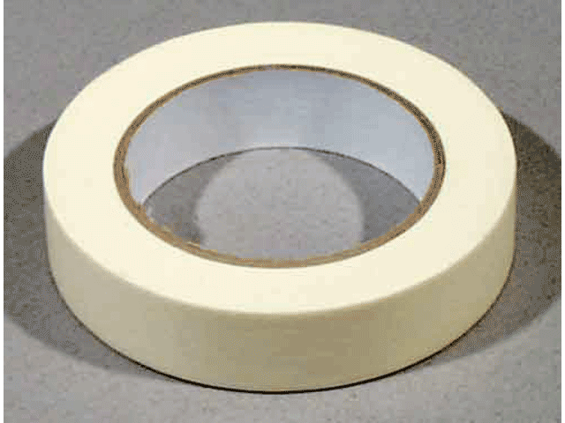
Equipment

Slide 5
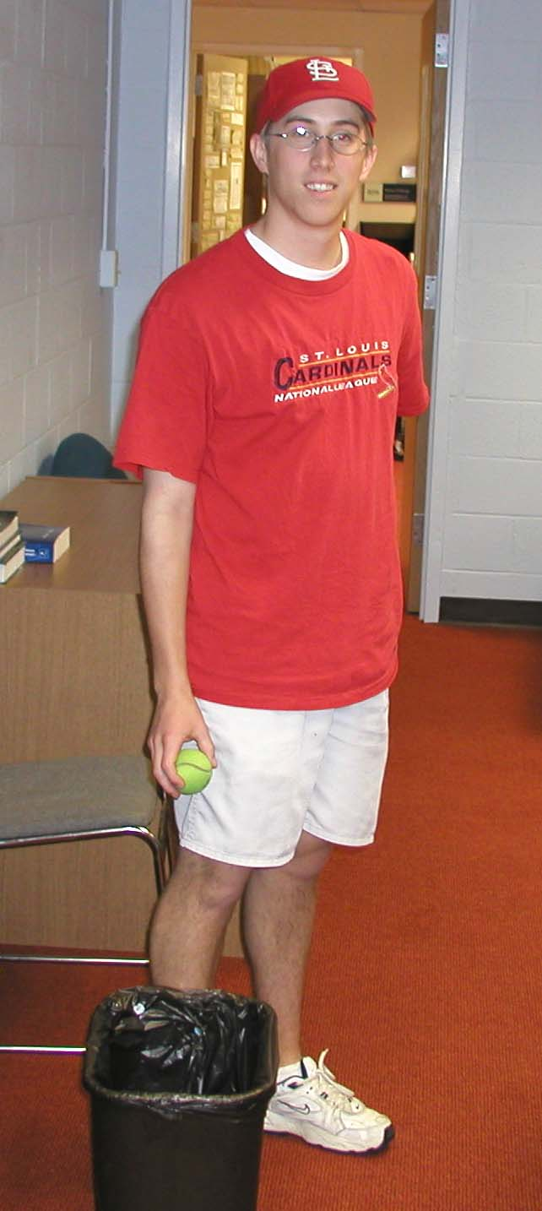
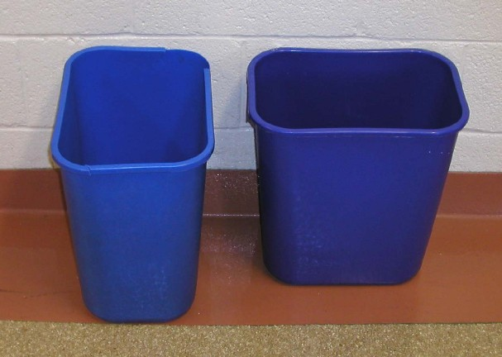
Design and Explanatory Variables
Four factors in the design of the experiment in the Fall of 2003:
distance from the trashcan (from 5 to 12 feet),
orientation of the trashcan,
gender of the student, and
type of ball used (tennis ball or racquetball).

Slide 6
Design and Explanatory Variables (Continued)
The settings of the explanatory variables make up the design of the experiment.
The various factors should be balanced across the experiment so that interaction terms can be estimated.
This may be difficult to achieve; some of the students were absent on the day of the experiment.
To increase the sample size, each student makes three attempts from varying combinations of distance, orientation, and type of ball.
The repeated observations may induce some non-independence and this should be mentioned during the execution of the experiment.

Slide 7
Design Results
 | Gender
 | Male | Female | Total
Raquet | 9 | 12 | 21
Tennis | 9 | 12 | 21
Total | 18 | 24 | 42
 | Gender
 | Male | Female | Total
Narrow | 9 | 12 | 21
Wide | 9 | 12 | 21
Total | 18 | 24 | 42

Slide 8
Design Results
 | Orientation
 | Narrow | Wide | Total
Raquet | 10 | 11 | 21
Tennis | 11 | 10 | 21
Total | 21 | 21 | 42

Slide 9
Design Results
 | Shot Distance (in feet)
 | 5 | 6 | 7 | 8 | 9 | 10 | 11 | 12 | Total
Raquet | 3 | 2 | 3 | 3 | 2 | 3 | 2 | 3 | 21
Tennis | 3 | 2 | 3 | 2 | 3 | 3 | 2 | 3 | 21
Total | 6 | 4 | 6 | 5 | 5 | 6 | 4 | 6 | 42

Slide 10
Design Results
 | Shot Distance (in feet)
 | 5 | 6 | 7 | 8 | 9 | 10 | 11 | 12 | Total
Narrow | 5 | 0 | 5 | 0 | 5 | 2 | 4 | 0 | 21
Wide | 1 | 4 | 1 | 5 | 0 | 4 | 0 | 6 | 21
Total | 6 | 4 | 6 | 5 | 5 | 6 | 4 | 6 | 42

Slide 11
Design Results
 | Shot Distance (in feet)
 | 5 | 6 | 7 | 8 | 9 | 10 | 11 | 12 | Total
Male | 2 | 2 | 3 | 2 | 2 | 3 | 2 | 2 | 18
Female | 4 | 2 | 3 | 3 | 3 | 3 | 2 | 4 | 24
Total | 6 | 4 | 6 | 5 | 5 | 6 | 4 | 6 | 42

Slide 12
Classroom Presentation
As Trashball is described, the students begin to realize that the response variable has only two outcomes.
Assumptions of linear regression not valid.
Linear regression may lead to predictions that are negative or greater then one.
We are actually trying to model the probability of a success - the results must be values between 0 and 1.
Introduce the logistic regression function and explain its properties.
Enter the data into Minitab as the activity progresses.
The results are immediately displayed using a classroom projection system.

Slide 13
Results of Activity
The activity was conducted in subsequent offerings of Experimental Research Methods, a junior/senior level course taken by majors and minors.
Here I present the actual data collected from the activity in the fall of 2003.
Figure 1. Shot Made vs. Distance.
Jitter is added to the points to show the repeated observations.
The Lowess curve is overlaid.

Slide 14
Minitab Output 1. Logistic regression for shot made with distance.
Binary Logistic Regression: ShotMade versus Distance
Link Function: Logit
Response Information
Variable Value Count
ShotMade 1 25 (Event)
0 17
Total 42
Logistic Regression Table
Odds 95% CI
Predictor Coef SE Coef Z P Ratio Lower Upper
Constant 5.204 1.695 3.07 0.002
Distance -0.5499 0.1842 -2.98 0.003 0.58 0.40 0.83

Slide 15
Minitab Output 1. (Continued)
Log-Likelihood = -22.294
Test that all slopes are zero: G = 12.102, DF = 1, P-Value = 0.001
Goodness-of-Fit Tests
Method Chi-Square DF P
Pearson 5.542 6 0.476
Deviance 6.488 6 0.371
Hosmer-Lemeshow 5.542 6 0.476
Table of Observed and Expected Frequencies:
(See Hosmer-Lemeshow Test for the Pearson Chi-Square Statistic)
Group
Value 1 2 3 4 5 6 7 8 Total
1
Obs 2 1 3 1 4 4 4 6 25
Exp 1.2 1.2 2.6 2.8 3.5 4.8 3.5 5.5
0
Obs 4 3 3 4 1 2 0 0 17
Exp 4.8 2.8 3.4 2.2 1.5 1.2 0.5 0.5
Total 6 4 6 5 5 6 4 6 42
The goodness of fit tests indicate that this model provides an adequate description of this data.

Slide 16
Fitted Logistic Model
P(Shot made | distance x) =
Figure 2. The fitted linear and
logistic regression models.

Slide 17
Minitab Output 2. Multiple Logistic regression
Binary Logistic Regression:
ShotMade versus Distance, Ball, Orientation, Gender
Logistic Regression Table
Odds 95% CI
Predictor Coef SE Coef Z P Ratio Lower Upper
Constant 5.782 1.990 2.91 0.004
Distance -0.7649 0.2349 -3.26 0.001 0.47 0.29 0.74
Ball 0.6156 0.8437 0.73 0.466 1.85 0.35 9.67
Orientation 2.420 1.015 2.38 0.017 11.24 1.54 82.16
Gender -0.1532 0.8330 -0.18 0.854 0.86 0.17 4.39
Log-Likelihood = -18.394
Test that all slopes are zero:
G = 19.904, DF = 4, P-Value = 0.001

Slide 18
Minitab Output 3. Final multiple logistic regression
Binary Logistic Regression: ShotMade versus Distance,
Orientation
Logistic Regression Table
Odds 95% CI
Predictor Coef SE Coef Z P Ratio Lower Upper
Constant 5.857 1.913 3.06 0.002
Distance -0.7425 0.2282 -3.25 0.001 0.48 0.30 0.74
Orientation 2.3096 0.9827 2.35 0.019 10.07 1.47 69.11
Log-Likelihood = -18.684
Test that all slopes are zero:
G = 19.323, DF = 2, P-Value = 0.000
Goodness-of-Fit Tests
Method Chi-Square DF P
Pearson 3.441 8 0.904
Deviance 3.994 8 0.858
Hosmer-Lemeshow 3.316 7 0.854

Slide 19
Observed proportion and modeled probabilities by orientation and distance.
 | Shot Distance (in feet)
Observed Probability | 5 | 6 | 7 | 8 | 9 | 10 | 11 | 12
Wide/ Shallow | 1.00 0.895 | - | 0.60 0.659 | - | 0.20 0.305 | 0.00 0.173 | 0.25 0.090 | -
Narrow/Deep | 1.00 0.989 | 1.00 0.976 | 1.00 0.951 | 0.80 0.903 | - | 0.75 0.677 | - | 0.33 0.322

Slide 20
Conclusions
Chapters or sections on logistic regression are appearing more frequently in texts on statistical methods/linear models.
Trashball may be used to motivate the use of logistic regression to model a binary response variable.
Our students had fun!
When conducting a mid-semester evaluation of the course, one student responded “More Trashball.”
Suggested modifications:
Use balls that are more different (tennis and table tennis).
Hand student uses to toss the ball (writing hand, other hand).
JSE paper: http://www.amstat.org/publications/jse/v15n1/morrell.html

