Slide 1
Resources for Teaching Statistics with Social Science Data Webinar for CAUSE
Lynette Hoelter
Director of Instructional Resources, ICPSR
June 8, 2010

Slide 2
Overview of the Presentation
Statistics and the Social Sciences
Quantitative literacy
Statistics courses for social science
Data and Tools for Statistics Education
ICPSR
SSDAN
TeachingWithData.org
Notes:
This Webinar will introduce several sources of data and tools that could be useful in both general and social science-specific statistics instruction. The Social Science Data Analysis Network (SSDAN) and the Inter-university Consortium for Political and Social Research (ICPSR), both a part of the University of Michigan's Institute for Social Research, are collaborating on two NSF-funded projects to support quantitative literacy in the social sciences. Resources from each organization and TeachingWithData.org, a result of the partnership, will be highlighted. Materials range from small extracts of data from the Census and American Community Surveys used with specific teaching modules to full datasets with accompanying online analysis tools.

Slide 3
Social Science and Statistics
Emphasis on quantitative literacy skills on many campuses
Difference between teaching quantitative literacy (QL) and statistics is that QL requires context for the facts and figures
Social sciences are a natural source of content
Social science students tend to put statistics off until late in their curriculum (no matter whether the course is taught in or outside their department)

Slide 4
Data and Tools for Teaching: Introducing Partners
Inter-university Consortium for Political and Social Research (ICPSR)
World’s oldest and largest social science data archive
Current holdings = approximately 7800 studies (64,800 datasets); most available in 4-5 formats
Tools for finding and analyzing data, instructional exercises

Slide 5
Partners (Con’t)
Social Science Data Analysis Network (SSDAN)
Repackaged data from the U.S. Census and American Community Survey to demonstrate demographic content
Maps and accompanying tabular data
TeachingWithData.org
Repository of data, tools, etc.

Slide 6
“Pre-Statistics” & Basic Applications
SSDAN DataCounts!
Contains data (WebChip – contingency tables) & pre-designed learning modules
www.ssdan.net/datacounts
ICPSR Online Learning Center
Pre-specified analyses for exploring social science content
Browse by analysis type
www.icpsr.umich.edu/OLC

Slide 8
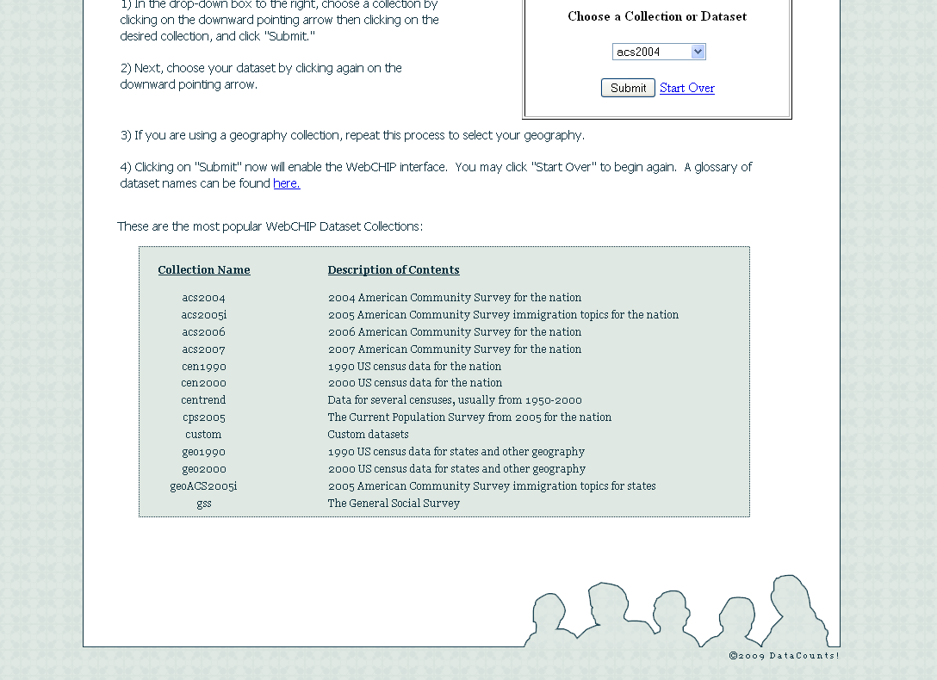

Slide 11
Other ICPSR Resources
Data searchable by variable, geographic location, topic, and more
Most data available for download in SPSS, SAS, Stata, and ASCII
Both as system files and as ASCII data with setup files
Online Analysis: Survey Documentation & Analysis (SDA) software

Slide 13
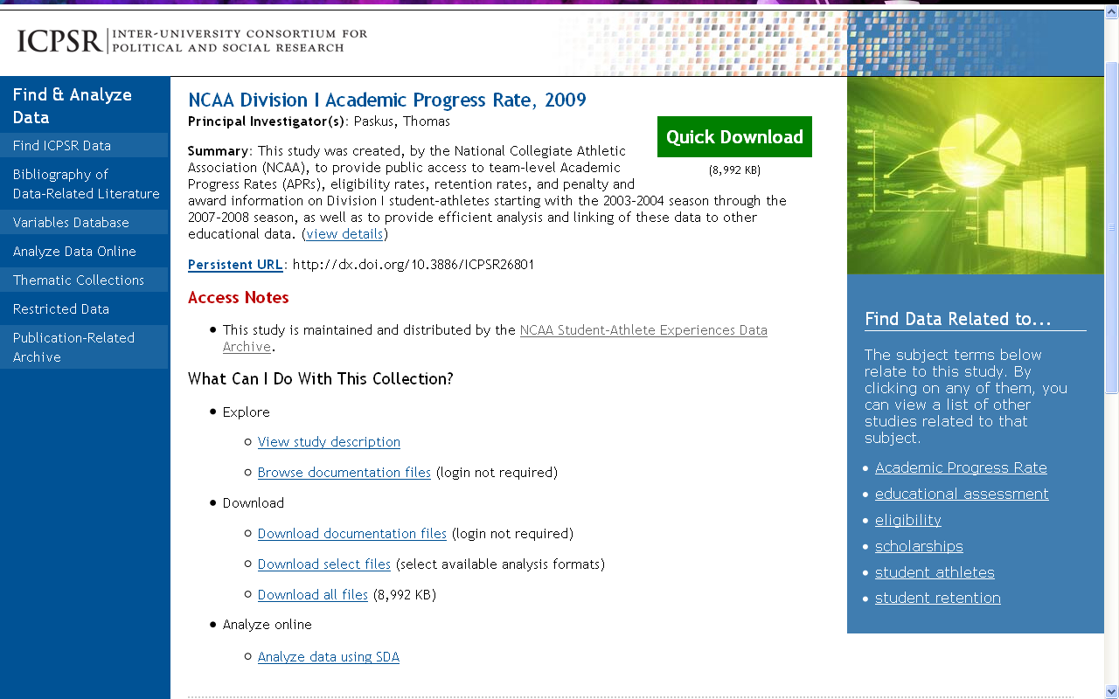

Slide 14
TeachingWithData.org
“One-stop shop” for social scientists wanting to include data in the undergraduate classroom
Classroom resources such as syllabi, lesson plans, data-based activities
Materials about pedagogy
“Data in the News”
Datasets and sources
Static and interactive charts, tables, maps, and graphs
Full datasets and instructional extracts

Slide 15
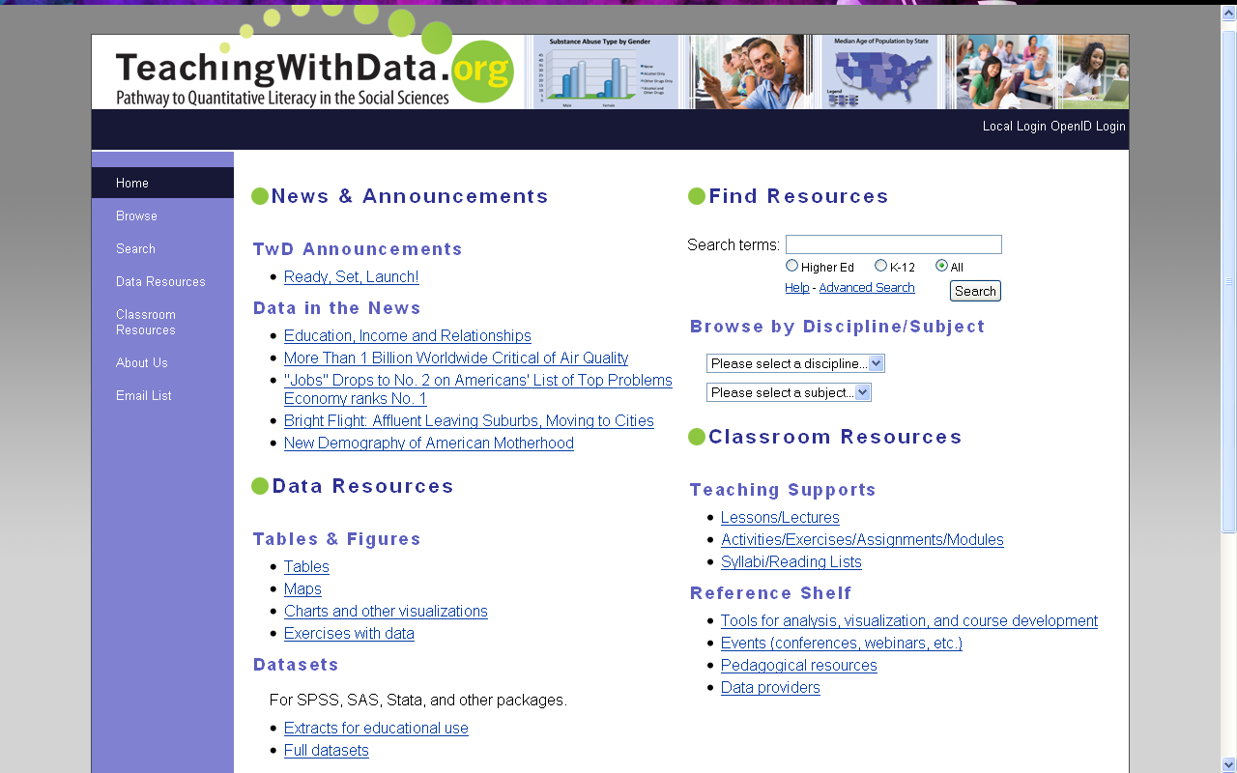

Slide 16
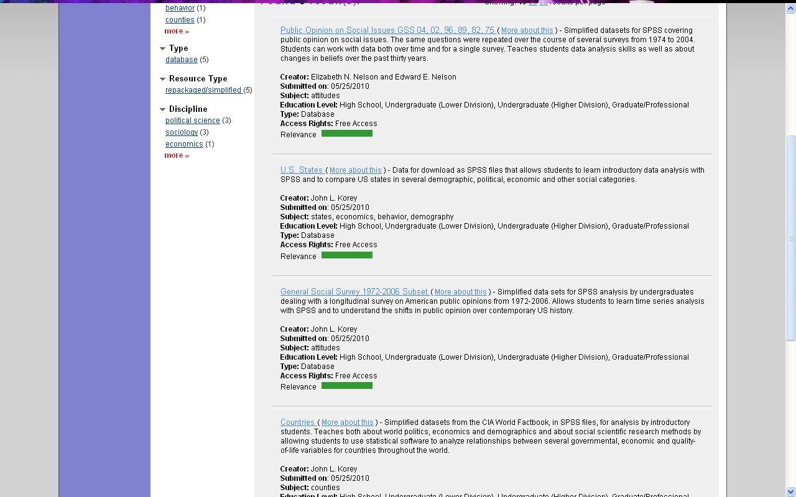
Data Extracts for Instruction

Slide 17
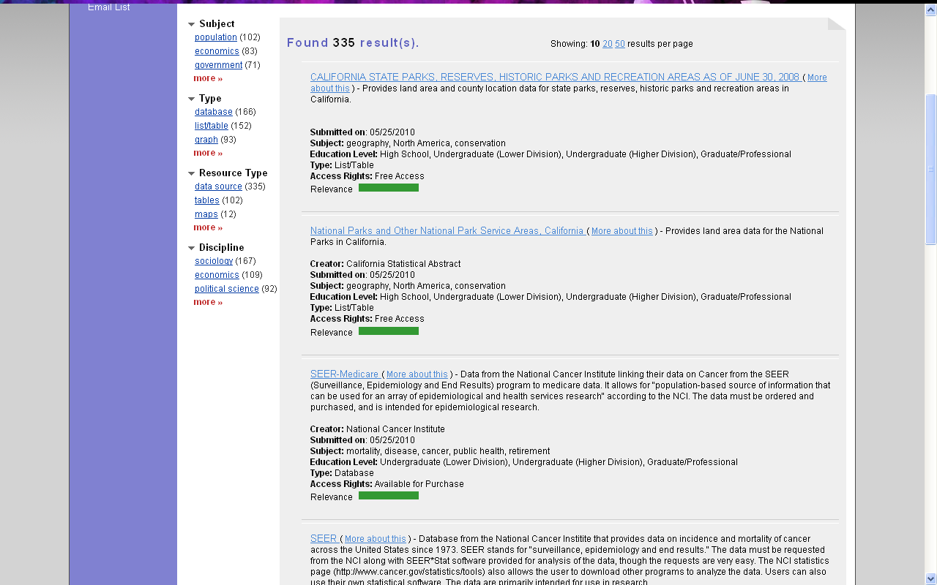
Data Providers

Slide 18
For More Information:
ICPSR-related:
User support – netmail@icpsr.umich.edu
Instructional Resources – Lynette Hoelter (lhoelter@umich.edu)
SSDAN-related:
Program manager – J.P. DeWitt (jpdewitt@umich.edu)
TeachingWithData.org
Lynette or J.P. or TwDstaff@icpsr.umich.edu

Slide 19
Questions? Comments?

