Slide 1

Homework 0: Demonstrating Limitations and Practical Considerations for Using AI as a Course Tool
Julie Deeke
jdeeke@illinois.edu
University of Illinois Urbana-Champaign
eCOTS 2026

Slide 2
Context
I teach a second course in data science, STAT 207: Data Science Exploration. This course:
Taught ~1000 students (4 sections) during the 25-26 academic year
Is the first course in the data science sequence to allow generative AI
Focuses on concepts and interpretations
Uses Python as a programming language
Starting 25-26 academic year, I allowed students to use generative AI to help with coding but not with interpretation or conceptual questions

Slide 3
Learning Objectives
In Homework 0, students will explore practical considerations of using AI, including:
That AI might not provide correct answers to questions, i.e. that it is not an answer generator that should be used blindly
Being aware of the broader implications (both advantages and drawbacks) of AI
Course-specific policies related to AI

Slide 4
Homework 0 AI Questions
With ChatGPT or another AI bot, explore the spelling of the name "Illinois". For example, you might ask it questions like how many times does the letter i appear in Illinois, and in what positions does the letter i appear. Then, choose another state name and repeat this process.
Once you have done this, compare the answers that you received with at least one friend. Note: if you do not want to use an AI bot, feel free to ask a friend about their answer/experience to this question.
Did your and your friend's AI bots give fully correct answers about the spelling of state names?

Slide 5
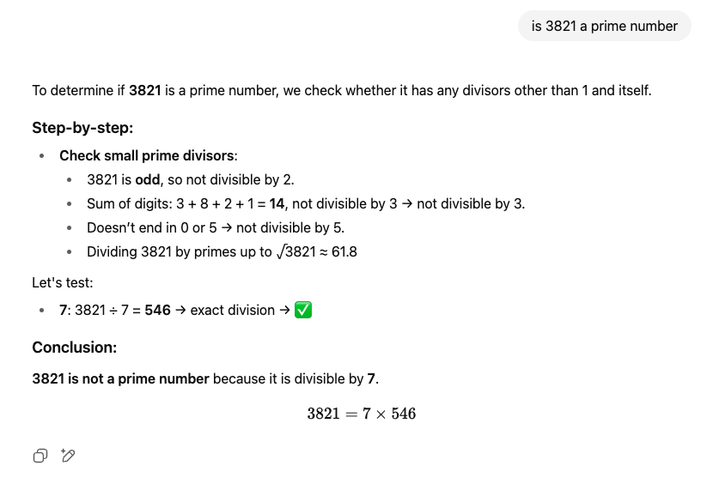
Homework 0 AI Questions
Is 3,821 a prime number? This means that it is only divisible by 1 and itself.
Is this response by ChatGPT (ChatGPT-4, free version, from 8/11/25) correct?

Slide 6
Homework 0 AI Questions
What ethical concern about generative AI was not directly addressed in the response that ChatGPT gave, provided on Canvas (the LMS)?
Prompt 1: What are the ethical concerns associated with ChatGPT?
Prompt 2: What are the benefits associated with ChatGPT?
Environmental impact (using environmental resources)
Hallucinations (giving made up and false answers, along with made up sources)
Job instability (AI might take our jobs)
Lack of transparency (black-box nature/lack of explainability)
Propagating biases (continuing human biases, stereotypes, or discriminating)

Slide 7
Homework 0 AI Questions
What is the policy for the use of generative AI in Stat 207? (code vs. interpretations)
What is the policy for the use of citing generative AI (specifying that you have used generative AI), if used, in Stat 207?
On what assignments can generative AI be used in Stat 207?

Slide 8
Homework 0 Limitations & Updates
Different versions of AI can make replicating incorrect answers challenging
Students were unsure about AI policies, so I added an AI acknowledgement section to the end of each course assignment to remind of course policies and encourage transparency of usage
Extra training/discussion needed for course staff while grading the AI acknowledgement section and AI-assisted answers

Slide 9
AI Acknowledgement
On each homework, lab, and project assignment that you submit, you will be asked to complete an AI Acknowledgement section.
Our course policy is that you should write all of your own interpretations and other narrative answers (phrases or sentences) yourself without the assistance of AI. You may use AI to help guide your code, although you should write all of your own code yourself (not copy-paste from another source) and you should cite your use of AI. I would encourage you to try to generate any necessary code yourself first using course resources and using AI as a debugging tool if/when you reach an error that you can't figure out or to help you perform any coding tasks that are more advanced than we've demonstrated during class (intended only for projects). This section is meant to guide and support your appropriate use of AI consistent with our course policy.

Slide 10
AI Acknowledgement
Did you use AI on this assignment? Did you use other resources outside of our course-provided resources on this assignment?
If you used AI or other resources, answer the following questions to cite your usage.
Which AI and/or resources did you use?
What prompts did you ask it?
How did you integrate the responses into your assignment? Specifically, which questions or parts are associated with this usage?
Note: answering these three questions are enough for our course but may not be enough for a different course or context.

