Slide 1



Using Evidence-Based Strategies to Engage & Motivate Students in Large Introductory Statistics Lectures
Welcome… as you enter take time to
Record your
name length
2. Make a name
tent
3. Use the QR Code to answer a question →
Sheri Johnson and Susan Hardy, Kennesaw State University

Slide 2



Using Evidence-Based Strategies to Engage & Motivate Students in Large Introductory Statistics Lectures
Sheri Johnson
Susan Hardy

Slide 3
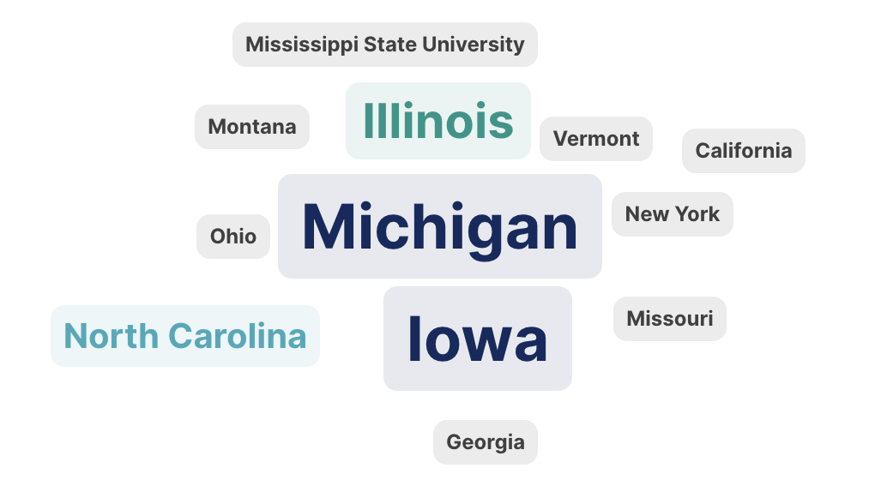

Slide 4
Agenda - Engage and Motivate in Large Classes
01
Welcome Activity
Name Length
Name Tent
QR Code Slido
02
Book Introductions
Lang’s Distracted
Lovett et. al.’s How Learning Works
03
Research-based Practices Enacted
Cultivating Community
Teaching Modules
Automate Course Logistics
04
Discussion and Brainstorming
What have you done
What do you want to try
What should be avoided
05
Reflection and next steps
Open questions
Big take-aways
Future Collaboration

Slide 5



Slide 6

A Humane Approach - Teachers should partner with students in cultivating focus

Slide 7
Key Points:
Rethinking Distraction - not a product of modern technology, but has always been a natural problem
Attention is a Skill - cultivate habits and classroom practices that build sustained focus
Classroom Culture Matters - build a sense of belonging, community, and curiosity will increases students’ motivation to focus.
Structure and Routine - predictable classroom structures—such as clear beginnings, active participation, and meaningful endings—help students settle in and stay engaged.
The Role of Emotion and Relevance - emotionally resonant and personally relevant content increases focus.
Technology in Context - rather than banning devices, set clear expectations and design learning experiences that make appropriate use of technology.

Slide 8
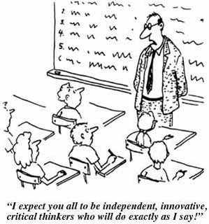

Slide 9
Identities and stages of development
Prior knowledge
Organize knowledge
Motivating factors
Developing mastery
Practice and feedback
Course climate
Self-directed learners

Slide 10
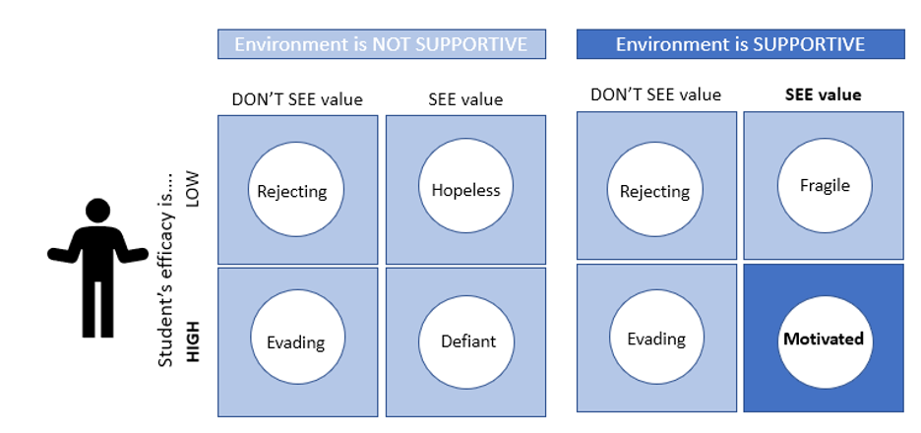
Expectation for success

Slide 11

Research Based Practices

Slide 12
Using Syllabus to create Engagement from the Start
Cultivating Community
Teaching Modules
Automate Course Logistics
“Have I whipped you up into a fevered pitch of excitement, eager to dive right into the semester?” Lang, p. 125
Research Based Practices Enacted

Slide 13
Using Syllabus to create Engagement from the Start
PUT AWAY AND TURN OFF YOUR CELL PHONES!
If your phone rings or vibrates in class, or I see you checking it or texting, you will be absent for that day.
Cultivating Community
Cold language → Warm language

Slide 14

Are you sacrificing the students who want to learn in the name of controlling the students who don't
Cultivating Community
Video sliders
Availability of materials
Accessibility
Lockdown browsers
Scanned Notes
Answer Keys
Formula Sheets online
…

Slide 15

Engagement Agreement
Cultivating Community
Engaged On phone Asleep

Slide 16

Cultivating Community

Slide 17
Getting to Know you Example Survey
Link to copy an sample of a Google Forms Survey

Slide 18

Cultivating Community
Reflection

Slide 19
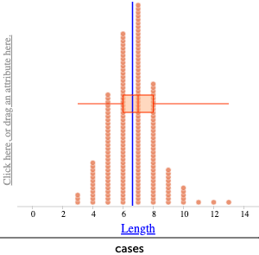
First Name Length
Cultivating Community
Mean = 6.63
Median = 7

Slide 20
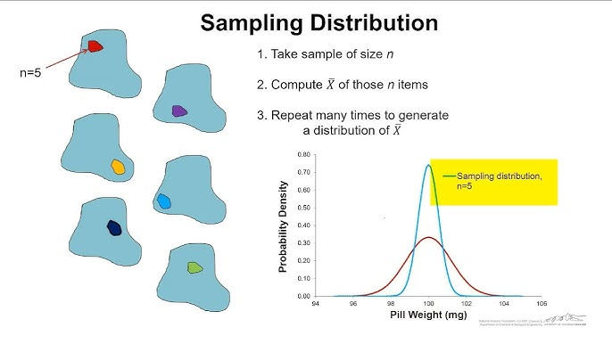
Sampling Distributions
Groups of 5
Average Name length
Cultivating Community
Average Name length

Slide 21

Peer-to-Peer Mentoring
Cultivating Community
Zoom room
Invite peer leaders
Note impact in LOR
Activity to make geographical connections
Group Messaging Apps (e.g. GroupMe)
Encourage teamwork with “Go Team” at the end of the class

Slide 22
Teaching Modules
What is happening in the classroom when students are engaged?
Research Based Practices Enacted

Slide 23

Cultivating Community
Teaching Modules
Automate Course Logistics

Slide 24
Teaching Modules
What helped stir up the attention of students was the shift from passive to active…
What mattered was the change.
Lang, p. 154

Slide 25

Structuring a Class with Teaching Modules
Teaching Modules
Write the teaching activities you do in your classes
(one activity per card)

Slide 26

Teaching Modules
Write the teaching activities you do in your classes
(one activity per card)
Link to anonymized list of activities

Slide 27
Structuring a Class with Teaching Modules
Teaching Modules
Classify each activity/module as active or passive for the student.
Passive
Active

Slide 28

Structuring a Class with Teaching Modules
Teaching Modules
Now, think of something you will cover in one class.

Slide 29

Structuring a Class with Teaching Modules
Teaching Modules
“<<3:00>>”
With that class in mind…
Select and order activities/modules, mixing active and passive.

Slide 30

Teaching Modules
How might you need to modify activities for a large classroom?

Slide 31
Cultivating Community
Teaching Modules
Automate Course Logistics
How can we automate course logistics in large classes so we can focus on student mastery?
Research Based Practices Enacted

Slide 32




Automate Course Logistics

Slide 33
Automate Course Logistics
Grading Policies
  Partial late credit with no exceptions
  Make-ups
  Re-takes
Pedagogically kind and Consistently Implemented
Resources
Student triage
Link to Susan Hardy’s Introductory Survey

Slide 34
Automate Course Logistics
Announcement prompted from student question
LMS Notification Apps
Weekly Communication

Slide 35


















Student Response Systems (SRS)
Automate Course Logistics
HW systems
Initial “Getting to Know You” Survey
Open attendance question
Exit tickets
Chapter reviews - test prep

Slide 36
Drawing in Students
Automate Course Logistics
Retakes with partial credit can be automated
Syllabus/grading reminders
Automate emails through LMS
  Struggling Students
  AWOL
  Positive reinforcement
Strategy suggestions

Slide 37


Slide 38
Discussion and Brainstorming
What have you done
What do you want to try
What should be avoided

Slide 39


Slide 40
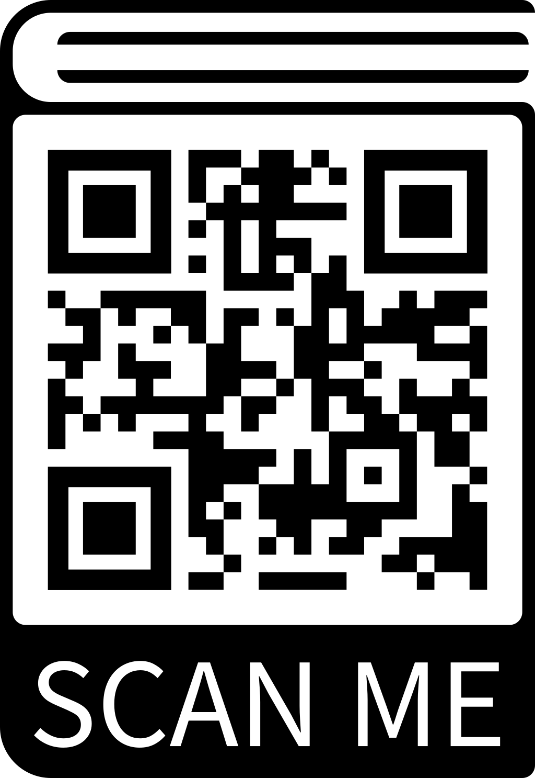

Interest in meeting?
https://forms.gle/w3WmM61EYxfq1eZbA

Slide 41

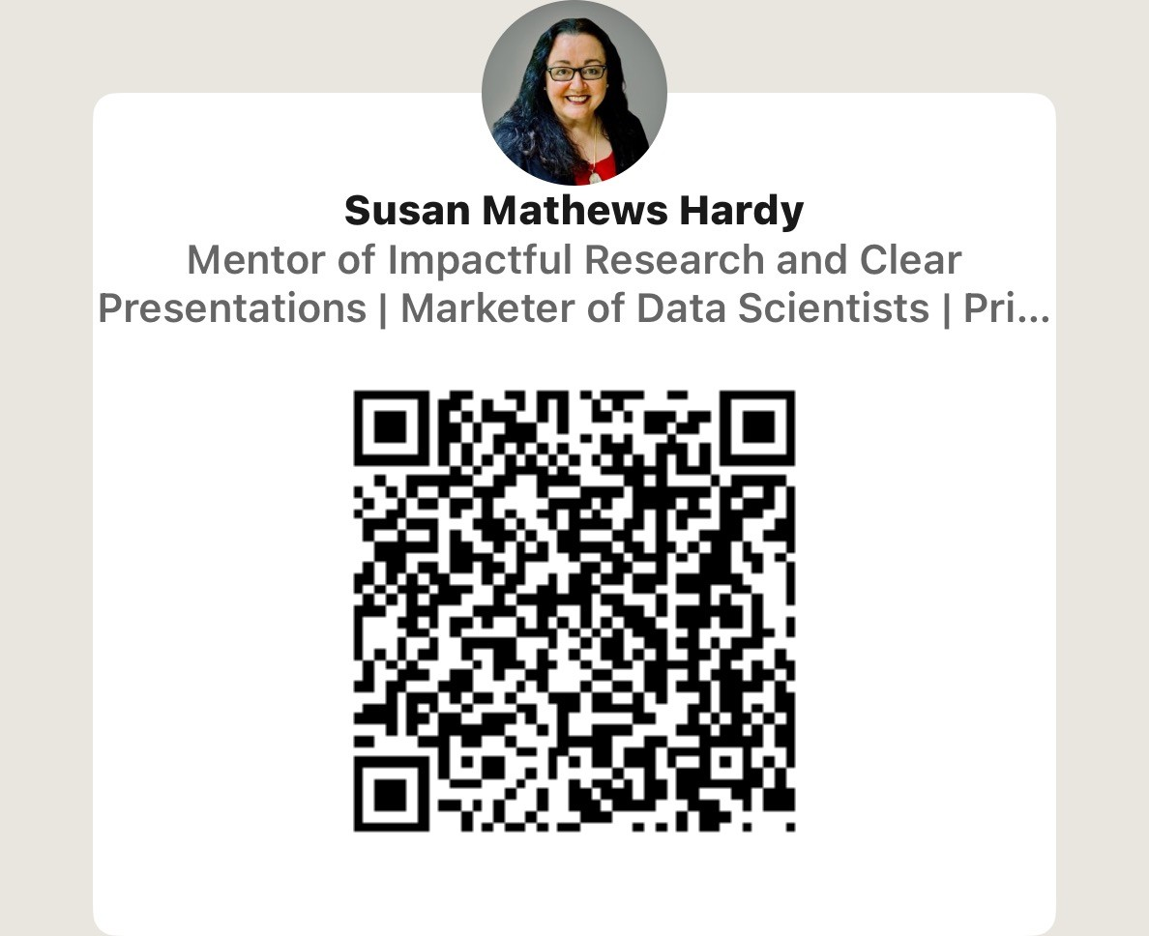
Contact us to continue collaboration
Link to “Entire Resource Folder for USCOTS 2025 B1I”

