Slide 1
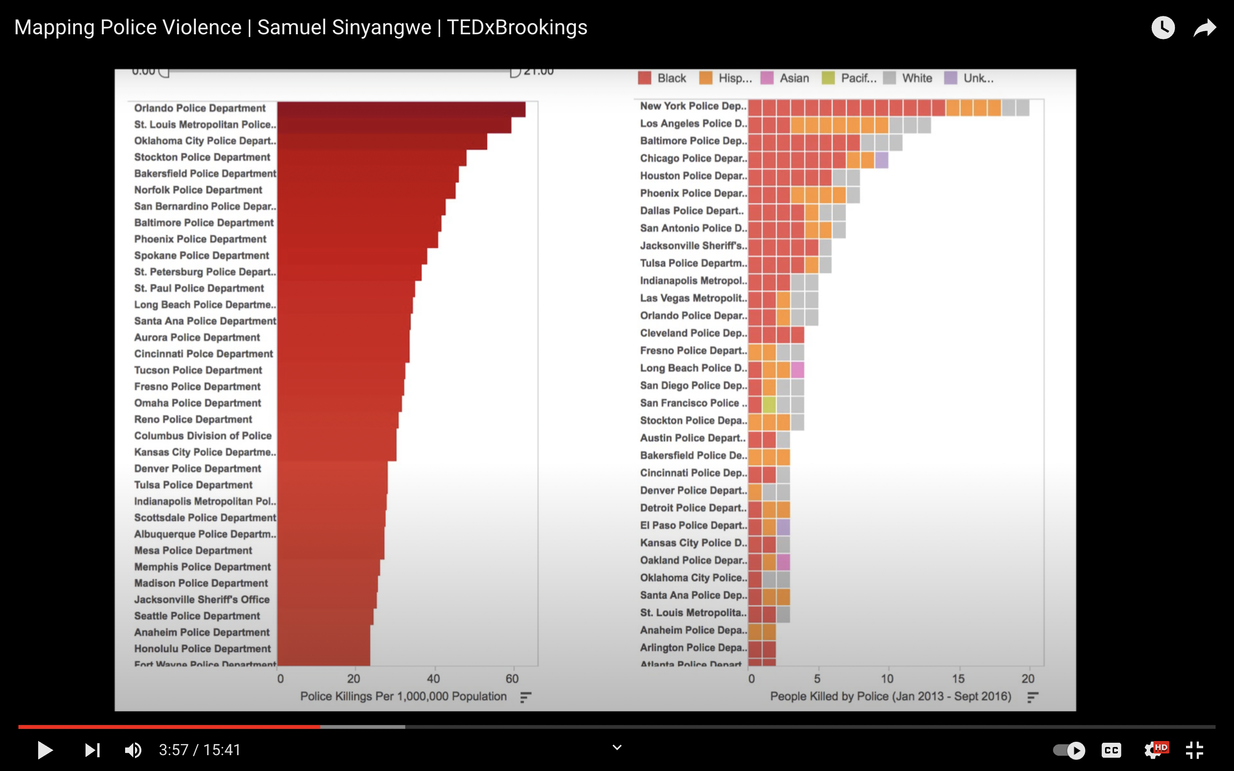
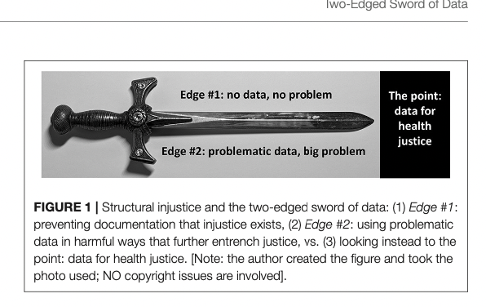
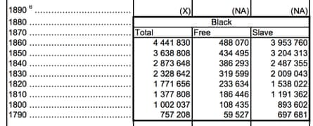
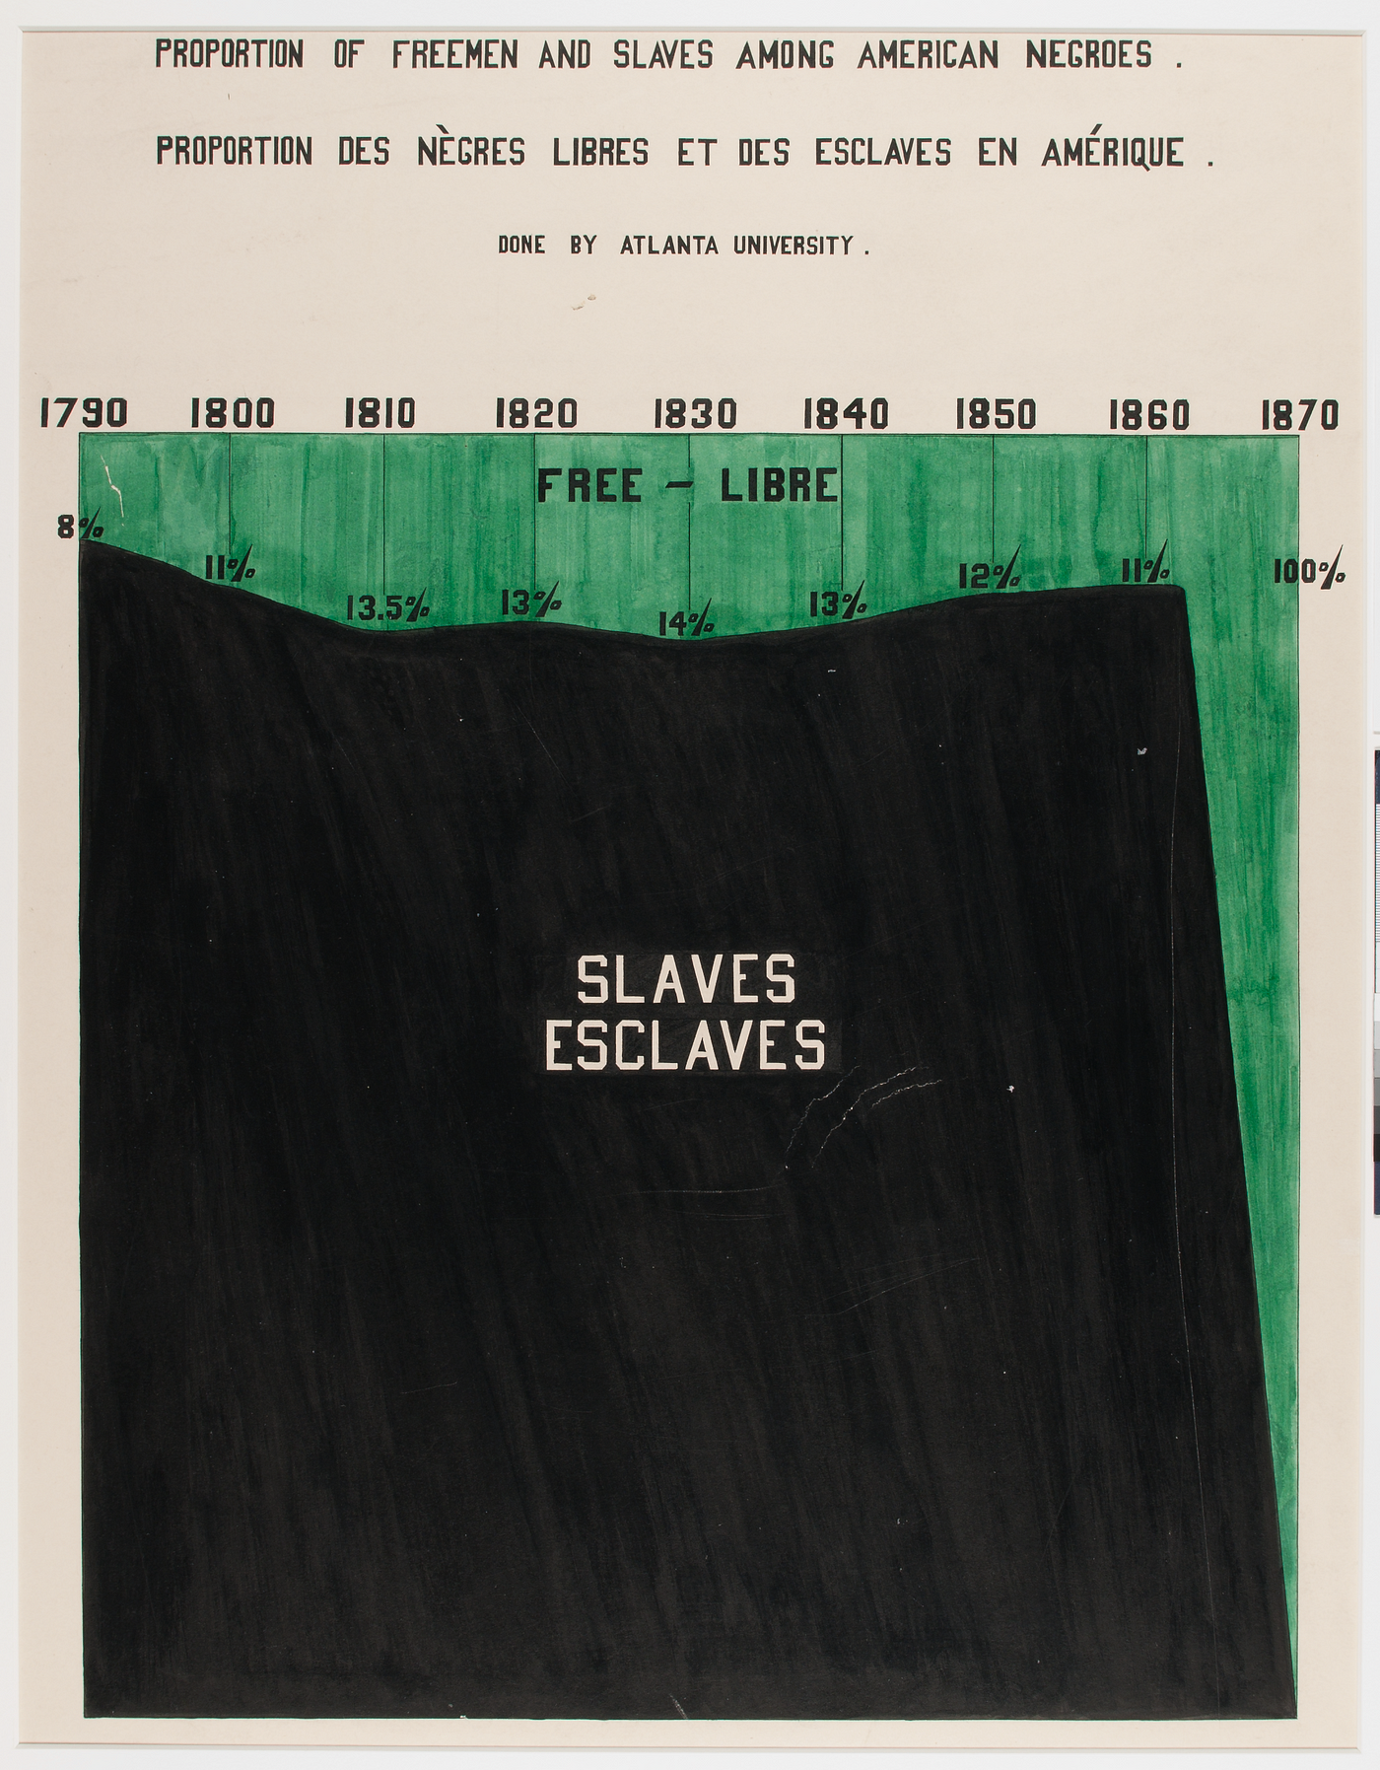
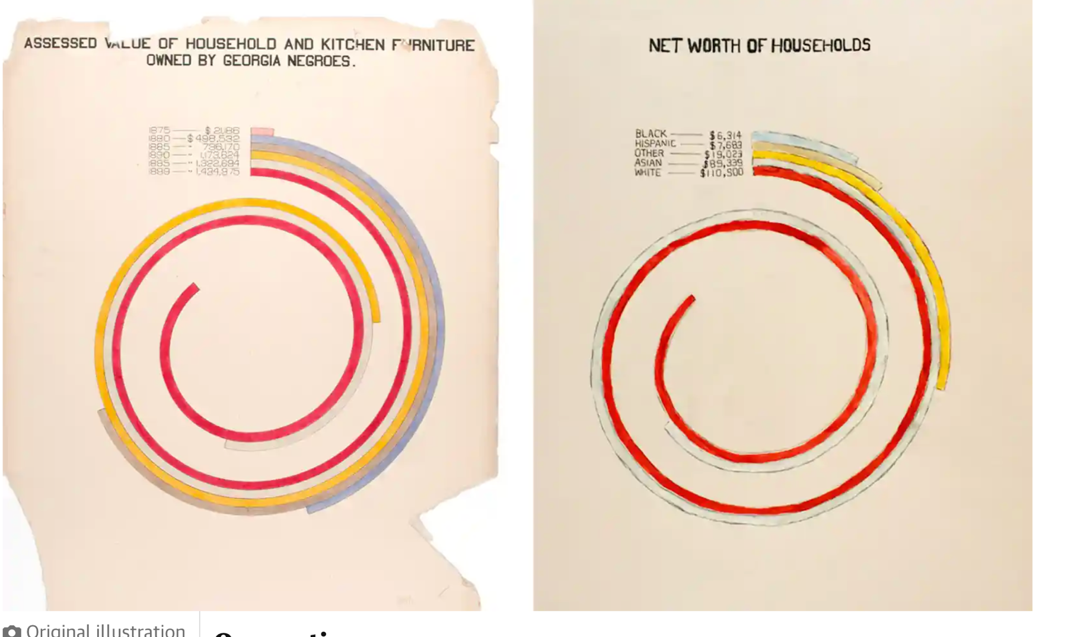
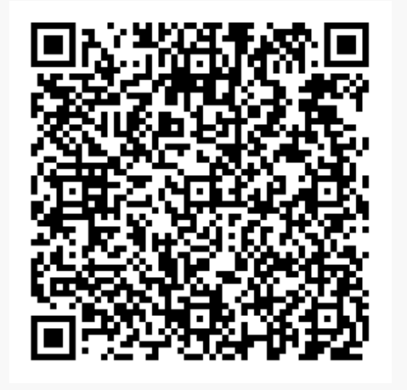
Using the “sword” of data to teach communication of problems and solutions
Elise Murowchick (Seattle University), Robin Yaure & Jackie Schwab (Penn State Mont Alto)
USCOTS 2023 – State College, PA
v
Recent and historical data about racism can teach us about
Ethical issues
The investigate process
Numeric & graphic summaries
#2 The investigative process
Think about a problem with data that is not great 2013-2016 police violence, talk about causality and association (think, pair, share) then watch the video with the data scientist Sam Sinyangwe
Red and orange unarmed people of color killed by police
After the pre-reflection and viewing moving discuss how existing data from 2013-2016 can be generative
#1 Ethical Issues
Have half the students write about edge #1 and half edge #2 and debate then read Krieger (2021) and repeat
Mapping Police Violence | Samuel Sinyangwe | TEDxBrookings (2017)
#3 Numeric and graphic summaries
v
v
W.E.B. Du Bois story:
Which is better the left or right?
Did things change?
1890(right,Du Bois) -1990 (left,Chalabi)
Krieger N. (2021). Structural Racism, Health Inequities, and the Two-Edged Sword of Data: Structural Problems Require Structural Solutions.
Frontiers in public health, 9, 655447. https://doi.org/10.3389/fpubh.2021.655447
<--Scan for more info
#3 Original illustration (left) created by WEB Du Bois, and (right) by Mona Chalabi Photograph: Mona Chalabi in the Guardian (from https://www.theguardian.com/world/2017/feb/14/web-du-bois-racism-data-paris-african-americans-jobs

