Slide 1
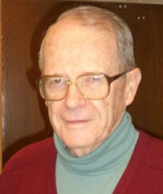
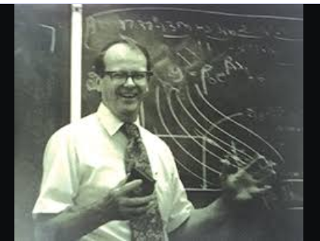
Saluting Stu Hunter on His 100th Birthday
Ronald D. Snee
Snee Associates, LLC Newark, Delaware
U.S. Conference on Teaching Statistics Penn State University State College, PA June 3, 2023

Slide 2
Our First Meeting - Rutgers University Advanced Design of Experiments - Spring 1965
Six Lectures – Three Hours Each
Two-Level Fractional Factorial Designs
Analysis of Fractional Factorials – Effect: ‘Consider”, “Safety”, “Error”
Main Effects Designs
Response Surface Methodology
Nonlinear Models
Nonlinear Design
Teaching Style
“+/- Signs from a Fire Hose”
“Teaching by Walking Around”

Slide 3
Industry Statistics Groups Founded in the 1950s
DuPont 1950
3M 1954
Procter and Gamble 1954
American Cyanamid 1954
General Foods 1955
General Electric 1955
Kodak 1957
Many Others: Merck, Smith-Kline, Amoco, Swift and Co., Union Carbide, Esso/Exxon, Monsanto
We Stand on the Shoulders of Giants

Slide 4
Statistics In Industry – Early Days 1950s and 1960s
Box and Wilson Response Surface Methodology Published in 1951
Chemical Industry strong emphasis on research – Nylon, Actylics, Polyester, Spandex, and many others
“Put research in project proposal and it got approved” John Gorman, Amoco Oil
Russia launched SPUTNIK in 1957 and the SPACE RACE was on!!
Major shock to American Psychic
American Industry and Government looking for answers
Design of Experiments and Response Surface Methodology become very popular in Chemical Research and Manufacturing
Where Do We Learn About This Stuff?
What? Why ? When? How?

Slide 5
Deploying Statistics and Design of Experiments in Industry
First Design of Experiments Conference Nov 1956, Stu spoke on RSM
Response Surface Methodology, Harvard, May 1956
Course was over subscribed, Also presented at U of Michigan, in Houston, MIT and elsewhere
First Fall Technical Conference in Oct 1957 Sponsored by ASQC Chemical Division
Statistical Methods in Chemical Industry, Stevens Institute, 1958 Stu on spoke on EVOP
Rutgers University Quality Control Conference since 1948 – Stu was a frequent Speaker – I first heard him speak at this conference in 1964 1
Princeton Conference – Began prior to 1958
Stu Was Always There!
Speaking, Teaching, Promoting, …….

Slide 6
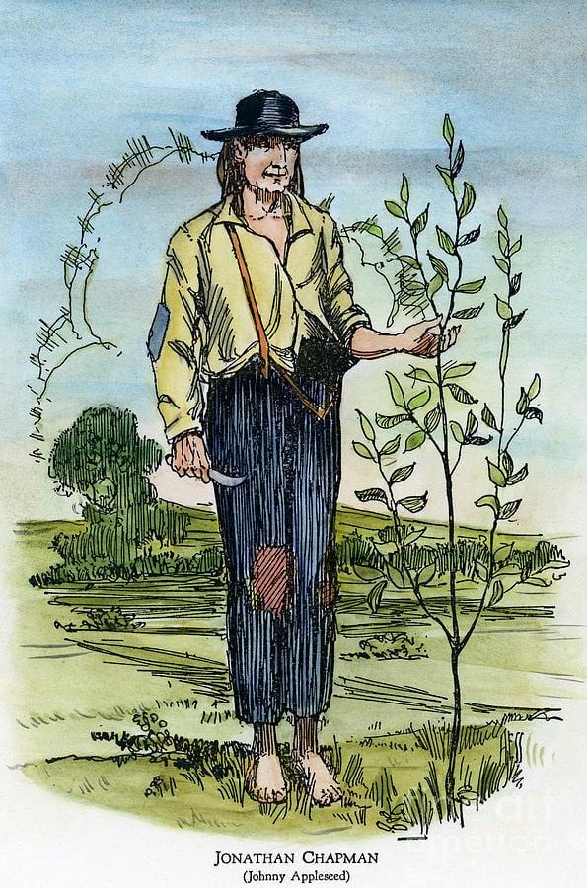
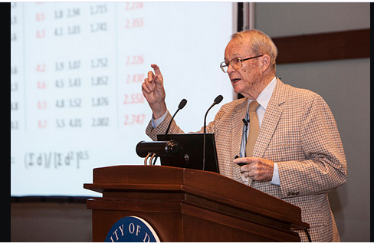
Stu Hunter The Johnny Appleseed of Statistics

Slide 7
So Where Did All the Short Course Money Go?
Industry had the need to develop and exchange ideas on statistical thinking and methods -
Technometrics provided the vehicle
Stu was the founding Editor
Short course $$ used to start Technometrics
Named by Sir Ronald A. Fisher
Other leaders during that time: George Box, John Tukey, Cuthbert Daniel, Otto Dykstra, Mavis Carroll, and many more

Slide 8
Stu’s Connection with Industry
Dairy Industry – “Milking Cows by Hand”
Prudential Insurance
Esso (Exxon) Bayway Refinery
American Cyanamid 1954-56
Numerous consulting engagements over the years
George Box, Stu’s professor and colleague worked at Imperial Chemicals Industry for 8 years

Slide 9
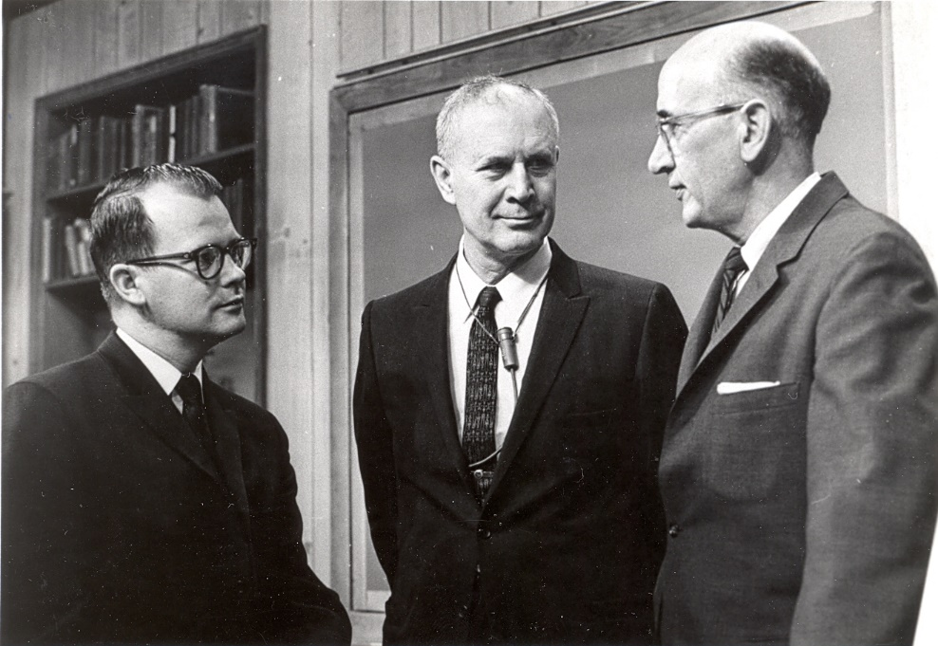
Ellis R. Ott Foundation
Founded in 1982
Promote the philosophy and teachings of Ellis Ott
Stu was a member of the Board of Directors
Ott Scholarship Founded in 1996 managed by ASQ Stat Division
Stu a Member of Governing Board
Granted > 62 Scholarships worth > $360,000 to Date
Stu Was A Guiding Light for Both the Ott Foundation and Scholarship Program

Slide 10
Stu is:
Widely Recognized as:
To Many of us:
Stu is a Role Model, Friend and “High Energy Particle”
A very important leader of our profession
We have all learned from his work and leadership
We are fortunate that Stu chose statistics as his profession
Teacher | Editor
Lecturer | Leader
Author | Statesman
Thank You Stu
Thank You, Thank You, Thank You!! ☺☺

Slide 11
Some Further Reading
De Veaux, R. D. (2020) “A Conversation with J. Stuart (Stu) Hunter”, Statistical Science, 35(4): 663-671 (November 2020). DOI: 10.1214/19-STS766
Hunter, J. S. (1983) “The Birth of a Journal”, Technometrics, Vol. 25, No. 1, 3-7.
Snee, R. D. (2019) “We Stand on the Shoulders of Giants – The Pioneers of Industrial Statistics” The American Statistician, Vol 73, No. 4, 400-407.

Slide 12
About the Speaker …..
He is also an Adjunct Professor in the pharmaceutical programs at Temple and Rutgers Universities. He worked at DuPont for 24 years prior to starting his consulting career.
Ron received his BA from Washington and Jefferson College and MS and PhD degrees from Rutgers University. He is an academician in the International Academy for Quality and Fellow of the American Society of Quality, American Statistical Association, and American Association for the Advancement of Science.
Ron is an Honorary Member of ASQ and has been awarded ASQ’s Shewhart, Grant and Distinguished Service Medals, and ASA’s Deming Lecture, Dixon Consulting and Hahn Quality and Productivity Achievement Awards.
He is a frequent speaker and has published 8 books and more than 330 papers in the fields of quality, performance improvement, management, and statistics. He is the recipient of the 2020 Washington and Jefferson College Entrepreneur of the Year..
Ron Snee, PhD is Founder and President of Snee Associates, LLC, a firm dedicated to the successful implementation of process and organizational improvement initiatives. He provides guidance to pharmaceutical and biotech senior executives in their pursuit of improved business performance using Quality by Design, Lean Six Sigma and other improvement approaches that produce bottom line results.
He has authored several articles on how to successfully implement QbD, coauthored three books on QbD tools and speaks regularly at pharmaceutical and biotech conferences.

