Slide 1
Orientation for First-Time Attendees
Dr. Sunghwan Byun & Dr. Wendy Moore

Slide 2
In this session
Introductions
Recommendations
Navigating the program

Slide 3
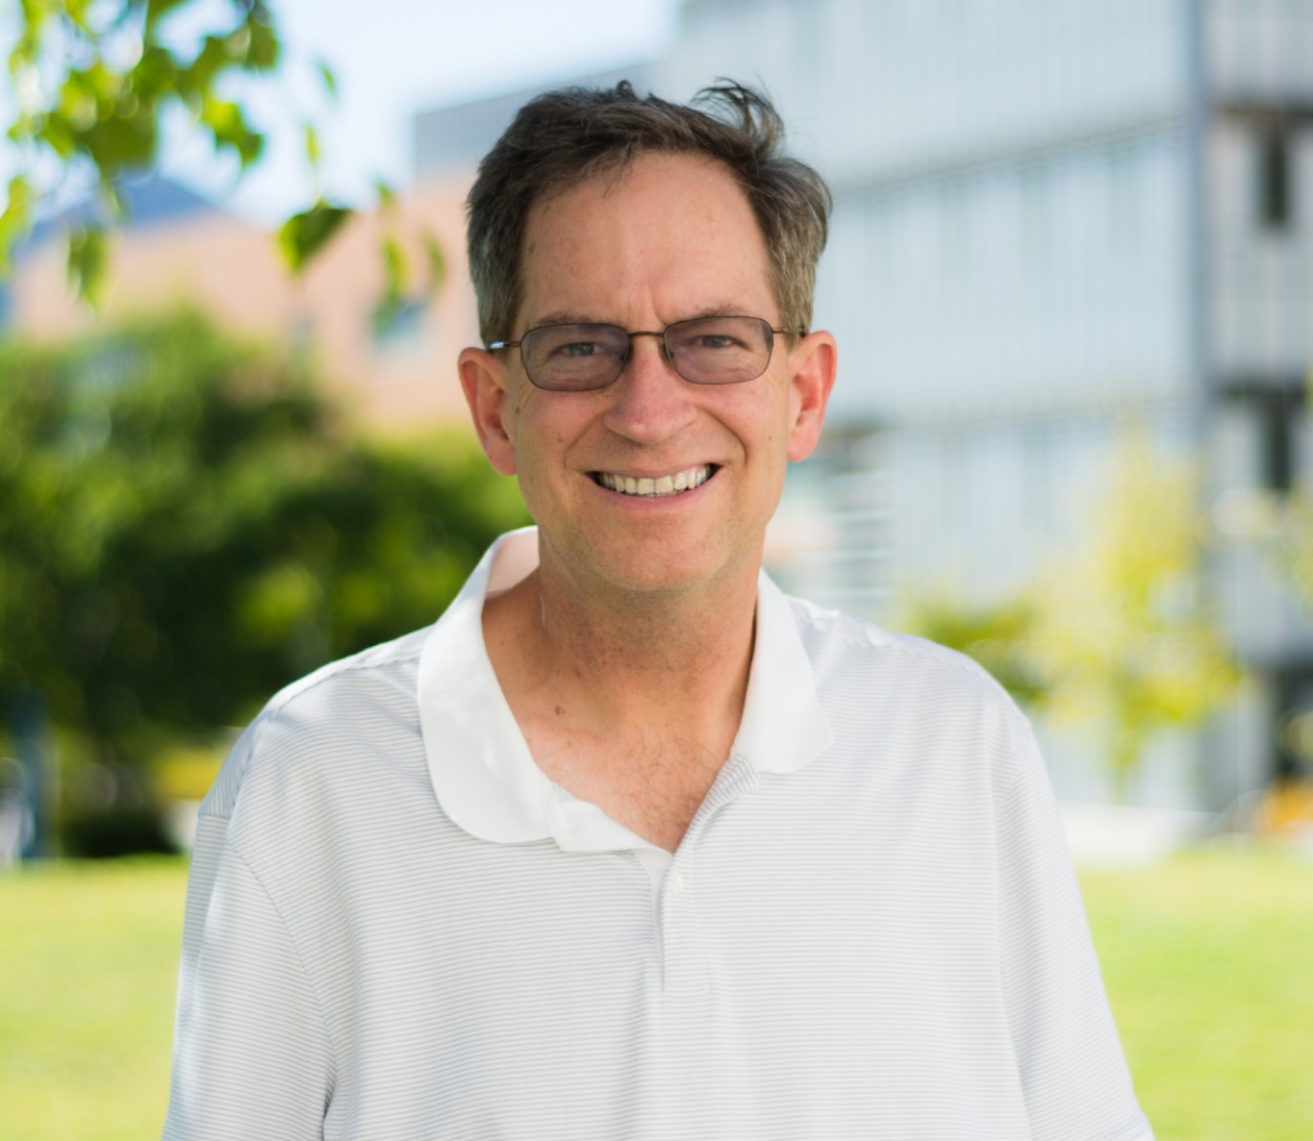
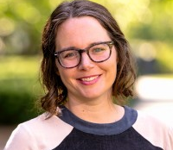
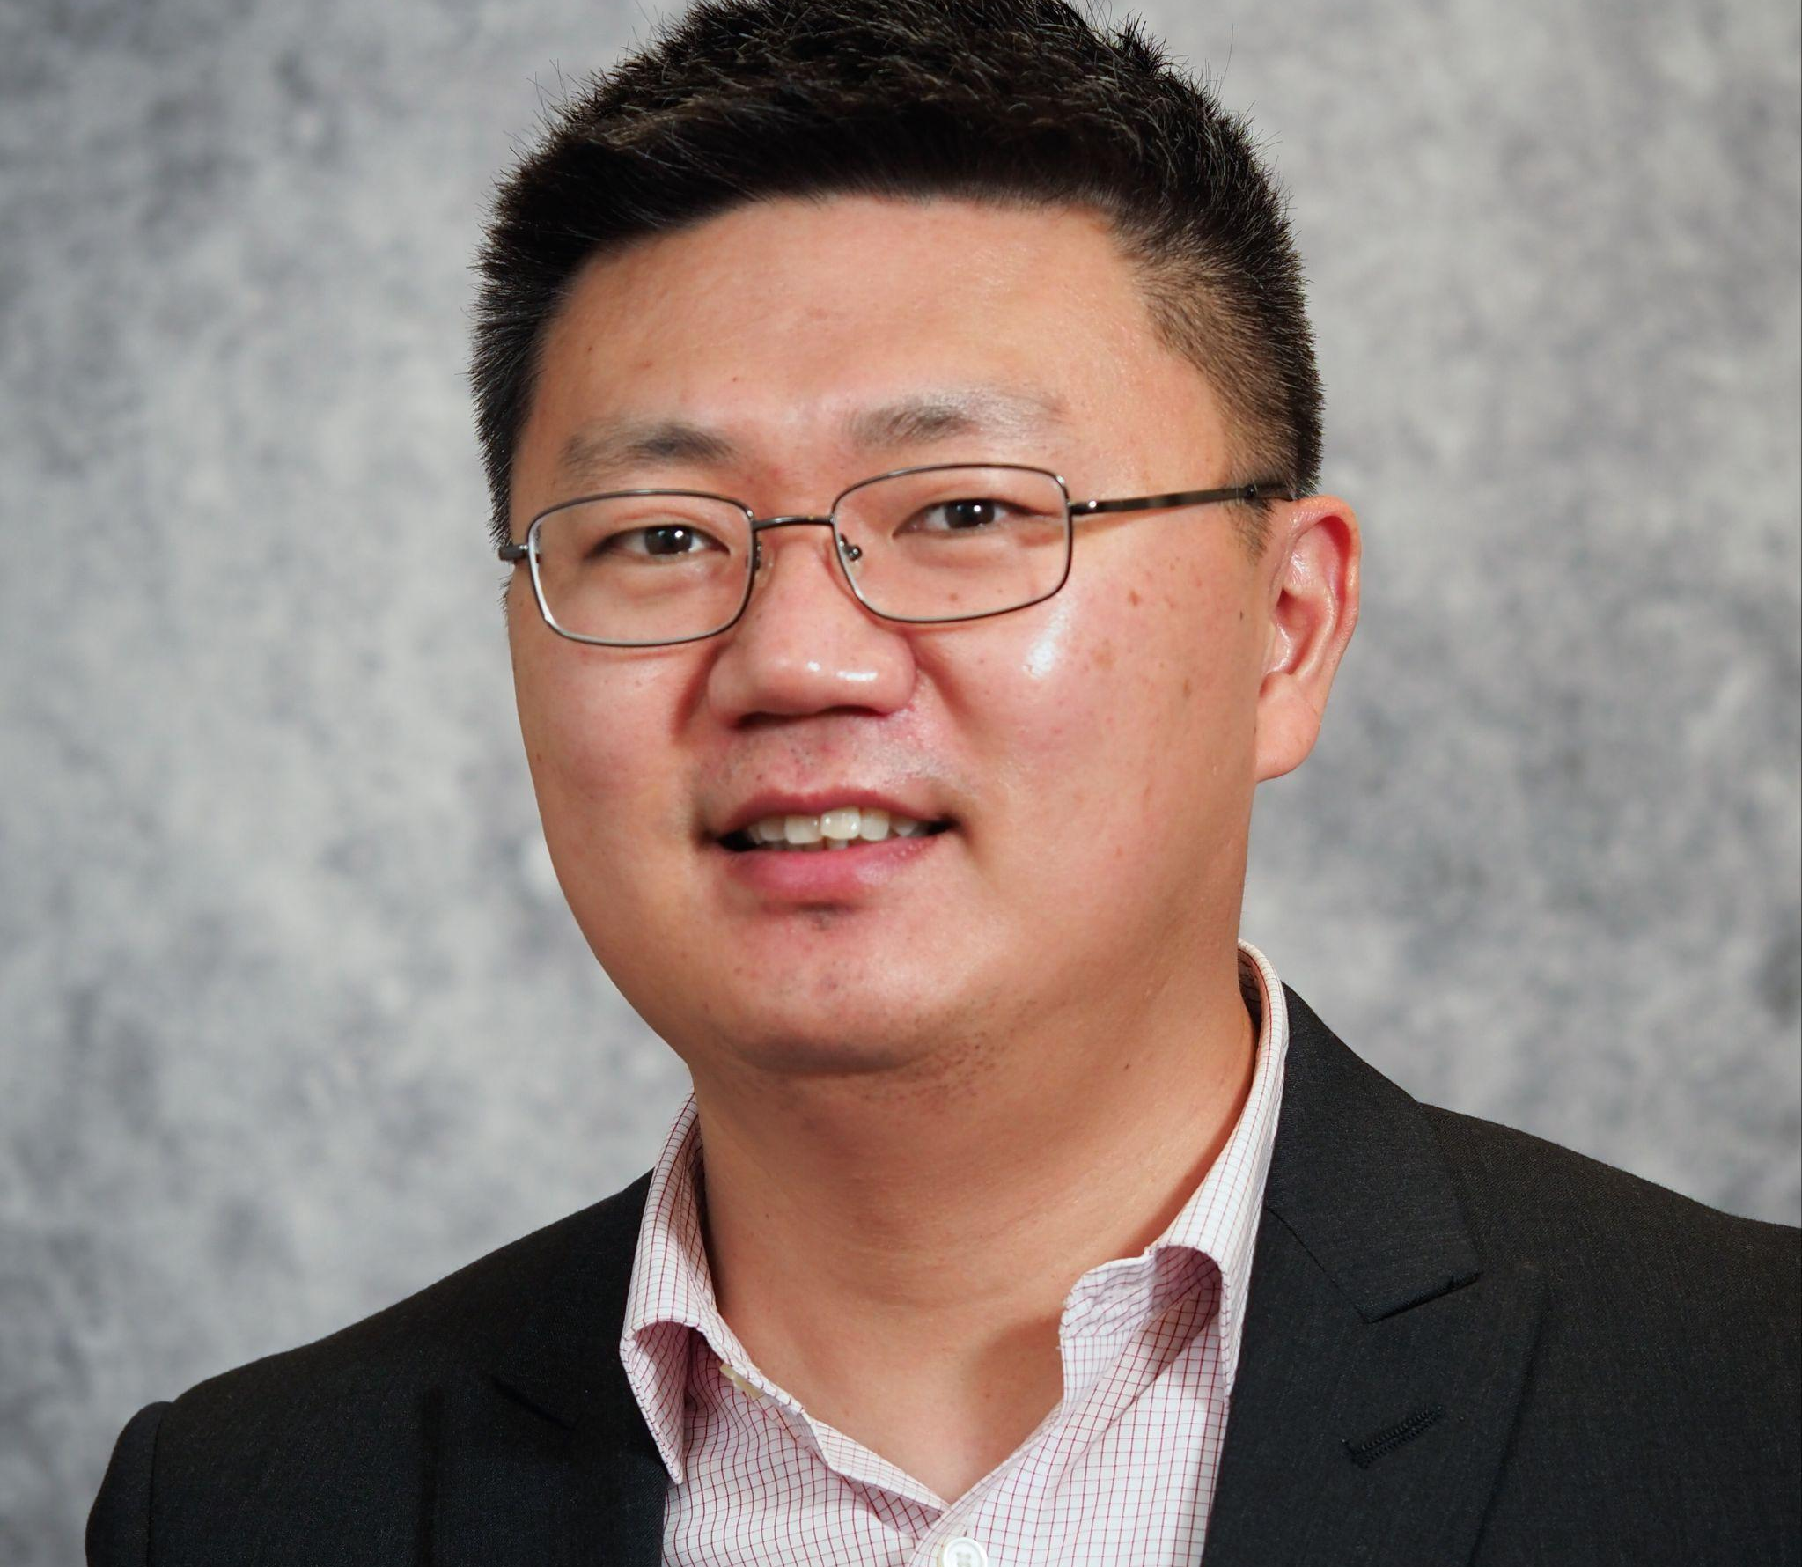
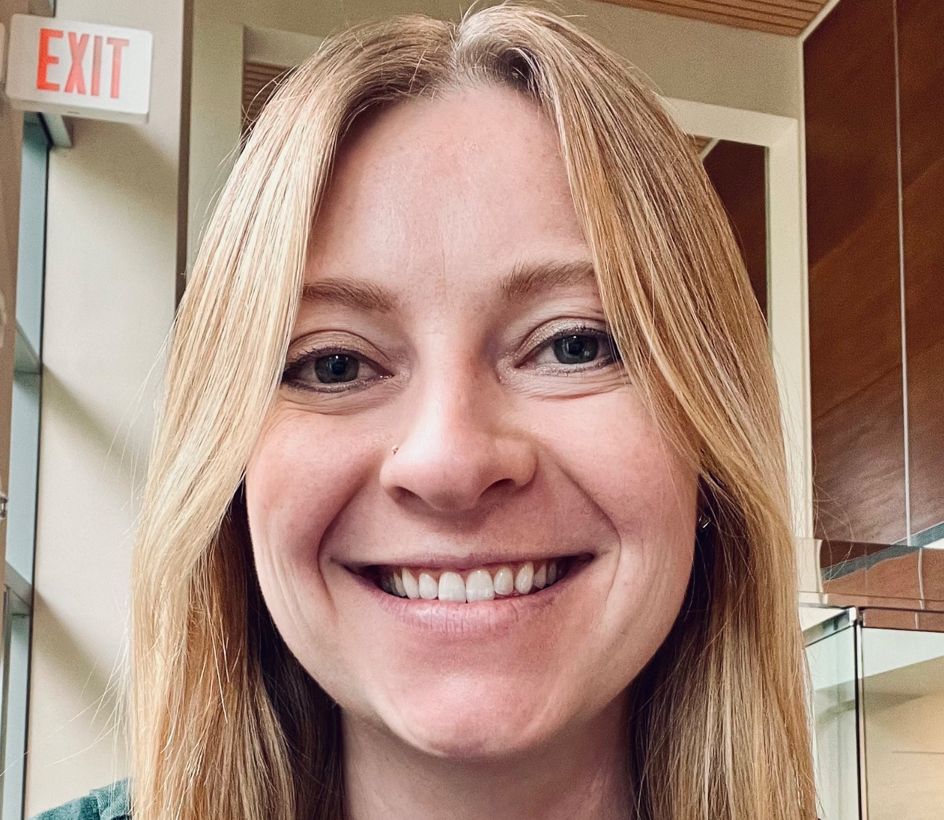
Who are we?
Allan Rossman
Kelly McConville
Sunghwan Byun
Wendy
Moore
Program Co-Chair
Program Co-Chair
Community Engagement
Community Engagement
Notes:
5 min

Slide 4
Ice Breaker
Form small groups and share:
Name
Affiliation
What do you hope to gain from USCOTS 2025?
Notes:
Wendy will come up with additional ideas and finalize
5 min,
Form groups of five, share name, affiliation, what do you like to gain from USCOTS?

Slide 5
Navigating the Program
Notes:
Both will contribute
10 mins
Types sessions
-Birds of feather, very informal, during lunch
-Concurrent session
-

Slide 6
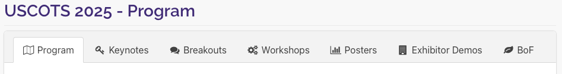
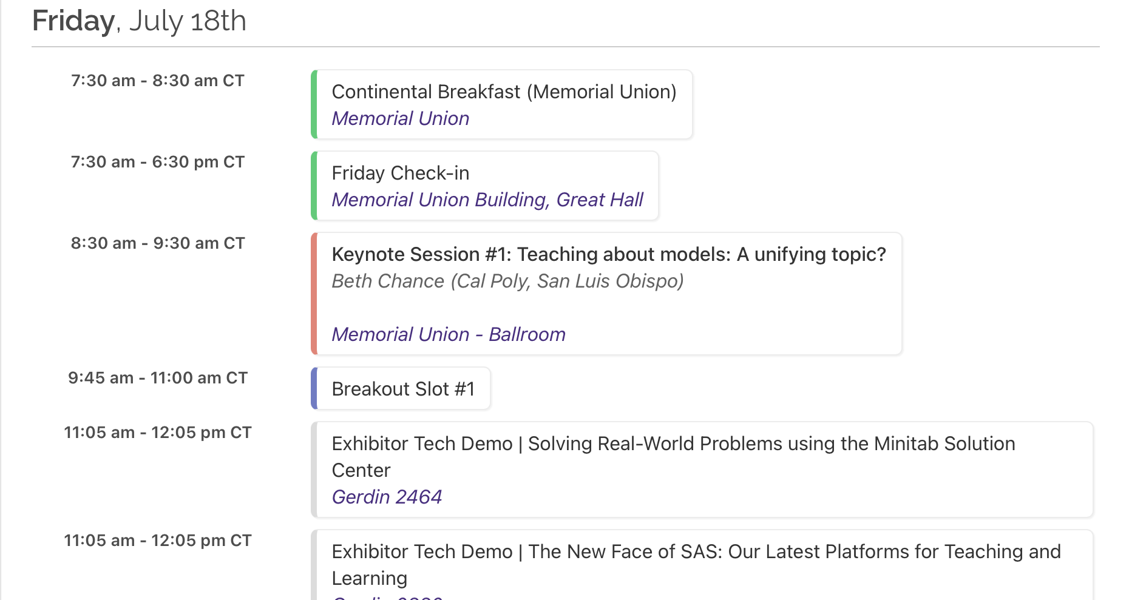
An overview of the entire program

Slide 7
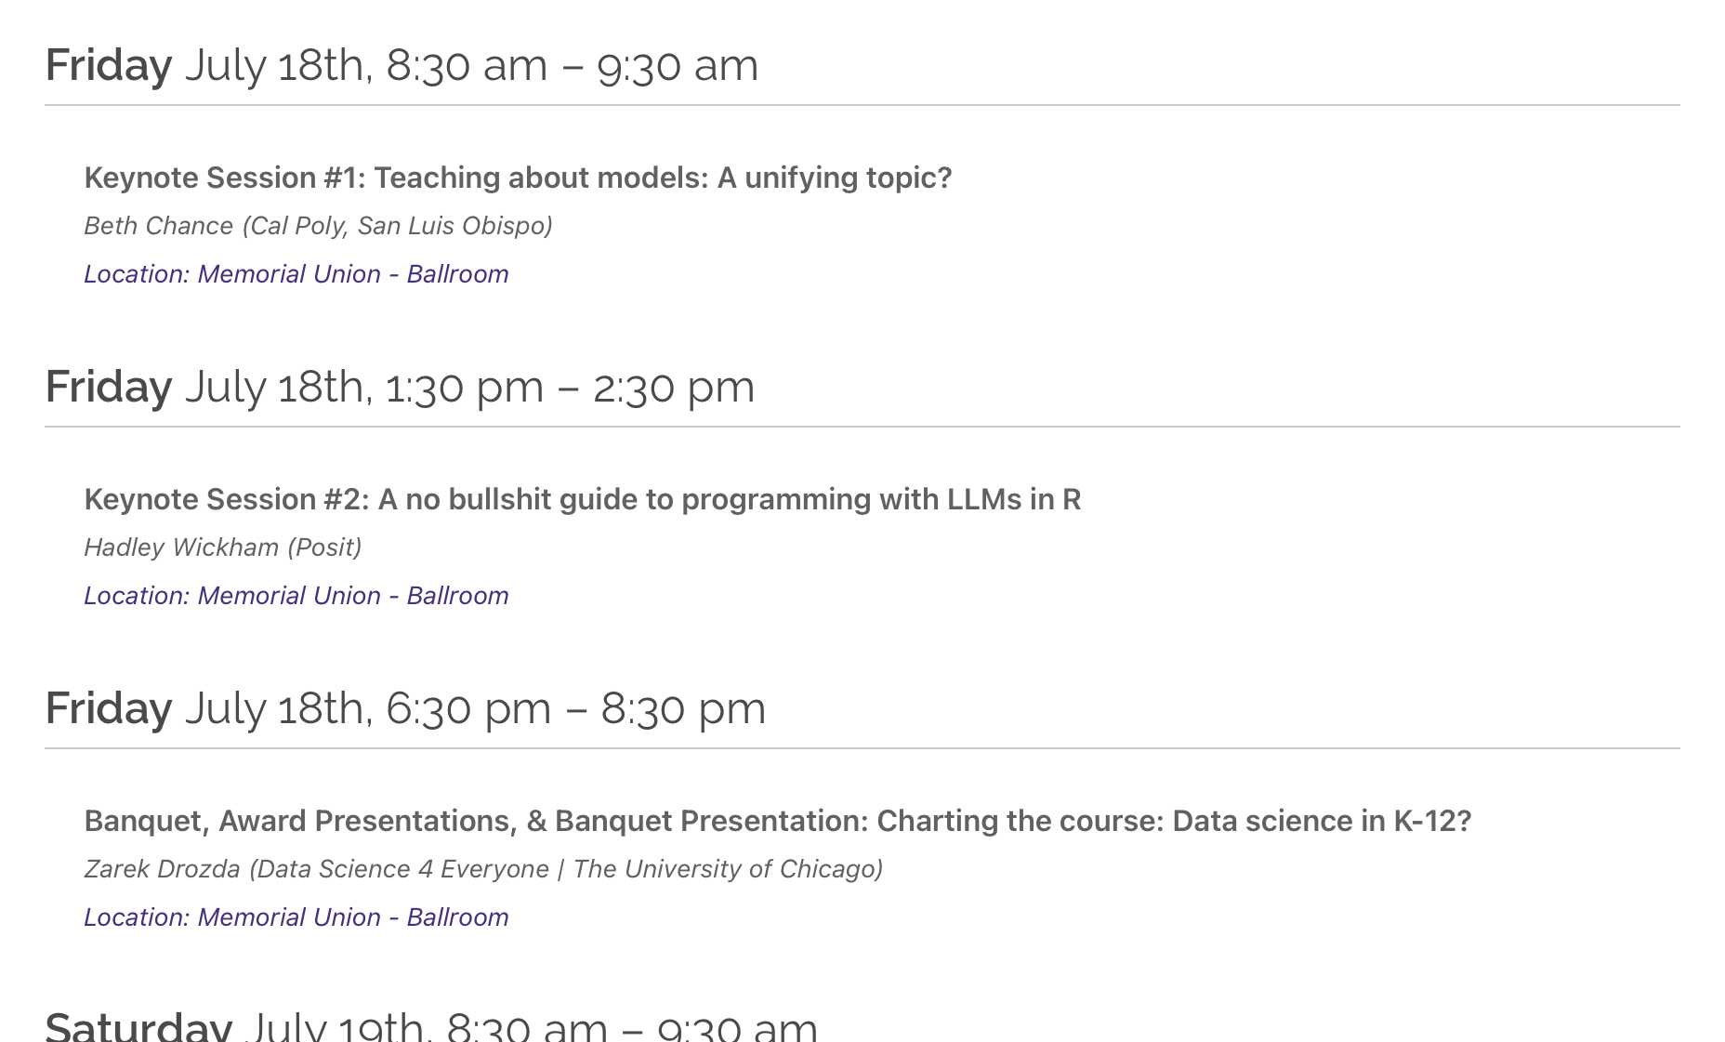
Keynote sessions, speaker, location
If you click on the session headers you’ll see the abstract and a short speaker bio

Slide 8
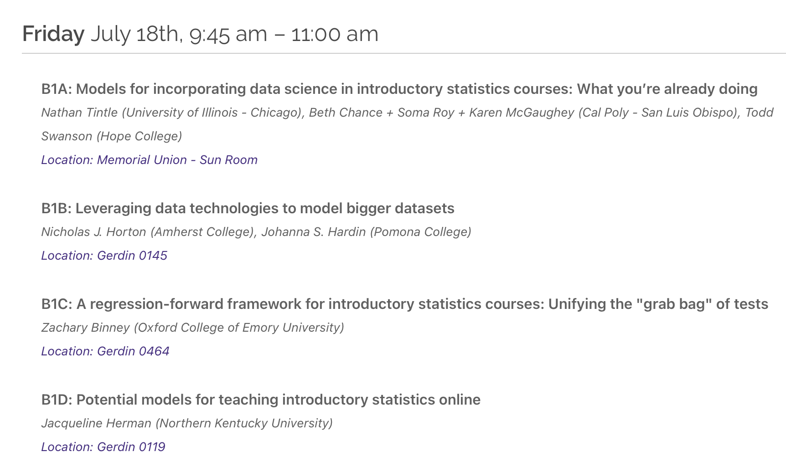
Breakouts organized by session: B for breakout, the number for the session, and a letter for each presentation
If you click on the session title you’ll see the abstract

Slide 9
Workshops have already concluded at this time, but for next USCOTS this is where you can find out our half-day and full day workshops!

Slide 10
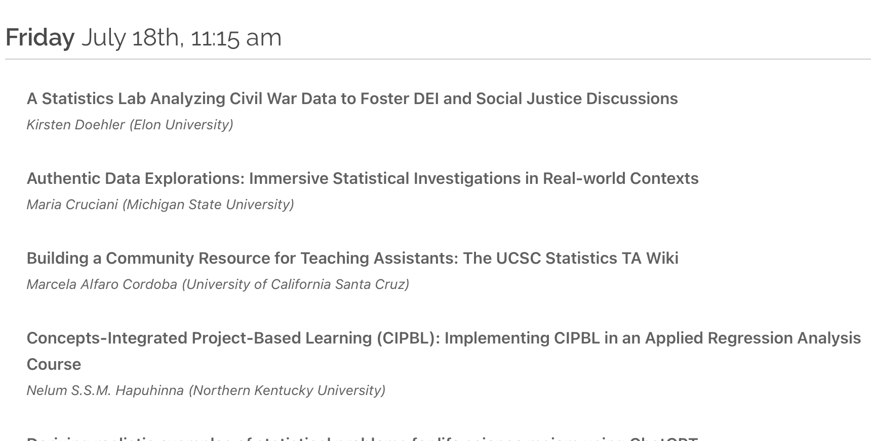
A list of the posters and presenters
If you click on the poster title you’ll see the abstract

Slide 11
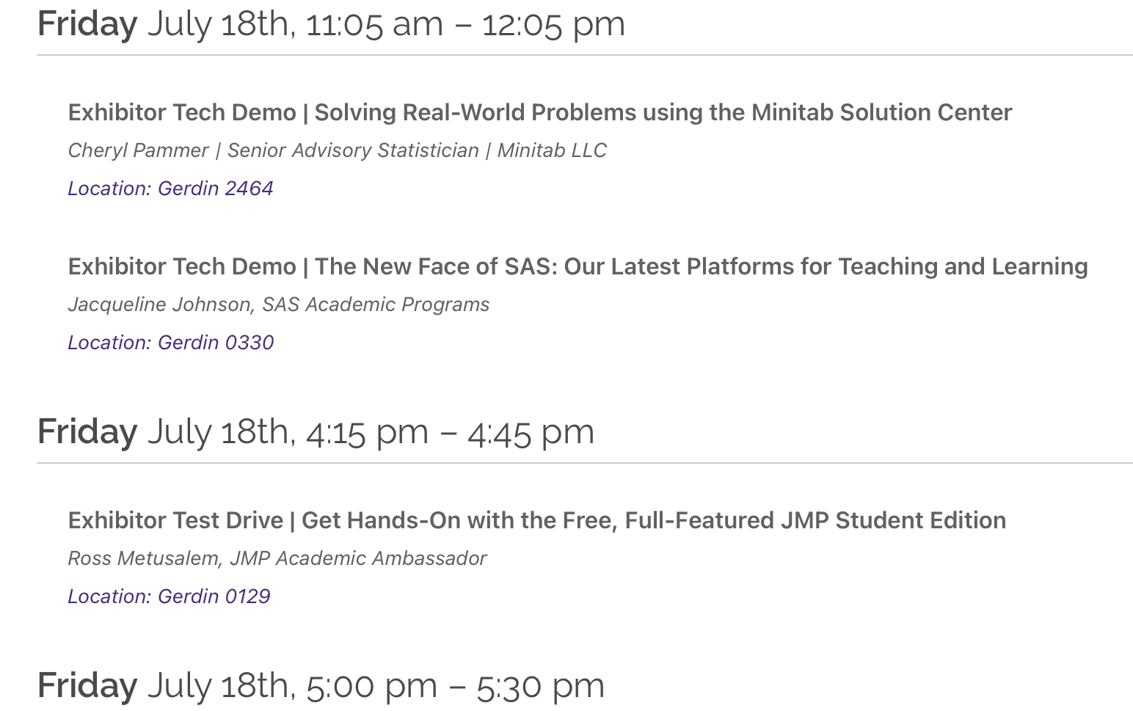
A list of our exhibitors and when they are doing demos
If you click on the exhibitor title you’ll see some info about the the resource

Slide 12
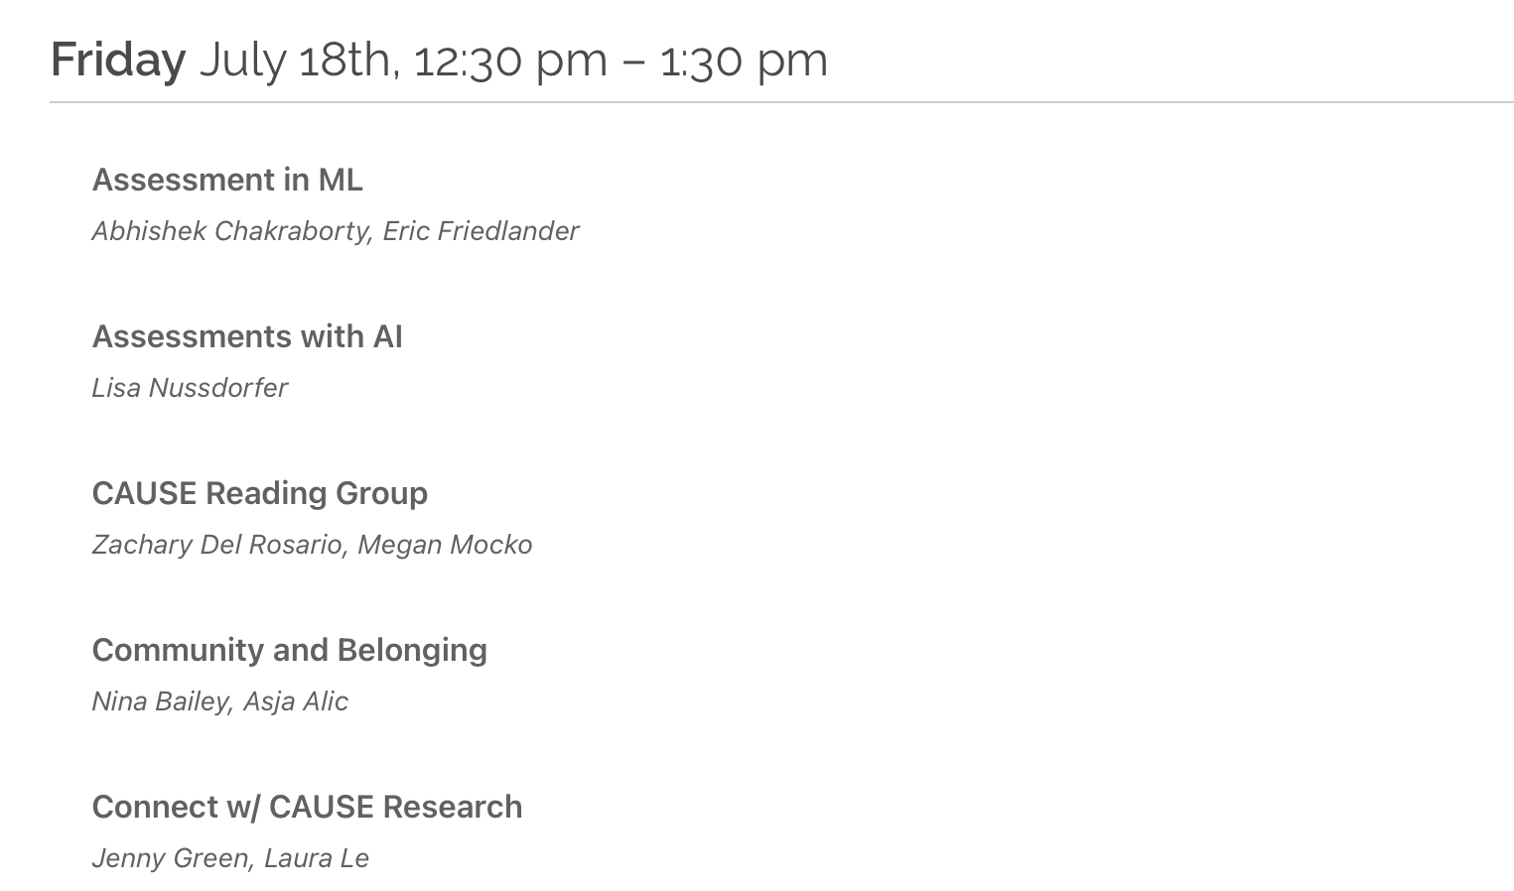
A list of all the Birds of a Feather topics. You will find the BoF topics at different tables during lunch.
If you click on the BoF title you’ll see more information on the topic

Slide 13
Scavenger Hunt
Work on your own or in pairs and complete the 2025 USCOTS scavenger hunt! Explore the different conference sessions, the ISU campus, and network. Complete the 16 items and be entered to win a prize!
Notes:
3 mins
Introducing Scavenger Hunt

Slide 14
Explore Iowa State!
Lake LaVerne (nice place for a walk) Across Morrill Rd from MU
If you are lucky, you may find the swan couple, Lancelot and Elaine!
Cafés and restaurants (Campus Town) Across Lincoln Way from MU
ISU Creamery (Food Science Building, RM 2955) 0.3 miles from MU
Reiman Gardens (Botanical garden) 1.4 miles from MU
Chocolaterie Stam (Old Town) 2 miles from MU
CyRide is local public bus. Regular fare is $1
Notes:
2 min
Gather some ideas in conference and visiting nearby places

Slide 15
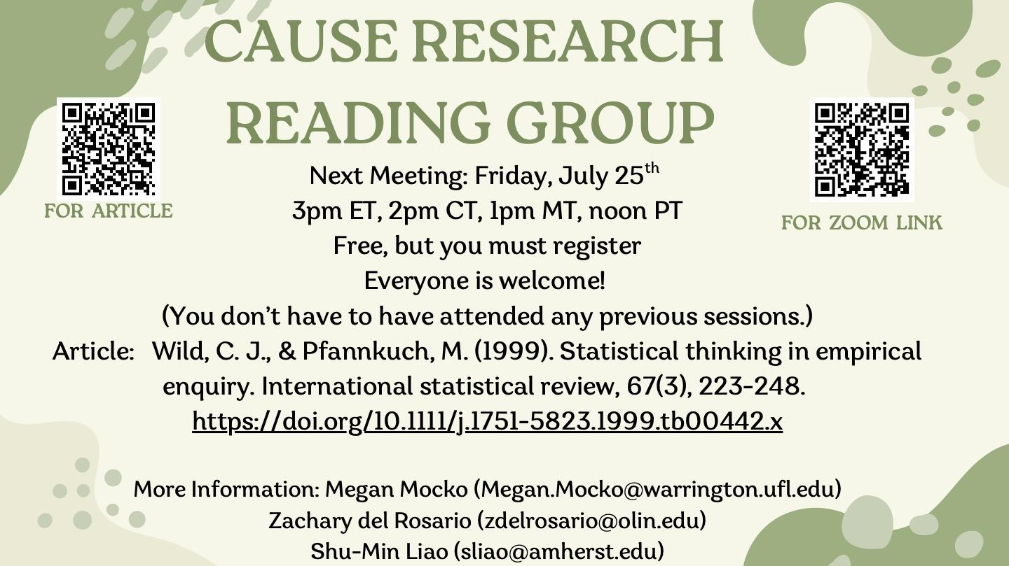

Slide 16
Questions?
Notes:
Both
3 min

