Slide 1
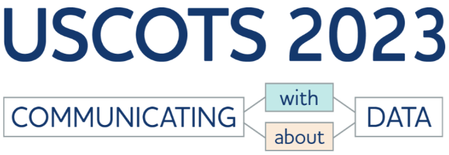
Susan A. Peters June 1, 2023
Notes:
Thank you, Allan (and/or Kelly)!

Slide 2
What should be the main goal of statistics education for all?
“The ultimate goal: statistical literacy for all” (Bargagliotti et al., 2020, p. 5).
“We want our students to become statistically literate” (GAISE College Report ASA Revision Committee, 2016, p. 12).
Notes:
Major policy documents in statistics education suggest that our main goal for ALL students should be statistical literacy.

Slide 3
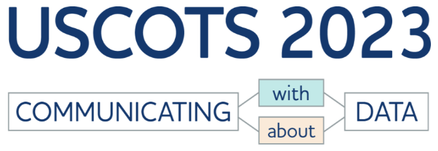
What do we mean by statistical literacy?
Ability to “evaluate conclusions from data and judge the legitimacy of reported results” (Bargagliotti et al., 2020, p. 5)
Be “educated consumers of statistical information [and] use and interpret…statistics in everyday life”(GAISE College Report ASA Revision Committee, 2016, p. 12)
“Ability to read and interpret summary statistics in the everyday media: in graphs, tables, statements, surveys and studies” (Schield, 2010, p. 135).
Notes:
Which entails the abilities to judge statistics encountered in everyday life and to evaluate conclusions from data, including the abilities to read and interpret data represented in specific forms.
[CLICK]
Thus, for statistical literacy, we see the importance of students not only being able to communicate with and about data but also being able to critically consider others’ communications.

Slide 4
Data Visualization
“In the information age, the ability to read and construct data visualizations becomes as important as the ability to read and write text” (Börner et al., 2019, p. 1857).
Notes:
Being able to critically interpret data visualizations is particularly important as more and more people consume news from social media on small digital devices. Journalists are moving away from writing to using data and visualization as a central element for conveying messages (Kelley et al., 2019). But the media at times presents data visualizations that distort reality in ways that make it easy to follow a particular narrative.

Slide 5
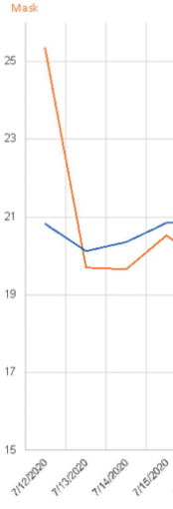
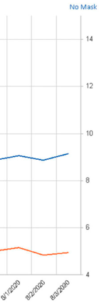
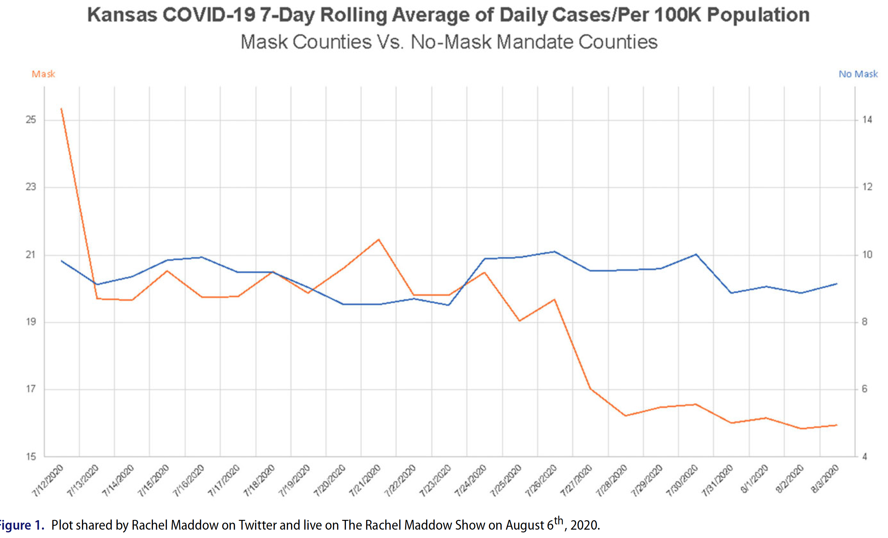
COVID Data Visualization
(Engledowl & Weiland, 2021, Figure 1)
Notes:
We’ve seen examples of this with reports on COVID-19. This visualization presents the rolling average of cases for counties with mask mandates in red and counties without mask mandates in blue and suggests a rapidly decreasing average and lower recent average for masked counties.
[CLICK]
Upon closer examination, however, we see that different scales with different lower bounds are used to display the two trends.
This example underscores the point that citizens need to be critical consumers of the data presented to them to see what is, and not what others want them to see. We need to empower our students with the skills to critically interpret data visualizations--skills that are important for responsible citizenship.

Slide 6
Data Visualization
“With the rise of data science and an increasingly data-infused society, the teaching and understanding of effective data visualizations has become even more crucial” (Engel et al., 2020, para. 2).
Notes:
The growth of data science also requires renewed focus on the teaching and learning of data visualization.

Slide 7
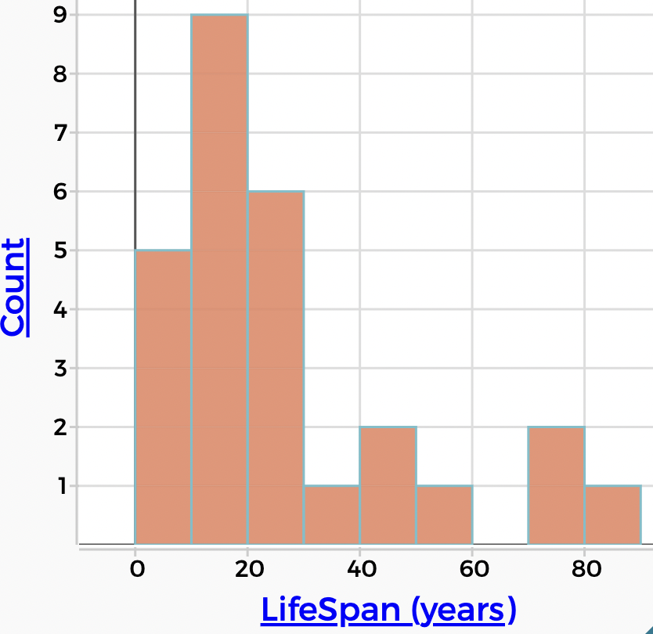
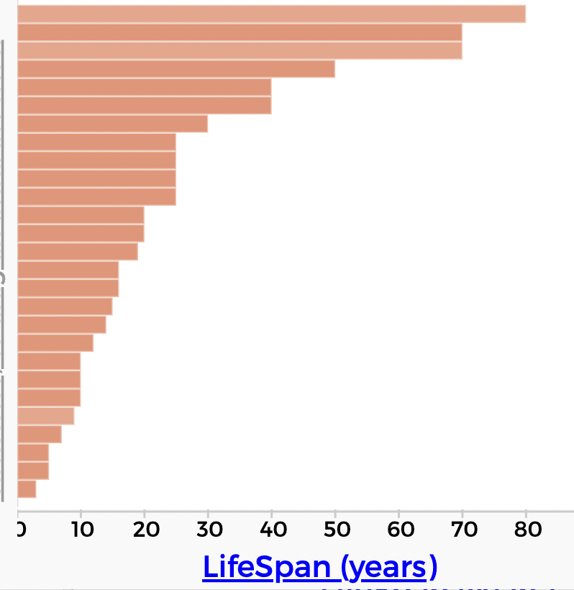
Prior Research
Students’ struggles with traditional forms of representation such as histograms (e.g., Kaplan et al., 2014) and boxplots (Lem et al., 2013)
Notes:
Much previously published research on data visualization focuses on standard forms of representation and highlights students’ interpretations, often in terms of student struggles. For example, a common struggle is to read a histogram as if it were a case value plot--to view the heights of the bars as representing data values rather than data frequencies.

Slide 8
Prior Research
Frameworks and hierarchies to consider students’ interpretations (comprehension) of represented data (e.g., Curcio, 2010, p. 9)
Notes:
Studies and syntheses of research on students’ interpretations contribute frameworks for levels of comprehension such as Curcio’s well-known framework of graphical comprehension or hierarchies of reasoning for interpreting represented data that can inform instruction.

Slide 9
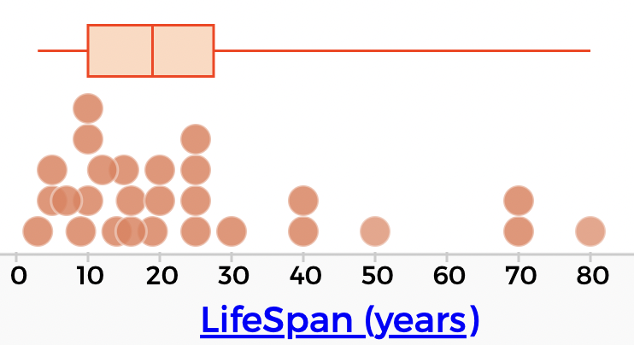
Prior Research
Instructional strategies for developing students’ understanding of traditional forms of representation such as scatterplots (e.g., Cobb et al., 2003) and boxplots (e.g., Lem et al., 2015)
Notes:
Researchers also identified instructional sequences and strategies that are beneficial for developing students’ graphical comprehension, such as superimposing a boxplot over or above a histogram or dotplot to consider the counterintuitive nature of what box and whisker lengths represent.
As a field, we have made progress with identifying typical areas of struggle, levels of reasoning and understanding, and instructional strategies for students to interpret graphical displays of data, but questions remain in the current environment…

Slide 10
Current Environment: Data Science and Computing Power
Large amounts of data produced at a rapid pace
Problems/issues/questions requiring consideration of multiple factors for understanding/solutions
Powerful computing power to quickly process large amounts of multivariate data
Availability of a wide range of visualization tools, many for free
(e.g., Engel et al., 2020; Prodromou & Dunne, 2017)
Notes:
With the proliferation of data and the computing power to handle large and complex data sets,

Slide 11
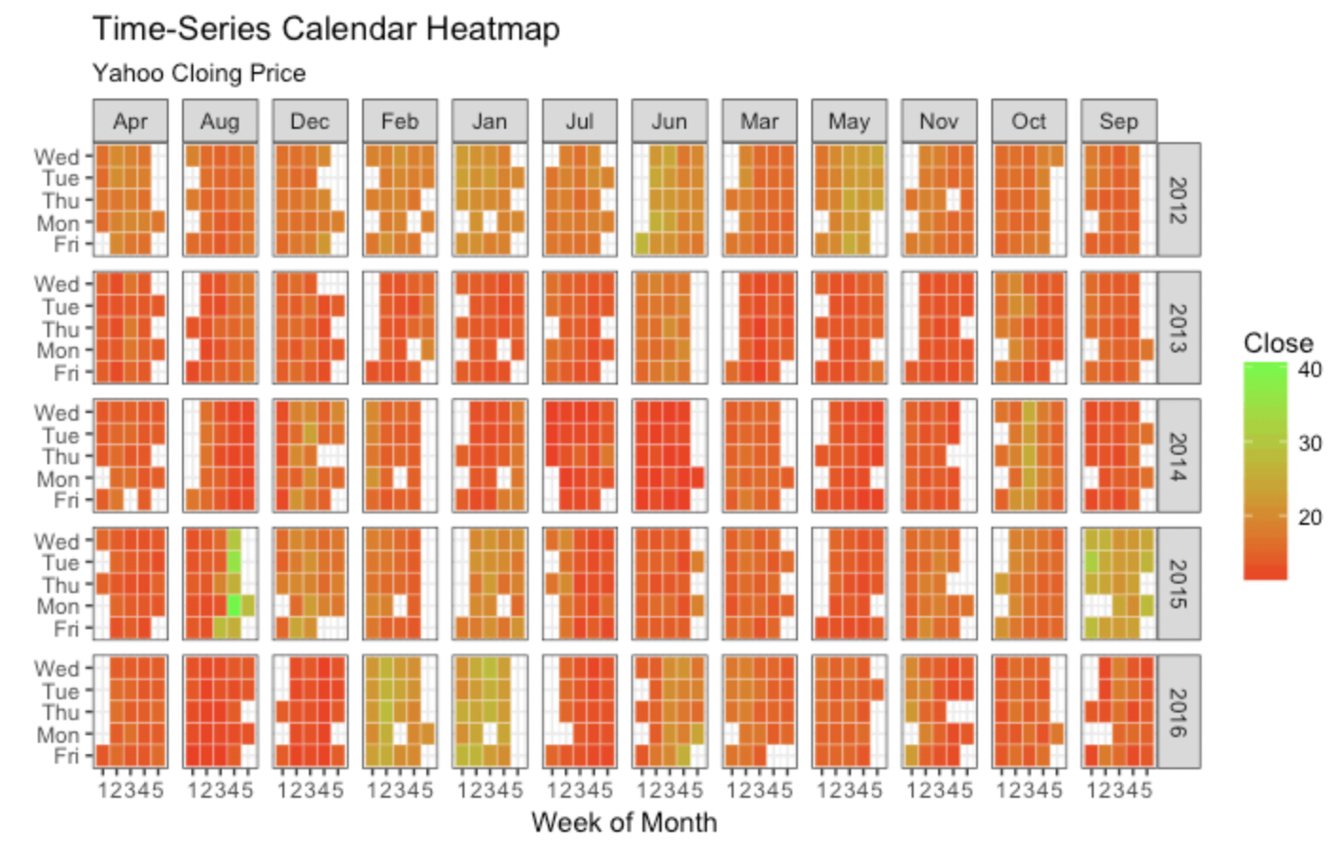
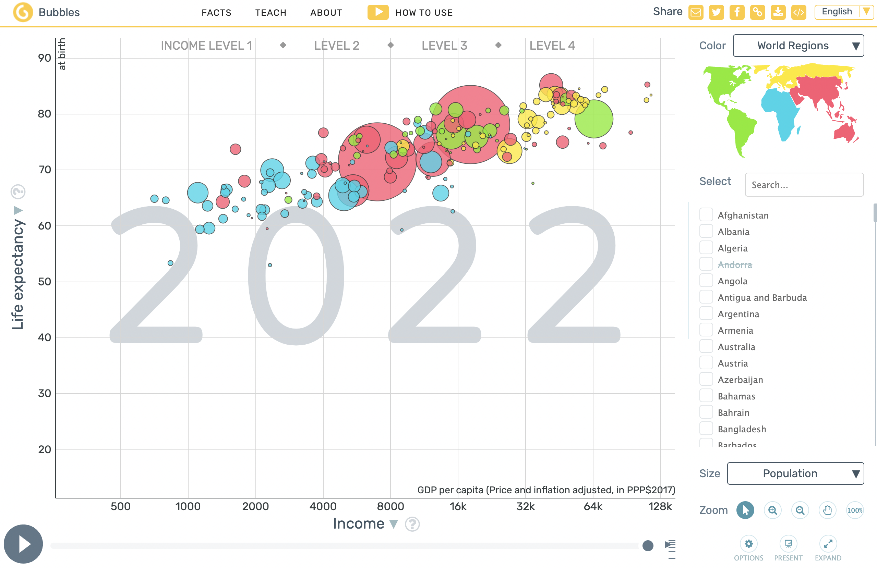
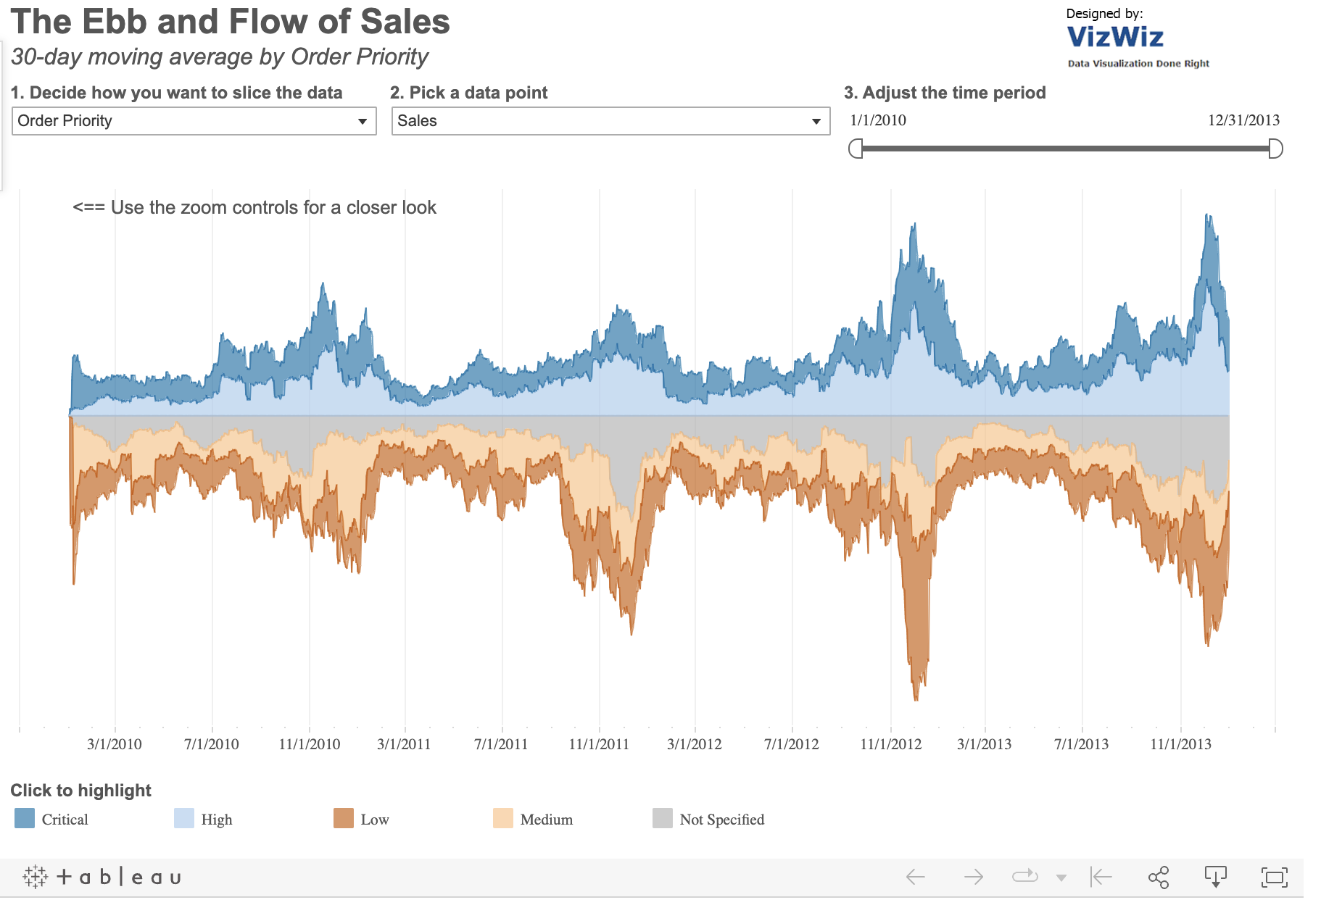
Data Visualization Currently
Heatmap from ggplot2 in R
Stream graph from Tableau
Bubble plot from gapminder.org
Notes:
A growth in visualization tools and visualization types,

Slide 12
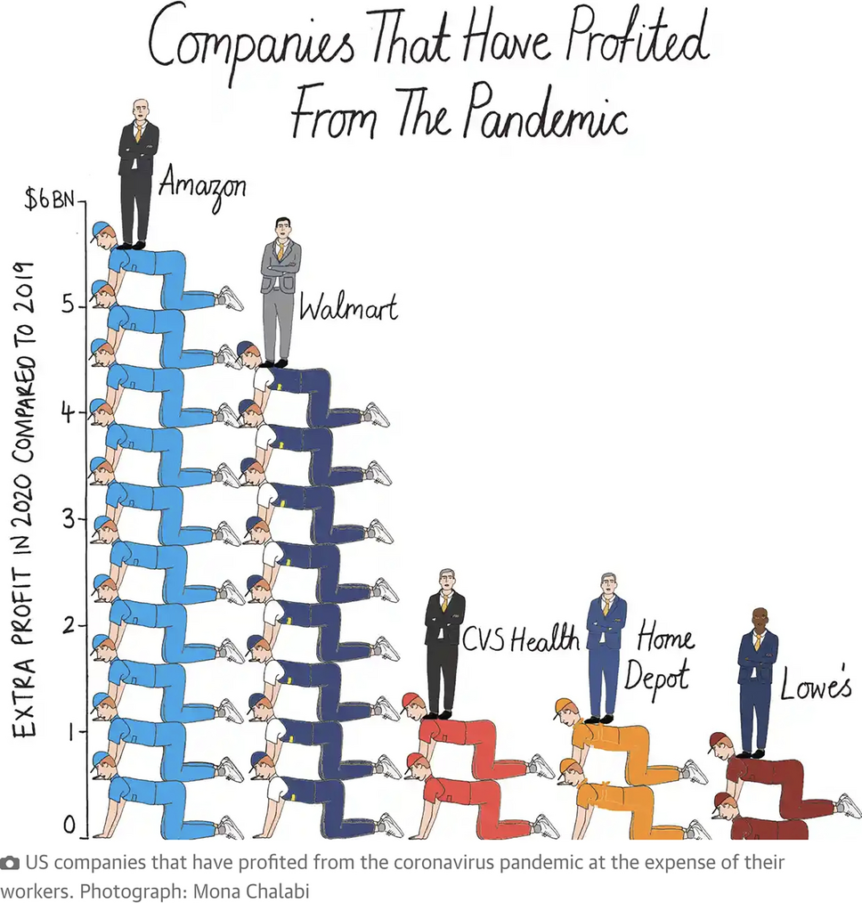
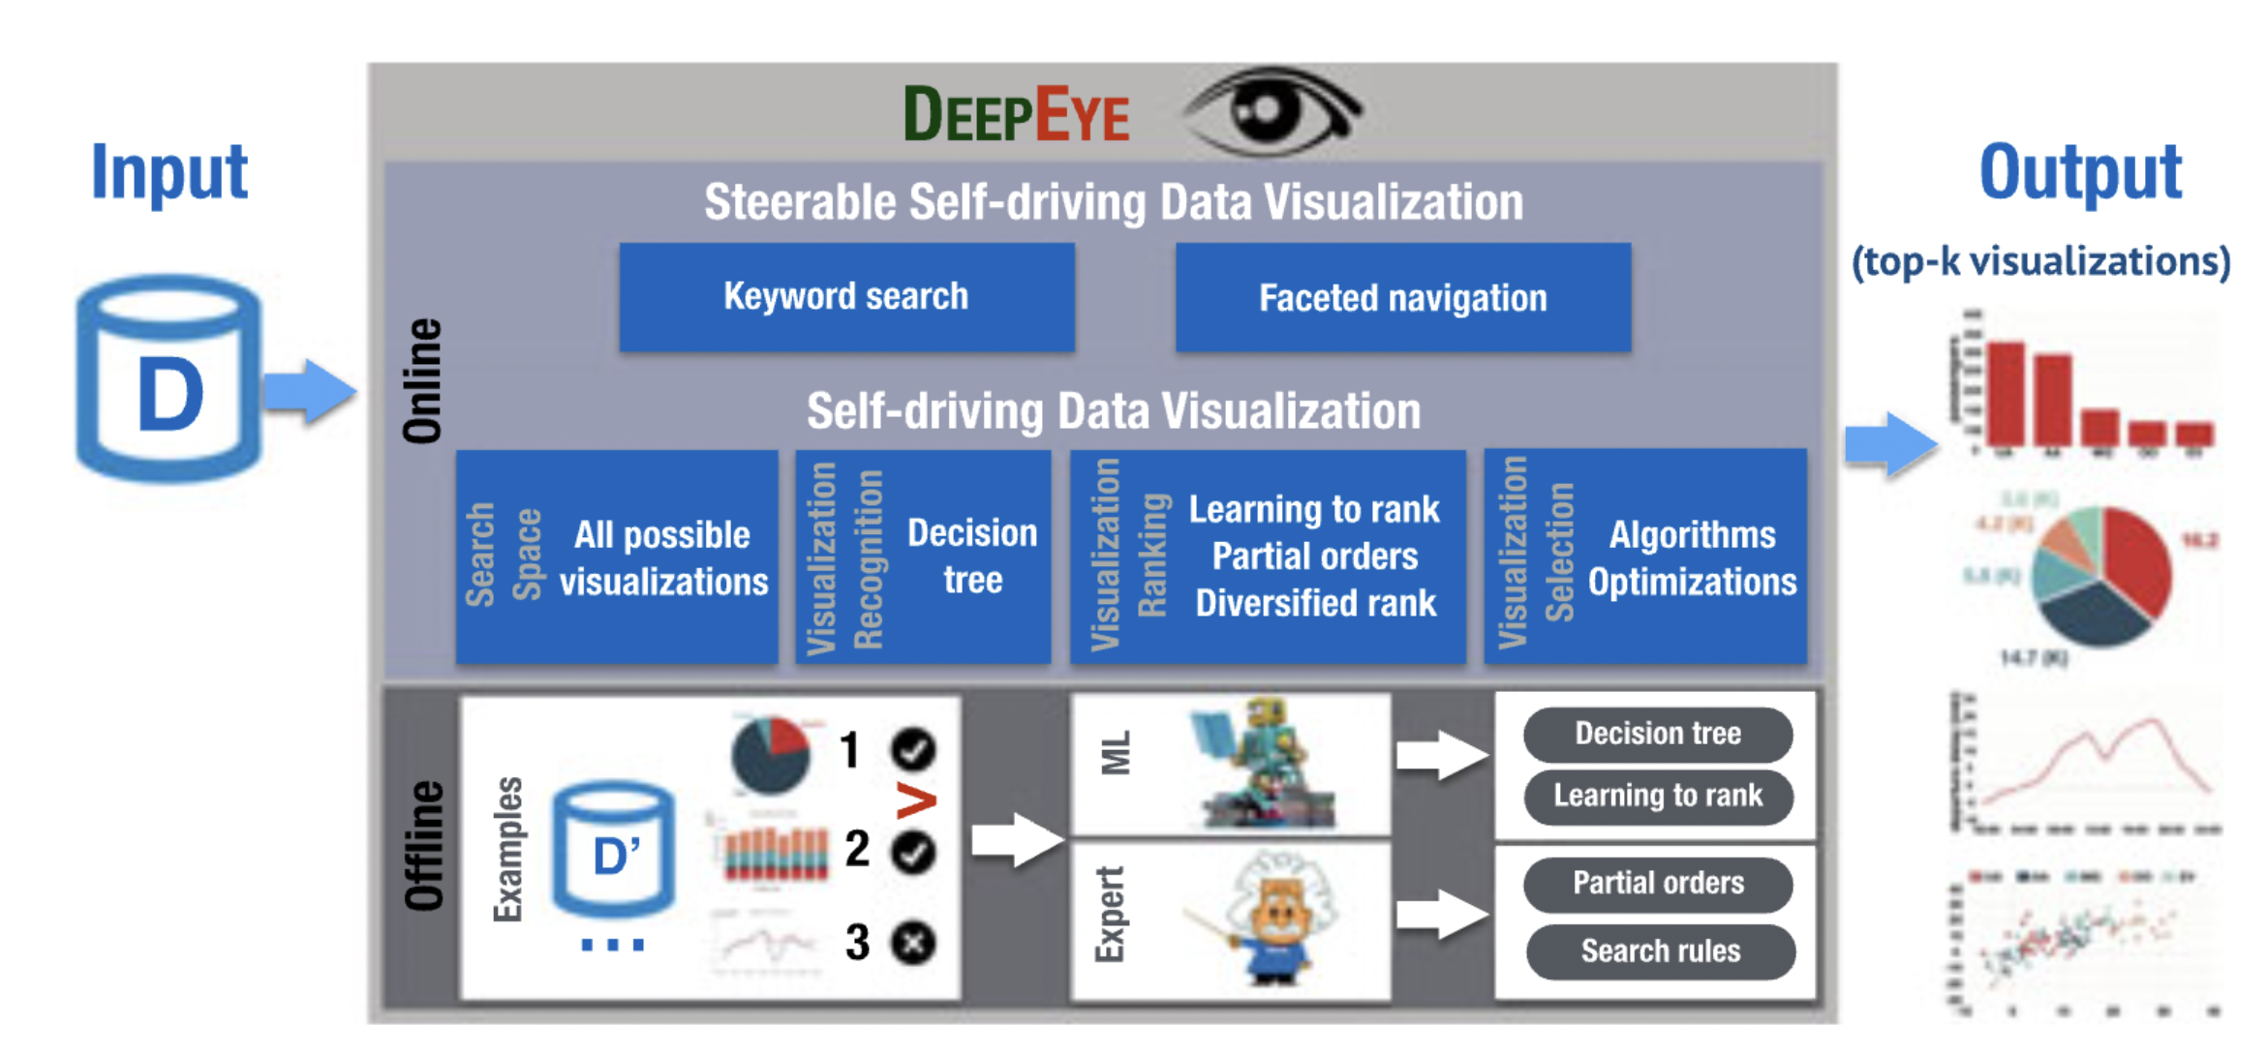
Current Environment: Data Visualization and Education
Mathematics education
Computer science
Figure 2 in Luo et al. (2022)
Figure 4 in Lim et al. (2023)
Notes:
And increased interest and focus from fields such as computer science and education more generally. For example, computer scientists are developing tools for learning and teaching data visualization, including tools that capitalize on artificial intelligence to use algorithms that automatically create data visualizations. The focus tends to be on the science of visualization more so than the art of visualization and examining multiple visualizations to tell the story of the data. We also see mathematics and urban educators interested in issues of social justice using visualizations to address societal issues with students, but some may focus so much on context that they lose sight of the science of interpreting data visualization.
Data visualization education can benefit from a focus on both art and science in teaching and learning, which includes educating students to become critical authors and consumers of visualizations. It’s this dual focus on the art and science of statistics where I think we as statistics educators can make our biggest contribution.

Slide 13
Current Literature
Notes:
Current work in statistics education includes the sharing of assignments and projects for teaching and learning data visualization. For example, these articles also focus on developing students’ understanding of good graphics principles such as creating informative visualizations that tell the story of the data to provide students with opportunities to consider both art and science.

Slide 14
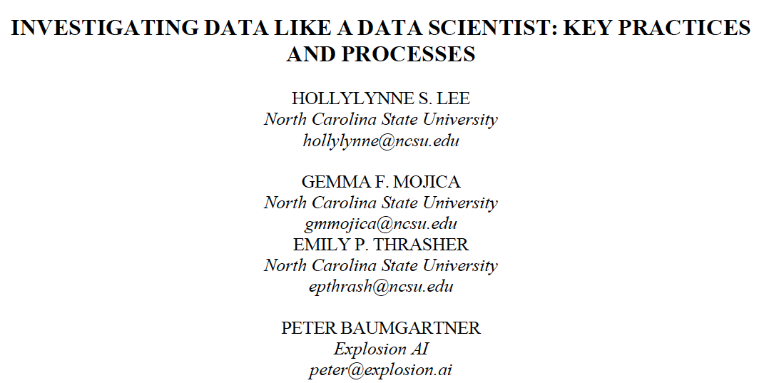
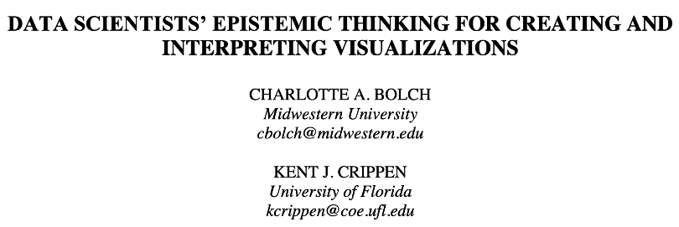
Current Research Literature
Notes:
Current research on data visualization in statistics education focuses on students’ interpretations of particular visualizations and developing potential learning progressions based on the work of expert data scientists. In general, however, little research focuses on students creating and interpreting a variety of nonstandard data visualizations or on instruction related to these visualizations.

Slide 15
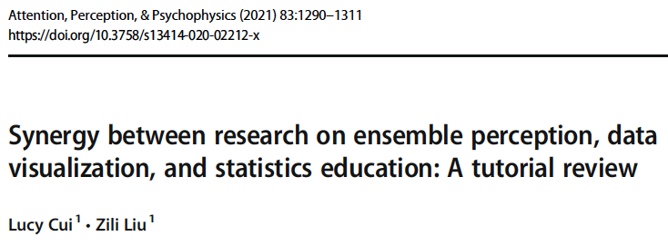
Current Research Literature
Notes:
Moving forward, interesting work might capitalize on the growing body of work outside statistics education to, for example, consider different lenses for studying students’ interpretations of visualizations.
Many questions about the learning and teaching of data visualization need to be asked, to be explored in new ways, and to be answered!

Slide 16
Some Research Questions
What should all K-12 and college students know about creating and interpreting data visualizations to be critical consumers of data visualizations both now and in the future?
(Rather than consider individual types of data visualization), What are different genres of visualization that are similar in how they can be interpreted, understood, learned, etc., and what are the important characteristics of the visualizations in each genre?
What types of visualization are appropriate for students at different grade levels to consider and interpret? What minimal set of visualization types do students need to create and interpret to achieve data visualization literacy?
What are appropriate learning progressions for developing students’ data visualization literacy?
How can we effectively and equitably teach the concepts, skills, and practices that are part of these progressions?
What (additional) knowledge do today’s teachers need to prepare students to be statistically literate? What learning experiences benefit teachers in developing this requisite knowledge?
Notes:
The questions listed here are just a small subset of unanswered questions whose answers can inform data visualization education towards developing a statistically literate citizenry.

Slide 17
Thank you!!
Notes:
And that brings me back to this conference. The importance of conferences such as USCOTS cannot be overstated as venues for sharing both practice and research in statistics education. I challenge you as you attend sessions throughout the conference to think about how the sessions might offer insights into teaching and learning the art and science of data visualizations and of statistical literacy in general.

Slide 18
References
Bargagliotti, A., Franklin, C., Arnold, P., Gould, R., Johnson, S., Perez, L., & Spangler, D. (2020). Pre-K–12 Guidelines for Assessment and Instruction in Statistics Education II (GAISE II): A framework for statistics and data science education. American Statistical Association. https://www.amstat.org/asa/files/pdfs/GAISE/GAISEIIPreK-12_Full.pdf
Bolch, C. A., & Crippen, K. J. (2022). Data scientists’ epistemic thinking for creating and interpreting visualizations. Statistics Education Research Journal, 21(2), Article 11. https://doi.org/10.52041/serj.v21i2.21
Börner, K., Bueckle, A., & Ginda, M. (2019). Data visualization literacy: Definitions, conceptual frameworks, exercises, and assessments. PNAS, 116(6), 1857-1864. https://doi.org/10.1073/pnas.1807180116
Cui, L., & Liu, Z. (2021). Synergy between research on ensemble perception, data visualization, and statistics education: A tutorial review. Attention, Perception, & Psychophysics, 83, 1290-1311. https://doi.org/10.3758/s13414-020-02212-x
Cobb, P., McClain, K., & Gravemeijer, K. (2003). Learning about statistical covariation. Cognition and Instruction, 21(1), 1-78.
Curcio, F. R. (1987). Comprehension of mathematical relationships expressed in graphs. Journal for Research in Mathematics Education,18(5), 382-393. https://doi.org/10.2307/749086
D’Ignazio, C., & Bhargava, R. (2020). Data visualization literacy: A feminist starting point. In M. Engebretsen & H. Kennedy (Eds.), Data visualization in society (pp. 207-222). Amsterdam University Press. https://doi.org/10.5117/9789463722902_CH13
Engel, J., Campos, P., Nicholson, J., Ridgway, J., & Teixeira, S. (2020). Visualizing multivariate data: Graphs that tell stories. In P. Arnold (Ed.), New skills in the changing world of statistics education. Proceedings of the roundtable conference of the International Association for Statistical Education (IASE). IASE.
Engledowl, C., & Weiland, T. (2021). Data (mis)representation and COVID-19: Leveraging misleading data visualizations for developing statistical literacy across grades 6-16. Journal of Statistics and Data Science Education, 29(2), Brief Communication 2. https://doi.org/10.1080/26939169.2021.1915215
GAISE College Report ASA Revision Committee. (2016). Guidelines for Assessment and Instruction in Statistics Education college report. American Statistical Association. https://www.amstat.org/asa/files/pdfs/GAISE/GaiseCollege_Full.pdf
Hudiburgh, L. M., & Garbinsky, D. (2020). Data visualization: Bring data to life in an introductory statistics course. Journal of Statistics Education, 28(3), 262-279. https://doi.org/10.1080/10691898.2020.1796399
Kaplan, J. J., Gabrosek, J. G., Curtiss, P., & Malone, C. (2014). Student understanding of histogram. Journal of Statistics Education, 22(2).
Lao, Y., Qin, X., Chai, C., Tang, N., Li, G., & Li, W. (2022). Steerable self-driving data visualization. IEEE transactions on knowledge and data engineering, 34(1), 475-490. https://doi.org/10.1109/TKDE.2020.2981464
Lee, H. S., Mojica, G. F., Thrasher, E. P., & Baumgartner, P. (2022). Investigating data like a data scientist: Key practices and processes. Statistics Education Research Journal, 21(2), Article 3. https://doi.org/10.52041/serj.v21i2.41
Lem, S., Kempen, K., Ceulemans, E., Onghena, P., Verschaffel, L., & Van Dooren, W. (2015). Combining multiple external representations and refutational text: An internvention on learning to interpret box plots. International Journal of Science and Mathematics Education, 13, 909-926. https://doi.org/10.1007/s10763-014-9604-3
Lem, S., Onghena, P., Vresdhaffel, l., & Van Dooren, W. (2018).On the misinterpretation of histograms and box plots. Educational Psychology, 33(2), 155-174. https://doi.org/10.1080/01443410.2012.674006
Lim, V., Peralta, L. M. M., Rubel, L. H., Jiang, S., Kahn, J. B., & Herbel-Eisenmann, B. (2023). Keeping pace with innovations in data visualizations: A commentary for mathematics education in times of crisis. ZDM-Mathematics Education, 55, 109-118. https://doi.org/10.1007/s11858-022-01449-0
Nolan, D. & Perrett, J. (2016). Teaching and learning data visualizations: Ideas and assignments. The American Statistician, 70(3), 260-269. https://doi.org/10.1080/00031305.2015.1123651
Prodromou, T., & Dunne, T. (2017). Data visualization and statistics education in the future. In T. Prodroumou (Ed.), Data visualization and statistical literacy for open and big data (pp. 1-28). IGI Global. https://doi.org/10.4018/978-1-5225-2512-7.ch001
Schield, M. (2010). Assessing statistical literacy: Take CARE. In P. Bidgood, N. Hunt, & F. Joliffe (Eds.), Assessment methods in statistical education: An International perspective (pp. 133-152). Wiley.

