Slide 1
Communicate about Data
Megan Mocko

Slide 2
How do we teach this?

Slide 3
Do projects!!
With Peer Review

Slide 4
A practice run in class

Slide 5
Prepare a medium-level written project report. Have the students score it versus a rubric. Enter that score in a classroom response system.

Slide 6
Go over the scoring as a class. Have them write a peer review in a google slide. Vote on the best one.
This Photo by Unknown Author is licensed under CC BY

Slide 7
Benefits
Students experience the rubric.
They see the standards necessary.
They practice writing a peer review.
They see other students’ examples of how to write a critique.

Slide 8
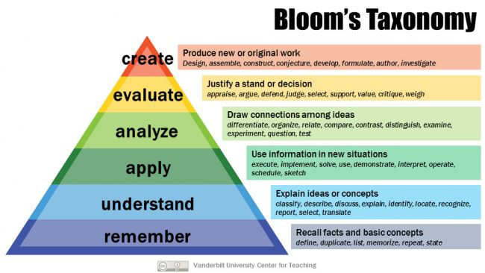
Bloom’s Taxonomy
Climb to “Evaluate”

Slide 9
“To put classroom talk and writing in the service of learning, . . . requires the change of many traditional instructional norms, first the role of teachers . . . aimed at effectively helping learners not only to possess certain information but also be enabled to think with and about that knowledge, and to do certain things with it.” Mason, 2001, pg. 22

Slide 10
References
Mason, L. (2001). Introducing talk and writing for conceptual change: A classroom study. Learning and instruction, 11(4-5), 305-329.

