Slide 1
What else is happening at USCOTS 2023?
Notes:
Want to take a few minutes to highlight the rest of the USCOTS program.
But first a quick note on the theme: communicating with/about data. So encourage you to take that to heart and communicate with others, expanding your stat ed network during the conference!
Several of the program components I am about to present will provide you with a structured opportunity to do just that!

Slide 2
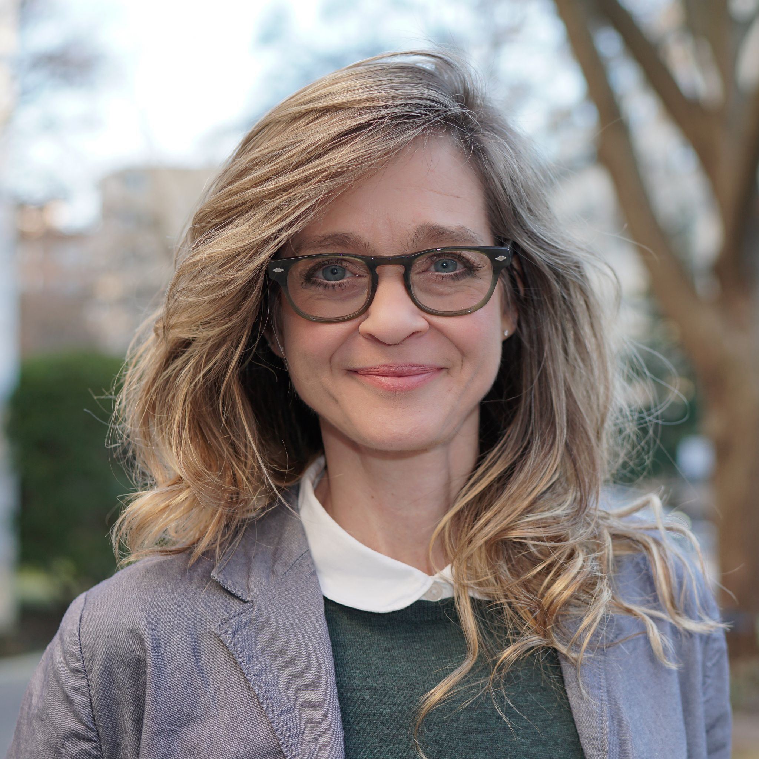
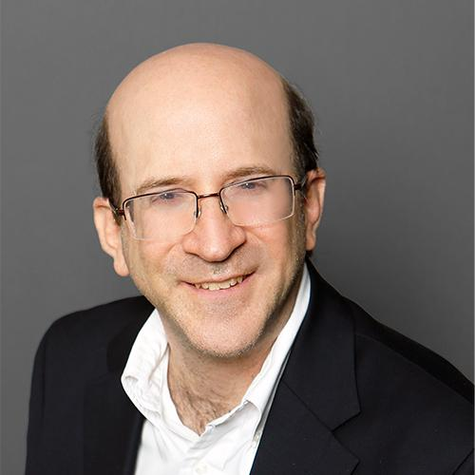
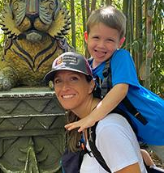
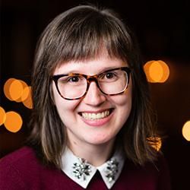
Keynotes (Presidents Hall)
Fri 8:00 am:
Hacking the News Story: What can bad journalism teach us about good stats communication?
Regina Nuzzo
Fri 2:45 pm:
Communication Rumination: Engaging with sci-comm and edutainment
Larry Lesser
Sat 8:00 am:
Communicating to Connect with ALL Students
Kelly Spoon
Sat 1:15 pm:
"Wait, What Do You Mean?": Helping students become "full stack" communicators
Sara Stoudt
Notes:
Keynotes, experts on statistical communication: Addressing the conference theme of communicating with/about data. Each from their own perspective.

Slide 3
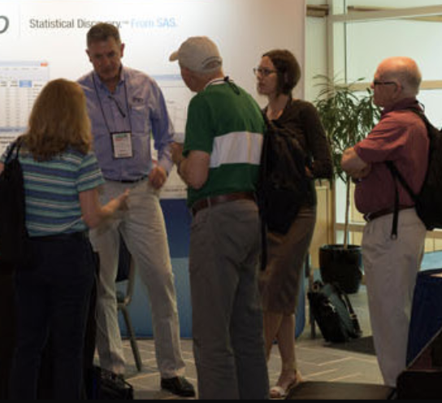
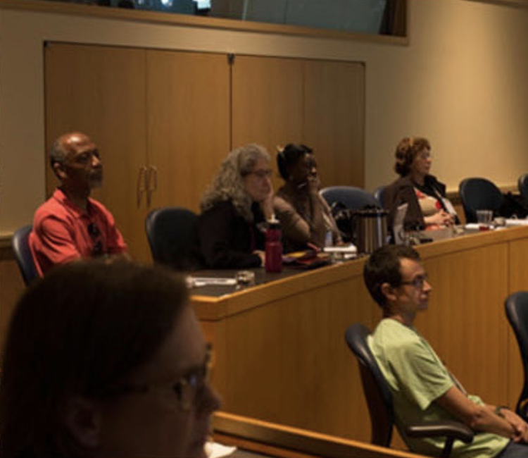
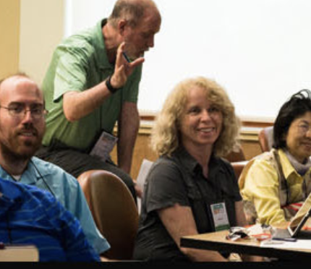
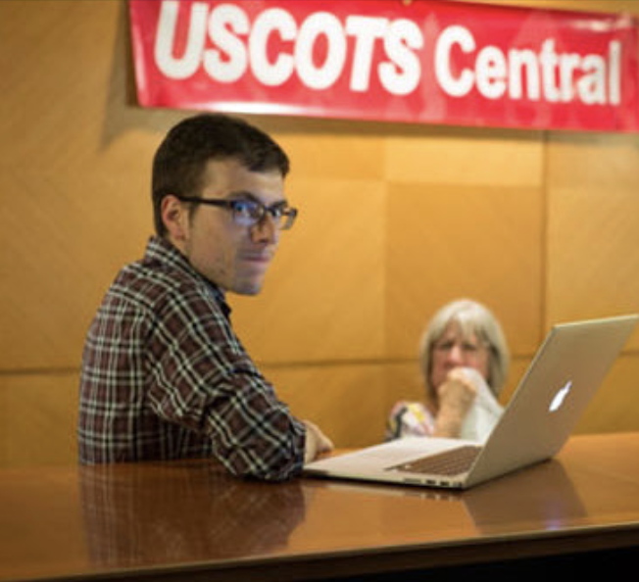
Breakout Sessions
Fri 9:30 am:
Choose one of eight different sessions!
Fri 1:15 pm:
Choose one of seven different sessions!
Fri 4:00 pm:
Choose one of seven different sessions!
Sat 9:30 am:
Choose one of seven different sessions!
Notes:
Breakouts are a unique type of session. Very interactive! For this time around, we have 3 on Fri/1 and 1 on Sat. Make sure to visit the online program to pick out which session you want to attend. But it will be hard to pick just one!

Slide 4
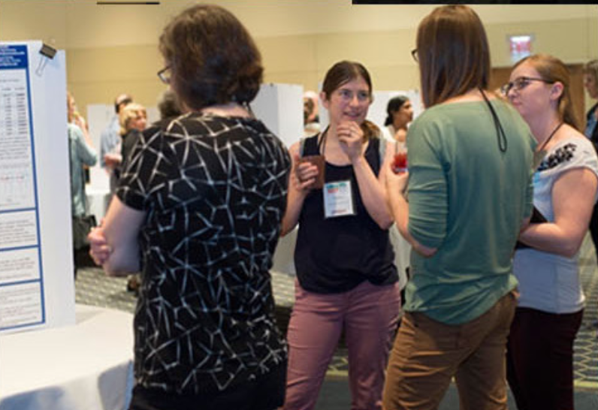
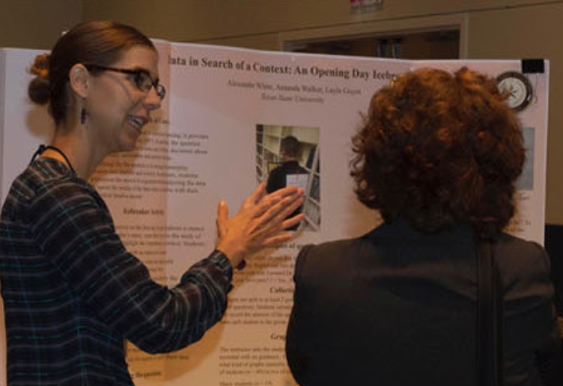
Posters and Beyond (Deans Hall)
Fri 11 am:
Come engage with 27 presenters!
Sat 11 am:
Come engage with 23 presenters!
Notes:
Right next door to us! Big thanks to Judith Canner for all her hard work putting this together!

Slide 5
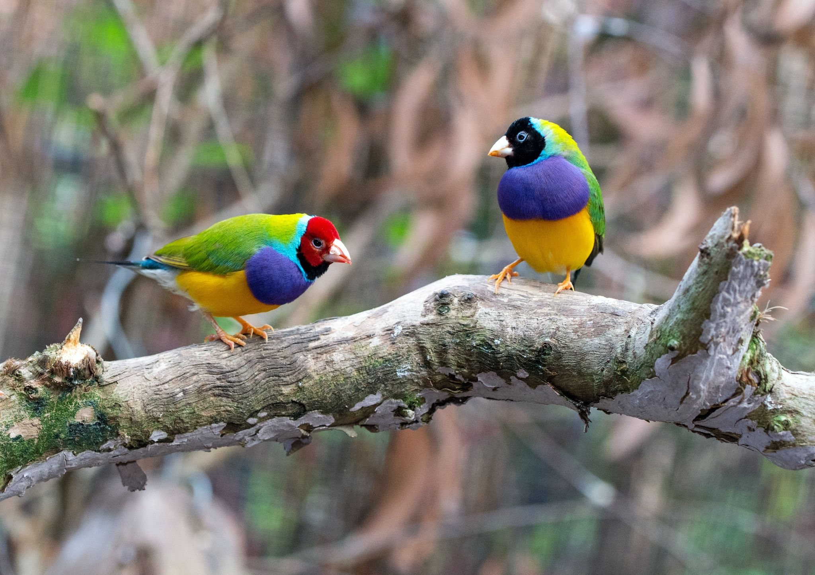
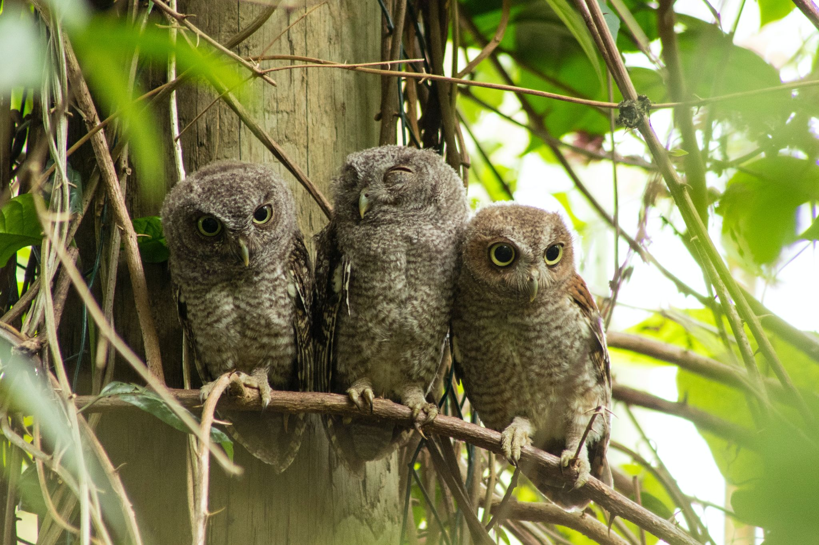
Lunch + Birds-of-a-Feather Discussions (Presidents Hall)
Fri noon: Lunch buffet
19 Birds-of-a-feather tables
Plenty of non-themed tables too!
(Pictured: Gouldian finches)
Sat noon: Lunch buffet
14 Birds-of-a-feather tables
Plenty of non-themed tables too!
(Pictured: Screech owls)
Notes:
Make sure to visit the online program to pick out which BoF you want to attend. But it will be hard to pick just one! First come first seated so pick out a few that would interest you.

Slide 6
A Big Thanks to our Sponsors
Stop by the exhibitor tables right outside Presidents Hall!
Attend one of the remaining exhibitor demonstrations!
Fri, 5:30pm: Communicating Data through SAS Visual Analytics (Room 107)
Fri, 5:30pm: Leveraging Integrated Media for Student Success in Introductory Statistics | Pearson (Room 109)
Notes:
Sponsors are what helps us keep the cost low for the conference and to offer registration grants.

Slide 7
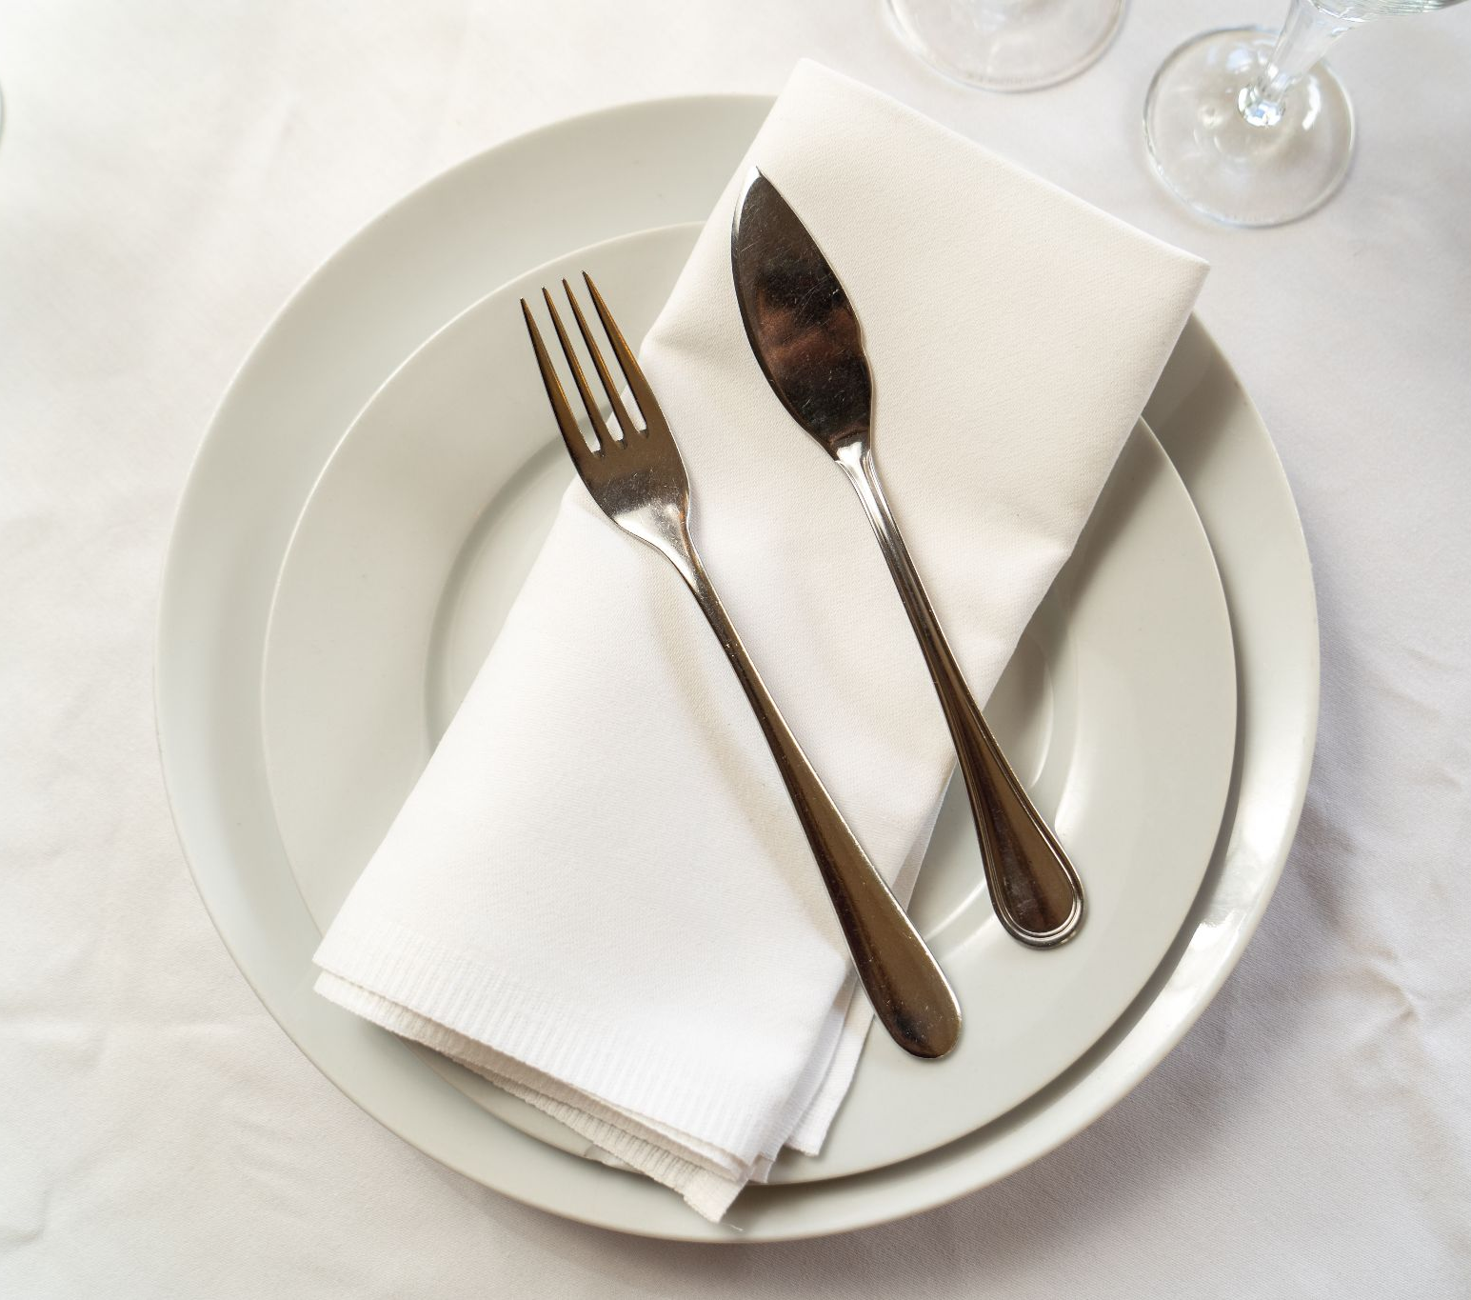
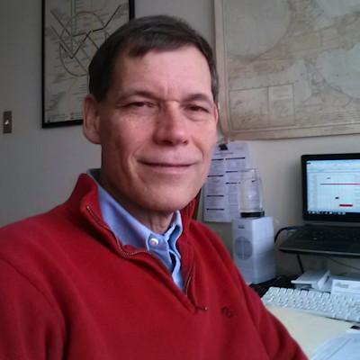
Banquet + Awards (Presidents Hall – Friday)
6:30 pm:
Dinner Buffet
7:00 pm:
Banquet Presentation: Deconstructing the News to Promote Statistical Literacy
John Bailer
7:30 pm:
A-Mu-Sing Winners
7:50 pm:
George Cobb Lifetime Achievement Award in Statistics Education
Notes:
Highlight that there are 3 on Fri/1 on Sat. Make sure to visit the online program to pick out which session you want to attend. But it will be hard to pick just one!

Slide 8
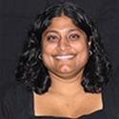
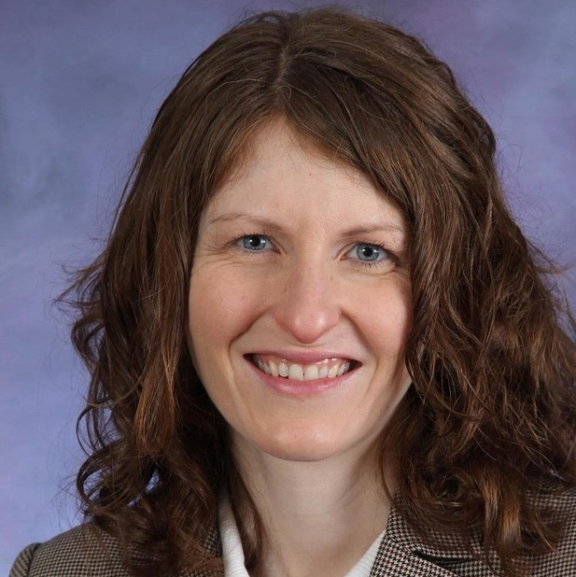
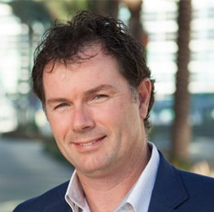
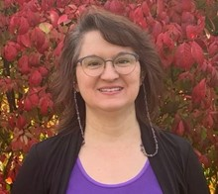
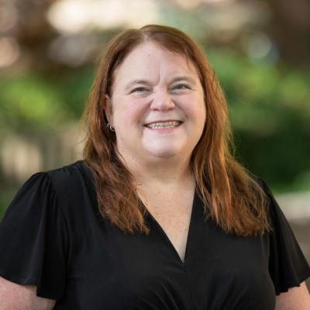
Closing Session (Presidents Hall)
Sat 2:30 pm:
5 minute talks reflecting on the conference and the theme of “Communicating with/about Data”
Notes:
Sure hope you can make it to the closing session.

Slide 9
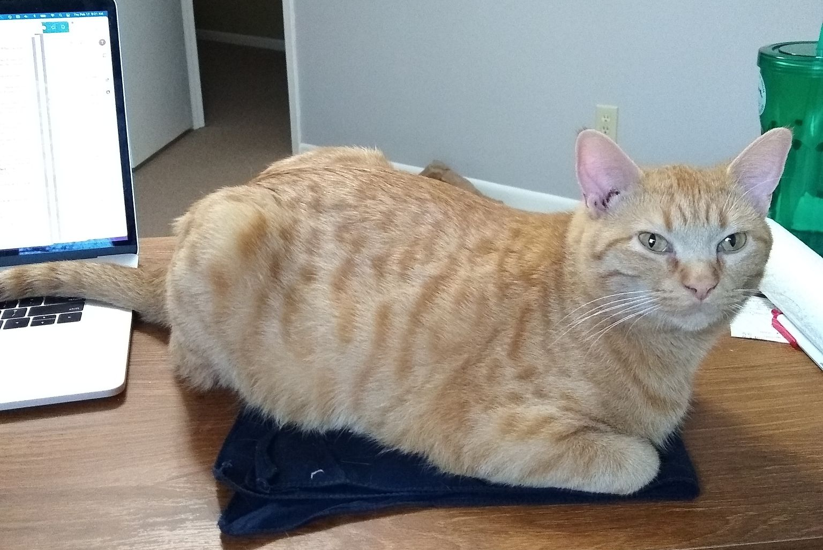
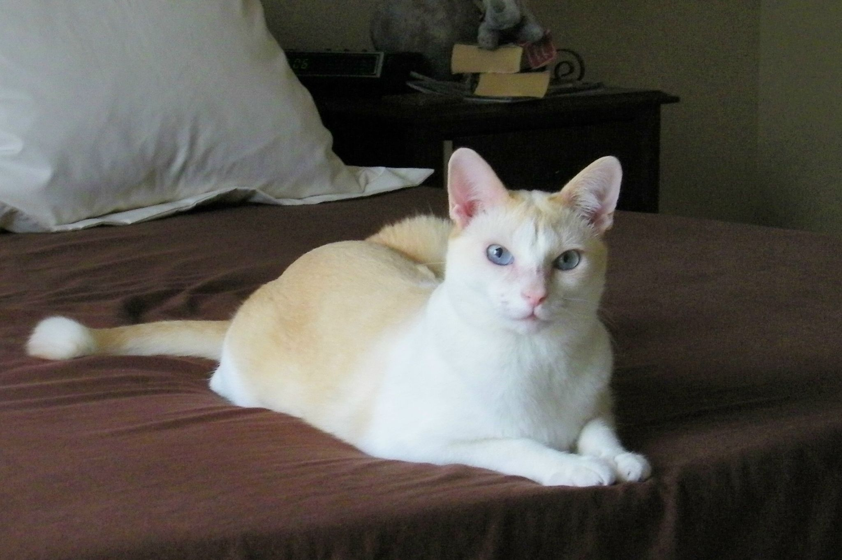
On the count of 3, please say the code word.
1… 2… 3…

Slide 10
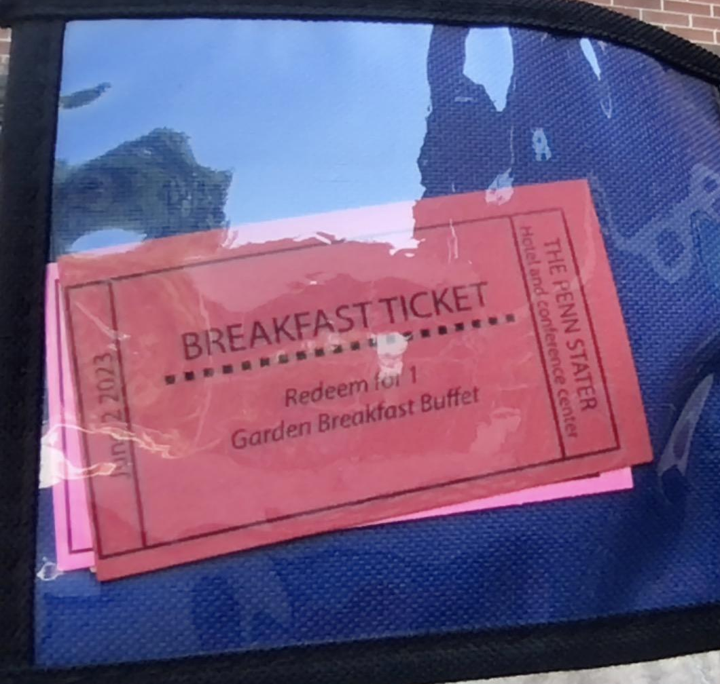
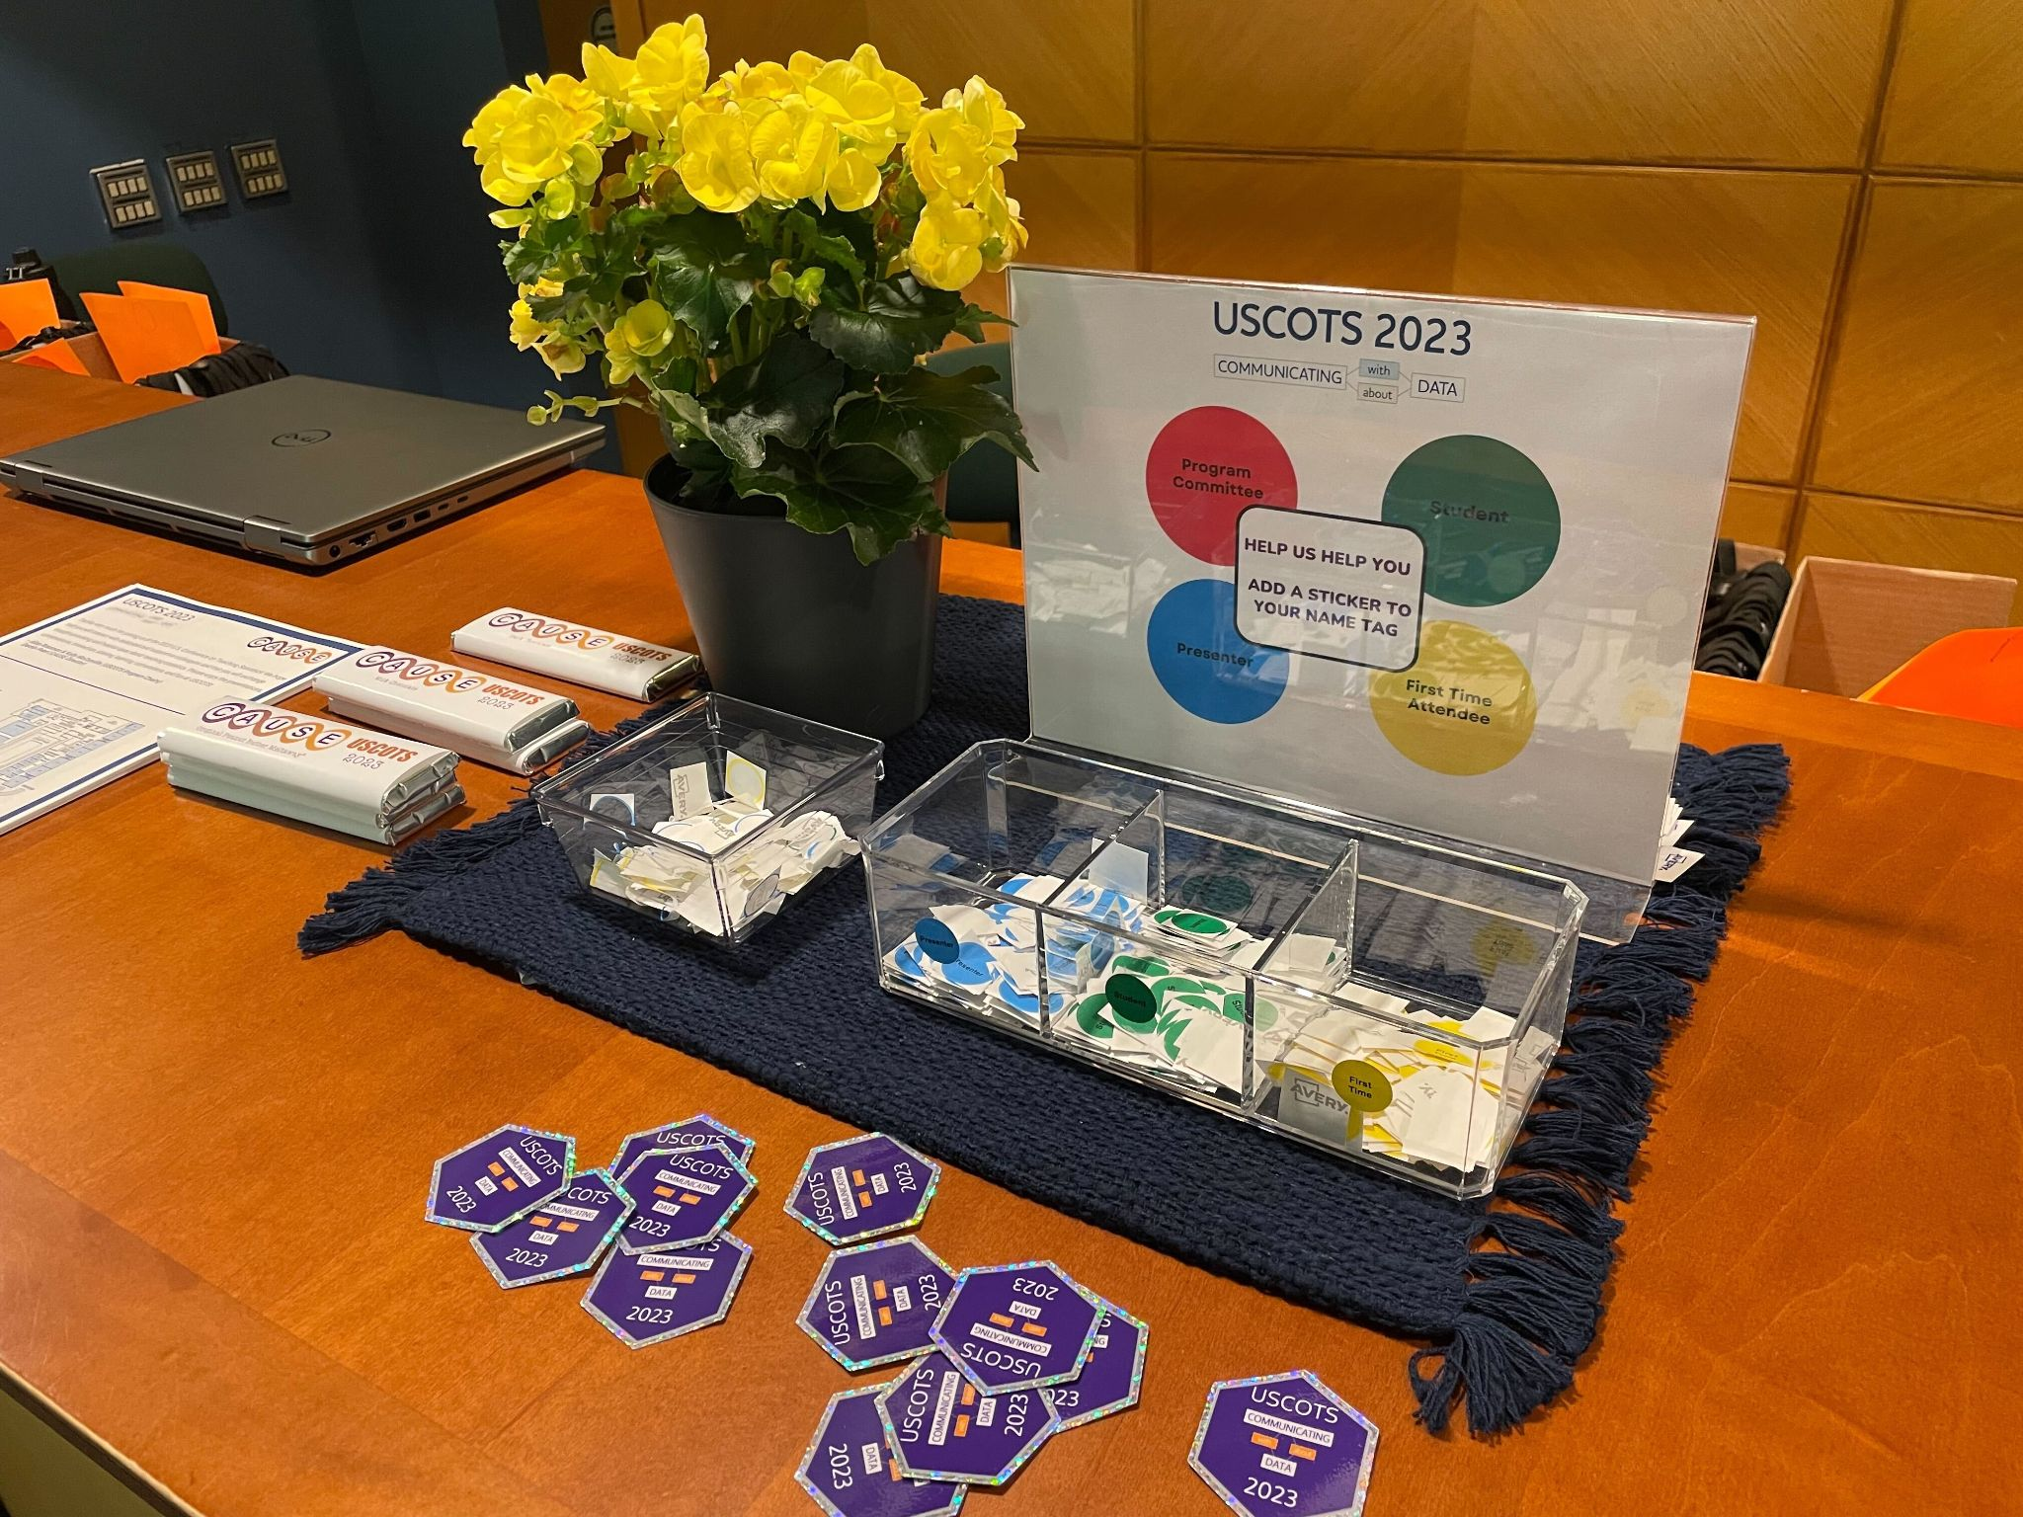
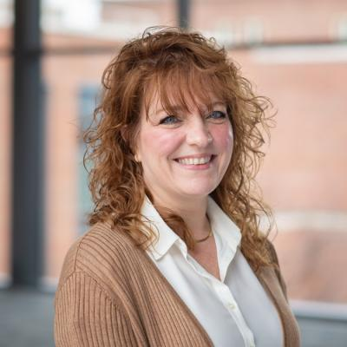
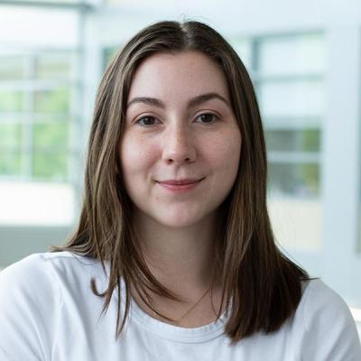
Logistics + Questions?
Breakfast vouchers are in your neck wallet!
Breakfast starts at 7am.
Stop by the registration table for stickers and tote bags.
Please join the discussion on the #uscots23 channel within the CAUSE Slack Workspace.
Other questions??

Slide 11
Have a great conference everyone!

