Slide 1
Data: What’s Communication Got to Do with It?
Lisa W. Kay
Eastern Kentucky University

Slide 2
What You Get Is What You See
Visualization/Visual Aids
Art, inspiration
Gestalt Principles
Using visuals in teaching: diagrams, tables, class generated visuals, formulas, interactive visuals
Quote from audience member: “Start with art”

Slide 3
We Don’t Need Another Hero
Instructional Approaches
Guided peer reviews
Instructor as “facilitator and co-learner”
Make interactive
Generate engagement

Slide 4
Let’s Stay Together
Collaboration
George Cobb (2007): “Statistics, at its best, is a collaborative undertaking.”
Power of collaboration
Assume grace and good intentions
Collaborative keys

Slide 5
(Not) One of the Living
Artificial intelligence
Chat GPT
Need to address, but everything will be okay, right?

Slide 6
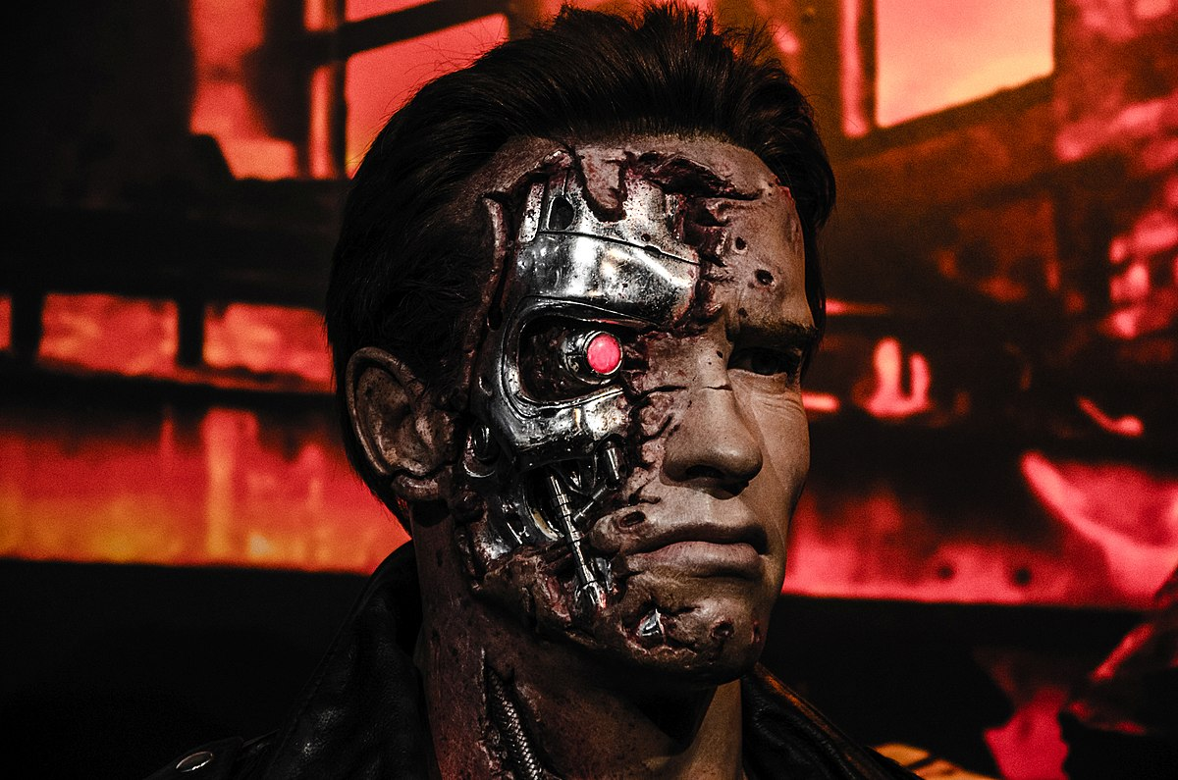
“Eventually, some believe, A.I. could become powerful enough that it could create societal-scale disruptions within a few years if nothing is done to slow it down, though researchers sometimes stop short of explaining how that would happen.”
From https://www.nytimes.com/2023/05/30/technology/ai-threat-warning.html?campaign_id=190&emc=edit_ufn_20230602&instance_id=94096&nl=from-the-times&regi_id=58861203&segment_id=134552&te=1&user_id=a24a6eeca7d8b188f444d87cbb6addb3
Juřena, D. (2017). File:Terminator in Madame Tussaud London (33465711484).jpg. https://commons.wikimedia.org/wiki/File:Terminator_in_Madame_Tussaud_London_%2833465711484%29.jpg . CC-BY-SA-2.0.

Slide 7
Look Me in the Heart
Humanizing Statistics
Embodied quantification
Social justice issues
Tell a story
Use edutainment
Statistics as plot elements

Slide 8
“Hi, everybody! I’m doing okay.”

Slide 9
Overall Impression of USCOTS?
(Simply) The Best

Slide 10
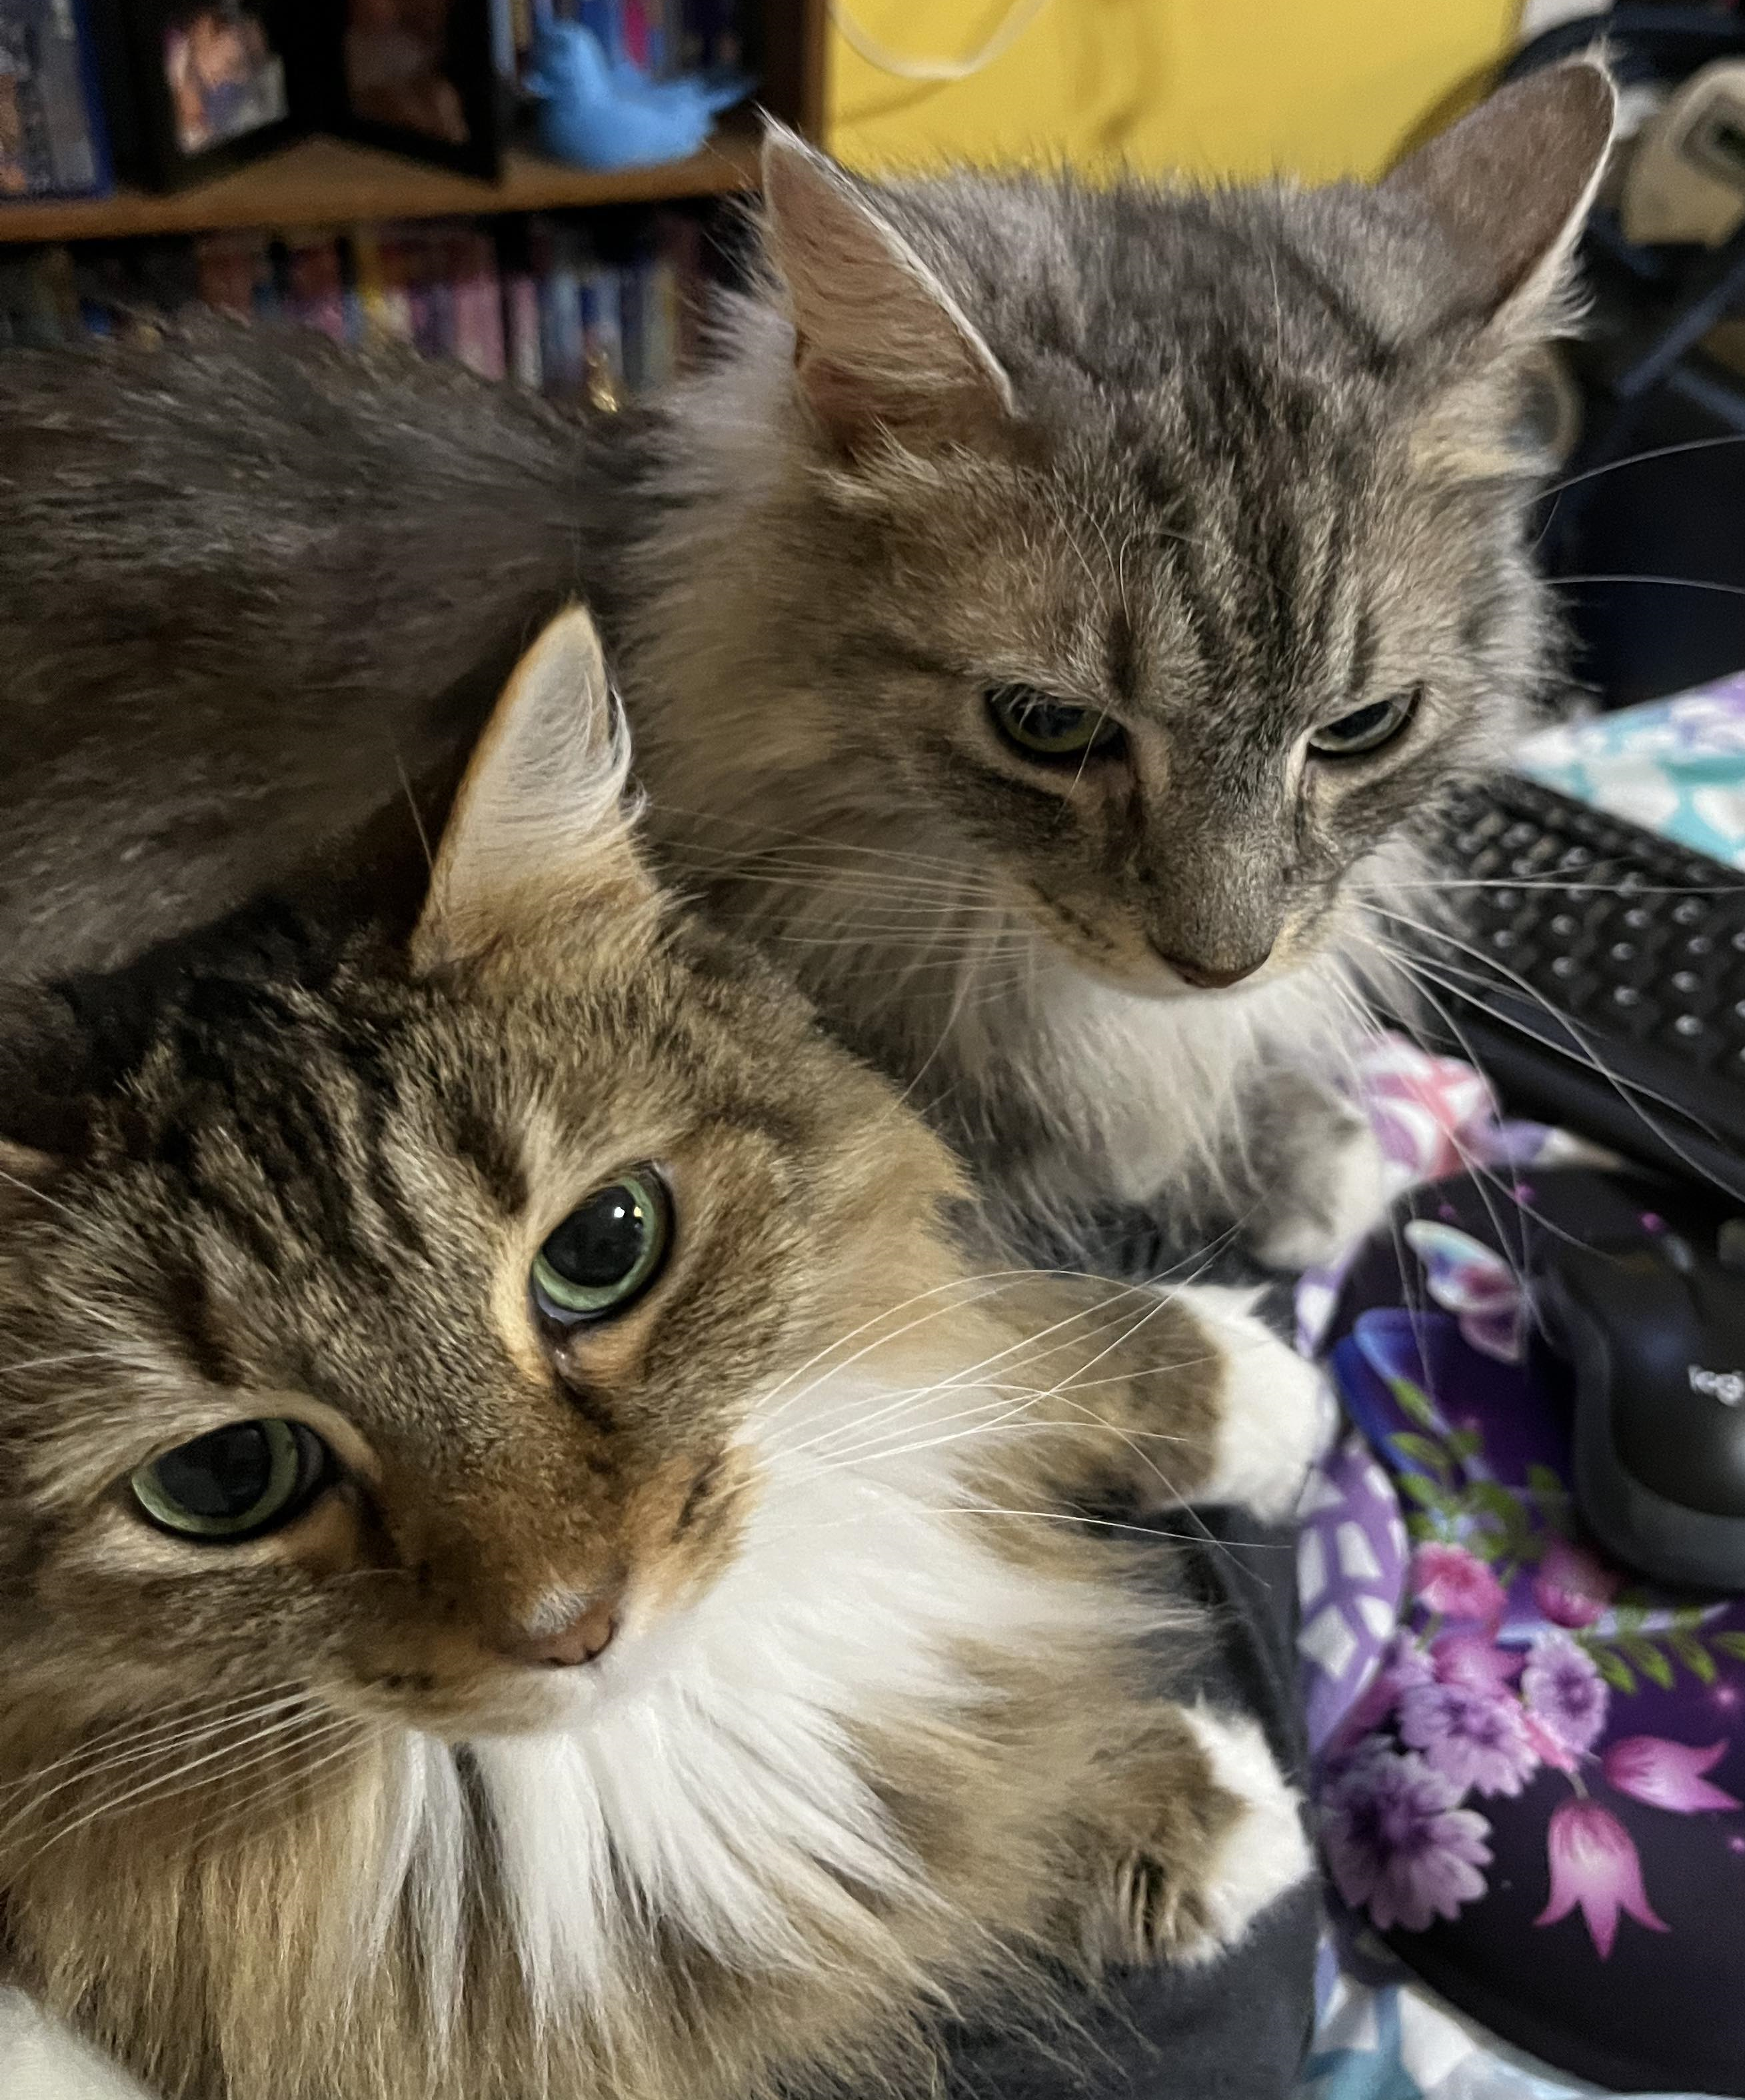
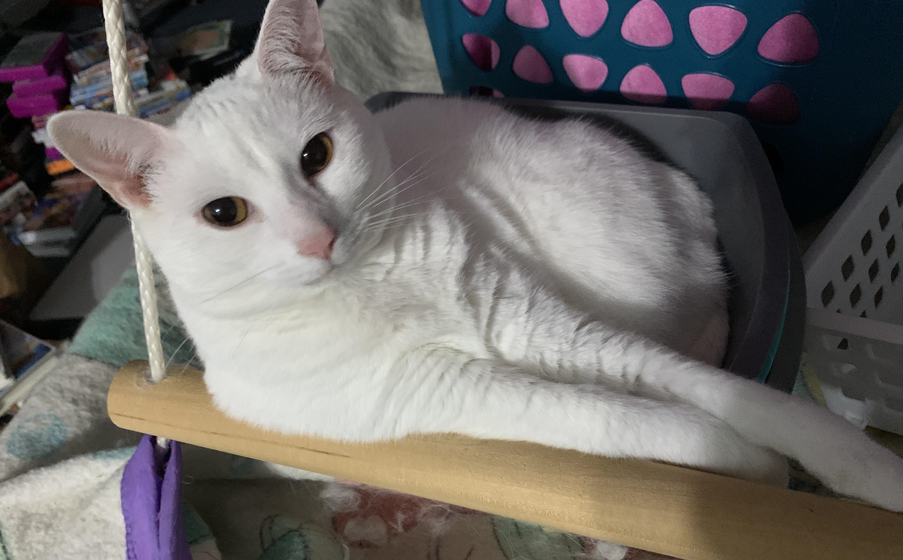
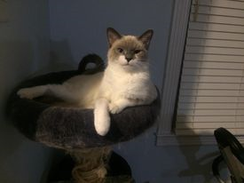
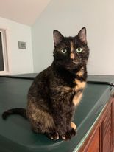
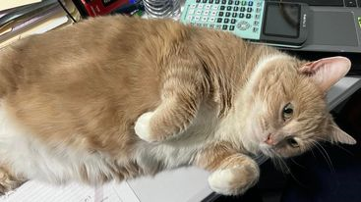
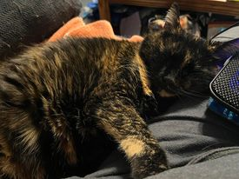
And a gratuitous nod to the conference code word—here are my cats. All 10 of them.

Slide 11
References
Cobb, G. W. (2007). One possible frame for thinking about experiential learning. International Statistical Review / Revue Internationale de Statistique, 75(3), 336–347. http://www.jstor.org/stable/41509874
Juřena, D. (2017). File:Terminator in Madame Tussaud London (33465711484).jpg. https://commons.wikimedia.org/wiki/File:Terminator_in_Madame_Tussaud_London_%2833465711484%29.jpg . CC-BY-SA-2.0.
Roose, K. (2023, May 30). A.I. poses ‘risk of extinction,’ industry leaders warn. The New York Times. https://www.nytimes.com/2023/05/30/technology/ai-threat-warning.html?campaign_id=190&emc=edit_ufn_20230602&instance_id=94096&nl=from-the-times&regi_id=58861203&segment_id=134552&te=1&user_id=a24a6eeca7d8b188f444d87cbb6addb3

