Slide 1
Closing
Session

Slide 2
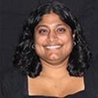
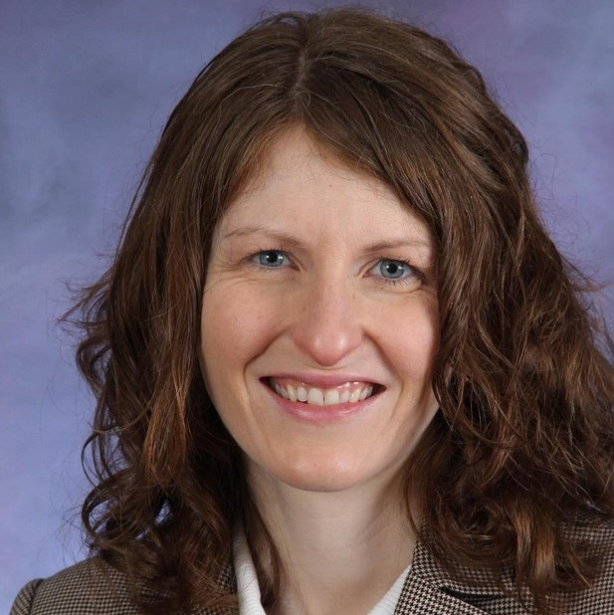
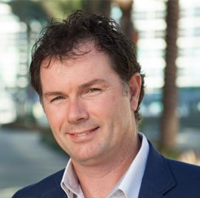
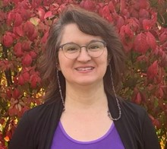
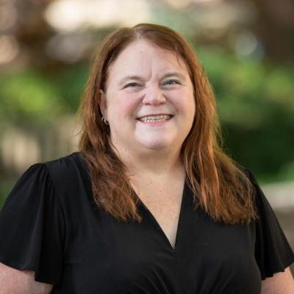
Closing Session 5-Minute Speakers
April Kerby-Helm (Winona State University)
Lisa Kay (Eastern Kentucky University)
Marian Frazier (College of Wooster)
Marjorie Bond (Penn State)
Michael Sullivan (Joliet Junior College)
Notes:
Sure hope you can make it to the closing session.

Slide 3
Closing
the
Closing
Session

Slide 4
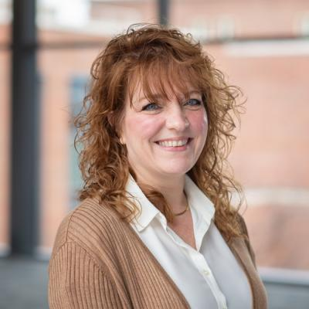
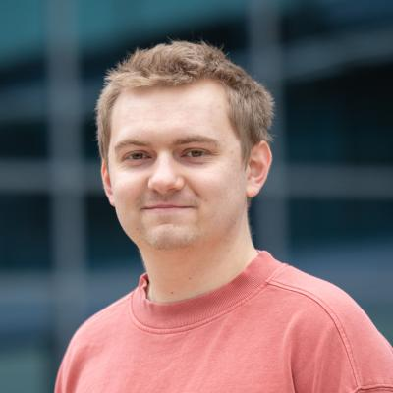
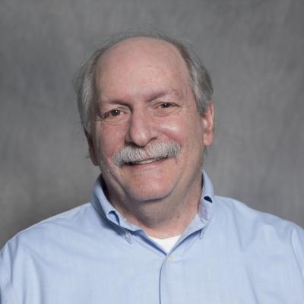
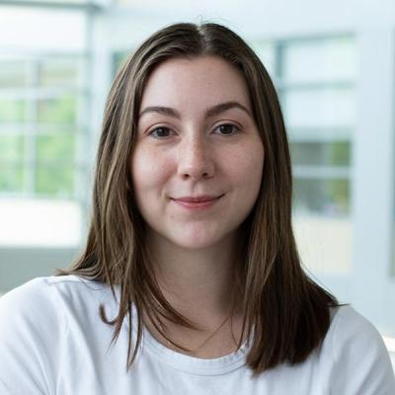
A Big Thanks
Notes:
Sponsors are what helps us keep the cost low for the conference and to offer registration grants.

Slide 5
A Big Thanks
Notes:
Sponsors are what helps us keep the cost low for the conference and to offer registration grants.

Slide 6
More Thanks
Program Committee
Presenters
Participants!
To show our thanks, let’s have one more round of door prizes.
Notes:
Program committee
Presenters
Participants

Slide 7
Feedback + Ways to Get Involved
Feedback form should be in your inbox.
We are especially looking for theme and speaker ideas for 2025!
If you want to get more involved in CAUSE or the ASA, reach out (kmcconville@g.harvard.edu, arossman@calpoly.edu)!
Keep connecting on the CAUSE Slack Workspace.
Safe travels everyone!

