Slide 1
Statistics Education for Students with Visual Impairment
Annabel Li
Applied Statistics and Research Methods
University of Northern Colorado
li0692@bears.unco.edu
Notes:
Hello! My name is Annabel, and I am a doctoral student in Applied Statistics and Research Methods at the University of Northern Colorado. I would like to share my experience working as a research consultant and statistical tutor with a graduate student who is totally blind. I will focus on a major challenge faced by this student while learning statistics, and the solutions that were employed to tackle this challenge.

Slide 2
“And I loved the numbers, but I hated when I had to mess with anything graphical because it simply didn't come naturally….I just didn't click with graphics…[for] stats, I always felt like I was slower than other students because I had to digest it textually instead of just being able to look at the graph and see the answer.”
—Georgia
Notes:
From my experience working with this student who would like to take the pseudonym Georgia, and from summarizing the literature, accessibility to graphical information is one of the major challenges faced by students with visual impairment when learning statistics. Georgia mentioned that graphs are something that did not come naturally to her, and having to read graphs can be an obstacle for her to understanding math and statistical concepts.
This past semester, Georgia took two statistics classes, experimental design and multivariate analysis. Both classes required accessibility to graphs and tables to understand more advanced statistical concepts. Therefore, we scheduled regular, weekly tutoring sessions to better support her in these classes.

Slide 3
Tactile Graphics Kit
Notes:
The best option we have found is the Tactile Graphics Kit produced by the American Printing House for the Blind.
The contents of this kit are shown in this picture. To make tactile graphs with the kit, you will turn a piece of foil to the back, place it on the plastic mat, then use the tools to draw anything you want.

Slide 4
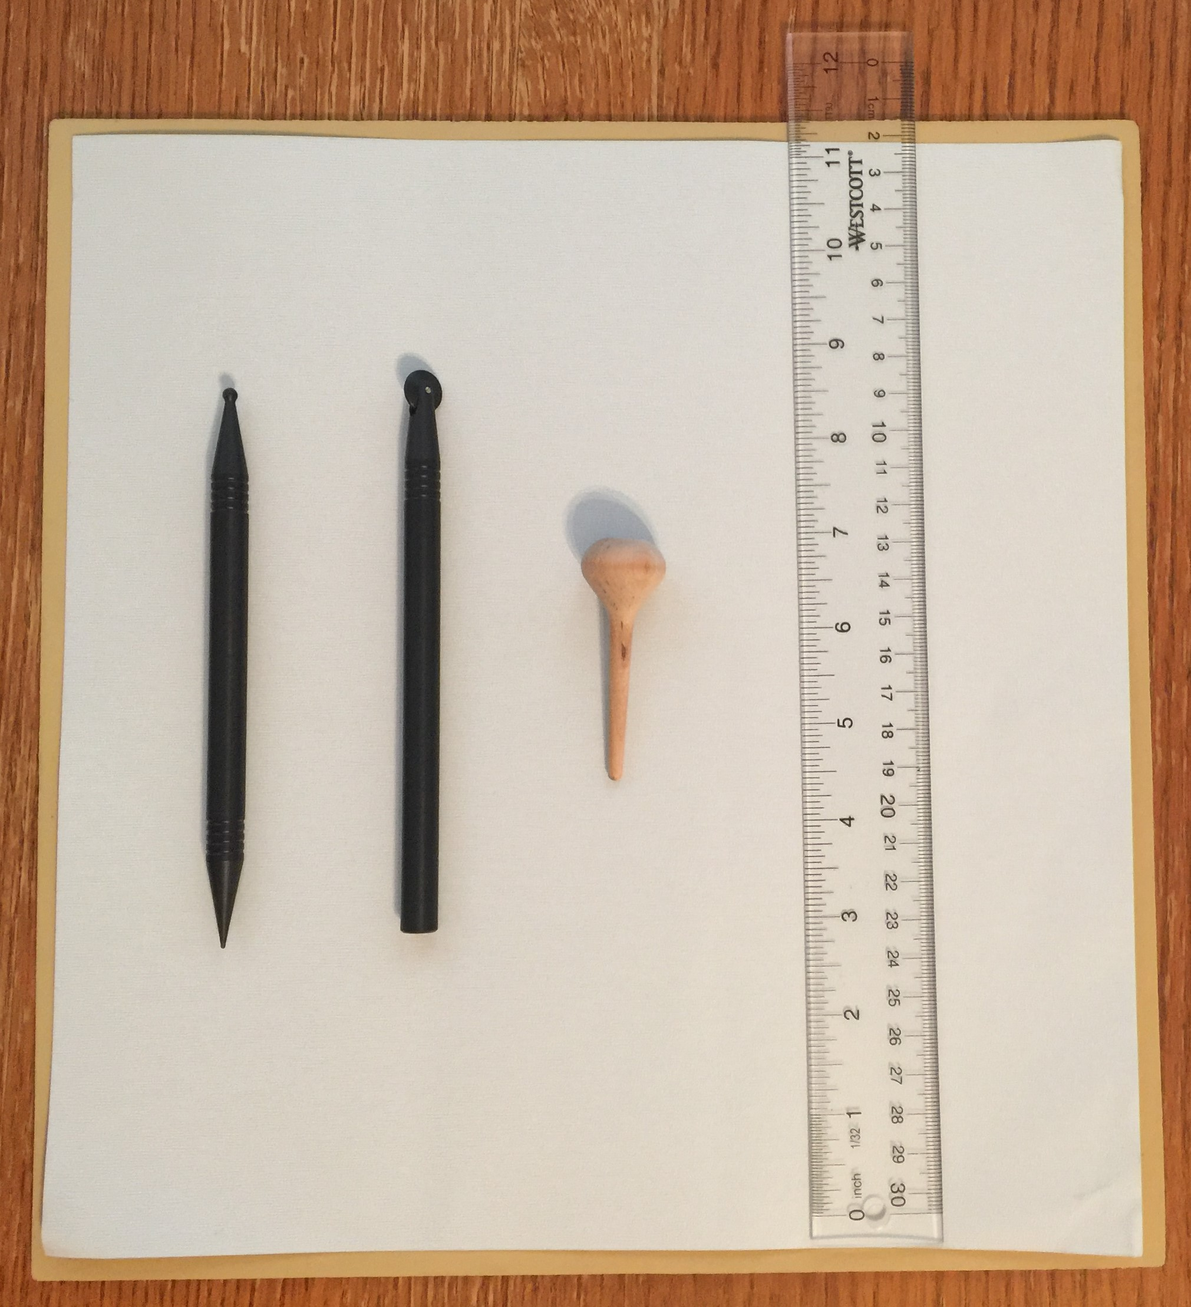
Notes:
Here is a closer look at the tools that I usually use. This tool has a sharp end and a round end. I use the sharp end to write and draw lines or some small marks, and the round end to draw lines and dots. This one has a small wheel at the tip and I sometimes use it to draw straight lines. This wooden thingy is an eraser. There is a flat surface on the bulb part which I use to flatten the lines or marks from the shiny metal side of the foil that I want to erase. Finally, a ruler is always needed for drawing straight lines.

Slide 5
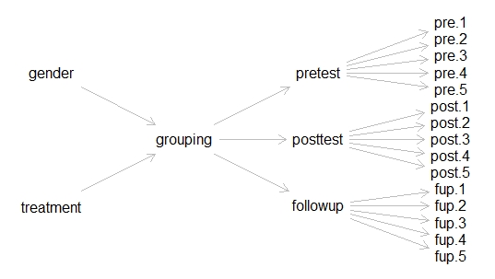
Notes:
Let me show you the steps of making a graph. So for one of Georgia’s assignments of the multivariate analysis class, she was to use R to create a DAG, or a directed acyclic graph. I wrote the R codes for her and ran the codes, which gave me the graph as shown here.

Slide 6
Notes:
I then planned out the graph on a white board, and also put the corresponding coordinates as specified in the R codes to facilitate Georgia’s understanding.

Slide 7
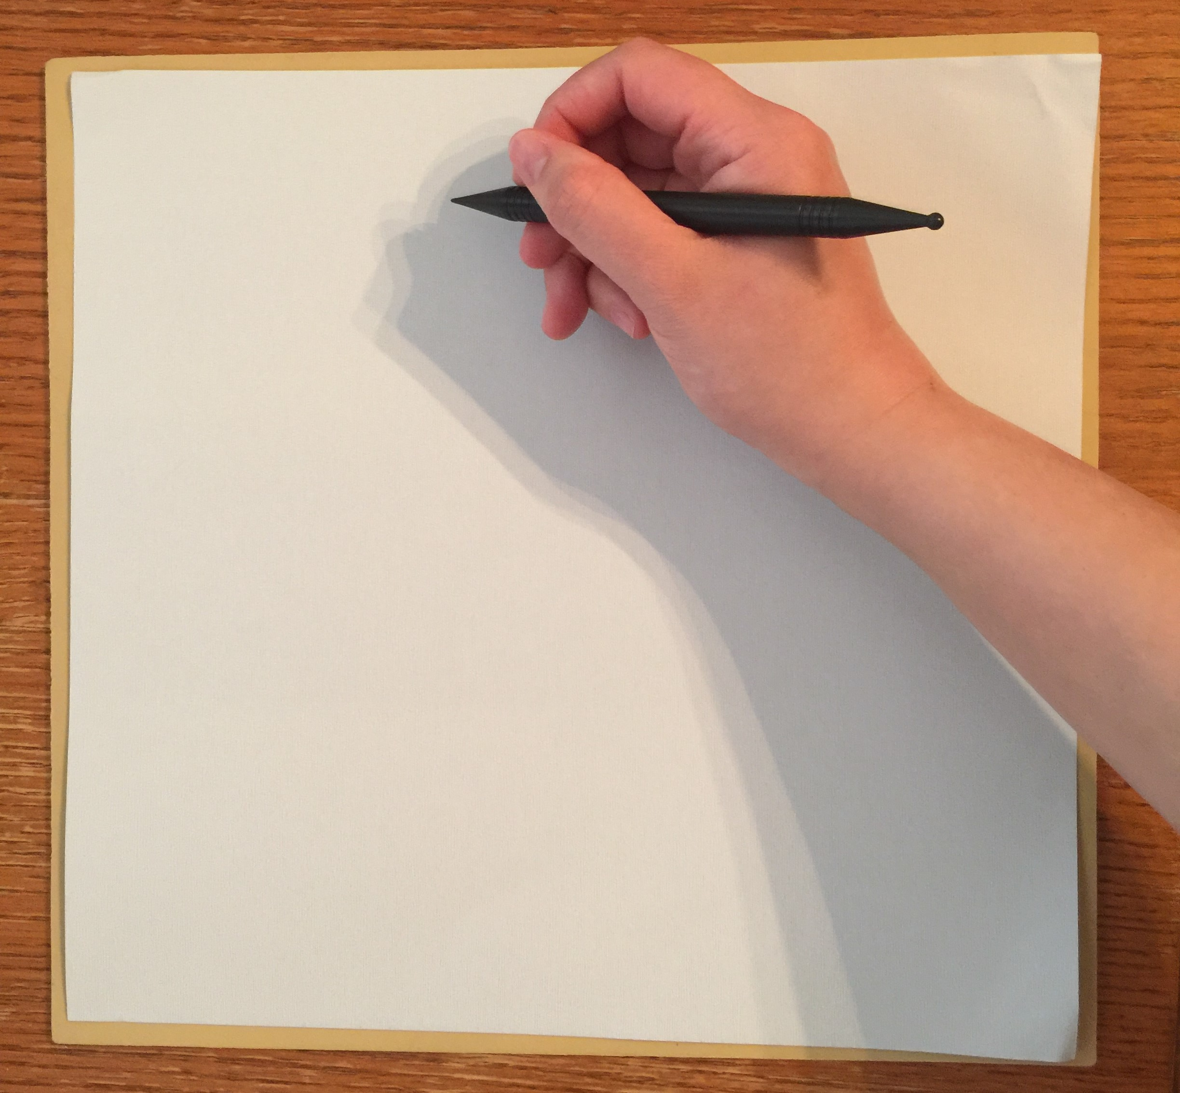
Notes:
So then I was ready to draw the graph. I took a piece of foil, turned it to the back, and started drawing. I began drawing from the far right hand side, starting with the 1-15 y-coordinates. Since everything has to be written or drawn backward, I found a website the translates English alphabets to their mirror images to make my life easier. I had to write the letters bigger, more distinct in shape, and better spaced to result in better tactile stimulation. It was necessary to write each letter twice to make the stimuli pop up more. At the same time, I was careful not to break the foil using the sharp end, because that might create sharp ridges and hurt Georgia’s fingers when she touched on the tactile graph.

Slide 8
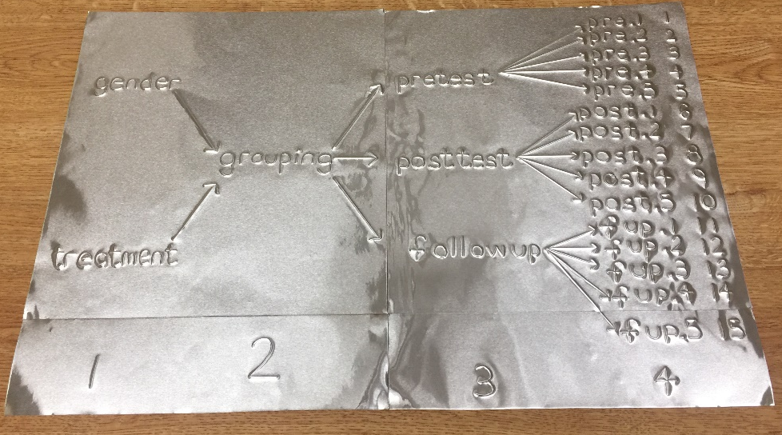
Notes:
And voila! After more than 2 hours of work and 3 pieces of foil, I finished! When I showed the DAG to Georgia, we walked through the x-coordinates (which are the 1, 2, 3, and 4 at the bottom), the variables, the arrows pointing to each of the variables, and the 1-15 y-coordinates at the far right end. I explained which parts of the R codes will give the corresponding part of the graph. Georgia reflected that it was the first time she had seen a graph organized like this.

Slide 9
My thoughts on the Tactile Graphics Kit
It works! For sure.
But…
Highly time consuming
Can be challenging when graphs are complicated
Still a long way to go for independence as a researcher
Time to explore the option of a 3D printer!
Notes:
Having used this kit and drawn many graphs in the past semester, my feelings about it are a bit complex. On the bright side, it is definitely a viable solution to creating tactile graphics in a relatively easy and low-cost way, hence making graphical information accessible for Georgia.
However, making a graph can be highly time consuming depending on how complicated the graph is. For example, the DAG I just showed you took me more than 2 hours. It can also be challenging to draw graphs that are much more complicated. The time and effort required to draw one graph also makes it highly inconvenient for Georgia if she wanted to just experiment with changing a few codes and seeing the outcome in a graph. I think it will be a good time to explore the option of a 3D printer.

Slide 10
Thank you!
Annabel Li
li0692@bears.unco.edu
Notes:
That’s it for all I have. I look forward to any questions or ideas in the live sessions. Thank you!

