Slide 1
2023 A-MU-SING Winners!

Slide 2
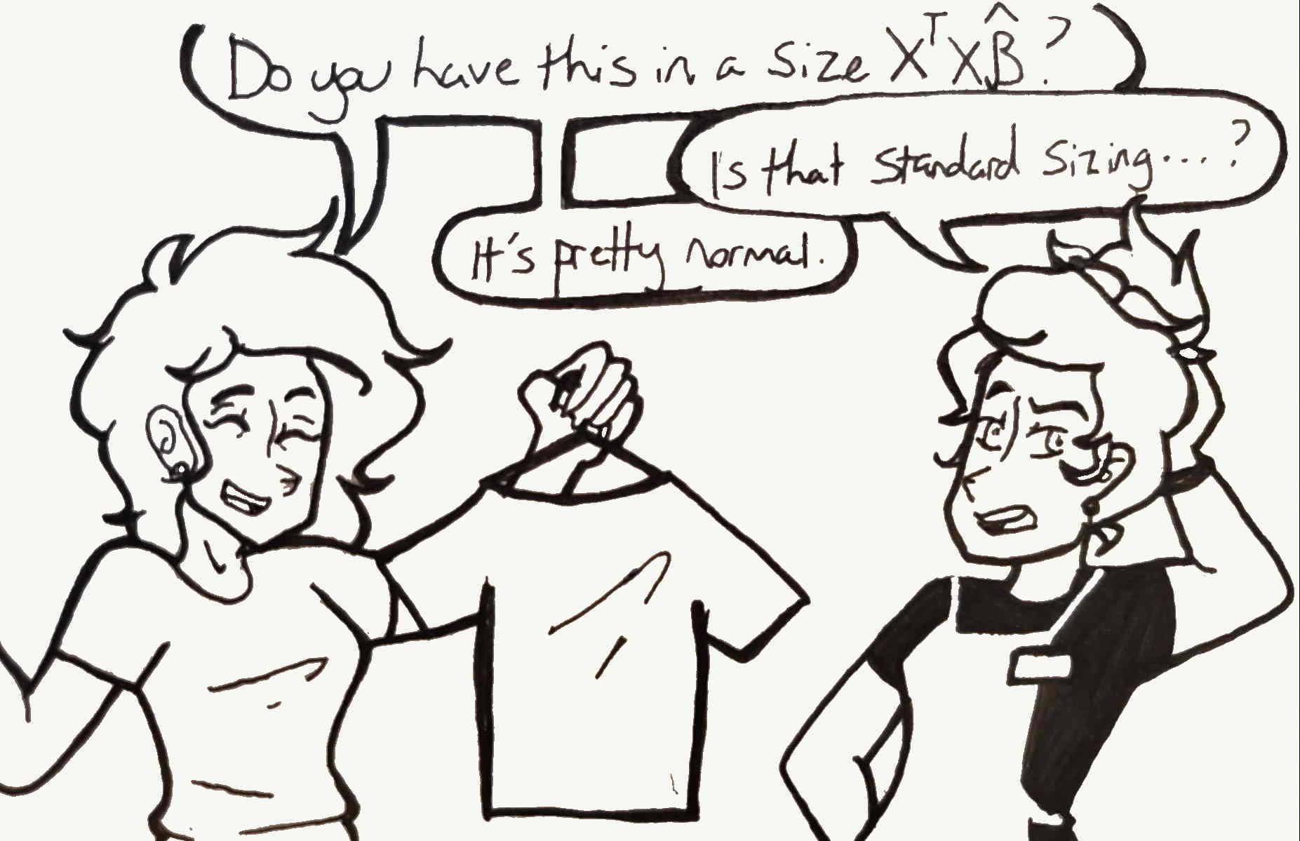
The Unsung Hero (Art, Cartoons, Jokes, & Poems)
First Place Winner: Kylie Lynch (University of Virginia)
Entry: Statistics Teacher's Back-to-School Shopping
Notes:
Sung Heroes

Slide 3
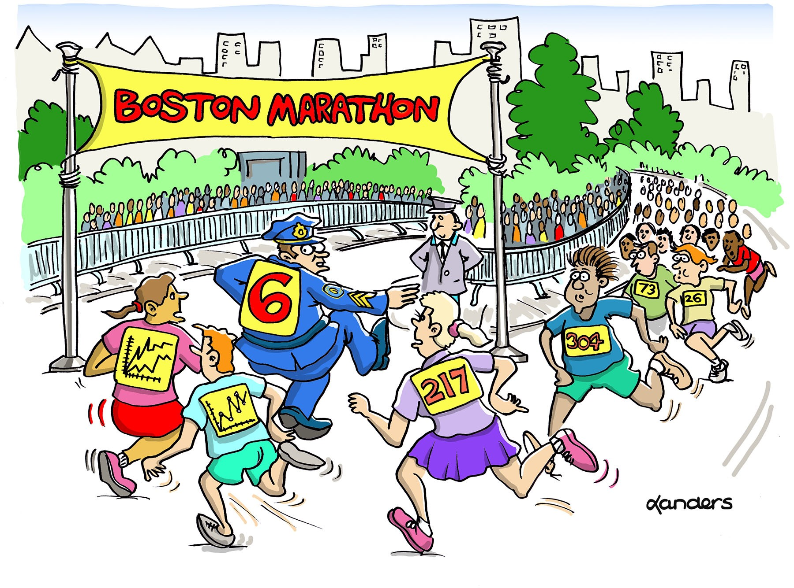
Want to join in the fun?
CAUSE has a monthly cartoon caption contest.
Accepting May submissions through end of USCOTS!
https://www.causeweb.org/cause/caption-contest/2023

Slide 4
The Sung Heroes (Song & Music Video Submissions)
Grand Prize Winner:
Cynthia Rudin (Duke University)
Entry: My k Nearest Neighbors, The Night's Overfitting Game, The Song of the Multi-Armed Bandit
Second Place Winners:
Greg Crowther (Everett Community College) and Leila Zelnick (University of Washington)
Entry: What's the Method You Want?
Jamie Tan Xin Yee, Joelyn Chong, Deston Tang, Christine Sia, Nellie Lee, Josiah Tan, and Lee Yi Yuan (Singapore Management University)
Entry: STATS
Larry Lesser (The University of Texas at El Paso)
Entry: 50 Ways to Leave Your Lover
Notes:
Sung Heroes

Slide 5
MORE DOOR PRIZES!

