Slide 1
FlipIt Statistics Leslie Hendrix & Brian Habing WH Freeman/Macmillan

Slide 2
What is “FlipIt Statistics”?
Content and supporting resources for students and instructors.
Designed for flipped, traditional, or hybrid classes.
FlipIt Statistics is for anyone who wants to fully engage students in the classroom.
Instructor resources that do not exist elsewhere set this product apart from others.
Notes:
Please leave comments and question in chat
Lots of people have different ideas of what a flipped classroom is.
Publish late 2018 --- looking for people to give us good ideas. We want more reviewers, contributors, and people to give us feedback let us know if you are interested.

Slide 3
What’s in “FlipIt Statistics”?
The heart of FlipIt Statistics is an integrated set of videos and questions to either prepare students for lecture, or give them additional reinforcement after.
Each daily module is approximately 20 minutes long and consists of:
6-8 1.5-2 minute videos
A reinforcing question following each video
2-3 Bridge questions to test readiness to participate in the lecture for a flipped class
Homework questions

Slide 4
What’s in “FlipIt Statistics”?
The videos and other materials are designed to be:
Customizable in terms of order and topics covered
Have options to select among several common notations
Textbook agnostic, but with suggested set-up options for many of the most widely used texts

Slide 5
Beyond the Basics
Instructors will get…
Instructor guide for each module, including common questions from students and areas of confusion.
Sets of completely developed in-class activities.
The ability to add their own videos and questions.
An actively curated community page with data sets, activities, and other shared ideas.

Slide 6
In Class Activities
Full suite of in-class active learning guides for
Small class/large lecture
With/without calculator/computer
Full explanation of each active learning activity
Detailed instructions, including
Common questions from students
Video demonstrations where needed

Slide 7
Built with several audiences in mind…
First time instructors including two-year/community colleges with many adjuncts
Service courses at larger institutions that have graduate teaching assistants teaching the sections
Flipped sections that would like additional pre-lecture resources
Traditional sections that would like an alternative or supplement to the text book after lecture

Slide 8
Let’s get Real
Imagine someone with some previous statistics teaching experience…
“Here is your class schedule and LMS login…
…and your book and FlipIt account information.”
“We’ll get you some old copies of the common final too.”
“Let us know if you have any questions!”
… but not with this book or class size…

Slide 9
Flip It Instructor Login:
Login with existing account
Create new account

Slide 10
Flip It Instructor Login:
Login with existing account
Create new account

Slide 11
We noticed you are new.
Guided tour.
Explore on my own.

Slide 12
We noticed you are new.
Guided tour.
Explore on my own.

Slide 13
Choose your text.

Slide 14
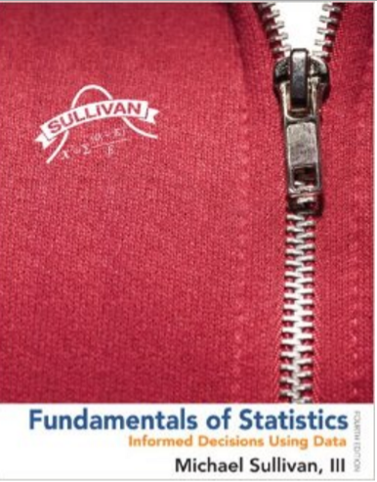

Slide 19
Triola 12th Edition Topics List
Introduction to Statistics and Frequency Distributions
Statistical Graphics
Measures of Center and Variation
Fundamentals of Probability and Addition Rule
…

Slide 20
…
15) Basics of Hypothesis Testing
16) Testing a Claim about a Proportion
17) Testing a Claim about a Mean
18) Testing a Claim about a Standard Deviation or Variance
…

Slide 21
…
15) Basics of Hypothesis Testing
16) Testing a Claim about a Proportion
17) Testing a Claim about a Mean
18) Testing a Claim about a Standard Deviation or Variance
…

Slide 22
Topic 15 – Basics of Hypothesis Testing
In this topic you can choose to
Use Proportions as the first Example
Use Means as the first Example

Slide 23
Topic 15 – Basics of Hypothesis Testing
In this topic you can choose to
Use Proportions as the first Example
Use Means as the first Example

Slide 24
Topic 15 – Basics of Hypothesis Testing
In this section you can choose to:
Cover Critical Values First
Cover p-values First

Slide 25
Topic 15 – Basics of Hypothesis Testing
In this section you can choose to:
Cover Critical Values First
Cover p-values First

Slide 26
Topic 15 – Basics of Hypothesis Testing
What would you like to see?
Lecture Videos
Embedded Questions
Bridge Questions
Problems
Instructor Guide and FAQ
In-Class Activities
Technology Supplement

Slide 27
Topic 15 – Basics of Hypothesis Testing Videos
Introduction
Null and Alternate Hypotheses
Test Statistic
Critical Value & Alpha
P-value & Alpha
Making the Conclusion
Errors and Power
Summary

Slide 28
Topic 15 – Basics of Hypothesis Testing
What would you like to see?
Lecture Videos
Embedded Questions
Bridge Questions
Problems
Instructor Guide and FAQ
In-Class Activities
Technology Supplement

Slide 29
Topic 15 – Basics of Hypothesis Testing
What would you like to see?
Lecture Videos
Embedded Questions
Bridge Questions
Problems
Instructor Guide and FAQ
In-Class Activities
Technology Supplement

Slide 30
Topic 15 – Basics of Hypothesis Testing Embedded Questions
Select to review…
Multiple Choice Questions
Fill in the Blank Questions
Free Response Questions

Slide 32
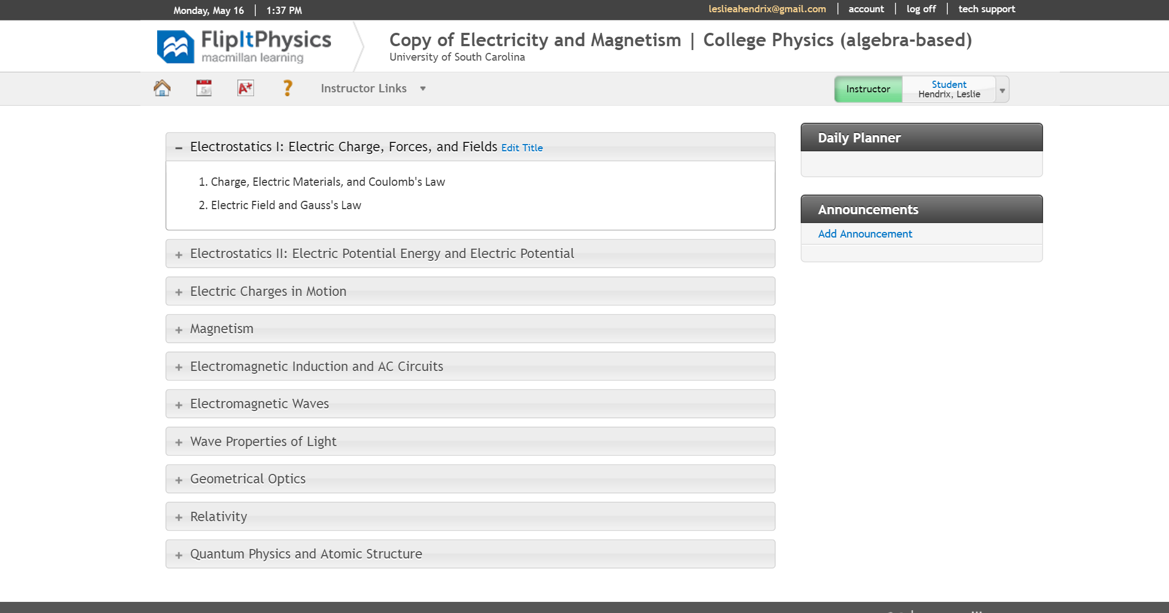

Slide 33
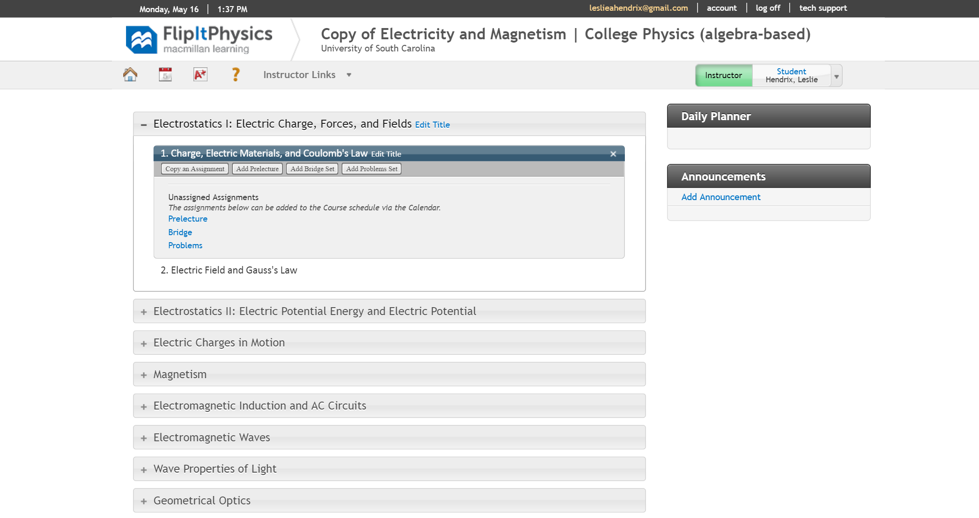

Slide 35
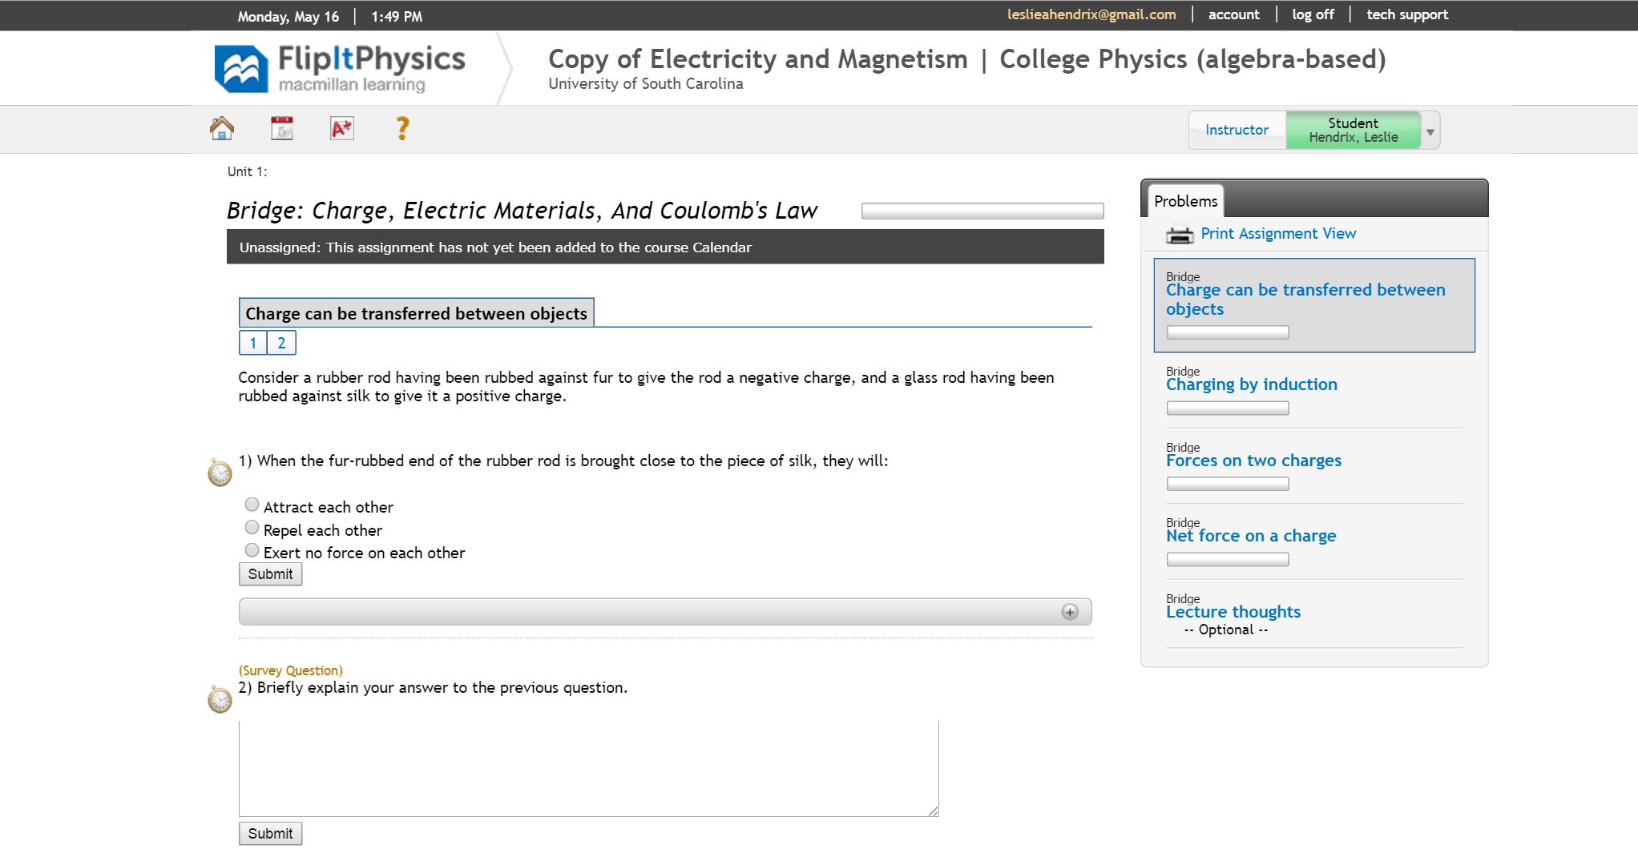

Slide 36
We would love your feedback….
Please click here to help us by answering the following questions (among others). It should take less than 7 minutes.
How would you use FlipIt Statistics or why wouldn’t you?
What instructor resources would you like to see included with FlipIt?
What student resources should we include?
What can we add to make students feel like they are getting value?
What suggestions do you have regarding including homework questions with FlipIt statistics?
What other ideas do you have for FlipIt Statistics?

