Slide 1
Gender Differences in Statistical Anxiety
Dennis Pearl & Hyen Oh (Penn State University),
Larry Lesser (University of Texas, El Paso) &
John Weber (Perimeter College at Georgia State University)

Slide 2
Context
970 students in concepts course at Ohio State Spring 2014
935 gave consent and took final exam
67% female; 33% male
77% White (not Hispanic), 8% Black, 4% Asian, 4% Hispanic, 2% Other & 5% Not Disclosed.
86% in majors with no calculus requirement
Course grades based on homework, lab reports, participation in problem solving sessions or online reviews, activities in lecture, quiz, two midterms & final
Pre- and Post-course (before final) measurements using
Statistical Thinking And Reasoning Test (START)
Student Attitudes Toward Statistics (SATS)
Statistics Anxiety Measure (SAM)

Slide 3
Statistics Anxiety Subscales
Anxiety about the practice of statistics
Negative attitudes toward the statistics Class
Fearful Behaviors related to statistics
Negative attitudes toward Math
Anxiety about expected Performance in class
Student Attitudes Subscales
Affect – feelings concerning statistics
Cognitive Competence – ability to learn statistics
Value – usefulness , relevance, and worth of statistics
Difficulty – attitudes about difficulty of statistics
Interest – student’s interest in statistics
Effort – amount of work student expends to learn statistics

Slide 4
Attitudes & Anxiety by Gender
Subscale | Females | Males | Gender Difference CIs: Pre & Post
SATS - Affect | 3.9 pre, 4.1 post | 4.4 pre, 4.4 post | (-.6,-.3) & (-.5,-.1)
SATS - Cognitive | 4.6 pre, 4.9 post | 4.9 pre, 5.0 post | (-.4,-.1) & (-.3,.1)
SATS - Value | 4.8 pre, 4.5 post | 4.9 pre, 4.7 post | (-.1,.0) & (-.4,.0)
SATS - Difficulty | 3.7 pre, 4.0 post | 3.8 pre, 4.1 post | (-.1,.0) & (-.3,.0)
SATS - Interest | 4.2 pre, 3.5 post | 4.6 pre, 4.0 post | (-.6,-.3) & (-.7,-.2)
SATS - Effort | 6.5 pre, 5.8 post | 6.2 pre, 5.4 post | (.2,.4) & (.2,.6)
SAM - Anxiety | 7.5 pre, 6.8 post | 6.8 pre, 6.9 post | (.4,1.1) & (-.6,.4)
SAM - Class | 6.6 pre, 6.5 post | 6.1 pre, 6.2 post | (.3,.9) & (-.0,.8)
SAM - Fearful | 12.7 pre, 13.4 post | 12.0 pre, 12.5 post | (.3,1.0) & (.4,1.4)
SAM - Math | 14.2 pre, 13.4 post | 13.5 pre, 13.1 post | (-.0,1.4) & (-.6,1.2)
SAM - Performance | 9.5 pre, 9.5 post | 8.9 pre, 9.1 post | (.3,.9) & (-.1,.9)
SAM - Total | 50.5 pre, 49.8 post | 47.1 pre, 47.9 post | (1.8,4.8) & (-.3,3.9)

Slide 5
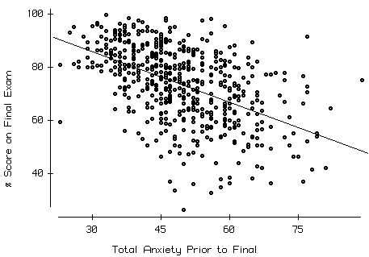
Importance of Anxiety as a Predictor of Course Performance
% Score on Final Exam
r ≈- 0.5
Total Anxiety Prior to Final

Slide 6
Overall Gender Differences in Student Effort
Rate of full participation in activities not graded for content:
Females: 67%
Males: 56%
95% CI for Difference (4.7% to 17.9%)
All Non-exam assessments (% score):
Females: mean = 90.9, median = 95.2
Males: mean = 83.8, median = 90
95% CI for Difference in means (5.0 to 9.2)

Slide 7
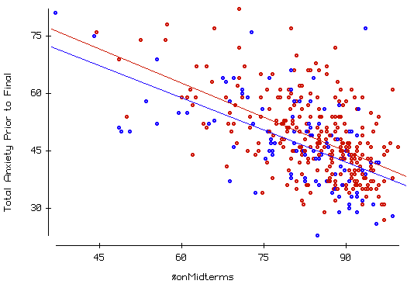
Fixing Effort & Performance, Women report more Anxiety
Total Anxiety Prior to Final
• = F
• = M
% Score on Midterms
r ≈ -0.57
Full participators only

Slide 8
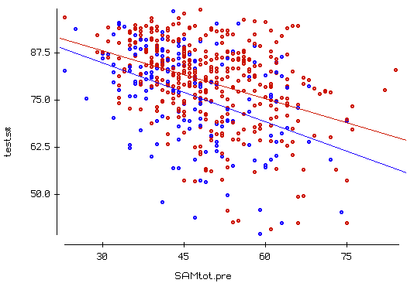
Fixing Effort & Anxiety, Women Perform Better
% Score on Exams
• = F
• = M
Total Anxiety Before Course
r ≈ -0.37
Full participators only

Slide 9
But Little Difference in Thinking & Reasoning
 | Females | Males | Gender Difference CI
START Pre | Avg = 3.4, SD = 1.7 n = 387 | Avg = 3.7, SD = 1.8 n = 161 | (-0.66, -0.03)
START Post | Avg = 4.8, SD = 2.3 n = 339 | Avg = 4.9, SD = 2.3 n = 134 | (-0.62, 0.32)
START Increase | Avg = 1.3, SD = 2.7 n = 314 | Avg = 1.2, SD = 2.7 n = 125 | (-0.46, 0.66)
*Full participators only

Slide 10
Some Issues & Limitations
SAM is a self-report instrument, so it is unclear if it might be biased with respect to gender comparisons. Perhaps, on average, women over-report anxieties and/or men under-report them.
We did not have a large enough sample to investigate possible differences in these findings by race & ethnicity.
SATS attitude subscales are generally more stable than the SAM subscales but are associated (especially Affect & Cognitive Competence).
Course exams were tied to both literacy as well as thinking and reasoning based learning objectives. A future study could examine how anxiety and possible interventions to decrease anxiety might be modulated by learning objective type and gender.

