Slide 1
Visualization and Data Science with Big Data in a Multivariate Data Analysis Elective
Amy Wagaman
Department of Mathematics and Statistics Amherst College

Slide 2
The W’s of Visualization and Data Science with Big Data
Who: Our students and their instructors (us)
What: Ability to think about, visualize, and work with Big Data including computational and data management skills
Why: Jobs require analyzing data to make decisions; Relevant for understanding results that impact their own life decisions
When/Where: Somewhere in our curriculum… Focus here is for a level beyond an intro course
How…do we tie these skills in to what we teach?

Slide 3
A Potential Home in Elective Courses
JSM 2013 session on “The 'Third' Course in Applied Statistics for Undergraduates”
Common theme was multivariate data analysis
Many schools have similar courses or other electives with heavy focus on data analysis
Needs to have some expectation of coding or computational skill development
Course projects help!

Slide 4
Stat 330: Multivariate Data Analysis at Amherst College
Taught F’09, F’12, and again in F’14
10-20 students
Module-based covering selected topics
Requires weekly/bi-weekly data analysis assignments and course project (including presentation); may use multiple projects
Uses R as software – RStudio/RMarkdown
Demonstrate current uses of methods to students via recent literature with examples

Slide 5
Infusing Visualization into a Course
Spend time showing students the importance of visualization – students should want to make many different pictures of their data before doing anything else
Communicate information with plots using colors, symbols, possibly in 3-D, maps
Incorporate a project solely designed for students to experiment with visualization
Many possible tools:
simple ideas: Chernoff faces and star plots
Ggobi (can link to R) or tourr package and associated GUI for projection-based tours through data
ggplot2 has many plotting options – easy to make maps

Slide 6
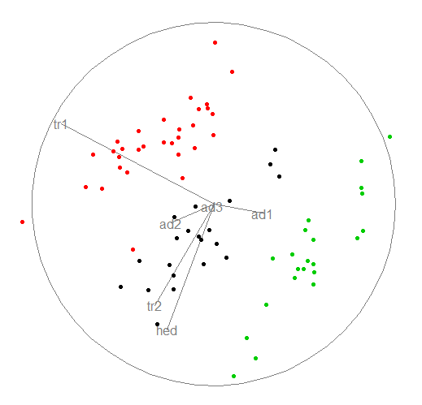
Visualization Example
Tourr package in R; example on flea beetle data set
Colors are different species; six measurement variables are scaled; length of axes shows projection coordinates
Simple command:
animate_xy(flea[,-7],col=flea[,7])
Ended tour on this frame

Slide 7
Infusing Big Data into a Course
Introduce students to alternative data formats such as streaming data or data in large databases
Discuss computational issues and issues computing ‘online’ rather than ‘offline’
Discuss issues with multiple testing including possible solutions such as false discovery rates
Discuss possibilities of sparse solutions to deal with some associated problems

Slide 8
Infusing Data Science Skills into a Course
Definition of a data scientist:
“a data scientist is someone who can obtain, scrub, explore, model and interpret data, blending hacking, statistics and machine learning.” (Daniel Tunkelang, LinkedIn; Forbes 2011 article)
Our students need to develop and practice:
Computing skills
Communication skills
Asking questions
And have opportunities to be inquisitive and creative along the way

Slide 9
Emphasis on Projects with Real Data
The sky (or rather, computational resources) is the limit!
Group projects offer a real benefit to students to learn from one another and produce something no individual one of them could have
Incorporate open-ended questions (or let them brainstorm their own questions)
Incorporate presentations (can be done at many stages of the project – proposals, handouts, final presentations, writing abstracts and reports)

Slide 10
Resources for Instructors
Ask colleagues for neat examples and suggestions for data sets
Plenty of data repositories online (may not be “BIG” data)
Model eliciting activities (MEAs) – practice group work, looking at data, and communication skills
References
Swayne, Deborah F., et al. "GGobi: evolving from XGobi into an extensible framework for interactive data visualization." Computational Statistics & Data Analysis 43.4 (2003): 423-444.
Wickham, Hadley, et al. "tourr: An R package for exploring multivariate data with projections." Journal of Statistical Software 40.2 (2011): 1-18.
Woods, Dan. “LinkedIn's Daniel Tunkelang On ‘What Is a Data Scientist?’” Forbes, October 24, 2011.

