Slide 1
Using an Online Course to Support Teaching of Introductory Statistics:
Experiences and Assessments
eCOTS 2012
Oded Meyer
Candace Thille
Marsha Lovett
Carnegie Mellon University

Slide 2
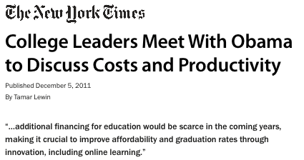
Notes:
One of the messages that came out of a meeting between college leaders and OBAMA is:

Slide 3
The Effort: Carnegie Mellon’s Open Learning Initiative (OLI)
Scientifically-based online courses and course materials that enact instruction, support instructors, and designed to improve the quality of higher education.
Notes:
CREATING…
Should mention:
Not collections of materials to support teaching
MUCH HARDER CHALLENGE
Courses that will be Complete enactment of instruction.
Designed to support learners who do not have the benefit of an instructors.
In practice: Used more in the Hybrid (Blended) mode – combined with face to face.
Because they were designed as stand alone courses they work so well in the blended mode.

Slide 4
The OLI Statistics Course
Notes:
Promoting coherence means teaching students how the discrete skills they are learning fit together in a meaningful big picture. Although the conceptual structure of knowledge in a domain is clear to experts, it is not to novices. The array of new ideas and unfamiliar terminology in introductory courses tends to overwhelm students into memorizing a set of isolated facts without understanding the underlying common principles (Chi, 2005; diSessa, 1993).
Studies have shown that students learn new material better when it is presented in a structured manner that provides the conceptual framework or “big picture”. For students to benefit from a conceptual framework that organizes the material they are learning, instruction needs to make that framework salient, and students need to practice making connections between related ideas (Eylon & Reif, 1984).
<Demo Stat Course> mean/median/boxplot section.
Main points in Demo:
Big Picture and structure of course
Effective Use of Media Elements: Course follows well researched principles to minimize cognitive load imposed by the learning design.
Immediate and Targeted Feedback:
Studies: immediate feedback → students achieve desired level of performance faster. Throughout the course immediate and tailored feedback is given.
mini tutors embedded in the material.
self assessments activities (Did I get this?)

Slide 5
Educational Mission of Funder
(The William and Flora Hewlett Foundation)
Provide open access to high quality post-secondary education and educational materials to those who otherwise would be excluded due to:
Geographical constraints
Financial difficulties
Social barriers
To meet this goal:
A complete stand-alone web-based introductory statistics course.
openly and freely available to individual learners online.

Slide 6
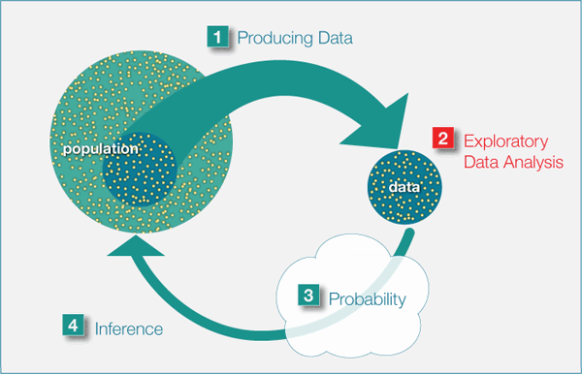
Key Feature of the OLI Statistics Course
High level of scaffolding in the course structure:
The course is based on the “Big Picture” of Statistics
Rigid structure throughout the material hierarchy
Smooth conceptual path
Notes:
A few examples of how we applied learning science principles.
Goal: Show our students how the discrete skills fir together in a meaningful big picture.
Especially important in intro classes where they are introduced to new ideas and terminology.
Studies have shown that if you do not make this big picture salient, the students
Understanding will be more about memorizing isolated facts without understanding the underlying common
Priciples.

Slide 7
Results…
Students using the OLI statistics course demonstrated learning outcomes equal to or better than the traditional class, in half the time.
Six months later, the students who used the OLI statistics course had retained the material just as well as the traditional class.
Imagine the following hypothetical
scenario…

Slide 8
Key Features of the OLI Statistics course
Immediate and Targeted Feedback
Studies: immediate feedback → students achieve desired level of performance faster.
Throughout the course immediate and tailored feedback is given.
mini tutors embedded in the material.
self assessments activities (Did I get this?)
Notes:
After this slide - demonstration

Slide 9
Key Features of the OLI Statistics course
Feedback to the instructor about students’ learning → Learning Dashboard
Presents the instructor with a measure of student learning for each learning objective.
More detailed information:
Class’s learning of sub-objectives
Learning of individual students
Common misconceptions
Notes:
After this slide - demonstration

Slide 10
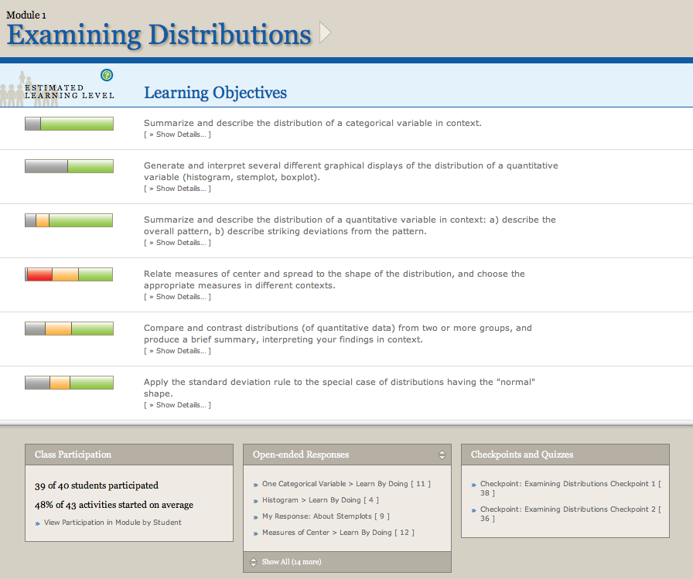
Learning Dashboard Team led by Dr. Marsha Lovett

Slide 12
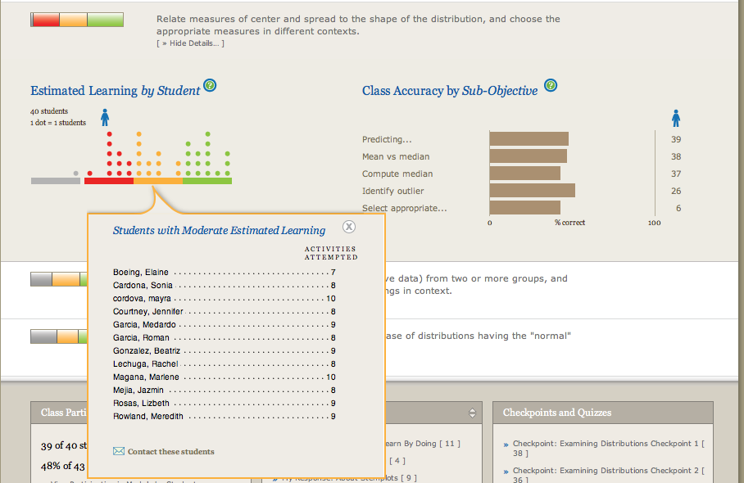

Slide 14
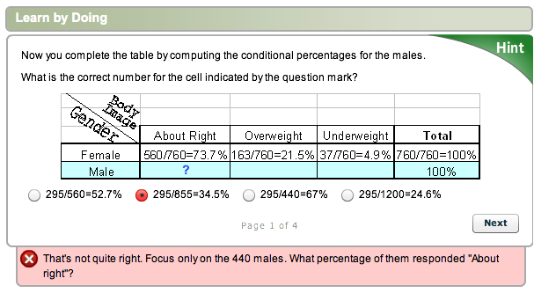
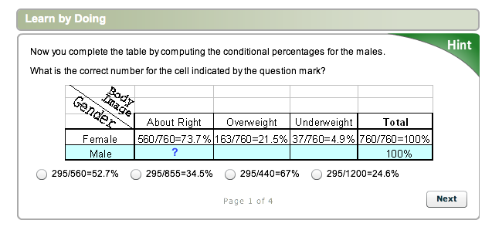
Learning activities are instrumented to continuously assess student learning
Feedback to Student
Feedback to Instructor

Slide 15
Learning activities are instrumented to continuously assess student learning
Feedback to Student
Feedback to Instructor

Slide 16
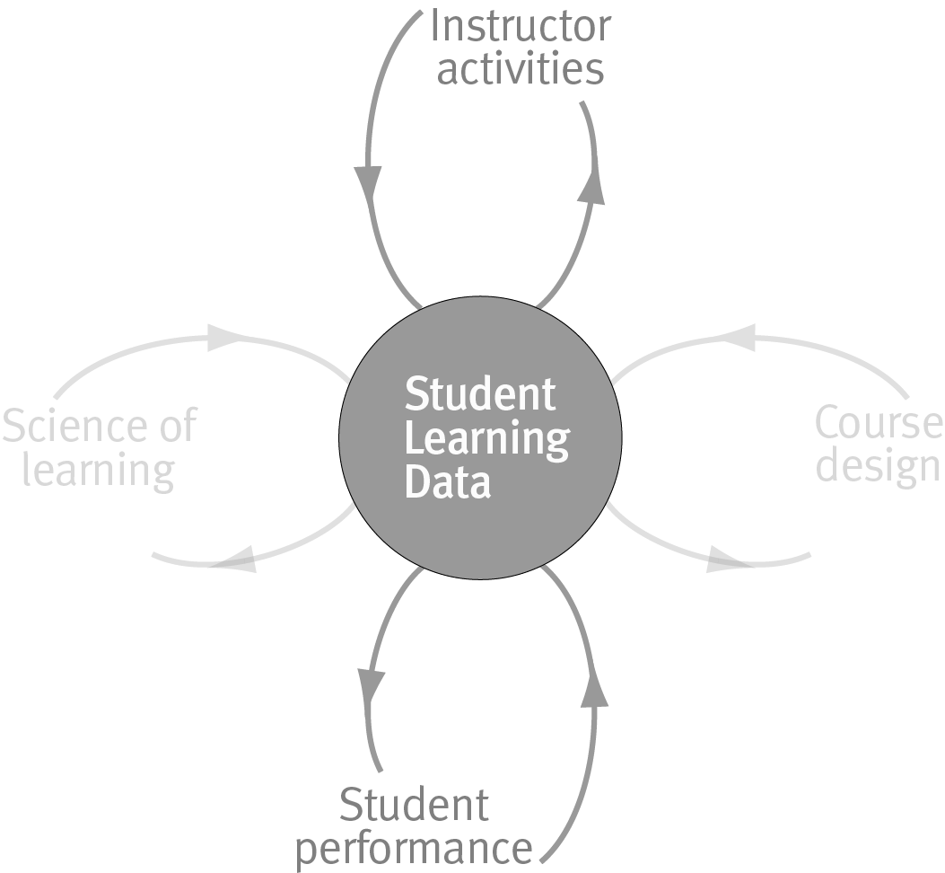
The Key…. Feedback Loops
Notes:
NO
The most powerful feature of web-based instruction is that it allows us to embed assessment into every instructional activity and use the data from those embedded assessments to drive powerful feedback loops for continuous evaluation and improvement.
By “feedback” we mean information derived from student activities that is used to influence or modify further performance.
Feedback to students:
In the case of feedback to students, we refer to corrections, suggestions and cues that are tailored to the individual’s current performance and that encourage revision and refinement. Many learning studies have shown that students’ learning improves and their understanding deepens when they are given timely and targeted feedback on their work (Butler & Winne, 1995; NRC, 2004.) Regarding the timing and frequency of feedback, the best learning outcomes occur when feedback comes immediately after the students’ response but not before the student is ready to revise his or her understanding (Corbett & Anderson, 2001).
Feedback to Instructors
In traditional face-to-face classrooms, the feedback loop between student learning activities and instructor activities is always cycling unmediated by technology. The traditional instructor-student feedback loop works well in classrooms that have an expert teacher and a not unreasonably heterogeneous class. For example, the instructor recognizes a need for additional explanation or practice by listening students' questions or by seeing confused looks on students' faces. In an online environment, this dynamic feedback loop is broken. The richness of the data we are collecting about student use and learning provides an unprecedented opportunity for keeping instructors in tune with the many aspects of students’ learning.
Ideally, OLI courses can assist instructors in addressing the challenges they confront as a result of the increasing variability in their students’ background knowledge, relevant skills and future goals. Creating an effective feedback loop to instructors using the OLI courses is our current area of research. Some of the research questions we are exploring in this area are: What measures best capture when students “get it” ? How do we construct an accurate representation of students’ knowledge? What is the most effective way to present this information to instructors? How can we best support instructors in making use of such information?

Slide 17
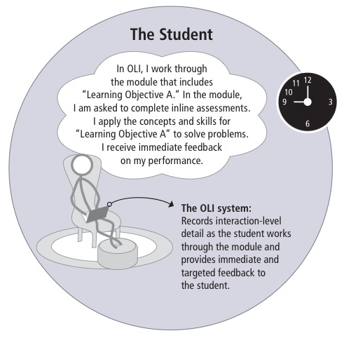
Notes:
The student prepared for class by going over learning objective A and B.
System – targeted feedback + records students interaction with the system

Slide 18
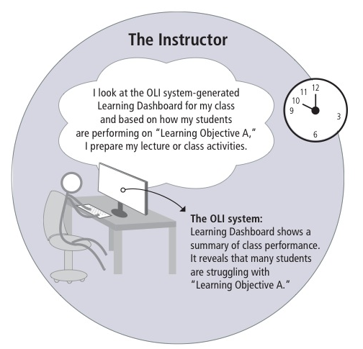
Notes:
Prepares class based on how students do on the different learning objective.
Learning Dashboard reveals that students are struggling with learning objective A.

Slide 19
Notes:
I see that you all got learning objective B, so we’ll focus on
Giving more examples on learning objective A.

Slide 20
Accelerated Learning
Hypothesis: With the OLI statistics course, students can learn the same material as they would in a traditional course in shorter time and still show equal or better learning.
Notes:
Hewlett:
Let’s see whether if you teach this way….

Slide 21
Three Accelerated Learning Studies
#1 Small class, expert instructor (2007)
#2 Replication with larger class (2009)
With retention follow-up 4+ months later
#3 Replication with new instructor (2010)
Experienced statistics instructor
New to OLI Statistics course and hybrid mode

Slide 22
Study 1: Method
~180 students
enrolled
68 volunteers for special section
24 students,
adaptive/ accelerated condition
44 students,
traditional control condition

Slide 23
Adaptive/Accelerated vs. Traditional
<
Two 50-minute classes/wk
Eight weeks of instruction
Homework: complete OLI activities on a schedule
Tests: Three in-class exams, final exam, and CAOS test
Four 50-minute classes/wk
Fifteen weeks of instruction
Homework: read textbook & complete problem sets
Tests: Three in-class exams, final exam, and CAOS test
<
?
=
Same content but different kind of instruction

Slide 24
Dependent Measure
CAOS = Comprehensive Assessment of Outcomes in a First Statistics course (delMas, Garfield, Ooms, Chance, 2006)
Forty multiple-choice items measuring students’ “conceptual understanding of important statistical ideas”
Content validity – positive evaluation by 18 content experts
Reliability – high internal consistency
Aligned with content of course (both sections)
Administered as a pre/posttest
Notes:
Standardized measures for statistical literacy f
“CAOS measures outcomes for which I would be disappointed if they were not achieved by students who succeed in my statistics courses.”

Slide 25
Study 1: CAOS Test Results
Chance
Adaptive/Accelerated group gained more (18% vs 3%)pre/post on CAOS than did Traditional Control, p < .01.

Slide 26
Brief Time-Log Study
Students in both groups recruited to complete time-logs
Self-report for both groups
Analogous point in the course (2/3 through)
Six consecutive days: Wednesday - Monday
Notes:
Maybe they spend more time?

Slide 27
Study 1: Time Spent Outside of Class
No significant difference between groups in the time students spent on Statistics outside of class

Slide 28
Study 2: Replication & Extension
Same method, same procedure, same instructor
Larger class (52 students in Adaptive / Accelerated)
Follow-up study conducted 4+ months later
Retention
Transfer

Slide 29
Study 2: CAOS Test Results
Chance
Adaptive/Accelerated group gained more pre/post on CAOS than did Traditional Control, p < .01.

Slide 30
Study 2: Follow-up study
Goal: study retention, transfer, and preparation for future learning
Students recruited from both groups at the beginning of the semester following the main study
Follow-up Begins
Trad’l Ends
Adapt/Acc Ends
Jan Feb Mar Apr May Jun Jul Aug Sep Oct
Adapt/Acc Delay (13 Students)
Trad Delay (14 Students)
Notes:
6 months delay for accelerated condition
4 month delay for traditional controls

Slide 31
Study 2, Retention: Re-taking CAOS
At 6-month delay, Adaptive/Accelerated group scored higher on CAOS than Traditional Control, p < .01.
Chance

Slide 32
Study 2, Transfer: Data-Analysis Problem
A weather modification experiment was conducted to investigate whether “seeding” clouds with silver nitrate would increase the amount of rainfall. Clouds were randomly assigned to the treatment group (to be seeded) or to the control group (not to be seeded), and data were collected on the total rain volume falling from each cloud. <data>
Does cloud seeding increase rainfall?
Students’ chosen analyses recorded and scored [0-3]
Scoring was blind to student condition

Slide 33
Study 2, Transfer: Data-Analysis Problem
Adaptive/Accelerated group scored higher than Traditional Control, p < .05.

Slide 34
Study 3: Further Replication & Extension
Same method, same procedure
New instructor
Not involved in development of OLI course
New to OLI statistics and hybrid teaching mode
Instructor held constant for both Adapt/Acc and Control conditions
Larger class (40 students in Adaptive / Accelerated)

Slide 35
Study 3: CAOS Test Results
Chance
Adaptive/Accelerated group gained more pre/post on CAOS than did Traditional Control, p < .01.

Slide 36
To Summarize…
With the OLI Statistics course, the Accelerated students:
Completed the course in half as many weeks with half as many class meetings per week
Spent the same amount of time in a given week on coursework outside of class as traditional students
Gained much more on the CAOS test than did the traditional controls
Retained their knowledge and maintained an advantage over traditional students in retention tests given 1+ semesters later.

Slide 37
Community of Use
This semester, the OLI statistics course is used by a diverse groups of 54 institutions (total of 5060 students)
Liberal Arts Colleges (Wesleyan University, Grinnell College)
Community Colleges (Nassau Community College, Santa Ana College)
High schools (Winchester Thurston School)
International (Singapore Management University)
State Schools (UC San Diego, University of Illinois Chicago)

Slide 38
Instructors’ Experiences
“Using OLI, we’ve developed what we think is a really innovative, inquiry-based approach to teaching stats”
“ There is generally a third of the class that hates statistics and doesn’t want to be there. Before [I used OLI], I didn’t know who those students were or how to support them”
“ The software not only taught procedures but helped students understand their possible applications. It answers the ‘Why do I care?’ question”

Slide 39
Instructors’ Experiences
“As an adjunct math professor, I was able to jump into a brand new course at my college ONLY because I had access to OLI materials”
“The learning curve is sharp and managing the resources was difficult at first but having access to what students are really learning and not is excellent…..Great for both instructors and students have access to the ‘truth’ and not just the perceived truth about the learning. This has given me an opportunity to grow as an instructor out of my usual comfort zone”

Slide 40
Students’ Experiences:
End of the course survey:
85% Definitely Recommend
15% Probably Recommend
0% Probably not Recommend
0% Definitely not Recommend
Student Quote: "This is so much better than reading a textbook or listening to a lecture! My mind didn’t wander, and I was not bored while doing the lessons. I actually learned something.“

Slide 41
Adaptation Projects
CC-OLI (Community College OLI)
Statway (Statistics Pathway)
(The Carnegie Foundation for the Advancement of Teaching)
University of Maryland University College Business School
Georgetown University School of Foreign Service

Slide 42
“Improvement in post-secondary education will require converting teaching from a ‘solo sport’ to a community-based research activity”
Herbert Simon,
Last Lecture Series, Carnegie Mellon, 1998

Slide 43
Contact Information
Oded Meyer: ogm@georgetown.edu
Collaborators:
Marsha Lovett (Cognitive Scientist, Learning Dashboard developer): lovett@cmu.edu
Candace Thille (OLI Project Manager): cthille@cmu.edu
To access the course: www.cmu.edu/oli

