Slide 1
Show me the data…
and tell me a story
Alison Gibbs
University of Toronto
alison.gibbs@utoronto.ca
Notes:
I decided to take this gift of 5 minutes I’ve been given to tell a story… It’s a story about statistics that I was told just a couple of months ago — and it’s one of those stories that keeps coming back to me — as a reminder of the value of statistical thinking.

Slide 2
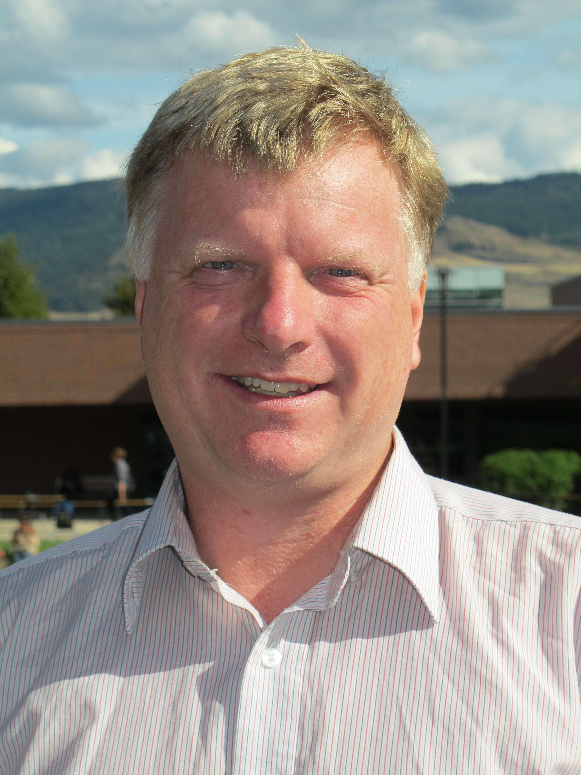
John Braun
University of British Columbia
Notes:
Admittedly it’s not my story — it belongs to my colleague John Braun of the University of British Columbia.
It’s a story about statistical thinking and the importance of the role of variability and sources of error.
And it’s a reminder that solving problems is often not just about what we can see and explain, but also what we can’t.

Slide 3
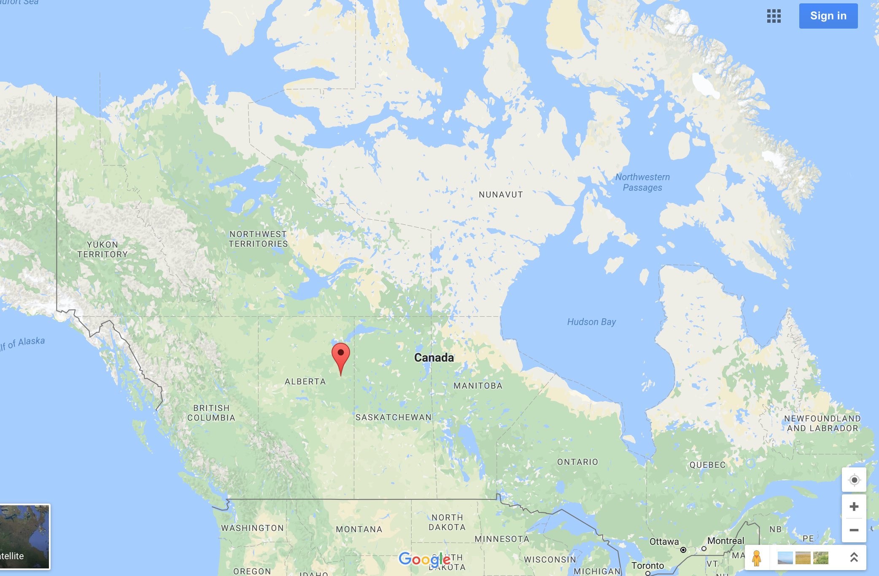
Fort McMurray
Notes:
The story is set in Fort McMurray. Fort McMurray is a city in northern Alberta. The fact that there are people living in such a remote area – and there are 88000 of them is due to some surrounding oil resources.
One year ago — at the beginning of May 2016 — the attention of Canadians was on Fort McMurray because of this

Slide 4
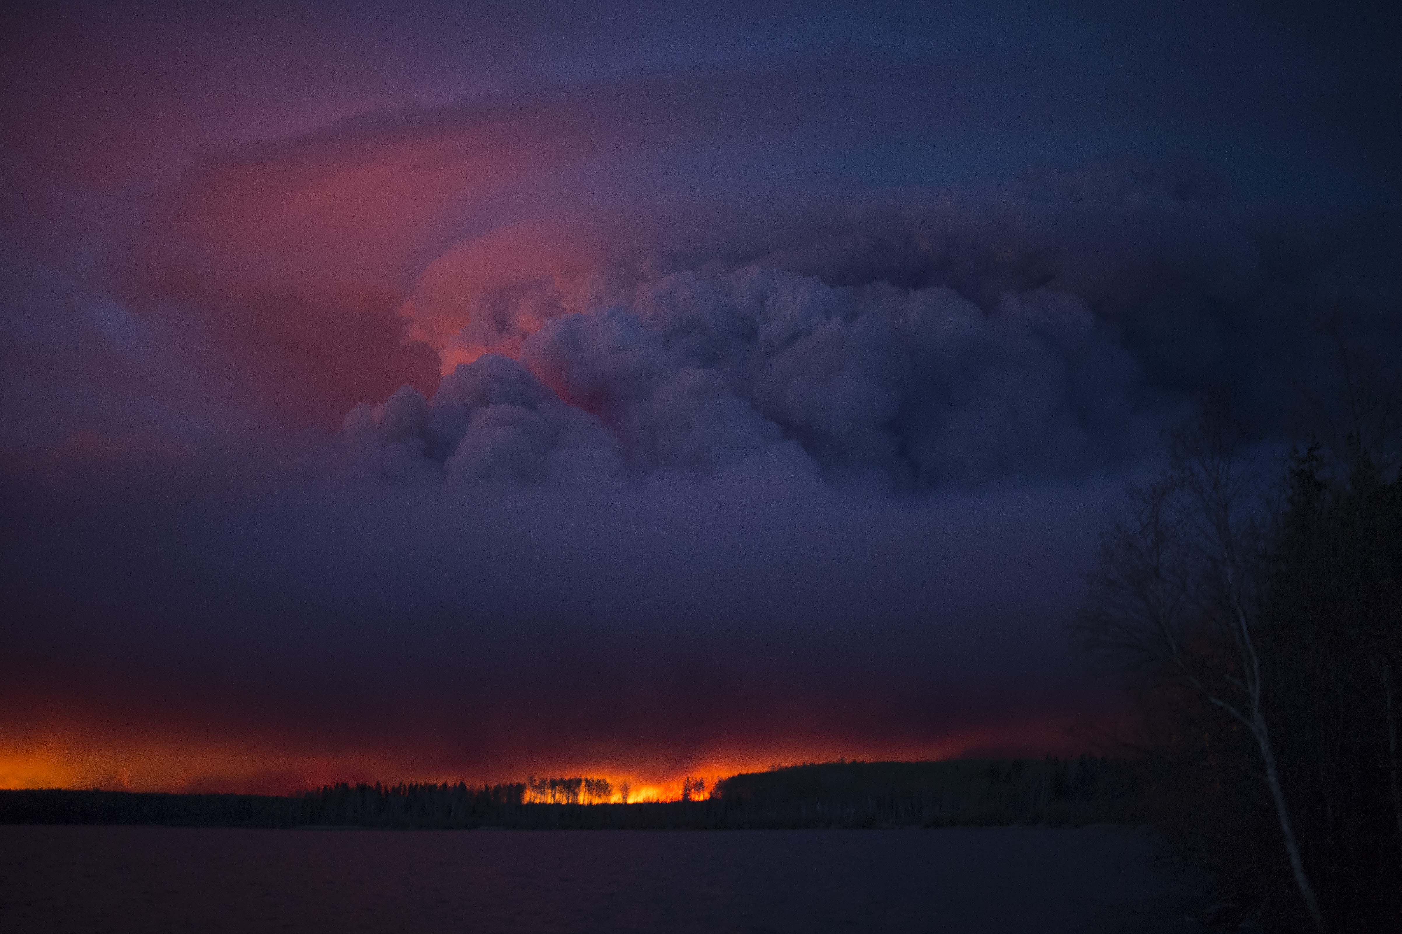
Notes:
— there was a massive forest fire burning around the city. This was a really big fire — the firefighters called it the “beast”.
In fact, I read this week that it is still burning. Last year, the fire was close enough to the city to be concerned.
https://www.flickr.com/photos/premierofalberta/26359650513

Slide 5
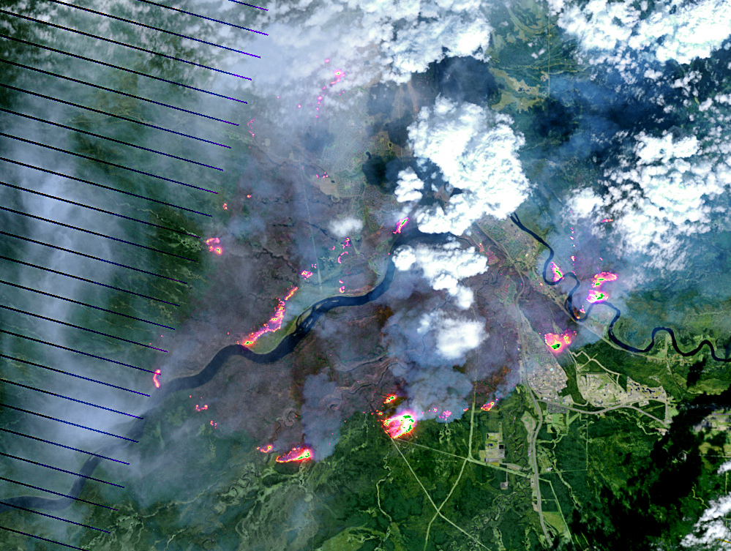
Notes:
This aerial shot shows brown burned areas, active hot spots, and the city on the bottom right in its midst.
By NASA Earth Observatory image by Joshua Stevens, using Landsat data from the U.S. Geological Survey. Caption by Kathryn Hansen - Cropped from mcmurray_etm_2016125_swir_lrg.jpg on http://visibleearth.nasa.gov/view.php?id=87988, Public Domain, https://commons.wikimedia.org/w/index.php?curid=48589043

Slide 6
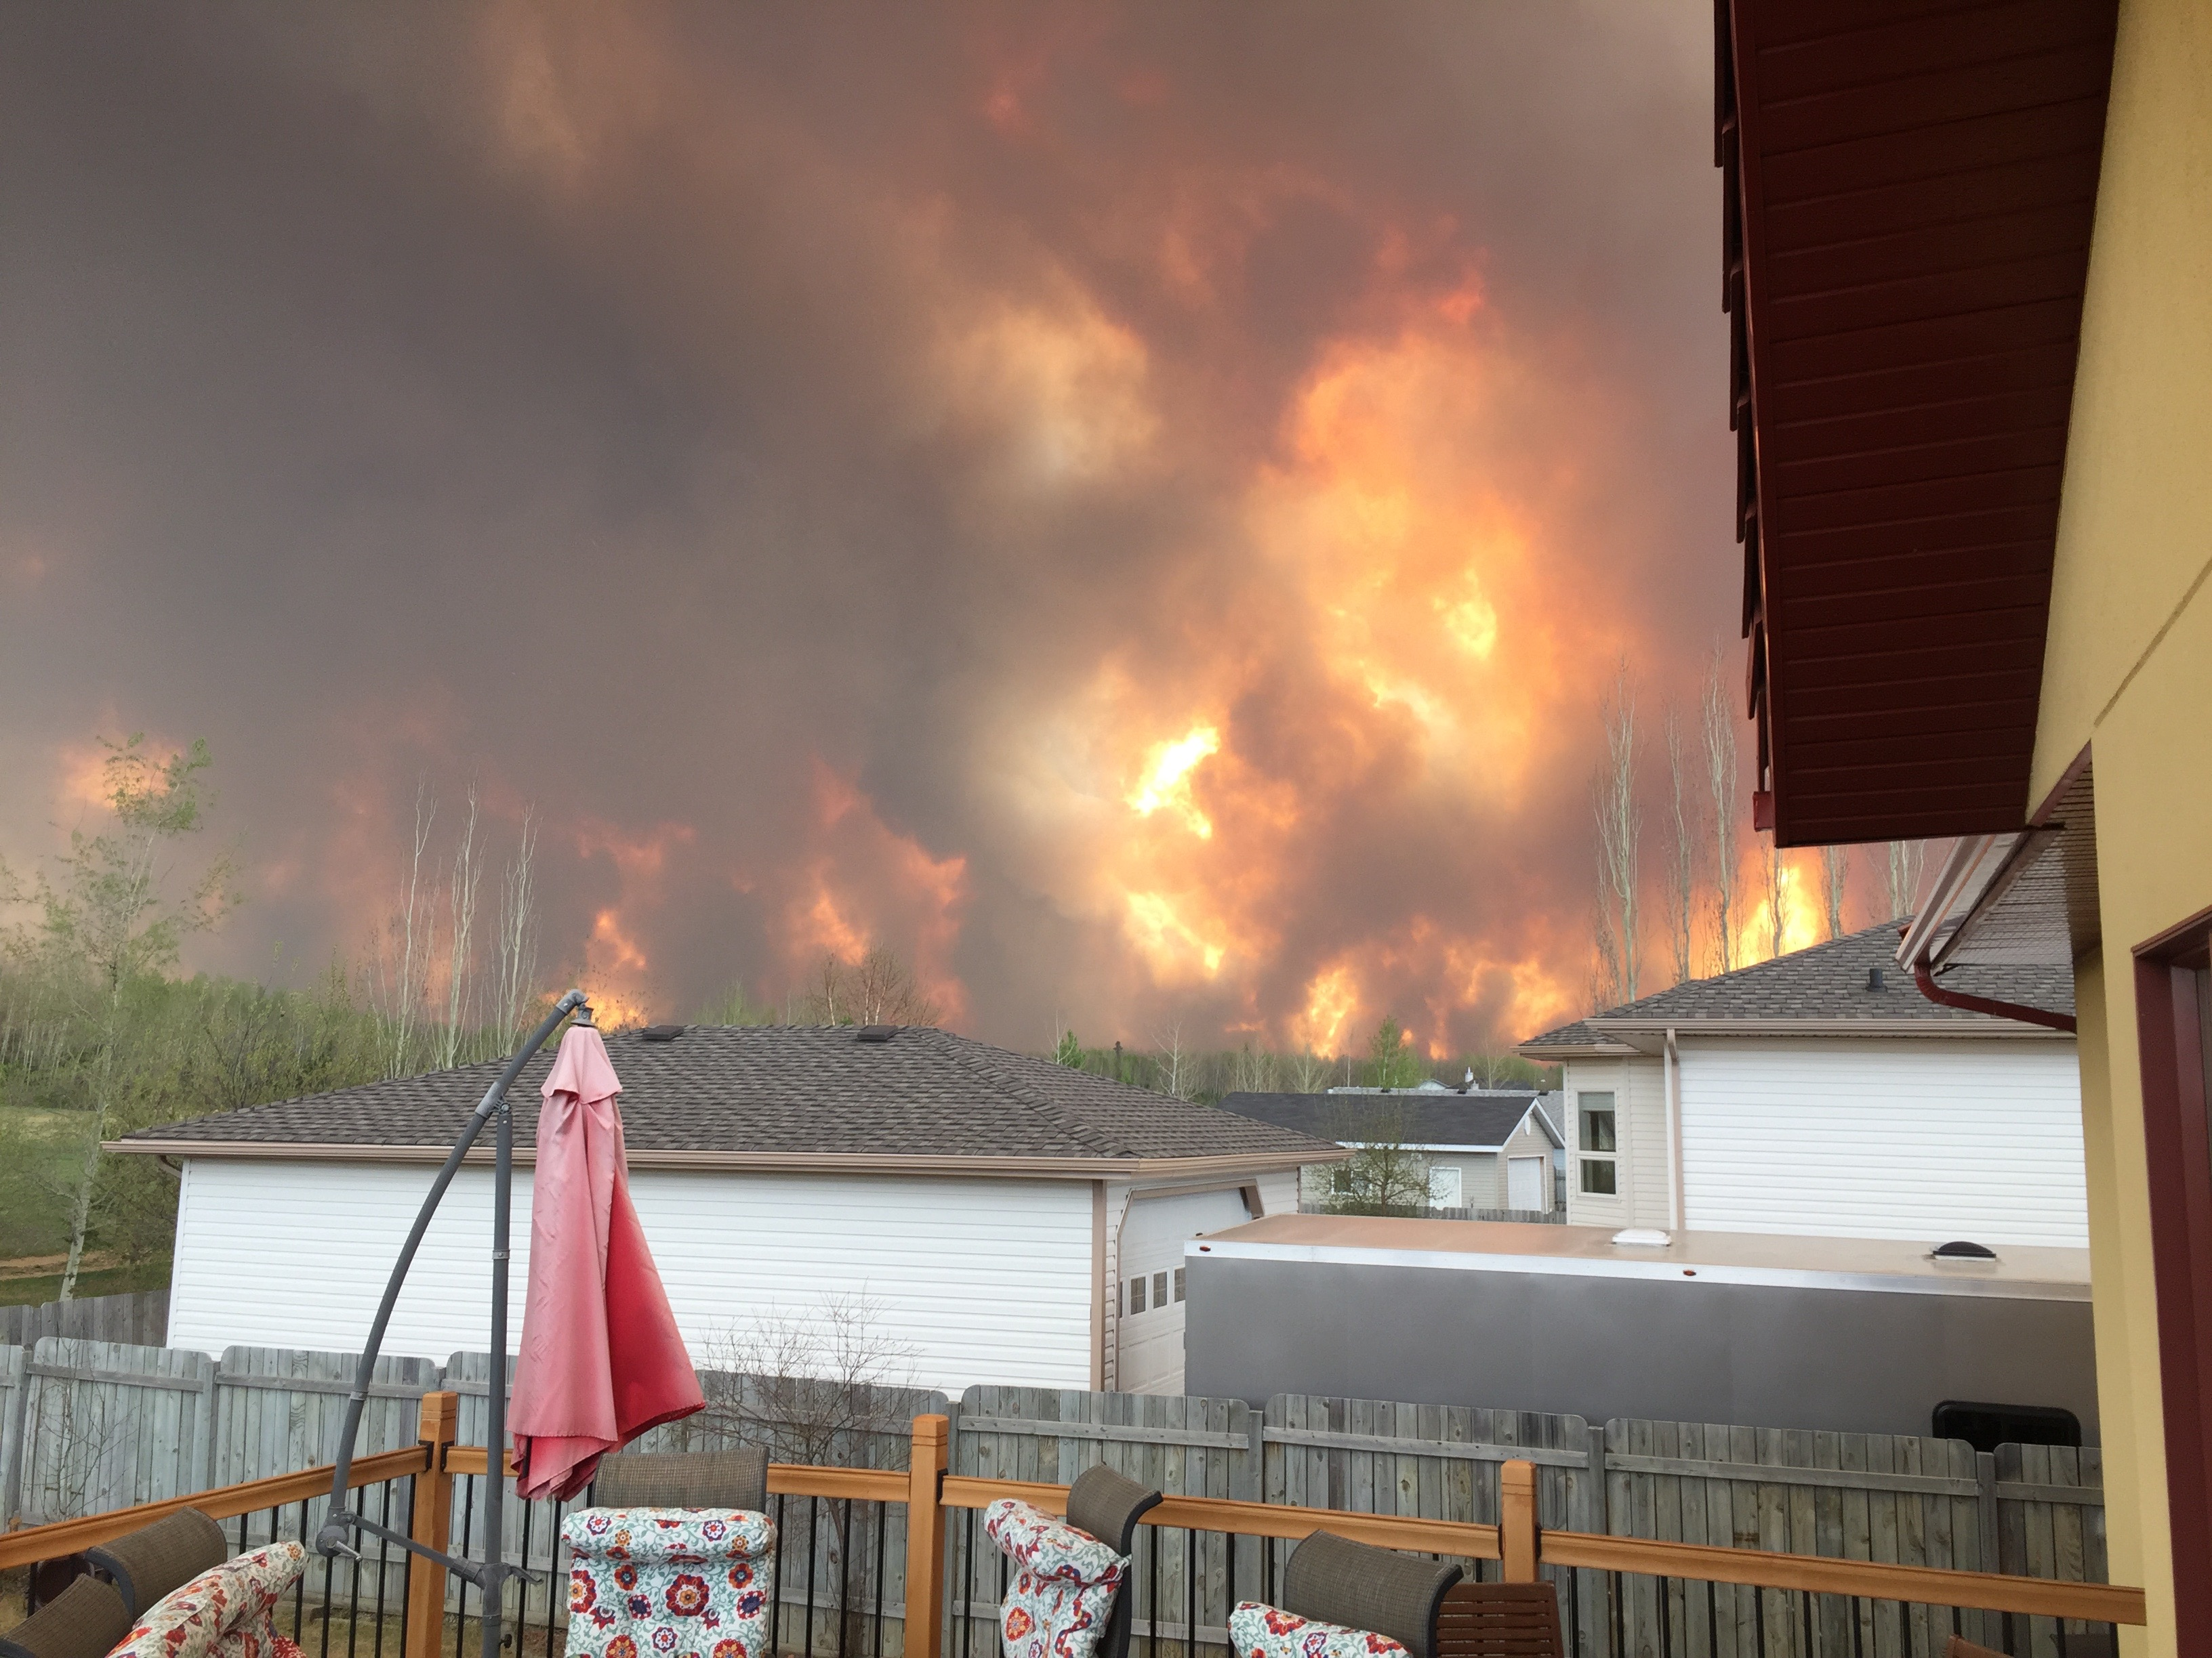
Notes:
And the fire did reach town —burning about 2400 structures and requiring a massive evacuation effort — all 88,000 of the city residents were evacuated.
Fort Mcmurray fire, on 3 May 2016. The shot was taken in Wood Buffalo estate of the southern fire getting close to Beacon Hill.
https://commons.wikimedia.org/wiki/File:حريق_فورت_ماكموراي-3مايو.jpg
https://commons.wikimedia.org/wiki/File%3A%D8%AD%D8%B1%D9%8A%D9%82_%D9%81%D9%88%D8%B1%D8%AA_%D9%85%D8%A7%D9%83%D9%85%D9%88%D8%B1%D8%A7%D9%8A-3%D9%85%D8%A7%D9%8A%D9%88.jpg
https://upload.wikimedia.org/wikipedia/commons/6/68/%D8%AD%D8%B1%D9%8A%D9%82_%D9%81%D9%88%D8%B1%D8%AA_%D9%85%D8%A7%D9%83%D9%85%D9%88%D8%B1%D8%A7%D9%8A-3%D9%85%D8%A7%D9%8A%D9%88.jpg
By Aboluay (Own work) [CC BY-SA 4.0 (http://creativecommons.org/licenses/by-sa/4.0)], via Wikimedia Commons

Slide 7
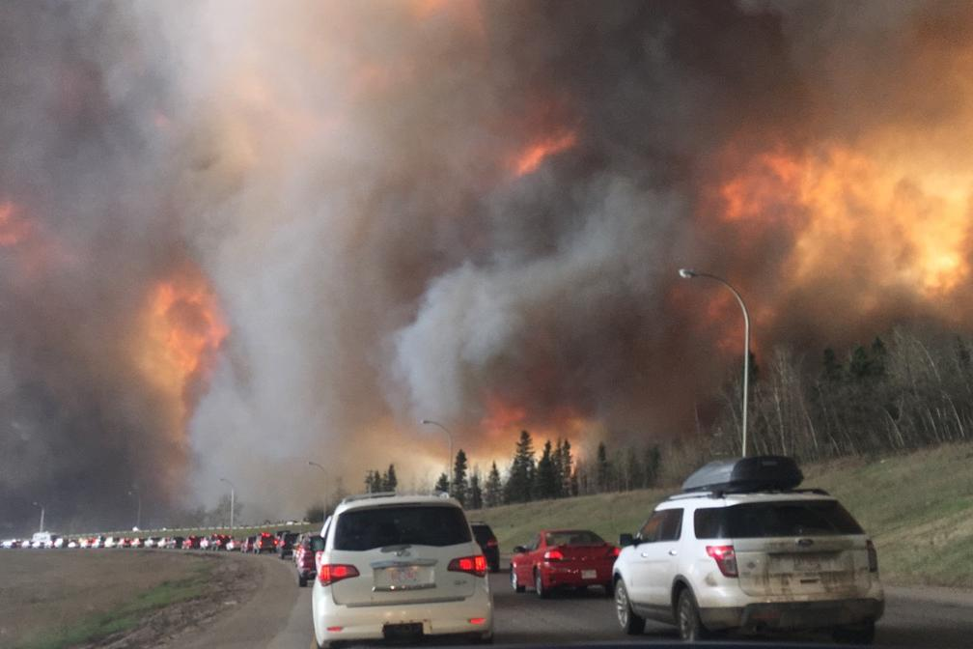
Notes:
And that evacuation effort led to horrific and gripping photos like this — huge convoys of cars leaving town, with walls of fire surrounding them.
[NEXT] [NEXT] [NEXT]
By DarrenRD - File:Landscape view of wildfire near Highway 63 in south Fort McMurray.jpg, CC BY-SA 4.0, https://commons.wikimedia.org/w/index.php?curid=48561288

Slide 8
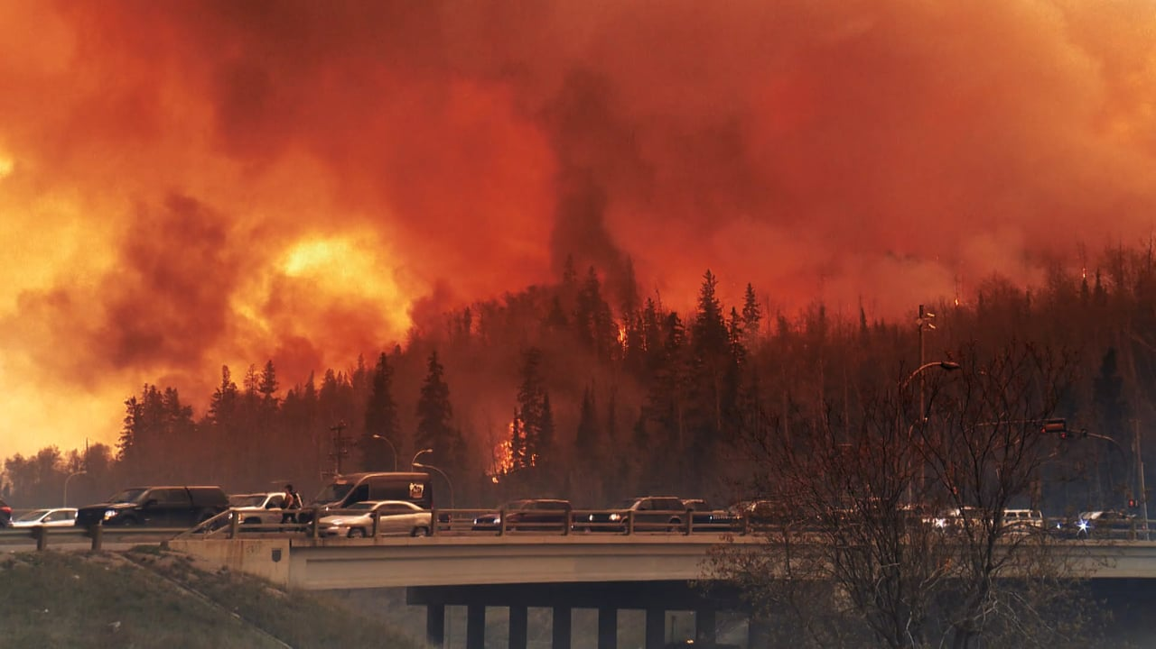

Slide 9
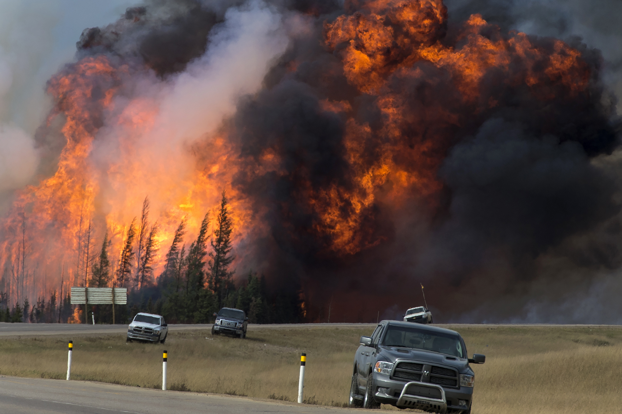
Notes:
You’re probably wondering, how did the evacuation cut things so close?
There are lots of reasons, don’t want to evacuate if its unnecessary — and enforcing the evacuation was no easy task. Authorities needed to make a decision — should they continue to invest all their resources in fighting the main fire, or should they divert resources to the centre of town and an evacuation effort?

Slide 10
Where will the fire spread to be a certain time?
Authorities used a model based on historical data, with inputs for weather, fuel, and topography.
Ignition point
Wind direction
Notes:
To help in this decision they used a fire simulator, which take a model built from data from previous fires, and takes inputs of weather, and topographical information, and information about the fuel the forest is providing to the fire, and then numerically solves a series of differential equations to estimate where the fire front will be at a given time.
You can think of its output as an ellipse, with the fire front spreading from an ignition point, primarily in the direction of the wind at a given time.

Slide 11
Where will the fire spread to be a certain time?
Authorities used a model based on historical data, with inputs for weather, fuel, and topography.
Ignition point
Wind direction
At noon, the model estimated that the fire would reach the town limits at 11pm.
Is it too early to divert resources to the evacuation?
Notes:
At noon on the day of the evacuation, the model estimated the fire from would reach town in 11 hours — so everyone had some time.

Slide 12
They had 11 hours. Was it too early to divert resources to the evacuation?
The fire reached the city limits in 6.5 hours.
Notes:
But the fire reached the city limits in 6.5 hours — and that 4 and a half hours led to those dramatic images.
So where’s the statistics in this?

Slide 13
The post-mortem analysis: Add in some statistical thinking...
The model relied on inputs they could explain: some are observable and some not observable.
The statistician exploited the unexplained variation in the historical data to create a probability distribution of envelopes for the fire spread.
90th percentile
Wind direction
Notes:
The statistics came in the recent post-mortem analysis (with John)
The model was focused on the inputs in estimating the location of the fire front— Some that could be observed: for example, wind direction and precipitation. But many that are unobservable.
Rather than the inputs, he statistician focused on the data about the previous fires; which could capture the unobserved variation.
He used the inputs they had, bootstrapped the data from previous fires so that he could look at the distribution of the estimate for the fire spread — to get contours for areas the fire would envelope with a specified probability at a given time.

Slide 14
The post-mortem analysis: Add in some statistical thinking...
90th percentile
The 90th percentile of the distribution estimated the arrival of the fire in town within 20 minutes of its actual arrival time.
What did statistical thinking bring?
A focus on the data, skepticism of the estimate, and comfort with unexplained variation.
The happy ending: A new model is now being beta-tested!
Notes:
& the 90th percentile of this distribution for the time for the fire to reach the city limits, was within 20 min of when it actually did hit town.
So a focus on the data rather than the inputs, and thinking that naturally goes to capturing the variation in an estimate, coming from a context of being complete comfortable with unexplained variation — perhaps could have resulted in a less hairy situation on the day of the evacuation.

Slide 15
Skills for Data Science
The epilogue to the story:
What is the implication
for my teaching?
Notes:
Now how is this story going to feed into my teaching?

Slide 16
Skills for Data Science
Statistics
Computation
Communication
Notes:
The rise of data science has become — probably the most — important driver for re-thinking what we do as statistics teachers.
The ideal data scientist has a combination of statistical thinking, computational skills, and communication skills, so that they can engage in real world problems. Historically, in our statistics programs of study, at least at the University of Toronto, we’ve been doing a pretty good job with equipping our students with the skills in that blue circle — but the overlap into the red and green circles has been small.

Slide 17
Statistics Curriculum: 2017
Statistics
Computation
Communication
Notes:
Our curriculum is evolving to look more like this — bringing more computation and communication skills in to our statistical work — in many ways.
But we haven’t forgotten our strengths in the blue circle where statistical thinking lies

Slide 18
Statistics Curriculum: 2017
Statistics
Computation
Includes working with unexplained variation
Communication
Notes:
We still want our students to be comfortable with things like considering the unexplained variation.
To borrow a phrase, “Statisticians don’t think just about how right our answers are, we also think about how wrong our answers are”.
So, with that blue circle in mind, I’m going to keep telling stories to my students …
About:
cats falling from buildings in NYC (not forgetting the ones who don’t survive); and
power poses (choosing to leave out some of the data, choosing analyses, and not to include outliers); and
literary digest polls — or the polls in the 2016 election or the Brexit vote

Slide 19
Statistics Curriculum: 2017
Statistics
Computation
Show me the data…
Both what you can explain and what you can’t
Communication
Notes:
With the hope that when they show their data and tell their data stories —
They remember that often the story is about both what they can explain and what they can’t.

