Slide 1
Teaching Introductory Students How to Evaluate Evidence
Kari Lock Morgan
Department of Statistics
Penn State University
USCOTS
May 18th, 2019

Slide 2
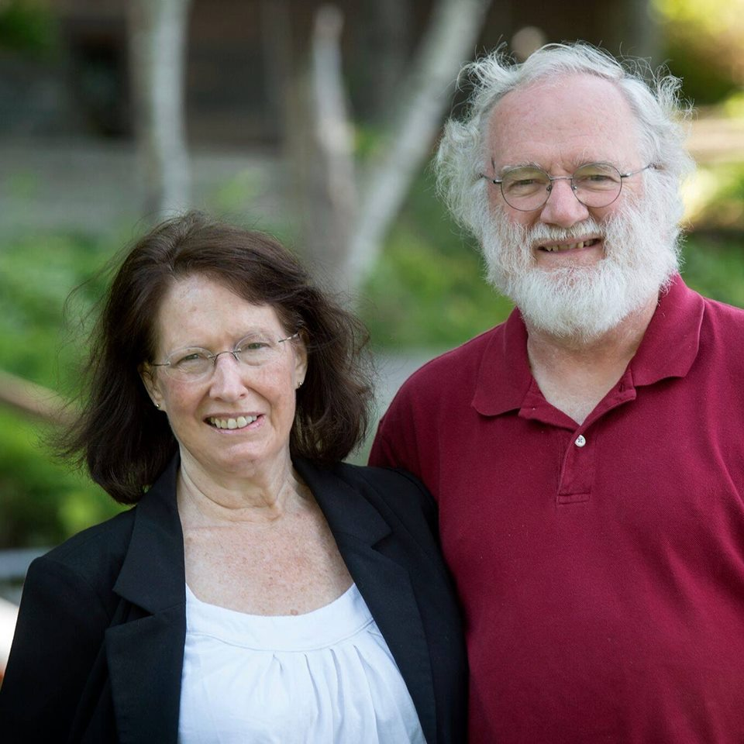
Teaching Introductory Students
+ stat ed community
(YOU!!)
Causal
^
How to Evaluate Evidence
+ causal inference community

Slide 3
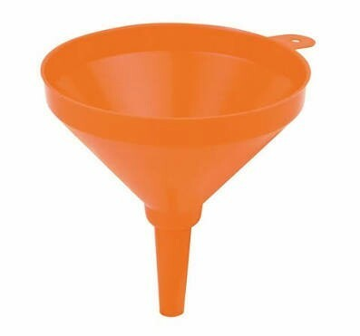
Everything an expert should know about evaluating evidence
What an intro student should know about evaluating evidence

Slide 4
Evaluating Evidence
Suppose we are comparing A vs B
In our sample, the A group has better outcomes than the B group
Possible explanations?
A causes better outcomes than B
the groups differed at baseline
just random chance
Evaluating evidence for (1) requires evaluating evidence against (2) and (3)

Slide 5
Yeah, yeah…
“Yeah, yeah… obviously I already cover confounding and inference in intro stat.”

Slide 6
GOALS National Post-Test Data
Related to confounding:
Learning Objective | % Correct
Able to reason about the purpose of random assignment
Able to reason about how correlation does not imply causation
26.9%
22.5%
*Significantly worse than random guessing*
Thanks to Bob DelMas for the GOALS data!
GOALS reference: Sabbag, A. G. & Zieffler, A. (2015). “Assessing Learning Outcomes: An Analysis of the GOALS-2 Instrument,” Statistics Education Research Journal (SERJ), 14(2), 92-116.

Slide 7
GOALS National Post-Test Data
Related to p-values:
Learning Objective | % Correct
Able to reason that a smaller p-value provides stronger evidence against the null hypothesis than a larger p-value.
Able to reason about a conclusion based on a statistically significant p-value in the context of a research study that compares two groups
Able to reason about an incorrect interpretation of a p-value (probability of a treatment being more effective).
45.2%
58.3%
50%

Slide 8
Question of the Day
?
Does eating organic improve your health?
Let’s evaluate the evidence!

Slide 9
Dataset #1: NHANES
NHANES: National Health and Nutrition Examination Survey
Large national random sample
2009 – 2010 data
n = 5060

Slide 10
“In the past 30 days, did you buy any food that had the word 'organic' on the package?”

Slide 11
“Would you say your health in general is Excellent, Very good, Good, Fair, or Poor?”

Slide 12
Current Health Status

Slide 13
Health by Organic
$${\hat{p}}_{organic}−{\hat{p}}_{not organic}=0.459−0.330=0.129$$

Slide 14
Evaluating Evidence
In our sample, people who bought organic are healthier
Possible explanations?
eating organic improves health
the groups differed at baseline
just random chance
???
p-value < 0.0000000000000002
(lowest p-value R will give)
Notes:
< 2 out of a quadrillion!

Slide 15
People who buy organic are richer

Slide 16
Richer people are healthier

Slide 17
Richer people are healthier

Slide 18
People who buy organic are richer
Richer people are healthier

Slide 19
Three “-ations”
VISUALIZATION
“Pictures speak louder than words”
Multivariable thinking!

Slide 20
Evaluating Evidence
In our sample, people who bought organic are healthier
Possible explanations?
eating organic improves health
the groups differed at baseline
just random chance
With more than one possible explanation, we cannot determine causal evidence!
But we also can’t rule it out!
Notes:
< 2 out of a quadrillion!

Slide 21
Non-comparable groups
Directly comparing groups that are not comparable (groups differ at baseline) cannot yield causal evidence!
(and can be very misleading)
What can we do if groups differ at baseline?
Look within similar groups

Slide 22
Health by Organic, by Income
Evidence that eating organic makes you healthier?

Slide 23
People who buy organic are more likely to have green vegetables

Slide 24
People who buy organic are less likely to smoke
etc…
Differences on many measured variables…
… and countless unmeasured variables!

Slide 25
Multiple Examples
Ideally, students will see multiple examples illustrating the dangers of comparing non-comparable groups, including…
Common sense baseline difference(s)
Baseline difference shifts effect
Baseline difference reverses effect
Baseline difference masks true effect
Baseline difference creates false effect…

Slide 26
Simulate “organic” based only on income
… so it has no real causal effect on health!
(solely due to baseline difference in income!)
p-value = 0.02

Slide 27
Fake Organic by Health by Income

Slide 28
Randomization
Simply observing data as it is will almost always result in baseline differences
How to alleviate this problem?
Baseline differences should be minimal (just due to random chance)
Allows for causal evidence!!!
RANDOMIZE treatment assignment!

Slide 29
Three “-ations”
VISUALIZATION
RANDOMIZATION
“Pictures speak louder than words”
Multivariable thinking!
Allows for causal evidence!
Foundation for inference

Slide 30
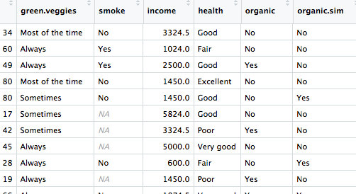
Simulate a randomization
Simulate a “randomly assigned” version of your treatment (permute it)

Slide 31
Baseline Differences?

Slide 32
Baseline Differences?

Slide 33
Baseline Differences?

Slide 34
Randomization!!
Without randomization…
… groups will differ at baseline
… so very hard to find causal evidence
With randomization…
… groups should look similar at baseline
… so can find causal evidence!
Can’t check for all baseline differences…
… but CAN check for random assignment!

Slide 35
Evaluating Evidence
Suppose A has better outcomes than B
Possible explanations?
A causes better outcomes than B
the groups differed at baseline
random chance
The best evidence against groups differing at baseline is the use of random assignment to treatment groups.
???

Slide 36
Randomizing Within Similar Groups
Cal and Axel Lock Morgan

Slide 37
Why “groups differ at baseline”?
Why “baseline”?
Why groups?
Groups must be similar
Groups may differ (due to treatment!)
baseline
post-treatment
treatment starts
outcomes measured

Slide 38
Teaching Confounding
Requires multivariable thinking!
Help students reason with a third variable
Use data, don’t just rely on intuition
(Thoughtfully) visualize the confounding
(Show) data broken down by confounder
Random assignment is important!
Not just about study design!
Simulation can help understanding!
simulate treatment based on confounder
simulate random assignment; no differences!

Slide 39
Three “-ations”
VISUALIZATION
RANDOMIZATION
SIMULATION
“Pictures speak louder than words”
Multivariable thinking!
Allows for causal evidence!
Foundation for inference
Makes the abstract concrete

Slide 40
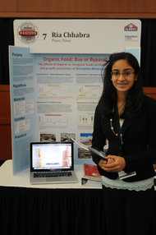
Dataset #2: Fruit Flies
Fruit flies randomly divided into two groups of 500 each
One group fed organic food, the other conventional food
Measured longevity, fertility, stress resistance, activity
Study done by a 16-year-old girl for a science project!
Chhabra R, Kolli S, Bauer JH (2013) Organically Grown Food Provides Health Benefits to Drosophila melanogaster. PLoS ONE 8(1): e52988.
Notes:
***SHOULD BE AT ABOUT THE HALF HOUR MARK!***

Slide 41
Longevity by Organic
${\overline{Y}}_{O}−{\overline{Y}}_{C}=18.9−15.5=3.4$ days
*Data approximated from figure in paper

Slide 42
Evaluating Evidence
In this sample, the fruit flies who ate organic lived longer
Possible explanations?
Eating organic increases longevity
The groups differed at baseline
Just random chance
???
What kinds of results would we see, just by random chance, if there were no difference?
We can simulate to find out!!!

Slide 43
Simulating Random Chance
Days | Group
31
26
27
18
. . . | . . .
10
27
10
27
Assume no difference (days survived the same regardless of organic)
Mimic random chance: Re-randomize into groups
Compute the statistic (difference in means)
4. Do this thousands of times!
T
T
T
T
$${\overline{Y}}_{O}−{\overline{Y}}_{C}=−0.684$$
C
C
C
C

Slide 44
Evaluating Evidence
In our sample, the fruit flies who ate organic lived longer
Possible explanations?
Eating organic increases longevity
The groups differed at baseline
Just random chance
EAT ORGANIC!!!
(if you’re a fruit fly)
Notes:
soybeans: after 10 days, ALL of the conventional flies were dead, and 60% of the organic flies were alive!

Slide 45
What about a p-value???
Students need to see, and understand, the concept of a p-value
But, maybe start with extreme examples where an exact calculation isn’t needed
(and where an exact threshold isn’t needed!)
Get students comfortable with “would I expect a result this extreme just by chance?”
THEN, p-value is a natural quantification…

Slide 46
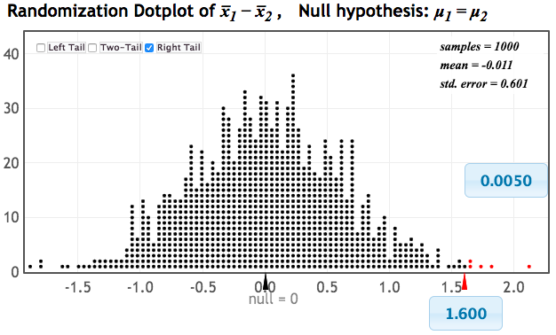
p-value: The chance of obtaining a statistic as extreme as that observed, just by random chance, if the null hypothesis is true
p-value: The chance of obtaining a statistic as extreme as that observed, just by random chance, if the null hypothesis is true
p-value: The chance of obtaining a statistic as extreme as that observed, just by random chance, if the null hypothesis is true
p-value: The chance of obtaining a statistic as extreme as that observed, just by random chance, if the null hypothesis is true
p-value: The chance of obtaining a statistic as extreme as that observed, just by random chance, if the null hypothesis is true

Slide 47
Three “-ations”
VISUALIZATION
RANDOMIZATION
SIMULATION

Slide 48
Simulation-Based Inference
Directly connected to key concepts!!!
Same process for many statistics
More flexible
Fewer conditions
Better connection with data collection
Less reliance on prerequisite knowledge
Promotes better understanding???
Let’s evaluate the evidence!

Slide 49
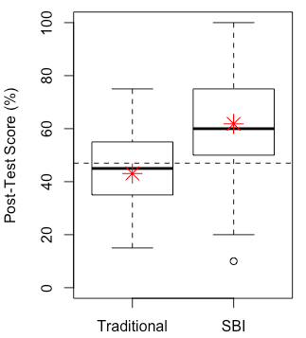
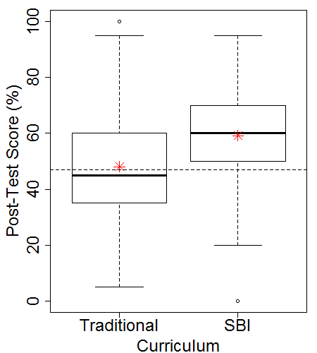
GOALS Post-Test: Penn State
Intro Biostats
Intro Stats
$${\overline{Y}}_{SBI}−{\overline{Y}}_{trad}=18.7$$
$${\overline{Y}}_{SBI}−{\overline{Y}}_{trad}=11.4$$

Slide 50
Evaluating Evidence
In our sample, the students in the SBI classes had higher GOALS scores
Possible explanations?
SBI better for conceptual understanding
The groups differed at baseline
Just random chance
???
p-value < 10⁻¹⁶

Slide 51
Baseline Differences?
$${\overline{X}}_{C}=38.2$$
$${\overline{X}}_{T}=38.4$$
Propensity score matching to create groups similar with respect to all measured baseline variables:
Post-test difference: ${\overline{Y}}_{SBI}−{\overline{Y}}_{trad}=10.9$

Slide 52
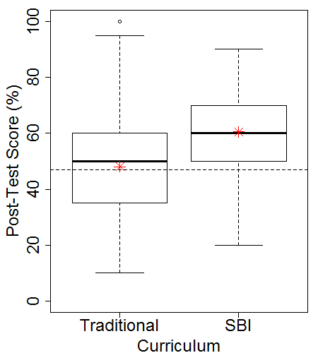
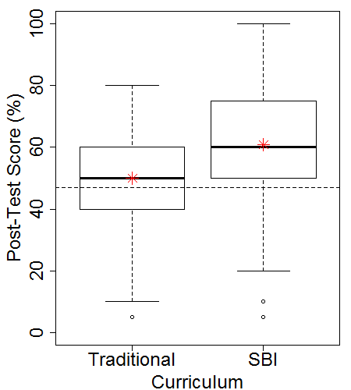
Within-Instructor Comparisons
Same instructor A, S17/F17
Same instructor B, S17/F17
$${\overline{Y}}_{SBI}−{\overline{Y}}_{trad}=12.5$$
$${\overline{Y}}_{SBI}−{\overline{Y}}_{trad}=10.8$$

Slide 53
What else? (not exhaustive!!!)
Meaningful effect size?
Intro Biostat:
Difference in means: 18.7 percentage points
95% CI: (11.6, 25.9)
Standardized effect size = 1.04
Intro Stat:
Difference in means: 11.4 percentage points
95% CI: (9.0, 13.8)
Standardized effect size = 0.76
Missing data?
Penn state intro stat SBI data: Post-test missing for…
36% of control students
8% of treatment students

Slide 54
Replication
Maurer, K. & Lock, D. (2016). “Comparison on Learning Outcomes for Simulation-based and Traditional Inference Curricula in a Designed Educational Experiment,” TISE, 9(1). [random assignment!!]
Chance, B., Mendoza, S., Tintle, N. (2018). “Student Gains in Conceptual Understanding in Introductory Statistic With and Without a Curriculum Focused on Simulation-Based Inference,” ICOTS 10.
Tintle, N., Clark, J., Fisher, K., Chance, B., Cobb, G. Roy, S. (2018). “Assessing the Association Between Precourse Metrics of Student Preparation and Student Performance in Introductory Statistics: Results from Early Data on Simulation-Based Inference vs. Nonsimulation-Based Inference,” JSE, 26(2).
Chance, B., Wong, J., & Tintle, N. (2016). “Student Performance in Curricula Centered on Simulation-Based Inference: A Preliminary Report,” JSE, 24(3).
All find better conceptual understanding with SBI!

Slide 55
Evaluating Evidence
Suppose, in our sample, group A has better outcomes than group B
Possible explanations?
A causes better outcomes than B
the groups differed at baseline
just random chance
Evaluating evidence for (1) requires evaluating evidence against (2) and (3)

Slide 56
Three “-ations”
VISUALIZATION
RANDOMIZATION
SIMULATION

Slide 57
klm47@psu.edu
Want to continue the conversation?
Join us for a collaborative discussion in Room 208!

