Slide 1
Fostering Active Learning with Model Eliciting Activities
Jeffrey A. McLean
St. Lawrence University
jmclean@stlawu.edu
Michael E. Schuckers
St. Lawrence University
schuckers@stlawu.edu
USCOTS 2017 May 19, 2017

Slide 2
Paul the Octopus
(https://www.youtube.com/watch?v=Cc0otVujNlE)
USCOTS 2017 May 19, 2017

Slide 3
Paul the Octopus
(Lock et al., 2017)
USCOTS 2017 May 19, 2017

Slide 4
Ophelia the Octopus
Paul has since passed away, leaving an opening for sports predicting octopuses. Zookeepers at the local zoo hope that their octopus Ophelia can fill this opening. The zookeepers' plan is for Ophelia to predict in a similar manner the winners of the University's next eight basketball games. The local newspaper has picked up on the story and contacted you to help them discuss Ophelia's predictions. The newspaper wants to discuss with you how they can interpret whatever results Ophelia comes up with.
Write a letter to the local newspaper with the range of outcomes that you think are likely for Ophelia to correctly predict. Include a description of the methods that you used to come to this conclusion. The newspaper staff can then use your method for stories about future sports predicting octopuses.
How can you use the cup of coins to help you write your letter to the newspaper?
(McLean, 2015)
USCOTS 2017 May 19, 2017

Slide 5
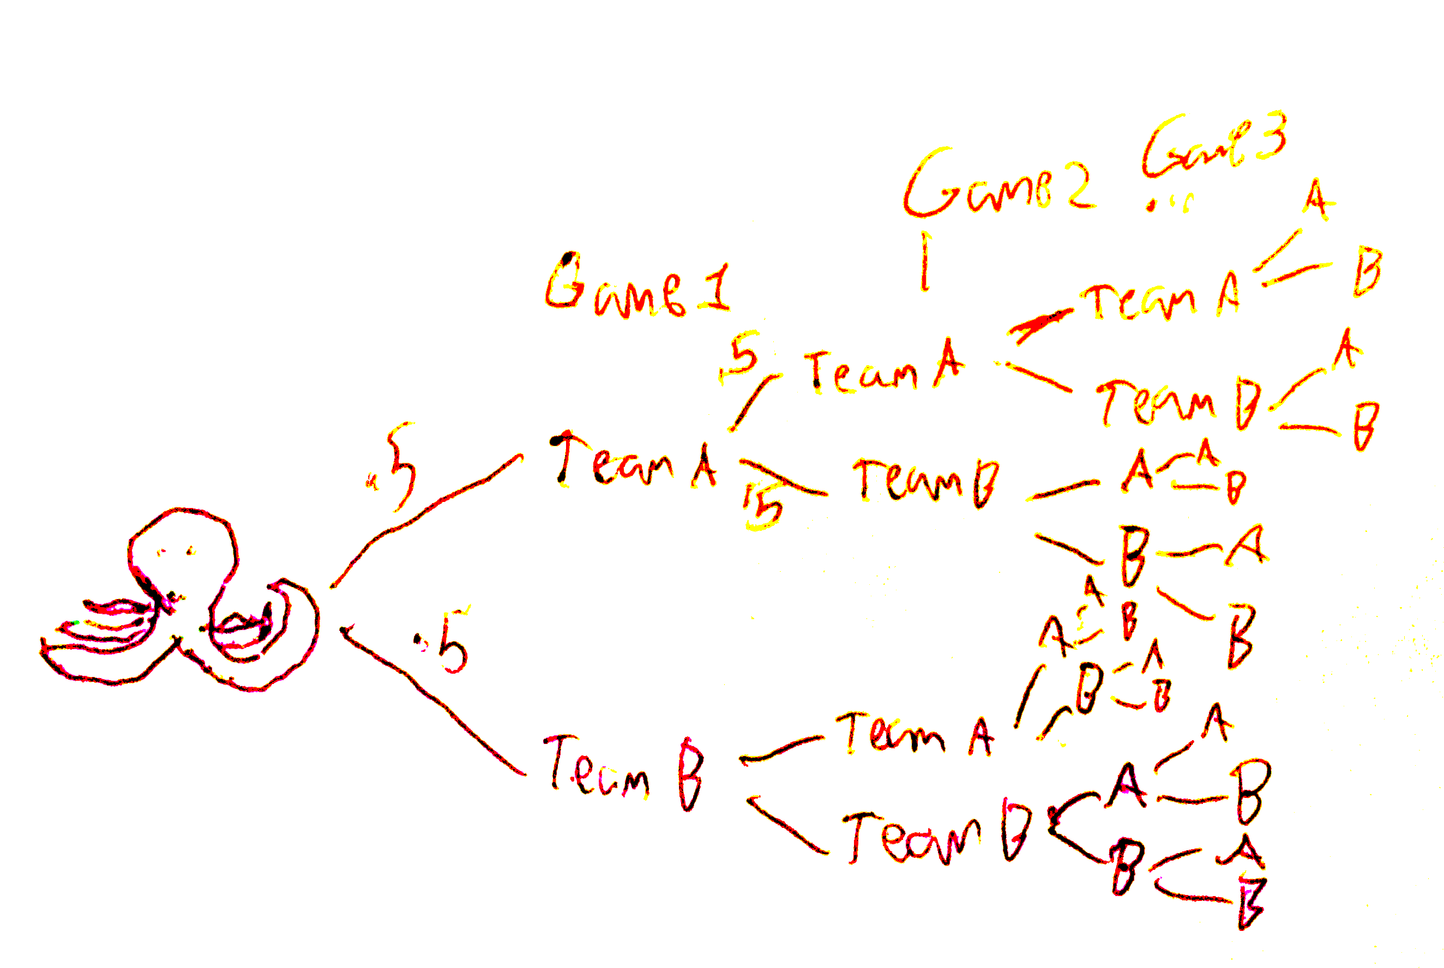
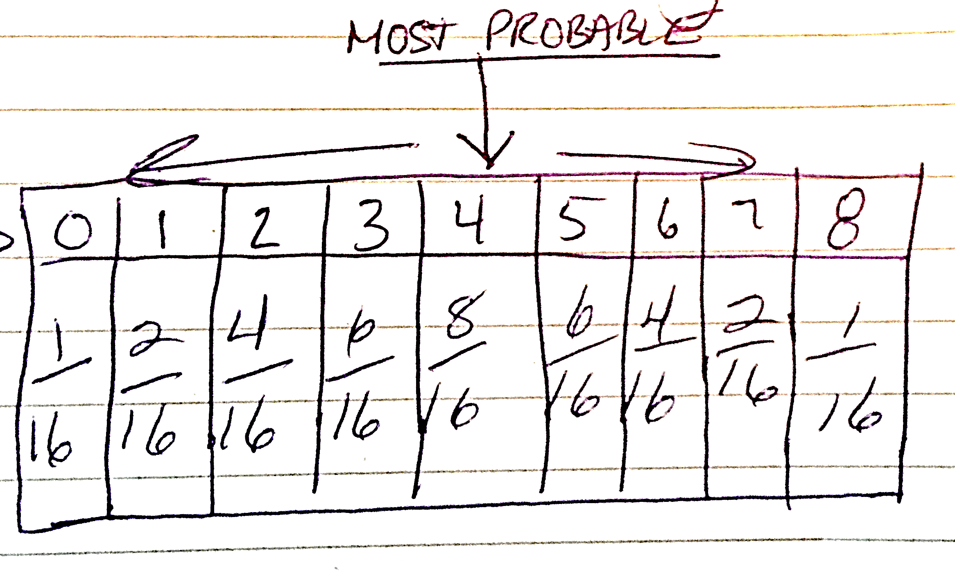
Ophelia the Octopus with Probability
The probability that Ophelia would predict all eight games correctly is (1/2)⁸ = 1/256
Out of the 8 total games Ophelia has a ½ or 50% chance of predicting each game correctly. There are 16 total outcomes.
USCOTS 2017 May 19, 2017

Slide 6
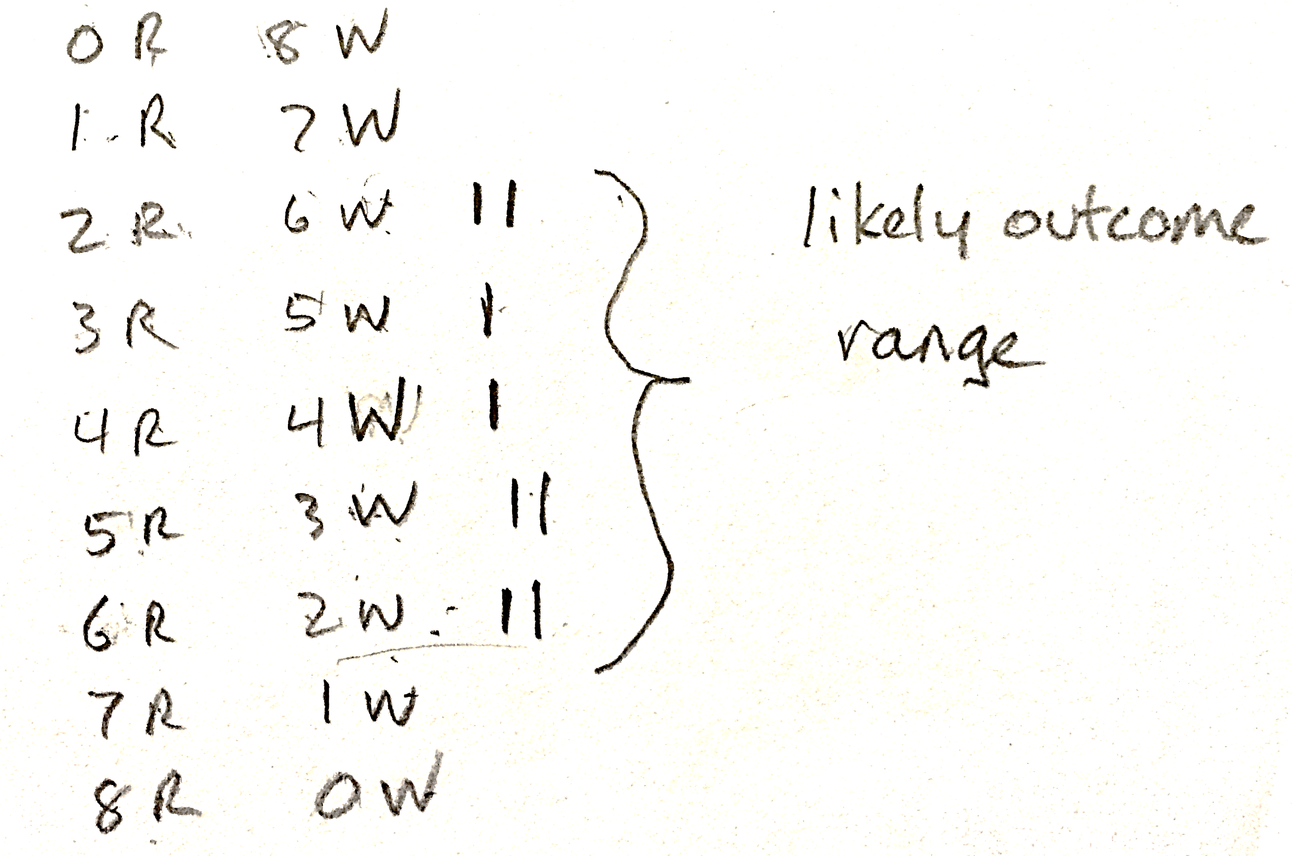
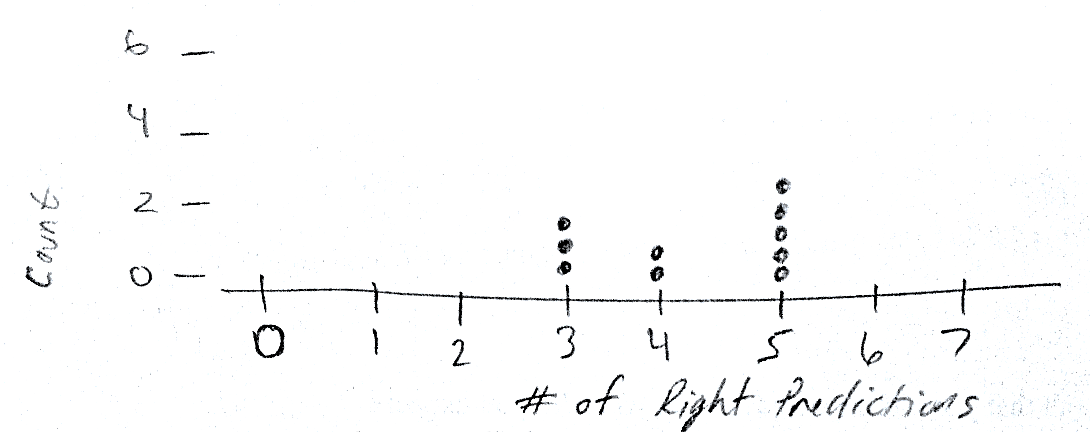
Ophelia the Octopus with a Few Samples
Because of varying values in their simulations, there was “no definitive answer as to the range of possible outcomes”
All simulated predictions are likely outcomes.
USCOTS 2017 May 19, 2017

Slide 7
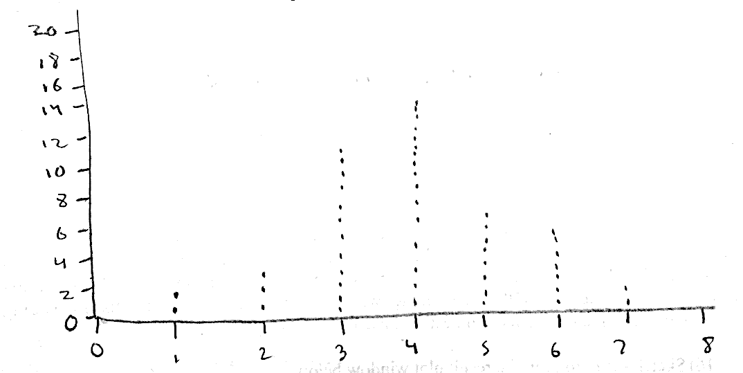
Ophelia the Octopus with a Lot of Samples
The likely range for correct predictions is three to six
USCOTS 2017 May 19, 2017

Slide 8
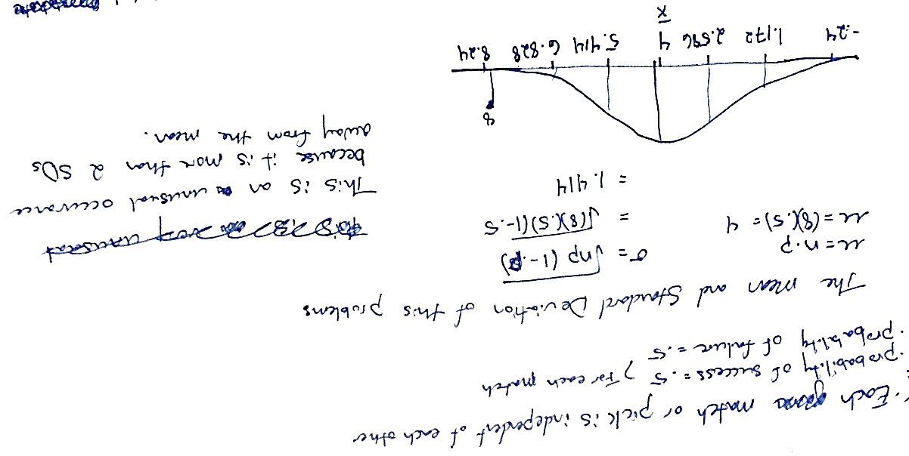
Ophelia the Octopus with the Normal Distribution
USCOTS 2017 May 19, 2017

Slide 9
The Models and Modeling Perspective
Models
Conceptual systems (consisting of elements, relations, operations, and rules governing interactions) that are expressed using external notation systems, and that are used to construct, describe, or explain the behaviors of other system(s)—perhaps so that the other system can be manipulated or predicted intelligently
(Lesh & Doerr, 2003, p. 10)
USCOTS 2017 May 19, 2017

Slide 10
The Models and Modeling Perspective
Model-Eliciting Activities (MEAs)
Students are presented with authentic, real-world situations where they repeatedly express, test, and refine or revise their current ways of thinking as they endeavor to generate a structurally significant product—that is, a model, comprising conceptual structures for solving the given problem.
(Lesh et al., 2003)
USCOTS 2017 May 19, 2017

Slide 11
Model Eliciting Activity Design
Students perceive the task as meaningful, based on their own real-life experiences.
To solve the problem, students must articulate an explicit and definite conceptual system (model).
Students are able to judge the adequacy of their in-process solution.
Students’ solutions are applicable to a whole range of problems
Students generate external representations of their thinking during the problem-solving process.
The problem serves as a memorable representative of a kind of mathematical structure, which can be invoked in future problem solving.
(Lesh & Harel, 2003; Lesh et al., 2000; Hjalmarson & Lesh, 2007)
USCOTS 2017 May 19, 2017

Slide 12
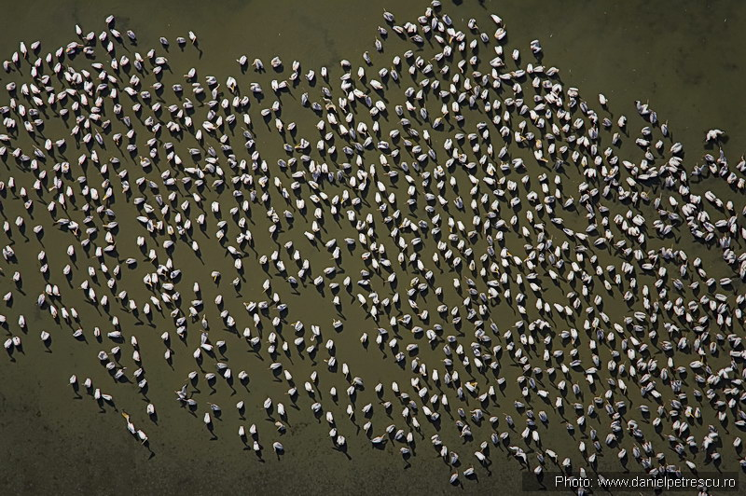
Pelican MEA
N
We are enlisting your team’s help to create a procedure that will allow us to estimate the number of nests in a pelican colony, based on the photograph that shows a sample of the colony, and a map that shows the size and shape of the entire site.
(Moore et al, 2015; Pompei, 2010)
USCOTS 2017 May 19, 2017

Slide 13
Pelican MEA Implementation
Play the role of your student and work in a small group to develop a procedure for estimating the number of nests at each pelican colony
Write a memo to Alice Heart that includes:
An explanation of your procedure
How you have tested your procedure
Your estimates for the number of pelicans in the two colonies
A description of any assumptions you have made.
Any requests for additional information or data that might allow you to improve the accuracy of your procedure.
USCOTS 2017 May 19, 2017

Slide 14
Pelican MEA Discussion
Possible questions for discussion:
What mathematical or statistical “big ideas” and skills were (or could be) used in solving this activity
What tools could students use and how could they use these tools?
How could students question their problem-solving processes and their results? How could they justify their assumptions and results?
When and how could this form of activity be incorporated into a statistics curriculum?
How could this activity be extended or modified to emphasis different “big ideas” in statistics?
USCOTS 2017 May 19, 2017

Slide 15
References
Hjalmarson, M. & Lesh, R. (2007) Design research: Engineering, systems, products, and processes for innovation. In L. D. English (Ed.). Handbook of international research in mathematics education: Directions for the 21st century (2nd edn). (pp. 520-534). New York, NY: Routledge.
Lesh, R., Cramer, K., Doerr, H., Post, T. & Zawojewski, J. (2003). Model development sequences. In R. Lesh, & H. M. Doerr (Eds.), Beyond constructivism: Models and modeling perspectives on problem solving, learning, and teaching (pp. 35–58). Hillsdale, NJ: Lawrence Erlbaum and Associates.
Lesh, R., & Doerr, H.M. (2003). Foundations of models and modeling perspective on mathematics teaching, learning, and problem solving. In R. Lesh & H.M. Doerr (Eds.), Beyond constructivism: Models and modeling perspectives on mathematics problem solving, learning, and teaching (pp. 3–33). Mahwah, NJ: Erlbaum.
Lesh, R., & Harel, G. (2003). Problem solving, modeling, and local conceptual development. Mathematical thinking and learning, 5(2-3), 157-189.
Lesh, R., Hoover, M., Hole, B., Kelly, A. E., & Post, T. (2000). Principles for developing thought-revealing activities for students and teachers. In A. Kelly, R. Lesh (Eds.), Research Design in Mathematics and Science Education. (pp. 591-646). Lawrence Erlbaum Associates, Mahwah, New Jersey.
Lock, R. H., Lock, P. F., Morgan, K. L., Lock, E. F., & Lock, D. F. (2017). Statistics: Unlocking the Power of Data (2nd eds.), Hoboken, NJ: Wiley.
McLean, J. A. (2015). Eliciting bootstrapping: The development of introductory statistics students’ informal inferential reasoning via resampling (Doctoral dissertation). Retrieved from http://surface.syr.edu/etd/396
Moore, T. J., Doerr, H. M., Glancy, A. W., & Ntow, F. D. (2015). Preserving Pelicans with Models That Make Sense. Mathematics Teaching in the Middle School, 20(6), 358-364.
Paul the octopus remembered [Video file]. (2010, October 27). Retrieved from https://www.youtube.com/watch?v=Cc0otVujNlE
Pompei, V. (2010). Pelican Colonies Model-Eliciting Activity. University of Minnesota. Retrieved from http://wordpress.unlvcoe.net/wordpress/wp- content/uploads/2013/01/Pelican-Colonies-MEA-Teacher-Materials.pdf
USCOTS 2017 May 19, 2017

