Slide 1
A flavor of the CATALST Course:
Using randomization-based methods in an introductory statistics course
Rebekah Isaak, Laura Le, and Laura Ziegler
with help from Joan Garfield, Andrew Zieffler,
and Robert delMas
Funded by NSF DUE-0814433
Notes:
2:00 PM - 30 seconds (REBEKAH)
– read the title, mention that it’s NSF-funded
- Mention that we have worked with Joan, Bob, and Andy on this project
- Mention the logistics of the workshop…
They need to have copies of the activities we sent available in such a way that they can view them in addition to viewing what we do on the screen

Slide 2
Abstract
As noted several times at the last USCOTS in 2011, randomization-based methods are the next big thing in teaching introductory statistics. The purpose of this session is to give participants a flavor of a new introductory statistics course, the CATALST Course, which focuses on ideas of randomness, randomization tests and bootstrap intervals. In the spirit of the active learning environment that is fostered in the course, this interactive workshop will encourage discussion and participation from all attendees. It will include examples of activities to demonstrate the progression of key concepts in the course, examples of assessments used in the course, details on how the course works and is taught, reflections on teaching the course and reactions of the modern student to the course. It will also include a demonstration of an innovative new technology tool called TinkerPlotsTM. Attendees will receive copies of the course materials, including activities, assessments, and lesson plans.
Notes:
2:00 PM - 15 seconds (REBEKAH)
I would like to pull out one main idea from our abstract:

Slide 3
Today’s Goal
The purpose of this session is to give participants a flavor of a new introductory statistics course, the CATALST Course, which focuses on ideas of randomness, randomization tests and bootstrap intervals.
Notes:
2:00 PM - 15 seconds (REBEKAH)
Our goal today is to give you a flavor of what the CATALST course is…
An introductory statistics course
That focuses on ideas of randomness, randomization tests, and bootstrap intervals

Slide 4
Outline of Presentation
Introduction
Unit 1: iPod Shuffle Model Eliciting Activity
Three Activities
  Unit 1: One Son
  Unit 2: Sleep Deprivation
  Unit 3: Kissing the Right Way
Assessment
Reflections
Looking Ahead
Notes:
2:01 PM – 1 minute (REBEKAH)
Today, we are going to give you a brief introduction to the CATALST course, show you a model eliciting activity that we use to start the course off with, and then we will focus on a sampling of the activities that make up the “meat” of this course.
We will wrap up the session with an overview of the assessments we use in this course, some reflections on our experiences teaching this course, and some thoughts about our vision for the future of this course.

Slide 5
Your participation is requested!
The CATALST course is VERY interactive
  Our goal is to have this workshop reflect the course environment
Please speak up
  Feel free to interrupt us with questions or comments as we go along
Please have access to the materials we sent you
Notes:
2:02 PM – 1 minute (REBEKAH)
- In the active spirit of the CATALST course, we encourage you to participate as much as possible in this workshop!
- We are going to try to keep all of your phones unmuted for the duration of the workshop, in order to allow you to ask or answer questions at any time. Please take a moment to close your office door or do whatever else you need to in order to reduce any background noise.
- Please remember that we asked you to have copies of the documents we sent you available during the workshop in such a way that allows you to view them at the same time you are viewing our presentation.

Slide 6
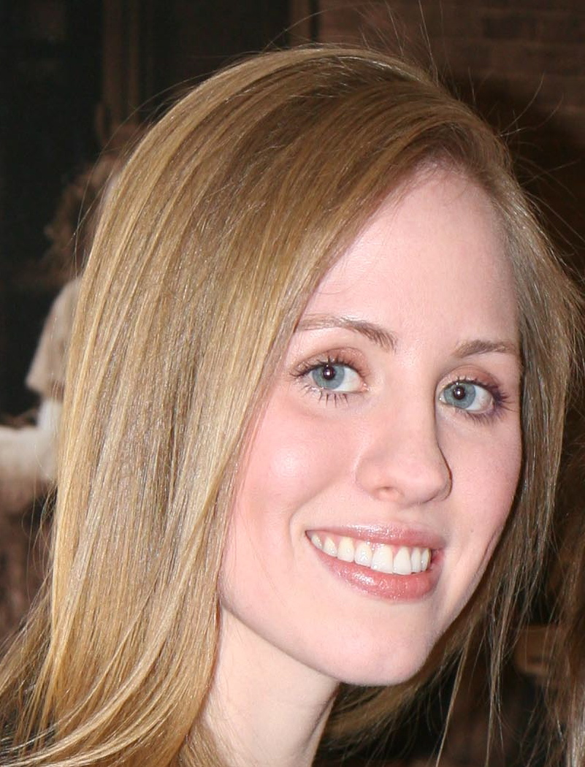
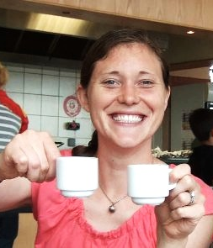

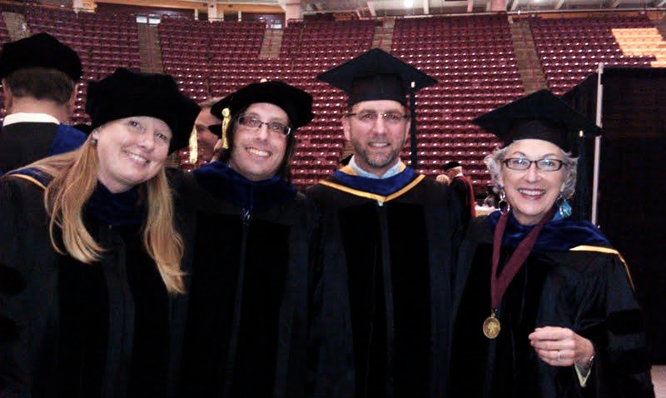
  University of Minnesota
  CATALST Team
Students
  Rebekah
  Laura Le
  Laura Z.
Faculty
  Joan
  Bob
  Andy
  Michelle
Notes:
2:03 PM – 3 minutes (REBEKAH starts, LAURA LE is in the middle, LAURA Z. finishes)
- Give our unique backgrounds (individually)
- Mention that we’re grad students in stat ed
- We have all been involved in the development of the curriculum
- We have all taught the CATALST course multiple times
- We are part of a teaching team that meets regularly
- Mention Joan, Bob & Andy

Slide 7
CATALST Collaborators
Allan Rossman
California Polytechnic State University–San Luis Obispo
Beth Chance
California Polytechnic State University–San Luis Obispo
John Holcomb
Cleveland State University
George Cobb
Mount Holyoke College
Notes:
2:06 PM – 1 minute (LAURA Z.)
These are the CATALST collaborators who have worked with us for many years. They have helped us to brainstorm, write materials, and revise the materials over and over again. ☺

Slide 8
CATALST Collaborators
Name | Institution
Jim Albert | Bowling Green State University
Aaron Weinberg | Ithaca College
Mike Huberty | Mounds View High School
Joe Nowakowski | Muskingum University
Herle McGowan | North Carolina State
Jennifer Noll | Portland State University
Nyaradzo Mvududu | Seattle Pacific University
Name | Institution
Erin Blankenship | University of Nebraska-Lincoln
Jenny Green | University of Nebraska-Lincoln
Dean Nelson | University of Pittsburgh at Greensburg
Sheila Weaver | University of Vermont
Tisha Hooks | Winona State University
April Kirby | Winona State University
Chris Malone | Winona State University
Notes:
2:07 PM – 1 minute (LAURA Z.)
These are the CATALST collaborators who have taught a CATALST course at some point this academic year.

Slide 9
Inspiration for CATALST
George Cobb (2005, 2007)
"I argue that despite broad acceptance and rapid growth in enrollments, the consensus curriculum is still an unwitting prisoner of history. What we teach is largely the technical machinery of numerical approximations based on the normal distribution and its many subsidiary cogs. This machinery was once necessary, because the conceptually simpler alternative based on permutations was computationally beyond our reach. Before computers statisticians had no choice. These days we have no excuse. Randomization-based inference makes a direct connection between data production and the logic of inference that deserves to be at the core of every introductory course."
Notes:
2:08 PM – 1 minute (LAURA Z.)
LAURA Z.
*Don’t wait’ too long here. Touch on main points briefly.
TISE = Technology Innovations in Statistics Education 2007
2005 was his plenary talk at USCOTS

Slide 10

Cooking in Introductory Statistics
CATALST teaches students to cook
(i.e., do statistics and think statistically)
The general “cooking” method is the exclusive use of simulation to carry out inferential analyses
Problems and activities require students to develop and apply this type of “cooking”
  Schoenfeld, A. H. (1998). Making mathematics and making pasta: From cookbook procedures to really cooking. In J. G. Greeno & S. Golman (Eds.), Thinking practices: A symposium on mathematics and science learning (pp. 299-319). Hillsdale, NJ: Lawrence Erlbaum Associates.
Notes:
2:10 PM – 2 minutes (LAURA LE)
Amongst the CATALST group, we like to say that we are teaching introductory statistics students how to cook, rather than just follow recipes.
This cooking analogy was influenced by a paper by Alan Schoenfield (1998).
In this paper, he drew parallels between thinking like a cook and thinking like a mathematician. Several of our group members were inspired by this analogy and decided to bring it into the statistics classroom (and on top of that, we had a passion for food as well).
Someone who knows how to “cook” (or is an expert in their field) knows the essential things to look for and focus on, and how to make adjustments on the fly.
We would argue that most introductory statistics courses teach students to follow “recipes” but not how to really “cook”. Because of this, students are only able to perform routine procedures and tests, but don’t have the big picture that allows them to solve unfamiliar problems and don’t have opportunities to articulate and apply this big picture understanding.
In the CATALST class, the general cooking method is the exclusive use of simulation to carry out inferential analyses.
The problems and activities that are given to the students require them to develop and apply this type of “cooking”.
Radically different content, pedagogy, and technology within the classroom teaches students how to “cook” rather than just following recipes.

Slide 11
Radical Content
New sequence of topics; building ideas of inference from first day
No t-tests; use of probability for simulation and modeling (TinkerPlots™)
A coherent curriculum that builds ideas of models, chance, simulated data
Immersion in statistical thinking
“Textbook” composed of research articles, internet sources
Notes:
2:11 - 1 minute (LAURA LE)
The radical content in this class centers around the idea of the core logic of inference. And this logic of inference isn’t taught at the end of the course, as you might see in a traditional class. The CATALST curriculum builds the ideas of inference from the first day of class.
The sequence of topics is also drastically different than what you would see in a traditional introductory course. We start with building ideas of models, then move on to comparing two groups, and then end with estimation. This sequence will be discussed later in the workshop.
Another radically difference piece is the lack of t-tests in the curriculum. We don’t mention anything about t-tests. Instead, the students use probability for simulation and modeling to answer research questions.
And throughout the curriculum, the ideas of models, chance, and simulated data are built up.
Students are also immersed in statistical thinking, the whole statistical investigative process rather than just learning a particular tool or procedure.
Lastly, the CATALST curriculum doesn’t use a traditional hard-cover textbook. Mainly because there is no textbook available that lends itself to this curriculum. What is used instead are relevant research articles and internet sources. We tell students at the beginning of the semester that they can “build up” their own “textbook” through these materials.

Slide 12
Radical Pedagogy
Student-centered approach based on research in cognition and learning, instructional design principles
Minimal lectures, just-in-time as needed
Cooperative groups to solve problems
“Invention to learn” and “test and conjecture” activities (develop reasoning; promote transfer)
Writing; present reports; whole class discussion
  Schwartz, D. L., & Martin, T. (2004). Inventing to prepare for future learning: The hidden efficiency of encouraging original student production in statistics instruction. Cognition and Instruction, 22(2),129- 184.
Notes:
2:12 - 1 minute (LAURA LE)
In terms of pedagogy, it is not a lecture course. CATALST uses a student-centered approach based on research in cognition and learning and instructional design principles.
The lectures are minimal, and employ a just-in-time method (usually at the beginning and end of the class).
Cooperative group are used daily to solve problems and learn the materials. To have cooperative groups, there must be positive interdependence within the groups and…
The activities are structured around the ideas of “invention to learn” (which comes from Dan Schwartz) and test and conjecture so as to promote transfer and develop reasoning.
Students are also required to write, present reports, and participate in whole class discussions.

Slide 13

Radical Technology
Focus of the course is simulation
TinkerPlots™ software is used
Unique visual (graphical interface) capabilities
  Allows students to see the devices they select (e.g., mixer, spinner)
  Easily use these models to simulate and collect data
  Allows students to visually examine and evaluate distributions of statistics
  Konold, C., & Miller, C.D. (2005). TinkerPlots: Dynamic data exploration. [Computer software] Emeryville, CA: Key Curriculum Press.
Notes:
2:13 - 1 minute (LAURA LE)
Since the focus of the class is simulation, we use a visual technology that allows the students to visualize the simulation called TinkerPlots.
TinkerPlots is different (as you will shortly see) than other software tools because it allows the students to see the chance devices they select (like mixers and spinners). It also allows students to easily use these chance devices as models to simulate and collect data and it allows students to visually examine and evaluate distributions of statistics.

Slide 14
Versions of the CATALST Course
  University of Minnesota
  Four semesters in-class
  One semester online
  Terminal course
  Primarily social science students
14 CATALST collaborators across the U.S.
  This past academic year
  Various types of students
Notes:
2:14 - 1 minute (REBEKAH)
University of Minnesota
- We taught up to three sections of the CATALST course each semester of the past two academic years (in the classroom) and one pilot section of it online this past spring
- It’s the only course in statistics (and probably mathematical reasoning) that many of our students take. Some of them take a research methods course in addition to this.
- Most of our students are not very mathematically inclined… we have a majority of social science students and a handful of other majors.
Elsewhere…
- The CATALST course was taught at 14 different institutions by 16 faculty members over this past academic year
- Some of the various types of students they taught were:
Economics students
Honors students
Liberal arts students
Mathematics teachers
Mathematics majors
Natural science students

Slide 15
14 CATALST Collaborators at 11 institutions
Notes:
2:15 – 30 seconds (REBEKAH)
This is a handy little map of the U.S. showing all of the locations the CATALST course has been implemented in the past year

Slide 16
Joe Nowakowski (Muskingum University)
Notes:
2:15 – 30 seconds (REBEKAH)
Right now, we’re going to focus in on the experience of one faculty implementer, Joe Nowakowski, from Muskingum University.

Slide 17

Joe Nowakowski
What did you think about CATALST prior to teaching the course?
How did it go?
What are your reflections now that it’s over?
Notes:
Finish at 2:20 or 2:25 - 5-10 minutes (JOE)

Slide 18
Questions?
What questions do you have for us about the course at this point?
What questions do you have for Joe about his experience?
?
Notes:
Finish at 2:30 - 3-5 minutes (REBEKAH)
Share what they are & how we responded
People are doing it and love it! Many are teaching it again!

Slide 19
3 CATALST Units
Chance Models and Simulation
  Learning to use the core logic of inference
    Specify a chance model
    Generate a trial, collect measure, repeat many times
    Evaluate fit of chance model to the data
Models for Comparing Groups
  Randomization Tests
    Studies using random assignment
    Studies using observational data
  Design: Random assignment and random sampling
  Drawing valid conclusions using logic of inference
Estimating Models Using Data
  Bootstrap method
  Standard error of a sample statistic
  Confidence intervals
Notes:
End at 2:32 - 2 minutes (LAURA Z.)
(14 Week Semester)

Slide 20
The Plan
Model Eliciting Activity
  Unit 1: iPod Shuffle
Selected class activities
  Unit 1: One Son
  Unit 2: Sleep Deprivation
  Unit 3: Kissing the Right Way
Notes:
2:33 – 1 minute (LAURA Z.)

Slide 21
Introduction to
Model Eliciting Activities
What are Model Eliciting Activities?
  Not your ordinary activities!
  Open-ended, real-world, complex problems
  Cooperative groups
Why use them?
  Deeper learning
  Improved retention
  Improved transfer of learning
http://serc.carleton.edu/sp/library/mea/what.html
Notes:
2:34 - 3 minutes (REBEKAH)
Ask the audience…?
Model Eliciting Activities (MEAs) are…
- A concept first introduced by Dick Lesh in the field of mathematics education
- “Activities that encourage students to invent and test models”
- They consist of “open-ended problems that are designed to challenge students to build models in order to solve complex, real-world problems.”
- “They may be used to engage the students in statistical reasoning and thinking and provide a means for statistics teachers and researchers to better understand students' thinking.”
- They Work best when students are in cooperative groups
students learn more deeply, retain what they learn, and transfer their learning to other problem contexts.
The research background on the effectiveness of MEAs is built on three areas: research on the use of MEAs in an engineering and mathematics context, use of invention to learn activities (of which MEAs are one type), and research on the extension, revision, and integration of prior knowledge.

Slide 22
Introduction to
Model Eliciting Activities
How do we use Model Eliciting Activities in the CATALST course?
  Unit 1: iPod
    Ideas of randomness
  Unit 2: Airline
    Comparing two groups
  Unit 3: ?
http://serc.carleton.edu/sp/library/mea/what.html
Notes:
2:37 - 1 minute (REBEKAH)
In the CATALST course, we use MEAs to introduce key concepts at the beginning of units 1 and 2. We currently don’t have an MEA for unit 3.

Slide 23
Unit 1 Model Eliciting Activity: iPOD SHUFFLE
“Albert Hoffman, an iPod owner, has written a letter to Apple to complain about the iPod shuffle feature. He writes that every day he takes an hour-long walk and listens to his iPod using the shuffle feature. He believes that the shuffle feature is producing playlists in which some artists are played too often and others are not played enough. He has claimed that the iPod Shuffle feature is not generating random playlists.”
Notes:
2:38 - 1 minute (REBEKAH)
Summarize the context
Talk about what we give students to start out with.

Slide 24
Unit 1 Model Eliciting Activity: iPOD SHUFFLE
The data
  Mr. Hoffman’s music library (8 artists with 10 songs each)
  Three playlists (20 songs each) that his iPod generated using the shuffle feature
The task
  Tim Cook, the CEO of Apple, Inc., has contacted your group to respond to Mr. Hoffman’s complaint.
  He has provided your group with several playlists of 20 songs each using the same songs as Mr. Hoffman’s library but generating them using a genuine random number generation method.
Notes:
2:39 - 1 minute (REBEKAH)
Summarize the questions
Students begin the activity by reading a brief article about this problem and discussing questions such as, “What comes to mind when you hear the word ‘random’?”

Slide 25
Unit 1 Model Eliciting Activity: iPOD SHUFFLE
Data
Notes:
2:40 - 1 minute (REBEKAH)
Explore and Describe
- Students examine 25 playlists of randomly generated data that look like this
- Write down two or more characteristics of a randomly generated playlist
Develop Rules
- Use the set of characteristics that they wrote down in the previous section to create a set of one or more rules that flag playlists that do not appear to have been randomly generated.
Test Rules
- using 5 different data sets
Summarize
- Students answer the questions posed at the beginning of the assignment.
- They must clearly explain how they obtained their answers (the process they used) in order to get full credit.

Slide 26
Unit 1 Model Eliciting Activity: iPOD SHUFFLE
Prior Knowledge
  NONE!
Notes:
2:41 - 1 minute (REBEKAH)
The nice thing about MEAs is that practically anyone with any level of experience in mathematics and modeling can do them and come up with meaningful answers.
Many students have experienced using a media player of some kind before and this activity grabs their interest based on that experience.

Slide 27
Unit 1 Model Eliciting Activity: iPOD SHUFFLE
Student Reports
  Process:
    After examining 25 truly randomly generated playlists from your library, our group came up with two rules regarding randomly generated playlists.
  Rules:
    A playlist is NOT random if either of the following are true
      1. it has six or more songs by the same artist played in any order in the playlist
      2. it has four or more songs of the same artist played in a row
  Conclusion:
    When reviewing your three playlists, none of them violated any of these rules. We conclude that your iPod is generating playlists randomly.
Notes:
2:42 - 1 minute (REBEKAH)
Share with them the pieces that the student groups would come up with, so they can see what it would look like
- What do students do?
Some students offer recommendations:
“Possible explanations for your complaints are the relatively small number of playlists you have, as well as the low variety of your library. Perhaps, if you were to purchase more of our songs, your playlist would have a more random feel to them. “

Slide 28
The Plan
Model Eliciting Activity
  Unit 1: iPod Shuffle
Selected class activities
  Unit 1: One Son
  Unit 2: Sleep Deprivation
  Unit 3: Kissing the Right Way
Notes:
2:43 - 1 minute (REBEKAH)
Next, we will walk through one activity from each unit, starting with Laura Le and the One Son activity

Slide 29
Unit 1 Activity:
ONE SON
Introduction
  “The one-child policy was introduced in 1978. It was created by the Chinese government to alleviate social, economic, and environmental problems in China, and authorities claim that the policy has prevented more than 250 million births from its implementation to 2000.”
  Scholars have wondered how things would change if instead of a one-child policy, a country adopted a one-son policy.
  Research Question: If the United States adopted this “one son” policy, how would the policy affect the average number of children per family, which is currently 1.86?
  One-child policy. (2010, July 23). In Wikipedia, the free encyclopedia. Retrieved July 26, 2010, from http://en.wikipedia.org/wiki/One-child_policy
Notes:
2:44 - 20 minutes (LAURA LE) Finish by 3:04
(Speaker’s note) Remember to ask them for any questions at regular intervals between activities.
At this point, you can refer to the One-Son activity that we sent you.
In Unit 1, the students are introduced to a problem called the One son problem. To set up the problem, we have this introduction (as you can see on your handout…it’s the second paragraph at the top of the page). “The one-child policy was introduced in 1978 in China. The reason for this policy was to alleviate social, economic and environmental problems in China. The authorities claim that the policy has prevented more than 250 million births from its implementation to the year 2000.”
We then tell the students that scholars wonder how things would change if a one-son policy was implemented instead of a one-child policy.
So at the beginning of all of our activities, there is a research question that we ultimately want to answer. The research question for this scenario is…

Slide 30
Unit 1 Activity:
ONE SON
Prior Knowledge
  Have NOT covered p-values or experimental design
  Have modeled random behavior in TinkerPlotsTM
    Coins
    Dice
    Basketball free throws
Notes:
To get a sense of where this activity falls, the one son activity occurs on Day 5. Up until this point, the students have learned the basics of TinkerPlots, have learned to model random behavior in TP, like coins, dice, basketball free throws, distributions of M&Ms in bags.
P-values have NOT be covered, nor has experimental designs.
So still very early on in the course. The learning goals for this activity are to expose students to a more complex phenomena and to learn to model real-life chance phenomena by simulating data to investigate probability questions.

Slide 31
Unit 1 Activity:
ONE SON
Directions
  Let’s walk through the activity
  Put on your “student hat”!
  Afterwards, you will get to put your “teacher hat” back on
Notes:
Normally, this is a 75 minute activity. But we are going to do an abbreviated version of the activity, but running through it in about 15 minutes.
So, put your “student hat” on at this point, and let’s go through the activity.
Let me now switch to the software TinkerPlots.

Slide 32
ONE SON:
Building the Model & Simulation

Slide 33
ONE SON:
Building the Model & Simulation

Slide 34
ONE SON:
Building the Model & Simulation

Slide 35
ONE SON:
Building the Model & Simulation

Slide 36
ONE SON:
Building the Model & Simulation

Slide 37
The Plan
Model Eliciting Activity
  Unit 1: iPod Shuffle
Selected class activities
  Unit 1: One Son
  Unit 2: Sleep Deprivation
  Unit 3: Kissing the Right Way
Notes:
3:04 – 1 minute (LAURA LE)
Next, Laura Z. will show us an example of an activity for comparing two groups using the randomization test in Unit 2.

Slide 38
Unit 2 activity:
SLEEP DEPRIVATION
Introduction
  Research Question: Does the effect of sleep deprivation last, or can a person “make up” for sleep deprivation by getting a full night’s sleep in subsequent nights?
  A recent study (Stickgold, James, and Hobson, 2000) investigated this question by randomly assigning 21 subjects (volunteers between the ages of 18 and 25) to one of two groups: one group was deprived of sleep on the night following training and pre-testing with a visual discrimination task, and the other group was permitted unrestricted sleep on that first night. Both groups were then allowed as much sleep as they wanted on the following two nights. All subjects were then re-tested on the third day.
Stickgold, R., James, L., & Hobson, J. A. (2000). Visual discrimination learning requires sleep after training. Nature Neuroscience, 3(12), 1237-1238.
Notes:
3:05 - 20 minutes (LAURA Z.) Finish by 3:25

Slide 39
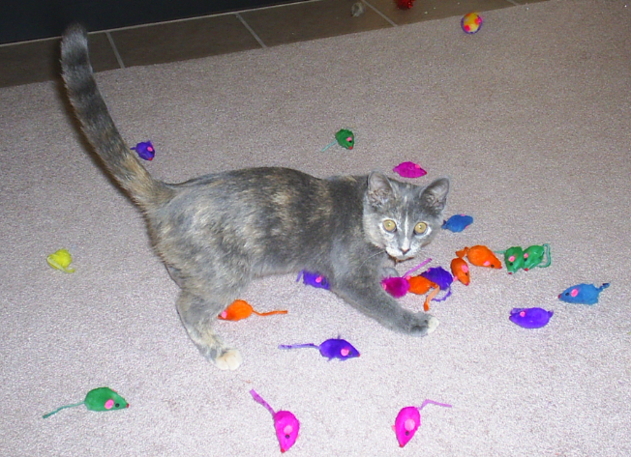
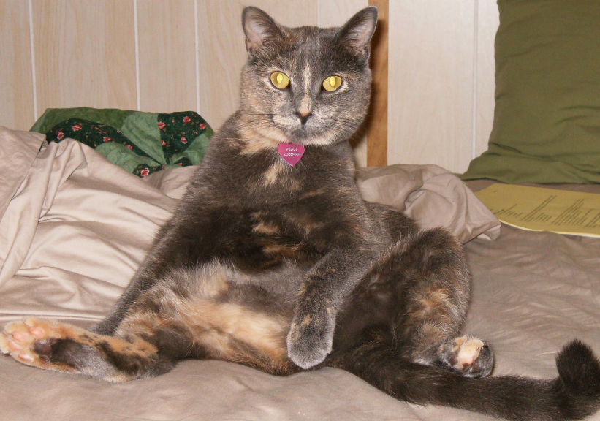
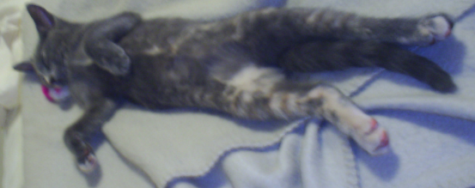
Unit 2 activity:
SLEEP DEPRIVATION
11 Sleep
Deprived
21 Human Subjects
10
Unrestricted
Sleep

Slide 40
Unit 2 activity:
SLEEP DEPRIVATION
Prior Knowledge
  Informal idea of p-value, but the term is introduced in this activity
  Basic idea of comparing groups
  Randomization test (by hand)
Notes:
20 minutes
Type of study
Experiment with random assignment
Quantitative data
Comparing groups based on difference in means using the randomization test

Slide 41
Unit 2 activity:
SLEEP DEPRIVATION
Directions
  Let’s walk through the activity
  Again, put on your “student hat”!
  Afterward, you will get to put your “teacher hat” back on
Notes:
20 minutes

Slide 42
SLEEP DEPRIVATION:
Building the Model & Simulation

Slide 43
SLEEP DEPRIVATION :
Building the Model & Simulation

Slide 44
SLEEP DEPRIVATION :
Building the Model & Simulation

Slide 45
SLEEP DEPRIVATION :
Building the Model & Simulation

Slide 46
SLEEP DEPRIVATION :
Building the Model & Simulation

Slide 47
Unit 2 activity:
SLEEP DEPRIVATION
Wrap-Up
  What was our null model?
  Why do we need to conduct a test, why can’t we just look at the observed difference?
  What is the purpose of random assignment?
  Where was the plot centered? Why does that make sense?
  What is a p-value?
  What conclusion did you come to for the sleep study?
Notes:
20 minutes

Slide 48
The Plan
Model Eliciting Activity
  Unit 1: iPod Shuffle
Selected class activities
  Unit 1: One Son
  Unit 2: Sleep Deprivation
  Unit 3: Kissing the Right Way
Notes:
3:25 PM - 30 Seconds (LAURA Z.)
We just finished talking about the “Sleep Deprivation Study” activity for comparing two groups in Unit 2.
Next, Rebekah will show us an example of a Unit 3 activity that we use to show the idea of a bootstrap confidence interval.

Slide 49
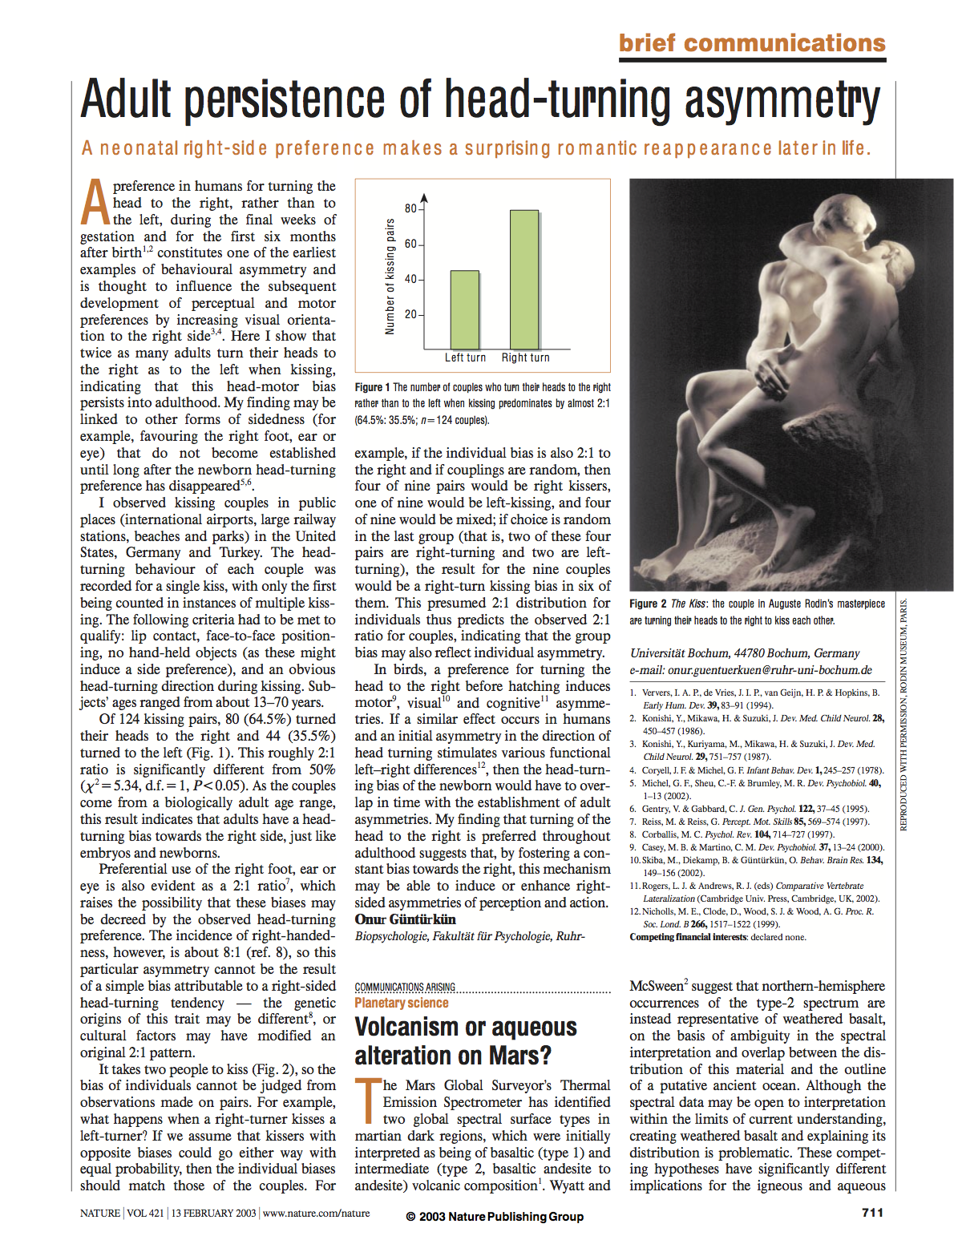
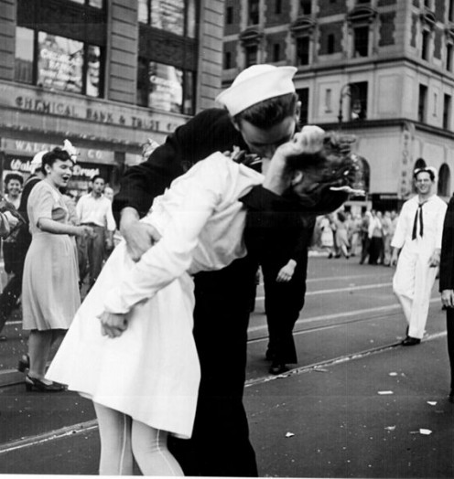
Unit 3 activity:
KISSING THE RIGHT WAY
Notes:
3:25 – 20 minutes (REBEKAH) Finish by 3:45
This activity is based on a real research article in Nature Magazine

Slide 50

Unit 3 activity:
KISSING THE RIGHT WAY
What percentage of couples lean their heads to the right when kissing?
How can we find out?
Collect data!
Notes:
-Talk about preceding activities…what leads them up to this point…(finding the average, finding a single probability, etc).

Slide 51



Unit 3 activity:
KISSING THE RIGHT WAY
80 Couples
Lean Right
44 Couples
Lean Left
124 Couples

Slide 52
Unit 3 activity:
KISSING THE RIGHT WAY
Sixty-five percent of the couples observed leaned to the right. What percentage of all couples lean to the right?
How much variation is there in the estimate from sample-to-sample?
Use sample as a substitute for the population
Notes:
-Talk about preceding activities…what leads them up to this point…(finding the average, finding a single probability, etc).

Slide 53
Unit 3 activity:
KISSING THE RIGHT WAY
Prior knowledge
  Randomization tests
  Bias and precision
  Sampling

Slide 54
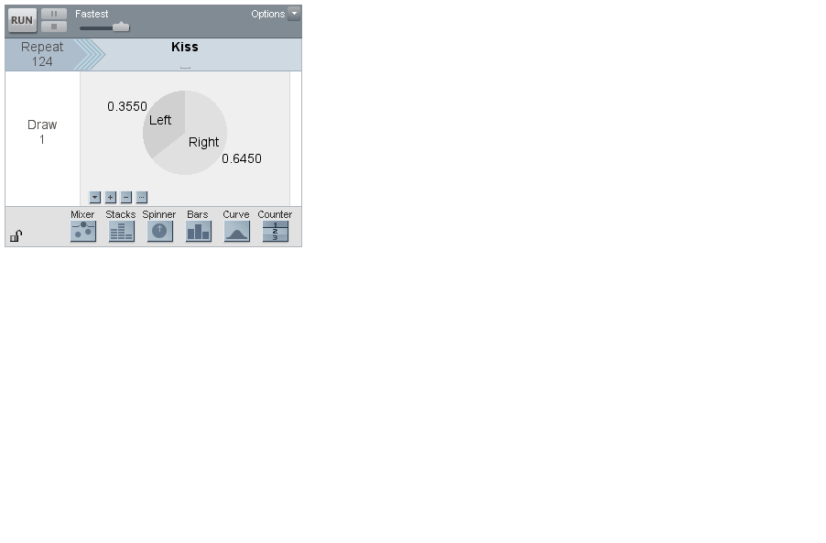
Kissing Study:
Building the Model & Simulation
Notes:
-Begin with a discussion on how to measure whether or not a therapy worked.
Have students come up with different methods.
Describe how that relates to the activity.
-Optional: Have students do a randomization test on a small data set without computer technology so students can visualize the test.

Slide 55
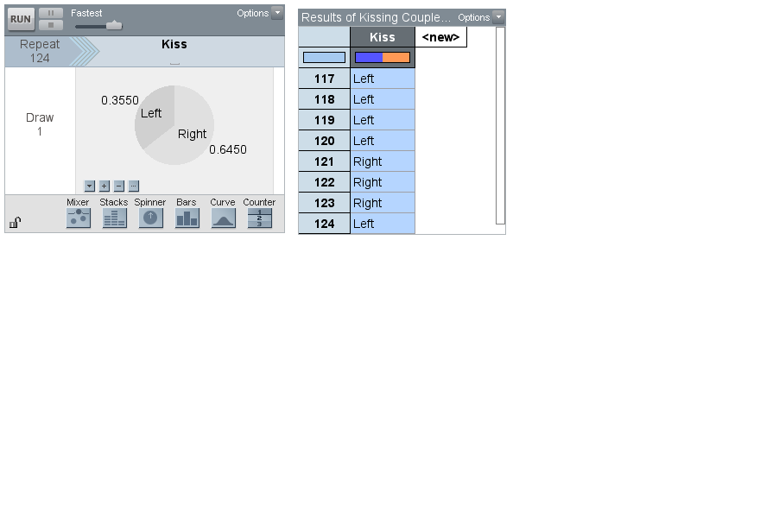
Kissing Study:
Building the Model & Simulation
Notes:
-Begin with a discussion on how to measure whether or not a therapy worked.
Have students come up with different methods.
Describe how that relates to the activity.
-Optional: Have students do a randomization test on a small data set without computer technology so students can visualize the test.

Slide 56
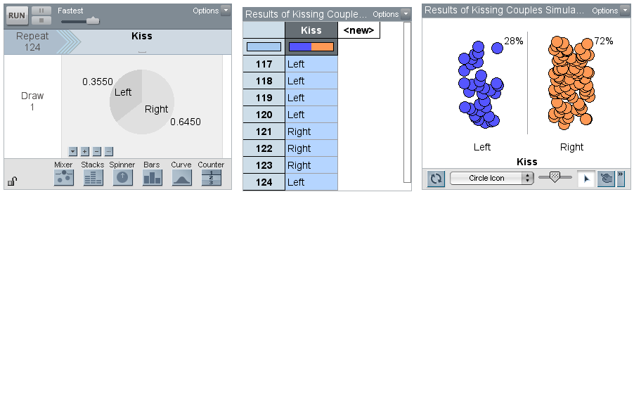
Kissing Study:
Building the Model & Simulation
Notes:
-Begin with a discussion on how to measure whether or not a therapy worked.
Have students come up with different methods.
Describe how that relates to the activity.
-Optional: Have students do a randomization test on a small data set without computer technology so students can visualize the test.

Slide 57
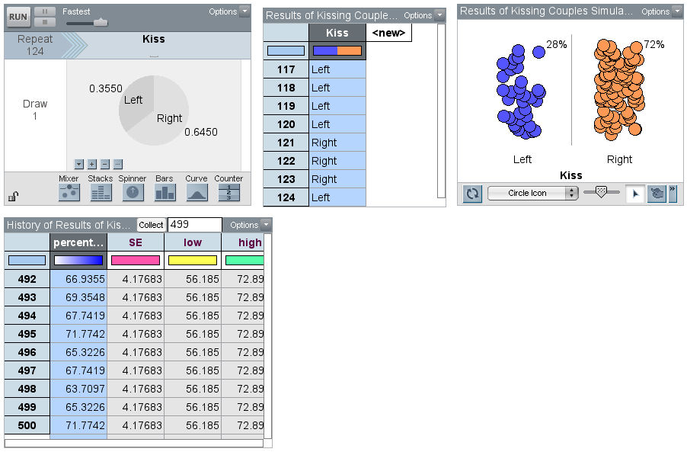
Kissing Study:
Building the Model & Simulation
Notes:
-Begin with a discussion on how to measure whether or not a therapy worked.
Have students come up with different methods.
Describe how that relates to the activity.
-Optional: Have students do a randomization test on a small data set without computer technology so students can visualize the test.

Slide 58
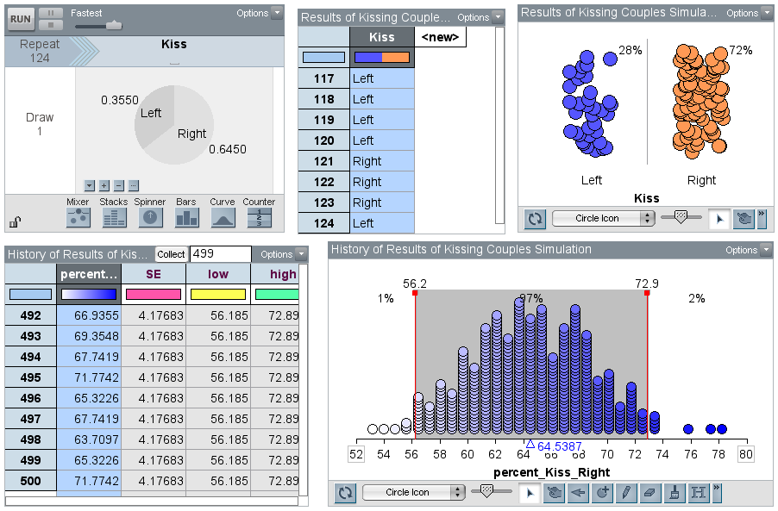
Kissing Study:
Building the Model & Simulation
Notes:
-Begin with a discussion on how to measure whether or not a therapy worked.
Have students come up with different methods.
Describe how that relates to the activity.
-Optional: Have students do a randomization test on a small data set without computer technology so students can visualize the test.

Slide 59
Student Assessments
Homework
  Approximately 1 per in-class activity (17 in total)
  Reinforces ideas from the in-class activities
Exams
  3 group exams
  2 individual exams
Final
  Basic knowledge (GOALS assessment)
  Attitudes and interest (Affect survey)
  Statistical thinking (MOST assessment)
Notes:
3:45 - 5 minutes (or less) (LAURA LE)
The assessments used in the course are homeworks, exams and a final.
We have 17 homework assignments throughout the curriculum, that’s almost 1 per in-class day. Some of these homeworks are just reading questions…asking the students to read from their “textbook” and answer some questions based on the readings. Most of the homework assignments reinforce ideas from the in-class activities. For example, students might have to run a randomization test for a different set of data and answer conceptual questions based on what they learned in class.
There is a total of 5 exams. 3 of those exams are group exams and 2 are individual take-home exams. We used to have all individual one semester, and then we tried all group another semester, but it is actually a balance of both that we really like. Since our class uses the cooperative group structure to learn new ideas and materials, it seems appropriate to build in a group test within the course. This emphasized the positive interdependence and …within the groups. What we realized through the semesters is we also need an individual accountability as well, so that is where the individual exams come into play. There is 1 group exam and 1 individual exam in both Units 1 and 2, and then just 1 group exam in Unit 3.
Lastly, there are final assessments. GOALS assessment gets at basic statistical knowledge that every intro student should know when they leave the course (not just CATALST students). There is the Affect survey that measures student attitudes and interest about statistics. And the MOST assessment tries to assess students’ statistical thinking...having them reason and think about the whole statistical investigative process and how they would solve a novel problem.
These final assessments are part of the summative evaluation for the CATALST grant…

Slide 60
14 CATALST Collaborators at 11 institutions
Notes:
3:50 – 30 seconds (LAURA LE)
Introduce Sheila Weaver

Slide 61
Sheila Weaver (University of Vermont)
Notes:
3:50 – 30 seconds (LAURA LE)
Introduce Sheila Weaver

Slide 62
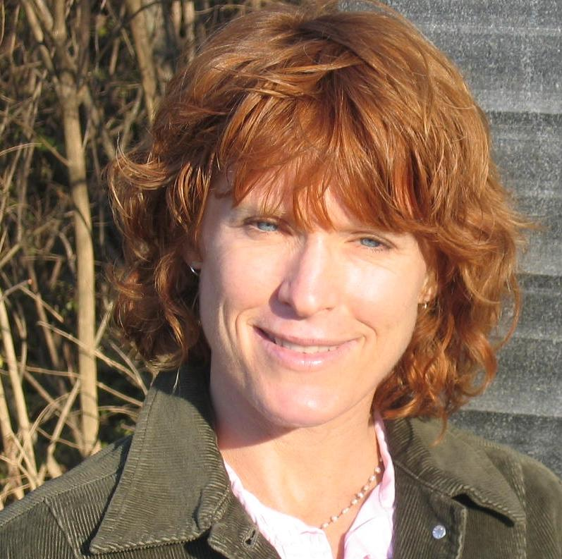
Sheila Weaver
Logistics
  Laptop issues
  TinkerPlotsTM issues
  Volume of work to grade
Student issues
  Group work
  Attitudes about format of the course
  Attitudes about content of the course
Notes:
3:51 – 5 minutes (SHEILA)
Other possible questions to ask her:
What were your expectations going into the course?
What has it been like to teach it?
Was anything surprising to you?
What went well? What would you do differently?

Slide 63
Our Reflections
What questions do you have about how it went at the University of Minnesota?
  Logistics
  Student issues
  Teaching team
  Multiple sections
  Online course
Notes:
5 minutes each (probably less – it depends on how things are going)
LAURA LE
REBEKAH
LAURA Z.
Mention that all of the materials are meant to be used TOGETHER, not just one thing here or there.

Slide 64
Future Plans
Full analysis of data from Spring 2012 (final version of course)
Retention study of fall 2011 students
Putting together a website
Creating a CATALST e-book
Next year
  University of Minnesota
  Elsewhere
Notes:
LAURA Z.

Slide 65

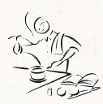
Contact Information
jbg@umn.edu
Joan Garfield
http://www.tc.umn.edu/~catalst/

Slide 66
Questions?
What questions do you have for us?
?
Notes:
LAURA Z.

Slide 67
It takes a village!
A great team: Graduate students, advisers and instructors
Co-teaching and Cooperative teaching groups/clusters
Meetings to discuss, plan, debrief and revise
Detailed lesson plans, coaching, mentoring
Experiencing a CATALST class (visiting)
Notes:
LAURA LE

Slide 68
It can be done!
Students respond well to the software and become adept at using TinkerPlots™ to setup and use models
Students HAVE to work together on the in-class activities (they need each other)
It can even be taught online!
But, it takes commitment, enthusiasm, and team support
Notes:
REBEKAH

Slide 69
References
Cobb, G. (2005). The introductory statistics course: A saber tooth curriculum? After dinner talk given at the United States Conference on Teaching Statistics.
Cobb, G. (2007). The introductory statistics course: A ptolemaic curriculum? Technology Innovations in Statistics Education, 1(1). http://escholarship.org/uc/item/6hb3k0nz#page-1
Schoenfeld, A. H. (1998). Making mathematics and making pasta: From cookbook procedures to really cooking. In J. G. Greeno and S. V. Goldman (Eds.), Thinking practices in mathematics and science learning (pp. 299–319). Mahwah, NJ: Lawrence Erlbaum

